Slide 1
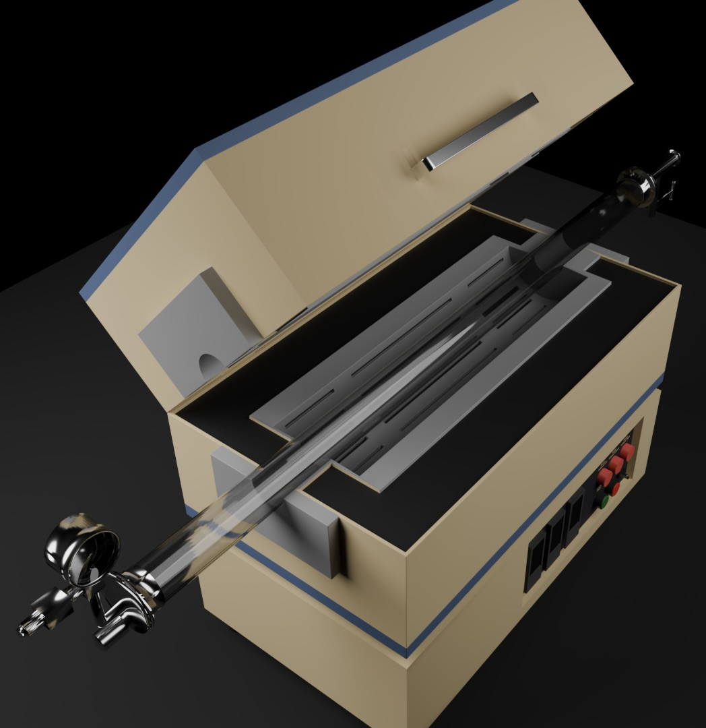
2026 IEEE METAVERSE GRAND CHALLENGE
Practice nanowire growth before touching the furnace
LabSpace VR transforms a complex split-tube furnace protocol into guided, hand-tracked practice.
THEME 3
Advanced Learning in Educational or Classroom Environments
LabSpace VR Team • Northeastern University
Notes:
Open with the learning promise: this is not a passive equipment tour. It is hands-on rehearsal of the decisions and safety sequence behind nanowire growth. The professor establishes the educational need, Barath Balamurugan presents the implementation as main developer, and Yilin demonstrates the learner experience as a project contributor.
[Sources]
- IEEE challenge theme and submission requirements: https://metaversereality.ieee.org/competition/
- Project description: README.md in the Lab Space VR repository
- Hero render: Images/IsoView.jpeg (project-owned asset)

Slide 2
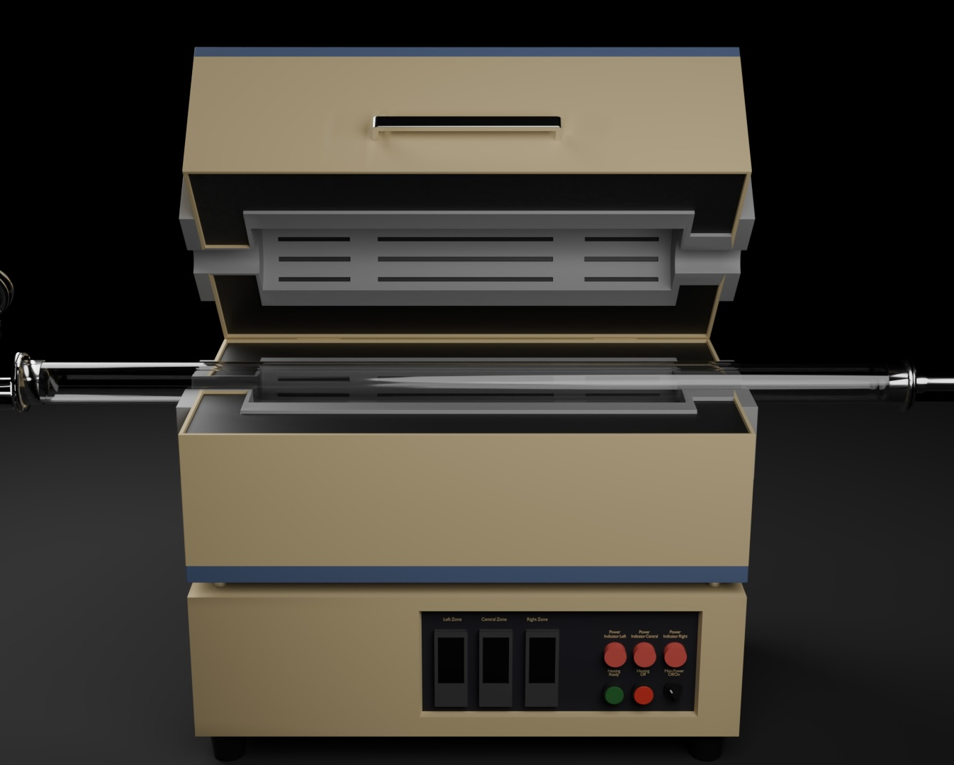
A protocol alone cannot teach coordinated lab judgment
Learners must manage sequence, safety conditions, and process response at the same time.
01
Load and position a substrate through a constrained feed mechanism.
02
Coordinate gas flow, three temperature zones, ramp, soak, and growth.
03
Cool to a safe state, withdraw the sample, and reset correctly.
VR makes the whole cycle repeatable before scarce equipment and consumables are involved.
LABSPACE VR • ADVANCED LEARNING
02
Notes:
Frame the educational gap. The difficult part is not recognizing the equipment; it is coordinating interdependent actions and understanding why the sequence matters. Virtual rehearsal avoids using furnace time, process gases, and substrates during early practice.
[Sources]
- Procedure and implementation summary: README.md
- Procedure state logic: Assets/Scripts/FurnaceProcedureManager.cs
- Furnace render: Images/FrontView.jpeg (project-owned asset)

Slide 3
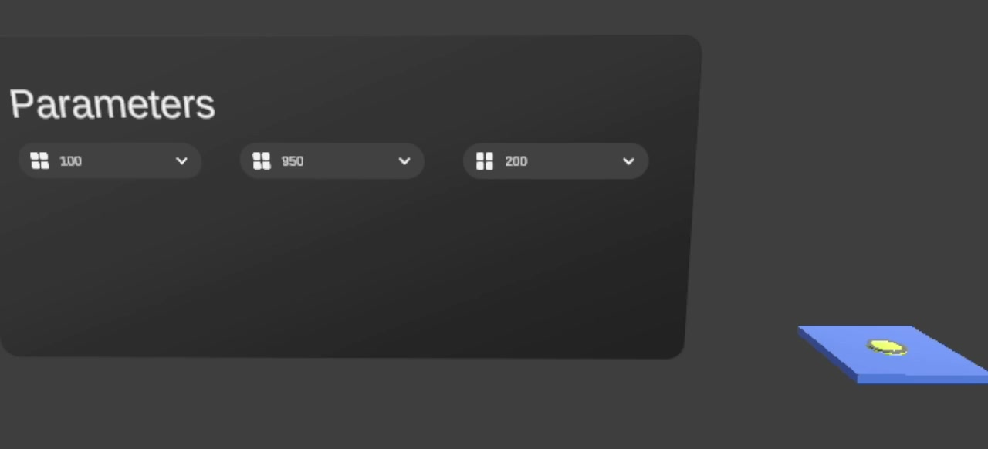
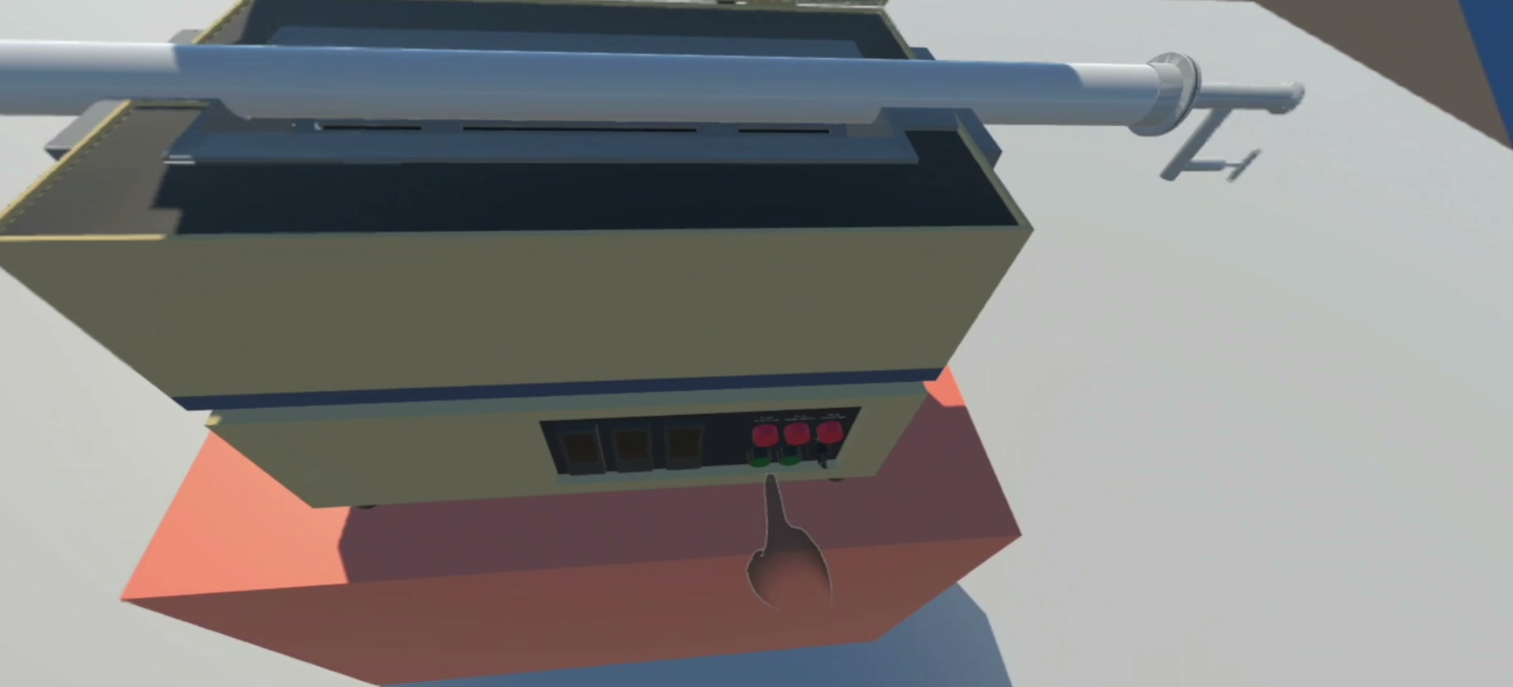
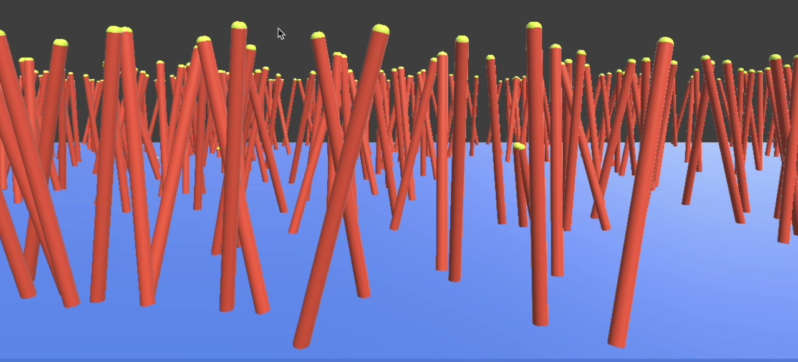
Thirteen guided steps turn the protocol into embodied practice
1–6
7–10
11–13
Prepare
Run the process
Finish safely
Confirm growth parameters
Power on • load • connect
Feed substrate • close lid
Set gas flow and 3 zones
Ramp and soak
Observe nanowire growth
Cool below threshold
Open furnace • withdraw
Power off and reset
Each step advances only when its required interaction and safety gates are satisfied.
LABSPACE VR • ADVANCED LEARNING
03
Notes:
Walk through the learning cycle in three phases. Emphasize that completion is driven by actual state: a placed substrate, a closed lid, sufficient gas flow, valid setpoints, safe cooldown, and successful withdrawal—not by pressing a Next button.
[Sources]
- Target procedure and safety gates: README.md
- Configurable step list: Assets/Scripts/FurnaceProcedureManager.cs
- Prototype frames extracted from Videos/SimDemov1.mp4, Videos/Demo_v1.mp4, and Videos/SImDemov3.mp4

Slide 4
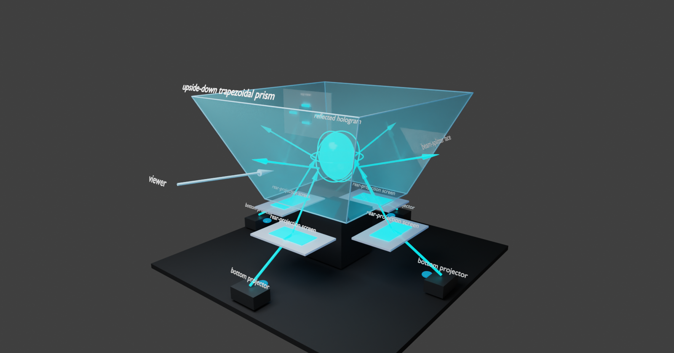
Guidance adapts to the learner’s current state
HAND-TRACKED ACTION
PROCEDURE STATE
REAL-TIME RESPONSE
MULTIMODAL GUIDANCE
Grab, rotate, press, snap, feed
Validate gates and unlock only what is relevant
Gas, heat, materials, growth, cooldown
Instruction panel, spatial arrow, audio feedback, synchronized hologram view
Rules-based adaptation—not an AI claim
Unsafe or out-of-sequence actions cannot advance the task. The same configurable procedure state also changes control availability, progress, simulation feedback, and camera focus.
Unity 6 • Meta XR • XR Hands/XRI • URP • WebRTC compositor
LABSPACE VR • ADVANCED LEARNING
04
Notes:
Explain the implementation from input to feedback. The procedure manager is the source of truth. This is currently a rules-based adaptive system: guidance changes with the learner's state, while invalid conditions pause or block the process. The four-view compositor mirrors the active step; describe physical receiver streaming only if it is stable in the final recording.
[Sources]
- Project technology stack: Packages/manifest.json and ProjectSettings/ProjectVersion.txt
- State-aware procedure implementation: Assets/Scripts/FurnaceProcedureManager.cs
- Hologram behavior: README.md and Assets/Scripts/Hologram/
- Hologram concept image: Artifacts/Blender/four_projector_trapezoid_prism_preview.png (project-owned asset)

Slide 5
The prototype makes laboratory preparation safer, repeatable, and scalable
Built for Meta Quest as a functional rehearsal environment—not a passive walkthrough.
13
3
4
guided steps
temperature zones
hologram views
A complete prepare → process → finish learning cycle
Coordinated setpoints, ramp, soak, cooldown, and safety checks
A synchronized output that refocuses with the active procedure step
Multimodal cues • adjustable simulation speed • no physical consumables during practice
Source & project updates: github.com/SINRG-Lab/lab-space-vr
LabSpace VR Team • Northeastern University
LABSPACE VR • ADVANCED LEARNING
05
Notes:
The professor closes on the educational value. The prototype supports repeatable practice with multiple cue types and adjustable simulation speed. Be explicit that learning-effectiveness validation is the next research step: compare sequence accuracy, safety errors, task completion, and retention before and after VR rehearsal.
[Sources]
- Prototype counts and accessibility features: README.md and Assets/Scripts/FurnaceProcedureManager.cs
- Project source link: https://github.com/SINRG-Lab/lab-space-vr
- IEEE judging priorities: https://metaversereality.ieee.org/competition/

