Slide 1
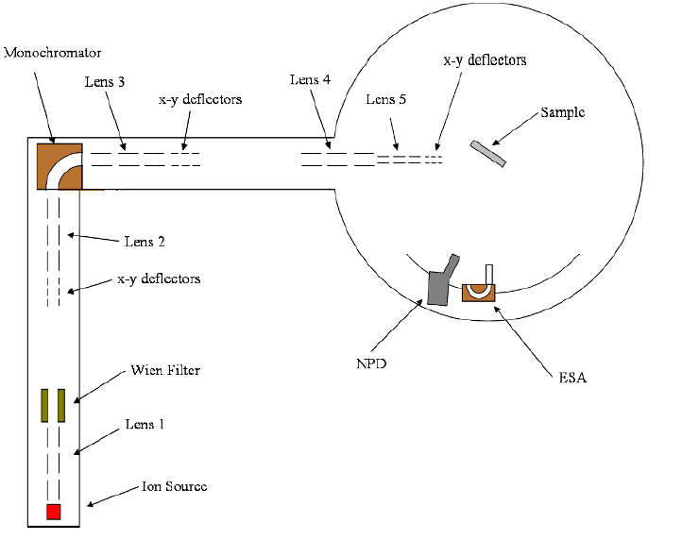
Raised
platform
7
8
9
4
3
11
6
BC
10
2
5
1

Slide 2
1: ion supply rack
2: computer desk
3: monochromator supply, X-Y deflectors, (red) trigger box, laser pulse delay, programmable counter, D/A interface
4: MAT chamber
5: X-Y-3 deflectors, Lens 4 & 5, element 5.3
6: X-Y-2 deflectors/time of flight chopper, ion gauge controller, mono HV output, SPUD box, HVM2, Ion pump (sec 2), faded unit (I couldn’t read it)
7: Analyzer low voltage supply, Pos/neg supply, analyzer supply (another one), Varian ion pump (M.C.)
8: Varian multigauge (MC), turbo controller (MC), LEED, SRS lock-in AMP, Auger system controller, 5 K Power supply, electron gun controller, McAllister EB-125 HV supply, Sublimator P.S. 500
9: SX-200, 5K supply, Kauffman P.S., Hiptronic, Floating Filament supply
10: Keithley stack:: 617 (electrometer), 2000 (x2 (multimeter)), 2400 (source meter)
11: ion gauge controller (blue chamber=BC), Edwards gauge controller (section 1 turbo)

