Slide 1
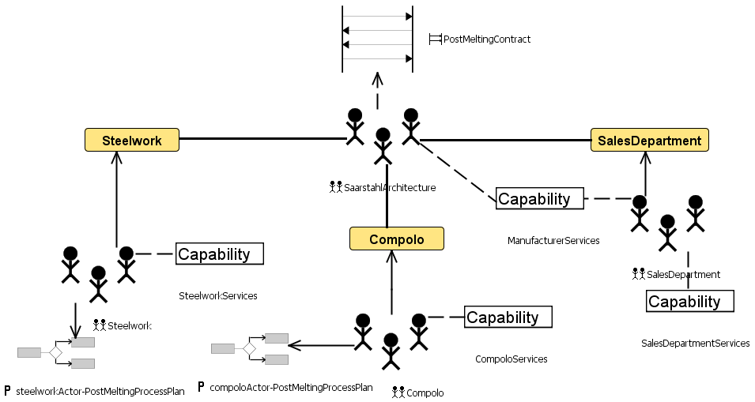
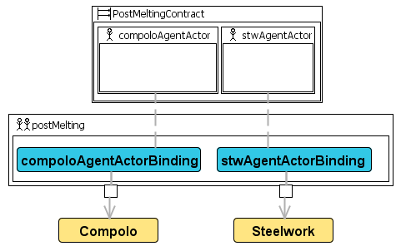
Saarstahl Multiagent System
Multiagent System
Interaction
Organization
Domain Role
Plan
Collaboration
Notes:
Legend??

Slide 2
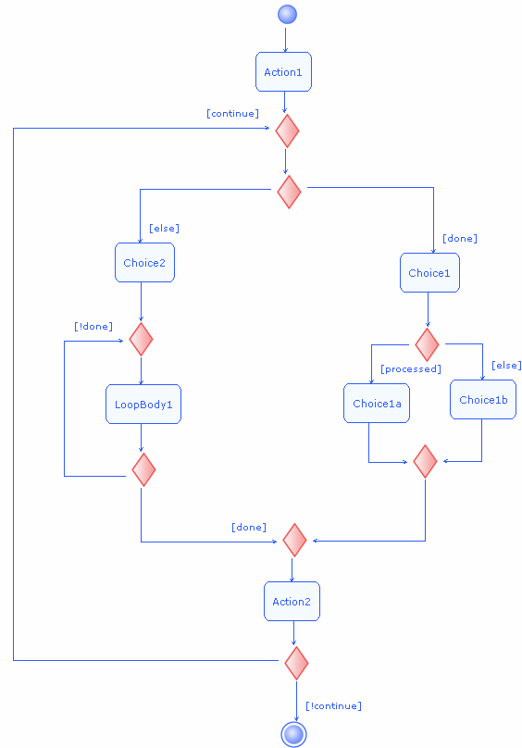
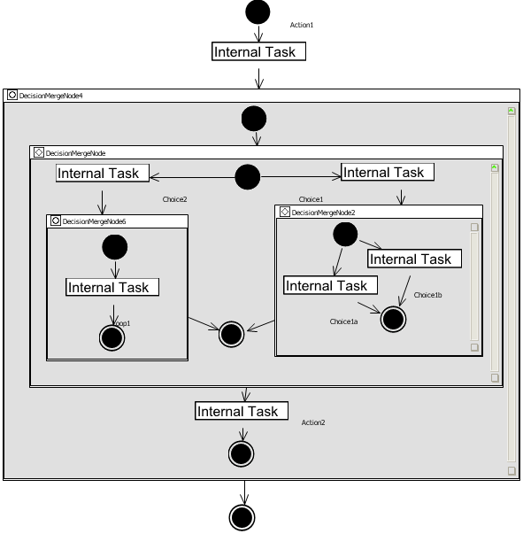
Saarstahl Behaviors

