Slide 1

SensApp Tools Evolutions

Slide 2

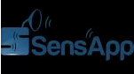
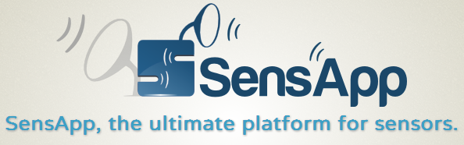
Existing Tools
SensApp-Android:
  Push data from local database (time, manual)
  HTTP protocol
  Display local database data (raw)
SensApp-Server:
  Register data, sensors, composites, notifications
  HTTP: URL and Rest methods (GET, POST, PUT, DELETE)

Slide 3

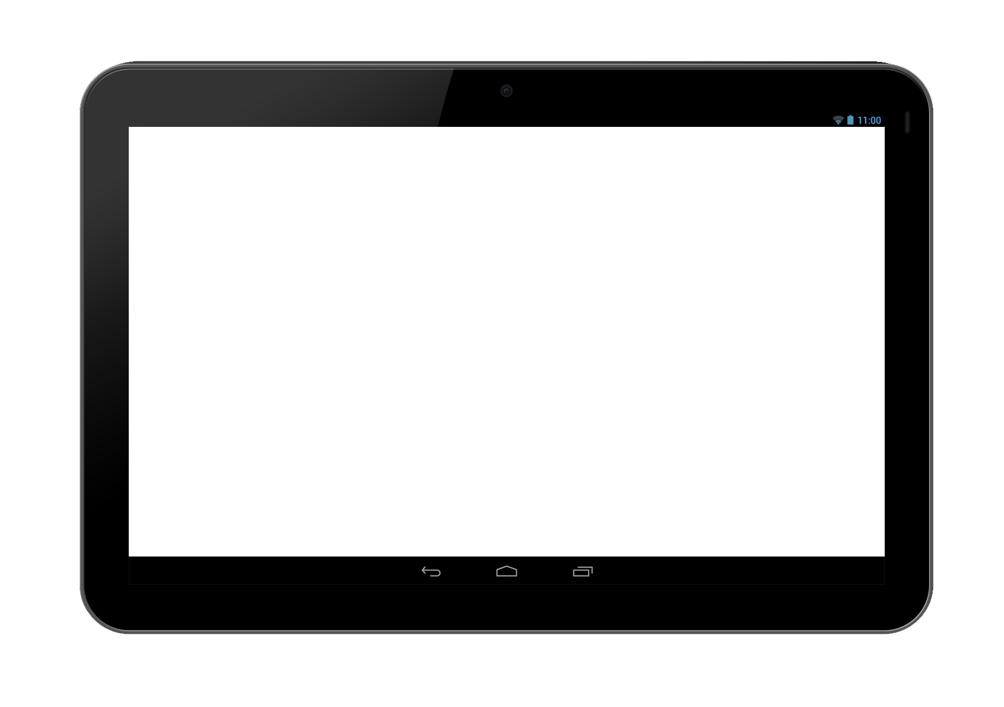
Tools Interactions
SensApp-Server
Legend
Data sent
SensApp-Android
Client

Slide 4
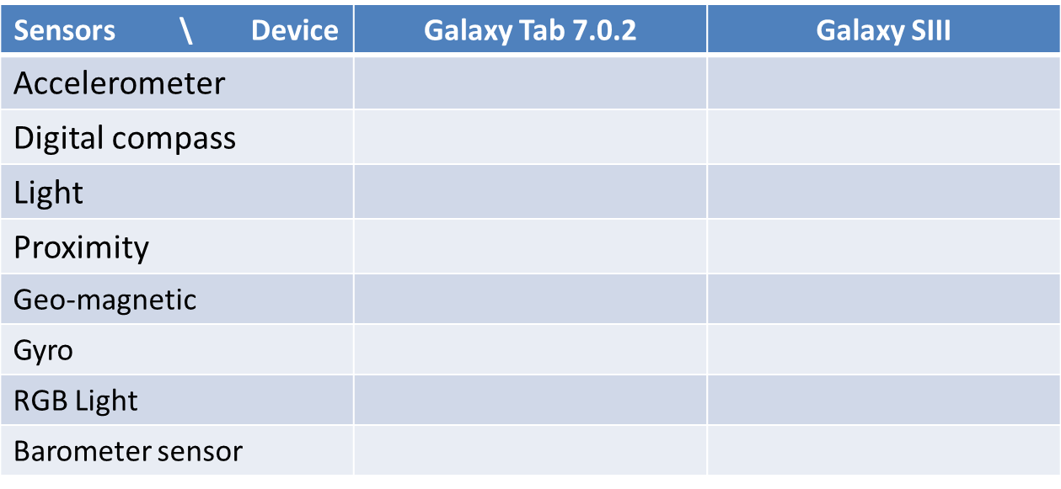


What about the Client?
Battery Logger
  Logging battery data of an android system into SensApp-Android
One client = One sensor? One device?

Slide 5
SensorLog
Generic client introspecting available sensors
Can add special sensors (battery, GPS, memory left)
Initial implementation was battery intensive
  Some sensors consumes a lot of energy
  Application was not optimized

Slide 6
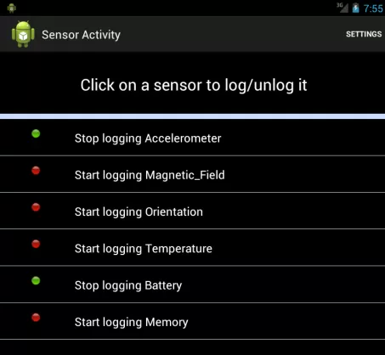
SensorLog - Log
Logging on/off
Logging rate settings

Slide 7
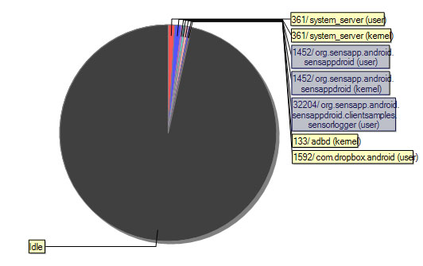
SensorLog – CPU profiling

Slide 8
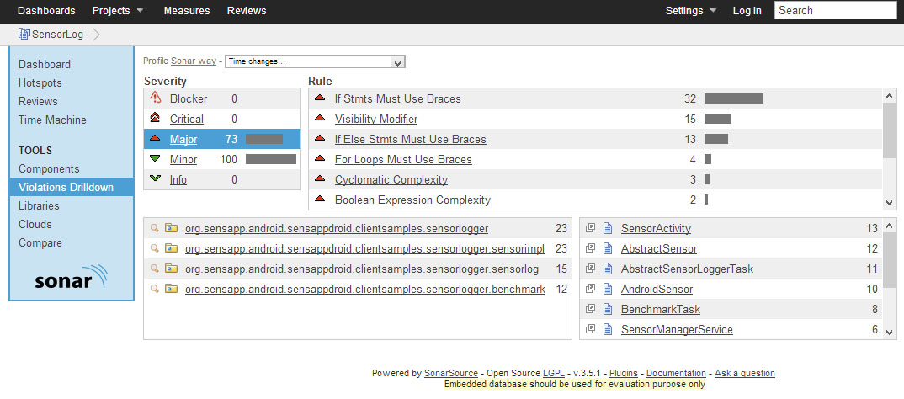
SensorLog – Sonar profiling

Slide 9
SensorLog - Benchmark
For 10 measures:
  Put all sensors logging
  Measures active time (sensor ON)
Average consumption for each sensor
  mAh
  % Battery/Hour, if battery power is setup in settings

Slide 10
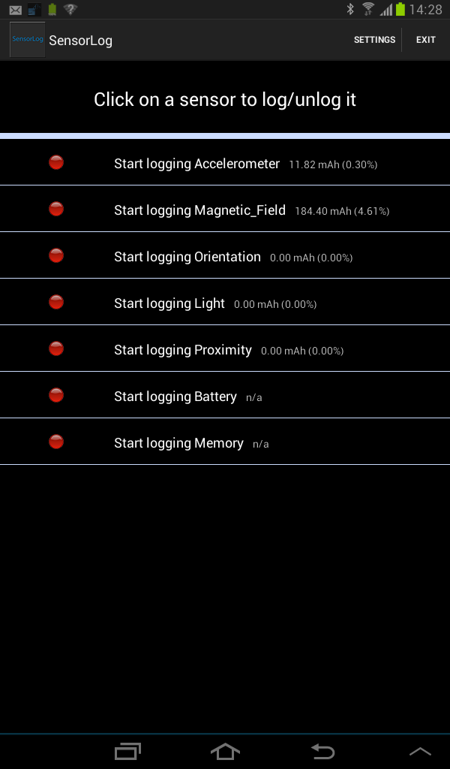
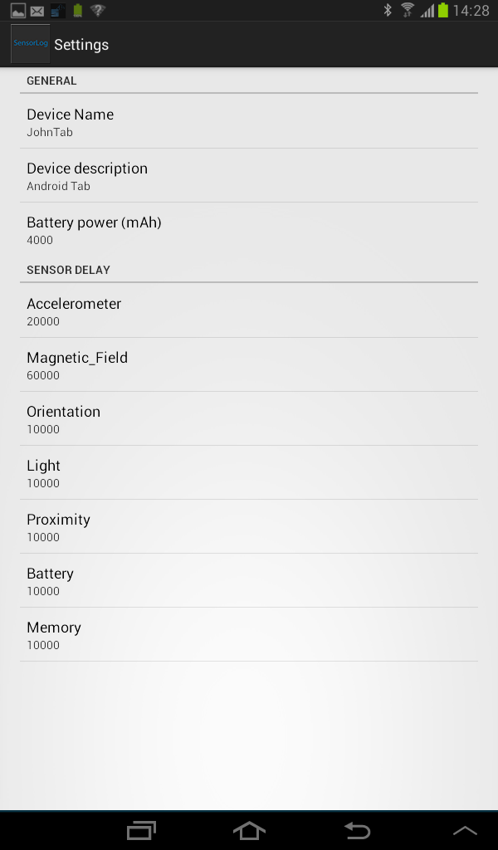
SensorLog

Slide 11
SensApp-Android
Automatic upload:
  Periodic
  Amount
Data displaying:
  Raw
  Graphs
Main screen changed for a swiping one

Slide 12
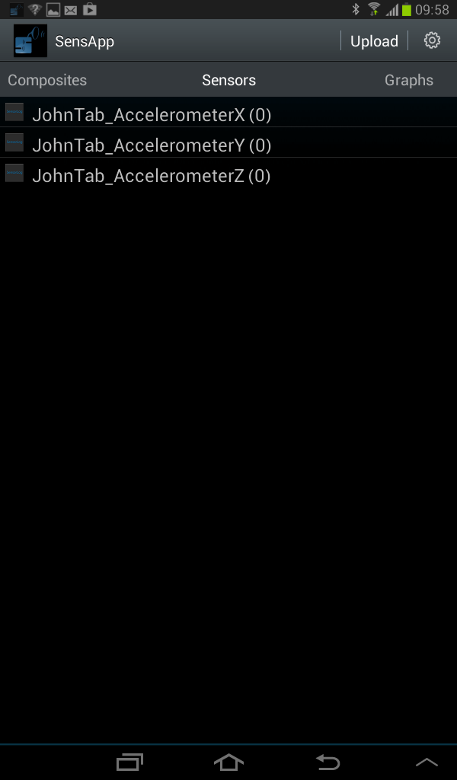
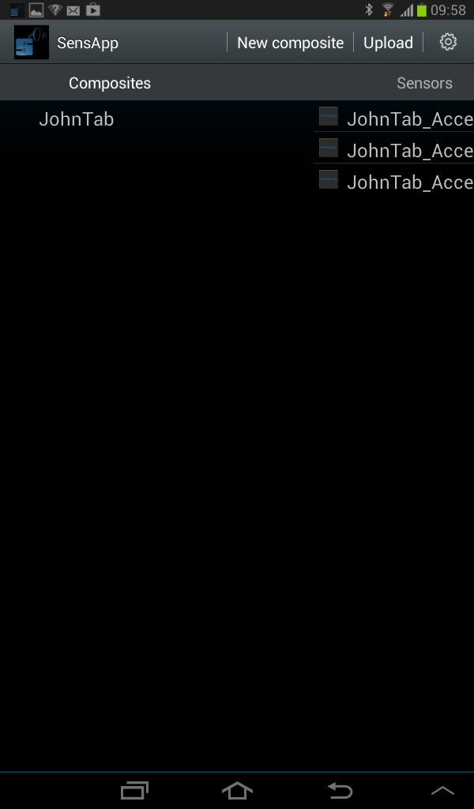
SensApp-Android

Slide 13
SensApp-Server
Trying to improve server response: WS
HTTP
Client
Server
Connection | Demand | Deconnection
Send 3 requests
n request -> 3 * n messages
WS
Client
Server
Connection | Demand | Deconnection
n request -> n + 2 messages

Slide 14
SensApp-Server: Parser
Demand: « getSensor(MySensor) »
isKnown(getSensor) ?
Response = Unknown Demand
no
yes
Response = sensor(MySensor)
Send(Response)

Slide 15
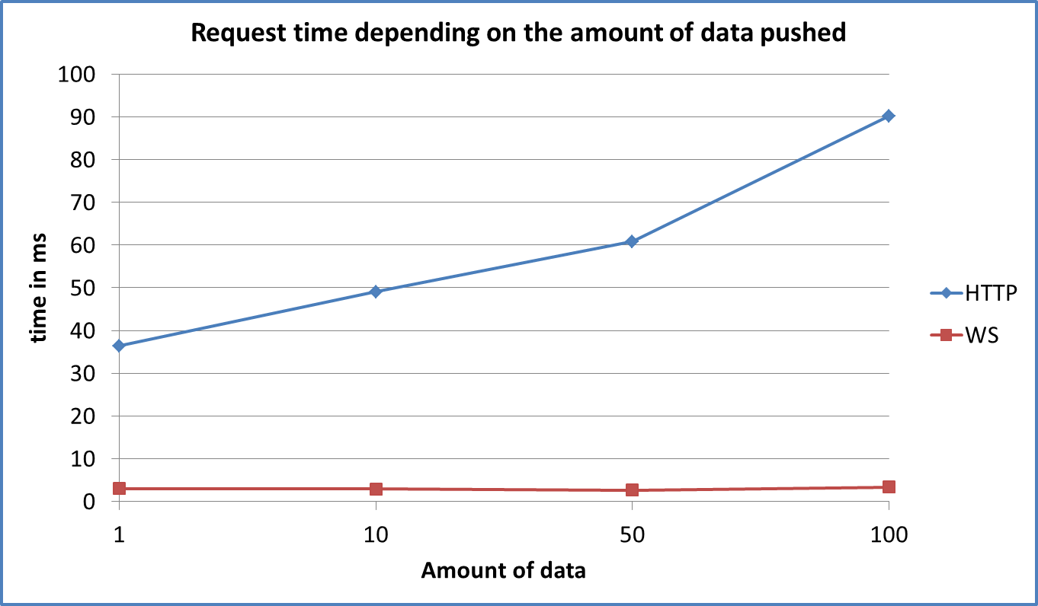
SensApp-Server: Results

Slide 16
SensApp-Android
Now the server runs with WS, it must run with WS.
sendData(…)
isDataFromWsSensor?
no
Function = HTTP_Send
yes
Function = WS_Send
ApplyFunction(Function)

Slide 17
SensApp-Android
So we push data on the server and we can see it with a web browser?
  Data from server can now be displayed with the app
  Using the notification service and WS

Slide 18
Final Tools Interactions
SensApp-Server
Legend
Data sent
SensApp-Android
SensorLog

Slide 19
Conclusion
SensApp-Server and SensApp-Android in WS
  More efficient
  Two side interactions
New client: SensorLog
  The android client to log all your sensors!
  As we can add some « other sensors », can send data from some « out-of-android » sensors using USB connection, Bluetooth, NFC, etc

Slide 20
HTTP-Linker
HTTP-Notification1
HTTP-Notification2
topic1
hookList1
topic2
hookList2
WS-Linker
WS-Notification1
WS-Client1
id1
topic1
WS-id1
WS-Client2
WS-Notification2
WS-id2
id2
topic2
WS-Client3
WS-id3

Slide 21
Composite
…
Sensor1
Sensor2
SensorN
data1
data2
…
dataN
data1
data2
…
dataN
data1
data2
…
dataN

Slide 22
Pause
Play
Sleep
Setup
Stop
Stop?
Loop
no
Play?
no

Slide 23


Car battery
Light Sensor
Accelerometer
Bluetooth
GPS
Bluetooth
Light Sensor
Temperature
Temperature
Bluetooth
Bluetooth

