Slide 1

SensApp Tools Evolutions

Slide 2

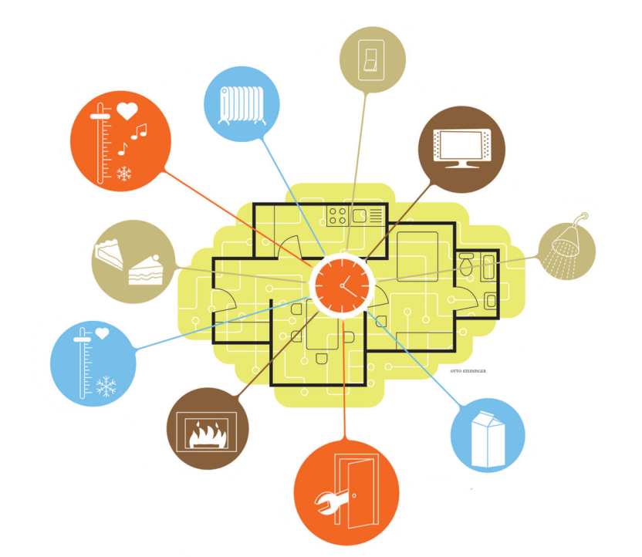
Why SensApp?
More and more sensors and data around us
Convenient to access and manage these from your mobile phone
  E.G. Use your mobile as a remote control of your Smart Home
Android is a powerful gateway
between sensors and the Internet

Slide 3

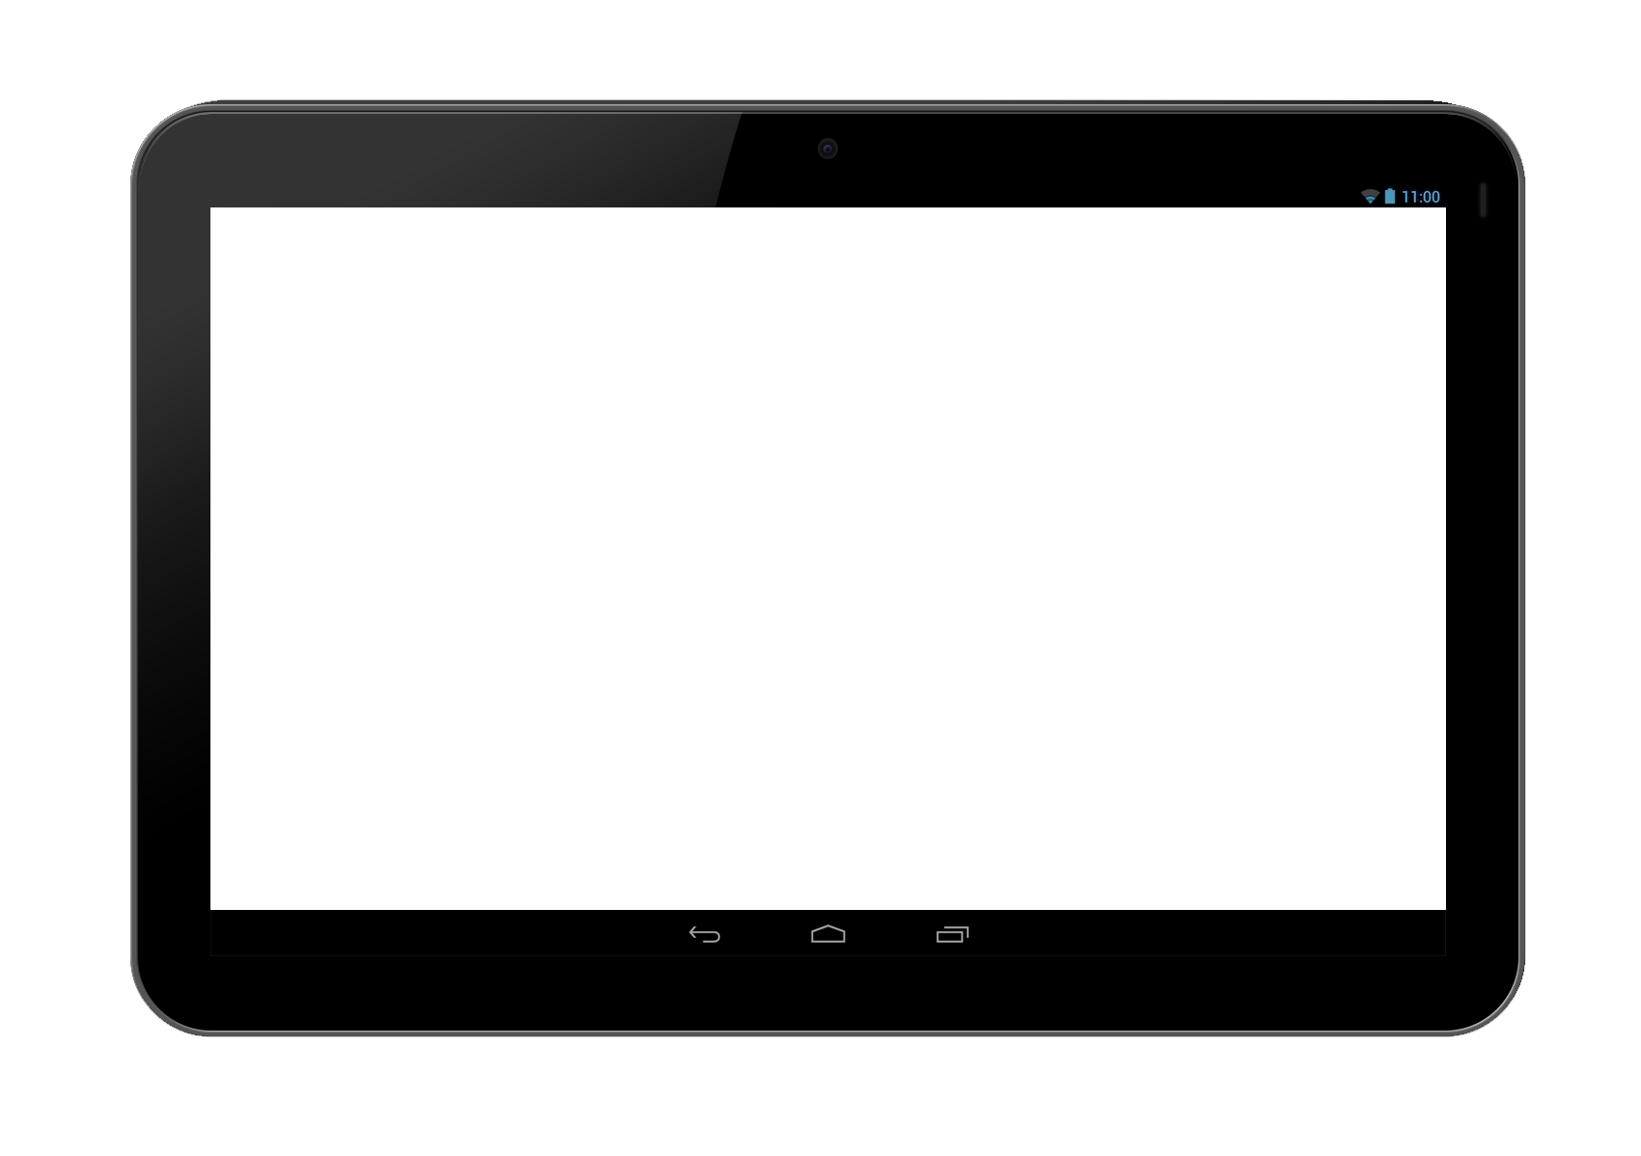
Tools Interactions
SensApp-Server
Legend
Data sent
SensApp-Android
SensorLog

Slide 4
SensorLog
Generic client introspecting available sensors
Can add special sensors (battery, GPS, memory left)
Can add remote sensors (Bluetooth, Wifi, etc.)
  E.G. can collect data from your Smart House

Slide 5
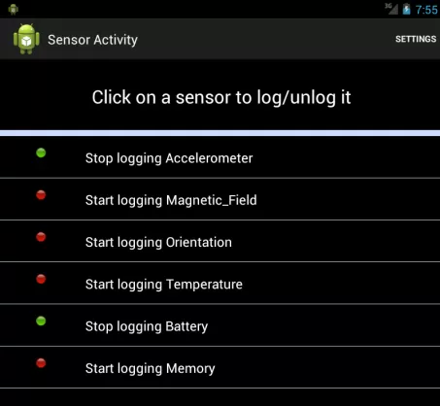
SensorLog - Log
Logging on/off
  E.G. you can chose
  to collect data or not

Slide 6
SensApp-Android
Automatic upload:
  Periodic
  Amount
Data displaying:
  Graphs
Can see the last data stored on the server

Slide 7
SensApp-Server
Using efficient technology: WS
HTTP
Client
Server
Connection | Demand | Deconnection
Send 3 requests
n request -> 3 * n messages
WS
Client
Server
Connection | Demand | Deconnection
n request -> n + 2 messages

Slide 8
Demonstration
SensApp - SensorLog
  Log using Bluetooth (JArduino)
  Log the Accelerometer of the tablet
SensApp - Android
  Show the local graph
  Show the server graphs
SensApp - Server
  See data flow

Slide 9
End of SensApp Demo

