Slide 1
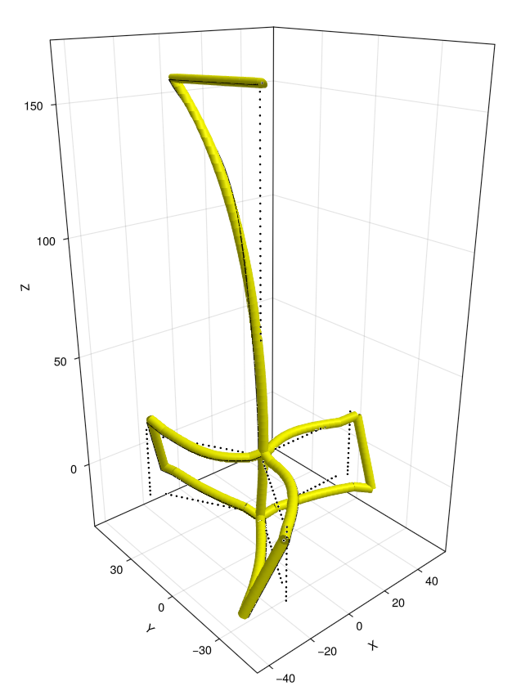

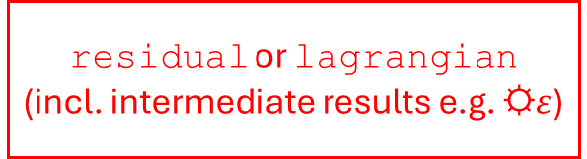
…
state (t=2)
FreqXU
state (t=1)
addnode!(…)
addelement!(…)
SweepXA
X=…
U=…
A=…
addnode!(…)
addelement!(…)
addnode!
addelement!
state (t=0)
DirectXUA solver
getdof
model
initialize!
getresult
☼$ε$=…
draw!
Automatic differentiation
Elements, user-defined or built-in
doflist
constructor
residual or lagrangian
(incl. intermediate results e.g. ☼$ε$)
allocate_drawing
update_drawing
display_drawing!

