Slide 1
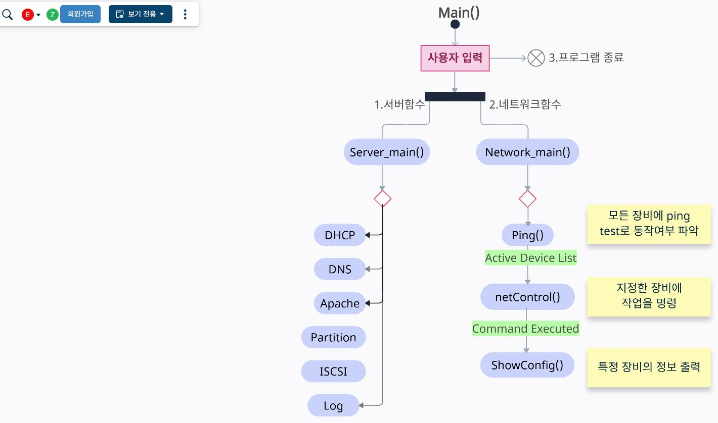


dhcpMain()
controlDNS()
Apache_run()
ControlPartitionMount()
iscsiServer()
iscsiClient()
logFilterMain()

