Slide 1
Two dimensional arrays and beyond
By Kenny Zenthoefer

Slide 2
Declaring
 | 0 | 1 | 2 | 3 | 4 | 5 | 6
0
1
2
3
4

Slide 3
Initialize/ setting value
 | 0 | 1 | 2 | 3 | 4 | 5 | 6
0
1
2 |  |  |  | b
3
4

Slide 4
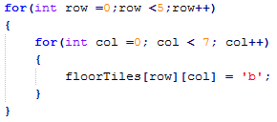
Double for loop

Slide 5

Initialize
 | 0 | 1 | 2
0 | 17 | 24 | 89
1 | 12 | 67 | 54
2 | 97 | 45 | 24
3 | 34 | 77 | 64

Slide 6
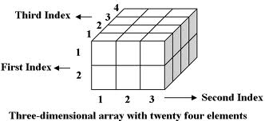
And beyond

