Slide 1
Arguments
Passing Variables by VALUE and REFERENCE
Jessica Sizemore, SIP 2015, 24 JUN 2015

Slide 2
Void Functions (Review)
Void functions performs tasks but does not return a value
A Void function may be used to do something like display information on the scree
Header begins with keyword void, instead of a return data type
Function body does not contain a return statement
Call a void function by including its name and actual arguments (if any) in a statement
Call to a void function appears as a self-contained statement, not part of another statement

Slide 3
Passing Variables to a Function
You can pass a variable’s value or its address
Passing a variable’s value is referred to as passing by value,
Passing a variable’s address is referred to as passing by reference
It depends on whether the receiving function should have access to the variable in memory
Passing by value WILL NOT permit the function to change the contents of the variable
Passing by reference WILL permit the function to change the contents of the variable

Slide 4
Passing Variables by Value
Passing a variable by value means that only a copy of the variable’s contents is passed, not the address of the variable
The receiving function cannot change the contents of the variable
It is best to pass by value when the receiving function needs to know the value of the variable but does not need to change it

Slide 5
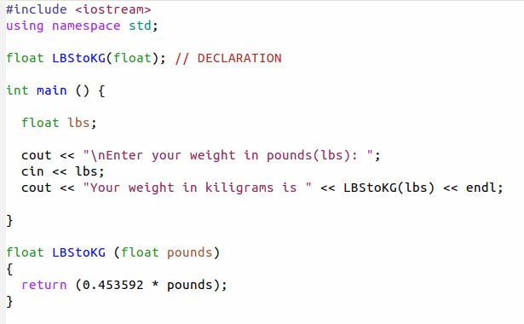
Passing Variables by Value
You are returning a value that is specific to this function.

Slide 6
Passing Variables by Reference
Passing a variable’s address to a function is referred to as passing by reference
When you want the receiving function to change the contents of the variable
You include an ampersand (&) before the name of the formal parameter in the receiving function’s header
Ampersand (&) is the address-of operator
  Tells the computer to pass the variable’s address rather than a copy of its contents

Slide 7
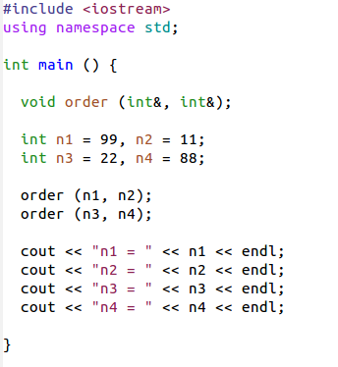
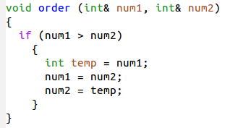
Passing Variables by Reference
  Void functions use variables passed by reference to send information back to the calling function, instead of a return value

Slide 8
Worked Cited
Robert Lafore, “Object-Oriented Programming in C++, Third Edition”,
  Chapter 5 – Functions.
Diane Zax, “An Introduction to Programming with C++, Sixth Edition”,
  Chapter 10 – Void Functions.
Towson University, Professor Robert Eyer, COSC 175,
  Chapter 10 Lecture Slides..

