Slide 1
Control Structures
Selection structures && Repetition structures
Jessica Sizemore SIP 2015 , 16 JUN 2015

Slide 2
Selection Structures
Using If and else

Slide 3
Overview
A selection structure is needed when a decision must be made (based on some condition) before selecting an instruction to execute
Must be phrased as a Boolean expression (evaluates to true or false)
Example: Entering the correct or incorrect password into your computer.
Single-alternative selection structure
  Set of instructions is executed only if condition evaluates to true
Dual-alternative selection structure
  Executes different sets of instructions based on whether condition evaluates to true or false

Slide 4
Overview
True path
  Instructions followed when condition evaluates to true
  Begins with if
False path
  Instructions followed when condition evaluates to false
  Begins with else

Slide 5
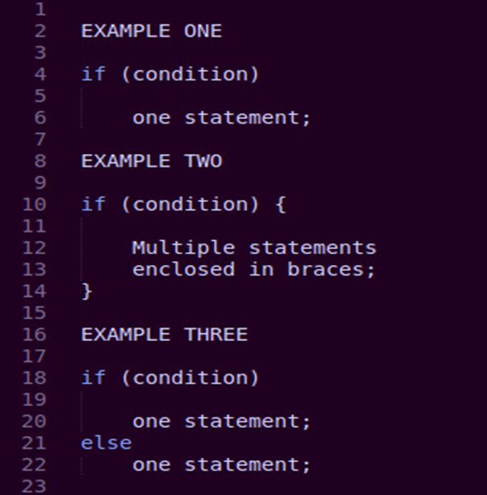
Coding a Selection Structure in C++
Syntax
  if (condition) ** Required
    one or more statements; (true path)
  else ** Required
    one or more statements; (false path)
If a path contains more than one statement, the statement much be entered as a Statement Block, meaning they must be enclosed in a set of braces… {example}

Slide 6
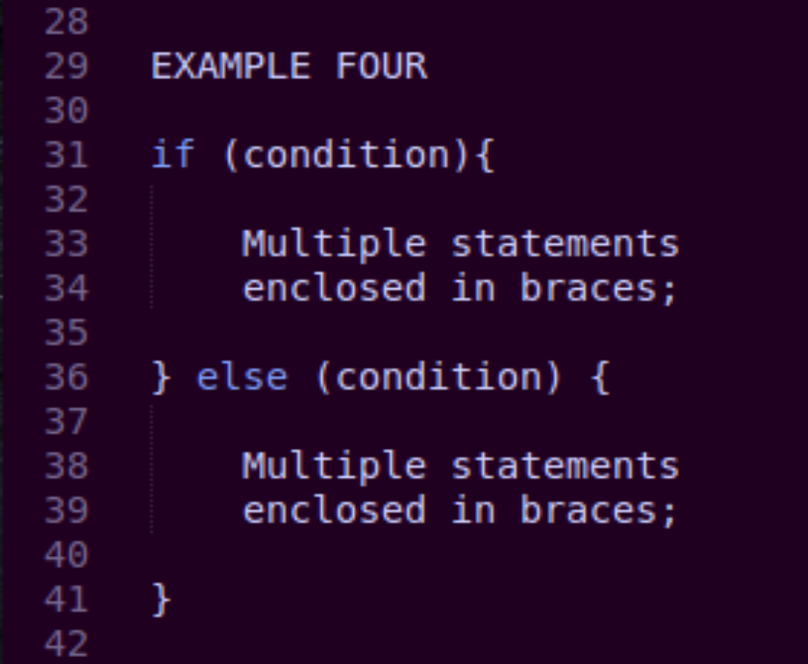
Coding a Selection Structure in C++
The condition must be a Boolean expression. They may contain variables, constants, arithmetic operators, comparison operators, and logical operators
  You are able to use Single and Multiple Statements where need. It is always better to use braces if you are unsure whether to use them or not.

Slide 7
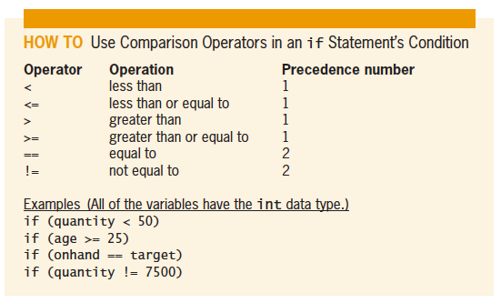
Using Comparison Operators
A variable that can be used only within the statement block in which it is defined is referred to as a local variable.
Figure 5-8 How to use comparison operators in an if statement’s condition

Slide 8
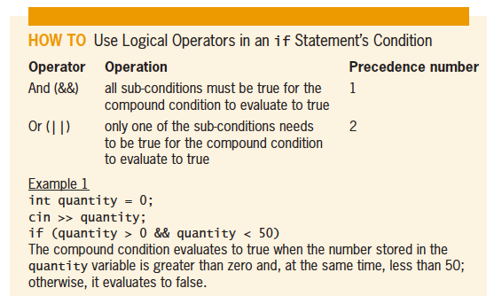
Using Logic Operators in If Statements
Logical Operators allow you to combine two or more conditions; Also called Boolean Operators because they always evaluate true or false.
Figure 5-15 How to use logical operators in an if statement’s condition

Slide 9
Using Logic Operators in If Statements
Example One
  if ( quantity > 0 && quantity < 50 );
  Is true when the quantity is greater than 0 AND also less then 50
Example Two
  if ( age == 21 || age > 55);
  Is true when age is equal to 21 OR greater than 55
Example Three
  if ( quantity > 0 && quantity < 100 || price > 34.55);
  When is this true?

Slide 10
Formatting Numeric Output
Real numbers are displayed in either fixed or scientific (e) notation
Small numbers can be displayed in fixed notation
Large numbers can be displayed in scientific (e) notation
fixed and scientific stream manipulators can appear alone in a cout statement but must be declared before the numbers that you want format
Manipulators are in effect until the end of the program

Slide 11
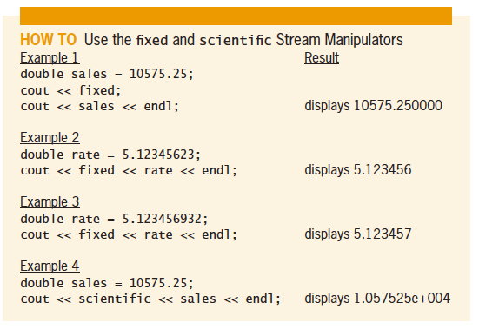
Formatting Numeric Output
Numbers that are formatted with fixed notation will have SIX numbers to the right of the decimal place
  EX. 123.456 is displayed as 123.456000
  EX. 123.3456789 is displayed as 123.345679
Figure 5-25 How to use the fixed and
scientific stream manipulators

Slide 12
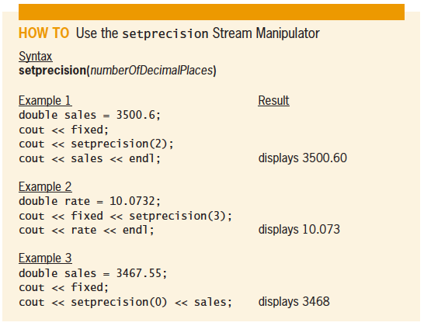
Formatting Numeric Output
setprecision stream manipulator controls the number of decimal places that appears when a real number is displayed
Definition of setprecision manipulator contained in iomanip file
Program must contain:
  #include <iomanip>
Figure 5-26 How to use the setprecision
stream manipulator

Slide 13
Repetition Structures
Using While and for

Slide 14
What is a Repetition Structure?
Repetition structure, or loop, processes one or more instructions repeatedly
Every loop contains a Boolean condition that controls whether the instructions are repeated
A looping condition says whether to continue looping through instructions
A loop exit condition says whether to stop looping through the instructions

Slide 15
What is a Repetition Structure?
The instructions that are inside a loop, and are told to repeat are called the loop body
A loop body can contain pretest or posttest
  Pretest loop, the condition is evaluated before the instructions in the loop are processed
  Posttest loop, the condition is evaluated after the instructions in the loop are processed
In both cases, the condition is evaluated with each repetition

Slide 16
Using Pretest Loops
Some loops require the user to enter a special sentinel value to end the loop to quit the loop
When a loop’s condition evaluates to TRUE, the instructions in the loop body are processed
When a loop’s condition evaluates to FALSE, the instructions are skipped and processing continues with the first instruction after the loop

Slide 17
Using Pretest Loops
After each time the loop body runs through its instructions, the loop’s condition is then reevaluates to determine if the loop should be processed again
A priming read is an instruction that appear before the loop; It is set up with an initial value that is entered by a user
An update read is an instruction that is written within a loop that allows the user to enter a new value each time the loop is processed

Slide 18
The while Statement
Syntax is:
  while (condition)
  one statement or a statement block to be processed as long as the condition is true
The while statement can be used to code a pretest loop
The condition must be supplied as a Boolean expression
A loop whose instructions are processed indefinitely is called an infinite loop or endless loop
You can usually stop a program that has entered an infinite loop by pressing Ctrl+c

Slide 19
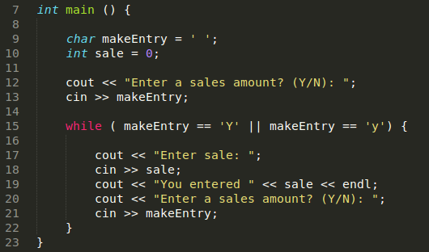
The while Statement

Slide 20
Counters and Accumulators
You may be asked to calculate a total average, to do this you use a counter and/or an accumulator.
A counter is a numeric variable used for counting something
An accumulator is a numeric variable used for accumulating (adding together) multiple values
Two tasks are associated with counters and accumulators:
  initializing and updating

Slide 21
Counters and Accumulators
Initializing means assigning a beginning value to a counter or accumulator (usually 0) – happens once, before the loop is processed
Updating (or incrementing) means adding a number to the value of a counter or accumulator
  A counter is updated by a constant value (usually 1)
  An accumulator is updated by a value that varies
Update statements are placed in the body of a loop since they must be performed at each iteration

Slide 22
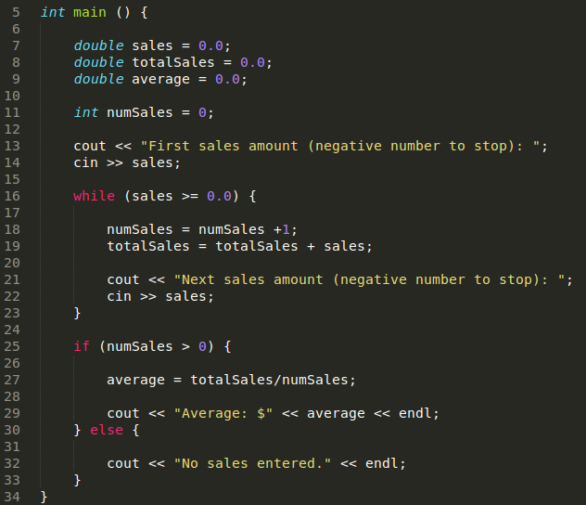

Average Sales Amount Calculator…
Uses a counter to keep track of the number of sales entered and an accumulator to keep track of the total sales
Both are initialized to 0
The loop ends when the user enters a sentinel value (-1)

Slide 23
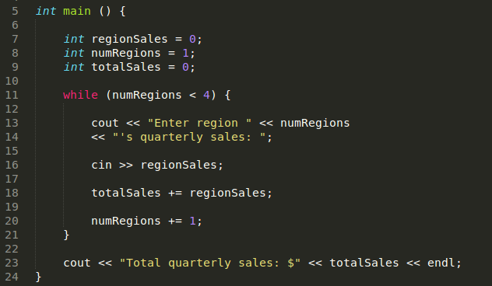

Average Sale Calculator with Counter-Controlled Loops
Counter-controlled loop is used that totals the quarterly sales from three regions
Loop repeats three times, once for each region, using a counter to keep track

Slide 24
The do while Statement
do while statement is used to code posttest loops in C++
Syntax:
  do {
  one or more statements to be processed one time,
and thereafter as long as the condition is true
} while (condition);

Slide 25
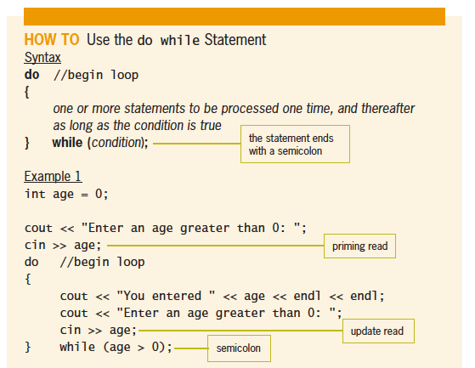
The do while Statement
Programmer must provide loop condition
  Must evaluate to a Boolean value
  May contain variables, constants, functions, arithmetic operators, comparison operators, and logical operators
Programmer must also provide statements to be executed when condition evaluates to true
Braces are required around statements if there are more than one
Figure 5-15 How to use logical operators in an if statement’s condition

Slide 26
The for Statement
The for statement can also be used to code any pretest loop
Syntax:
for ([initialization]; condition; [update])
  one statement or a statement block to be processed
  as long as the condition is true
Initialization and update arguments are optional

Slide 27
The for Statement
Initialization argument usually creates and initializes a counter variable
  Counter variable is local to for statement
Condition argument specifies condition that must be true for the loop body to be processed; loop ends when it evaluates to false
  Condition must be a Boolean expression
Update argument usually contains an expression that updates the counter variable

Slide 28
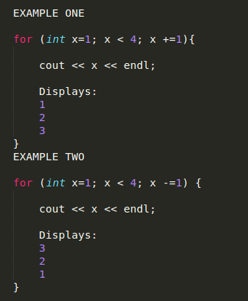
The for Statement

Slide 29
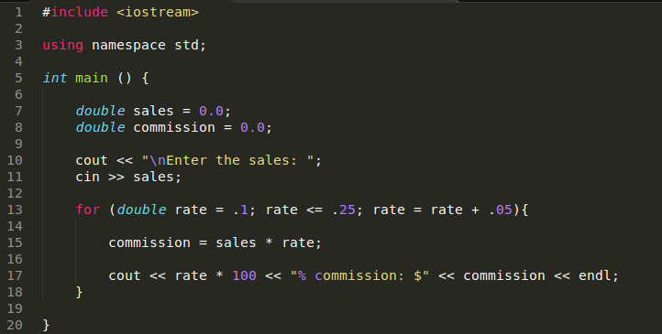

The Colfax Sales Program
Calculates the commission for a given sales amount using four different rates
A for loop keeps track of each of the four rates

Slide 30
Work Cited
Diane Zax, “An Introduction to Programming with C++, Sixth Edition”,
  Chapter 5 – The Selection Structure.
  Chapter 7 – The Repetition Structure.
Towson University, Professor Robert Eyer, COSC 175,
  Chapter 5 Lecture Slides.
  Chapter 7 Lecture Slides.

