Slide 1
Nested Control Structures
Nested Selection structures && Nested Repetition structures
Jessica Sizemore SIP 2015 , 17 JUN 2015

Slide 2
Nested Selection Structures

Slide 3
Nested Selection Structures
Contained within an outer selection structure
Nested selection structures are used when more than one decision needs to be made before choosing an instruction
Inner selection structures are indented within their outer selection structures
Outer and inner selection structures can be thought of as making primary and secondary decisions, respectively

Slide 4
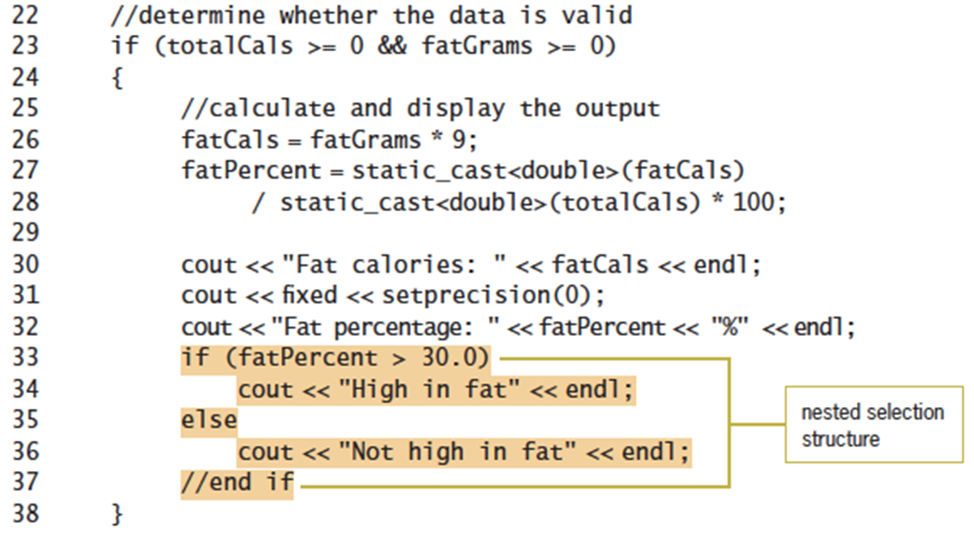
Coding nested selection structures
Nested selection structures uses the if and else statements
Can be placed in either if or else statement blocks
Figure 6-7 Modified program for the health club problem from Chapter 5’s Lab 5-2 (cont’d.)

Slide 5
Logic Errors in Selection Structures
Three common logic errors made when writing selection structures
  1. Using a compound condition rather than a nested selection structure
  2. Reversing the outer and nested decisions
  3. Using an unnecessary nested selection structure

Slide 6
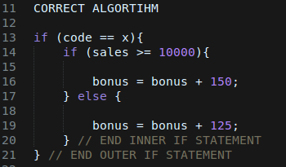
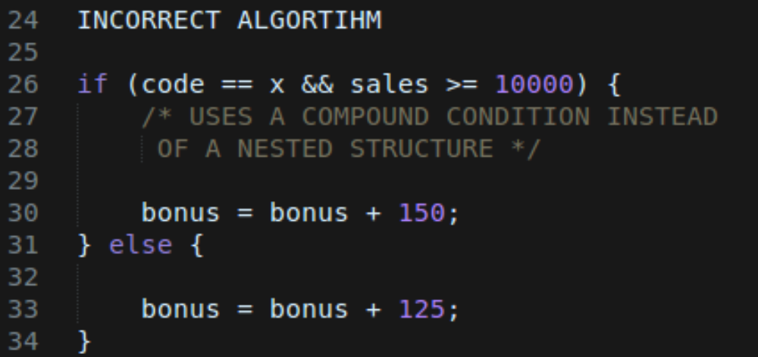
First Logic Error
Using a compound condition rather than a nested selection structure
Ignores the hierarchy between two sub-conditions
  - One applies only if the other is a certain value

Slide 7

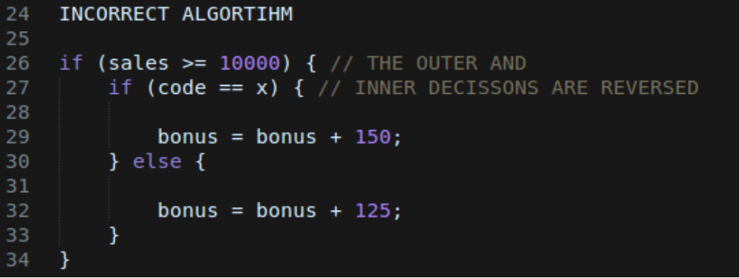
Second Logic Error
Reversing the outer and nested selection structures

Slide 8
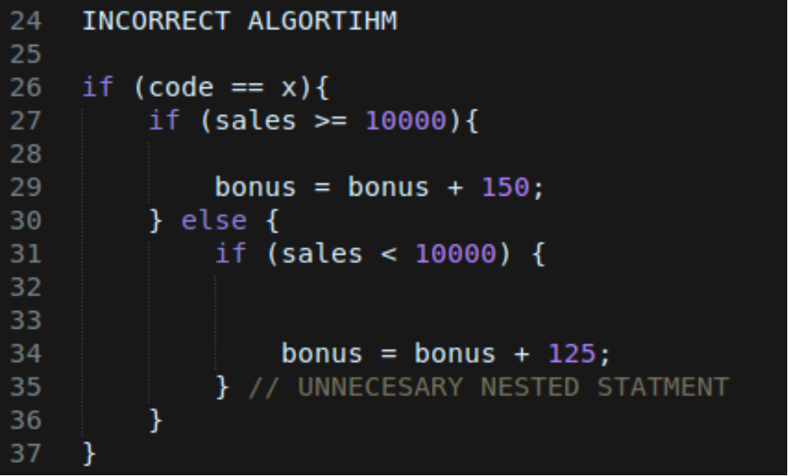
Third Logic Error
Using an unnecessary nested selection structure
Often will produce the correct result, but will be inefficient

Slide 9
Multiple-Alternative Selection Structures
Sometimes problems require a selection structure that chooses between several alternatives
Called multiple-alternative selection structures or extended selection structures

Slide 10
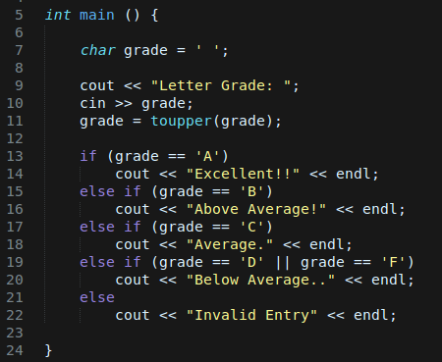
Grading Calculator
Processing
Algorithm:
Enter Grade
If (the grade is one of the following: )
  A Display “Excellent”
  B Display “Above Average”
  C Display “Average”
  D of F Display “Below Average”
Else
  Display “Invalid Grade”
Figure 6-21 IPO chart for the Kindlon
High School problem

Slide 11
The Switch statement
The switch statement to code a multiple-alternative selection structure
Begins with switch keyword followed by a selector expression in parentheses
Selector expression can be anything
Must result in a data type that is bool, char, or int
After selector expression, there are one or more case clauses inside brackets

Slide 12
The switch Statement
Each case clause represents a different alternative
Each case clause contains one or more statements processed when selector expression matches that case’s value

Slide 13
The switch Statement
break statement tells computer to break out of switch at that point; must be the last statement of a case clause
Without a break statement, computer continues to process instructions in later case clauses
Can also include one default clause; processed if selector expression does not match any values in case clauses
default clause can appear anywhere, but usually entered as last clause
  If it is the last clause, a break statement is not needed at its end
  Otherwise, a break statement is needed to prevent computer from processing later case clauses

Slide 14
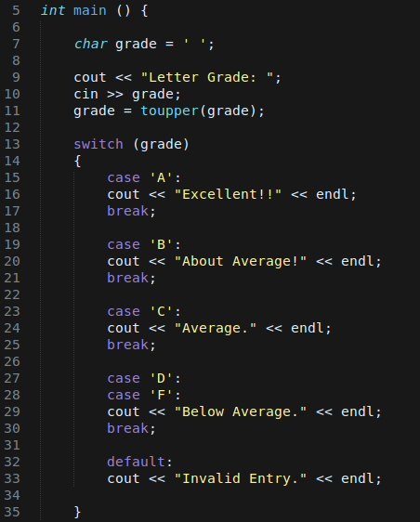
The switch Statement
This is the same Grading program that we wrote with else if statements.

Slide 15
Nested Repetition Structures

Slide 16
Nested Repetition Structures
You can place one loop (inner loop) inside another loop (the outer loop)
Both loops can be pretest loops or posttest loops, or different types

Slide 17
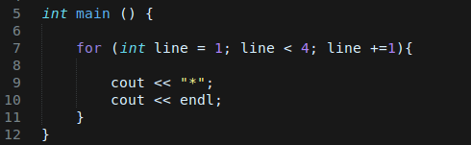

The Asterisks Program
Simple program that prints asterisks to the screen (Without Nested Loops):

Slide 18
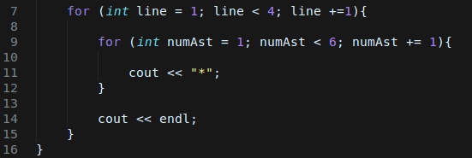

The Asterisks Program
Simple program that prints asterisks to the screen (With Nested Loop):

Slide 19
The pow Function
convenient tool to raise a number to a power (exponentiation)
The pow function raises a number to a power and returns the result as a double number
Syntax:
  pow (x,y); Where x is the base and y is the exponent.
At least one of the two arguments must be a double
Program must contain the #include <cmath> directive to use the pow function

Slide 20
Work Cited
Diane Zax, “An Introduction to Programming with C++, Sixth Edition”,
  Chapter 6 – More on the Selection Structure.
  Chapter 8 – More on the Repetition Structure.
Towson University, Professor Robert Eyer, COSC 175,
  Chapter 6 Lecture Slides.
  Chapter 8 Lecture Slides.

