Slide 1
STRINGS
Jessica Sizemore, SIP 2015, 22 JUN 2015

Slide 2
The string Data Type
To use the string class, a program must contain the #include <string> directive
You can use the string class to create string variables or string named constants

Slide 3
The string Data Type
Example
  string zipCode = “”;
  Declare and Initializes a string variable named zipCode
Example
  const string VALID_LENGTH = “Valid Length”;
  Declares and Initializes a string named constant called VALID_LENGTH
Example
  const string COMPANY_NAME = “ABC Company”;
  Declares and Initializes a string named constant called COMPANY_NAME

Slide 4
The getline Function
The getline function obtains string data from the keyboard and stores it in a string variable
Syntax is:
  getline(cin, stringVariableName, [delimiterCharacter]);
Three actual arguments (first two required):
  cin argument refers to computer keyboard
  stringVariableName argument is name of a string variable in which to store input
  Optional delimiterCharacter indicates character that immediately follows last character of string

Slide 5
The getline Function (delimiter character)
Function will continue to read characters entered at keyboard until it encounters a delimiter character
Default delimiter character is newline character { “\n” }
When the function encounters a delimiter character, it discards the character—process called consuming the character
Backslash is called an escape character
Backslash and character following it are called an escape sequence

Slide 6
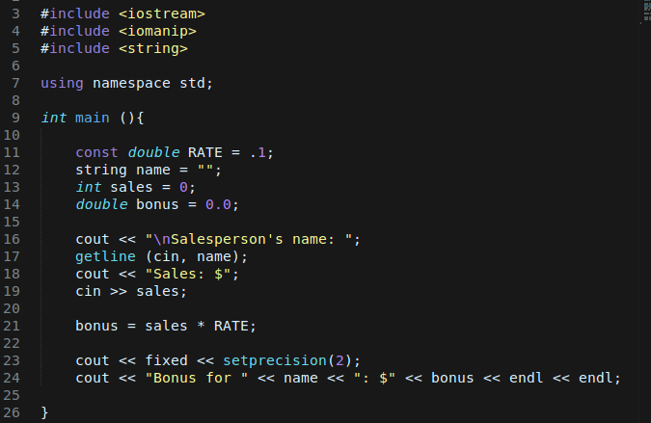

The “Creative” Sales Program
Program that enters a salesperson’s name and sales amount; It calculates the salesperson’s bonus by multiplying the sales amount by 10%.

Slide 7
The ignore Function
The ignore function instructs the computer to read and ignore characters stored in the cin object by consuming (discarding) them
Syntax is:
  cin.ignore([numberOfCharacters][, delimiterCharacter]);
Has two actual arguments, both optional:
  numberOfCharacters argument is maximum number of characters function should consume (default is 1)
  delimiterCharacter argument stops ignore function from reading and discarding any more characters when consumed

Slide 8
The ignore Function
Example One
  cin.ignore();
  Reads and consumers one character; also written as cin.ignore(1)
Example Two
  cin.ignore(5);
  Reads and consumes five characters
Example Three
  cin.ignore(100, ‘\n’)
  Reads and consumes until either 100 characters or newline characters are consumed
Example Four
  Cin.ignore(25, ‘#’);
  Reads and consumes until either 25 characters or the # character is consumed

Slide 9
Number of Characters Contained in a string Variable
You use string class’s length function to determine the number of characters in a string variable
Syntax is:
  string.length()
  Returns number of characters contained in string
Example
  string name = “Nancy Haberdeen”;
  cout << name.length() << endl;
  Displays the number 15 on the screen

Slide 10
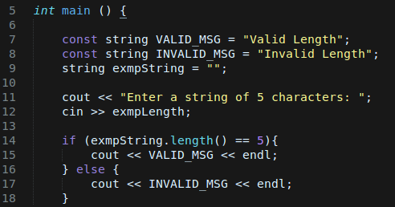
Number of Characters Contained in a string Variable
Compares the number of characters stored in the exmpLength variable with the number 5 and then displays an appropriate message

Slide 11
Accessing the Characters Contained in a string Variable
The substr function allows you to access any number of characters contained in a string variable by returning the specified characters
Syntax is:
  string.substr(subscript[, count])
Has two arguments (first is required):
  subscript argument represents subscript of first character you want to access in string
  count argument is number of characters to return after character specified by subscript

Slide 12
Accessing the Characters Contained in a string Variable
If you omit count argument, function returns all characters from subscript position through end of string
Each character has a unique subscript that indicates character’s position in the string

Slide 13
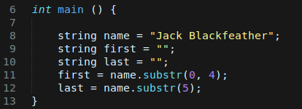
Accessing the Characters Contained in a string Variable
Assigns “Jake” to the first variable and “Blackfeather” to the last variable

Slide 14
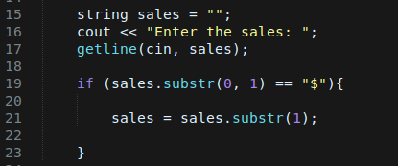
Accessing the Characters Contained in a string Variable
If the string stored in the sales variable begins with $ the code assigns the variable’s contents, excluding the $ to the variable

Slide 15
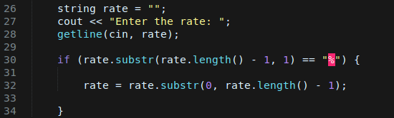
Accessing the Characters Contained in a string Variable
If the string stored in the rates variable ends with the % the code assigns the variable’s contents, excluding the % to the variable

Slide 16
Searching the Contents of a string Variable
You use the find function to search contents of a string variable to determine whether it contains a specific sequence of characters
Syntax is:
  string.find(searchString, subscript)
  searchString argument is a string for which you are searching within string
  subscript argument specifies starting position for the search

Slide 17
Searching the Contents of a string Variable
The find function performs a case-sensitive search (uppercase and lowercase letters are not equivalent)
  When searchString is contained within string, function returns an integer that indicates beginning position of searchString within string
  Function returns -1 when searchString is not contained within string

Slide 18
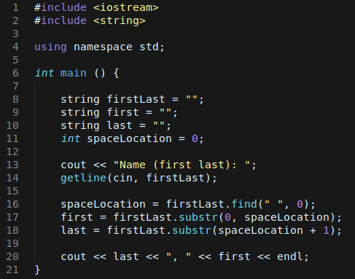

Rearranged Name Program
Gets first and last name
Locate space, then pulls out first and last names
Displays rearranged name

Slide 19
Removing Characters from a string Variable
You can use the erase function to remove one or more characters from a string variable
Syntax is:
  string.erase(subscript[, count]);
  subscript is position of first character you want to remove
  Optional count argument is an integer that specifies number of characters you want removed
  If you omit count, function removes all characters from subscript through end of string

Slide 20
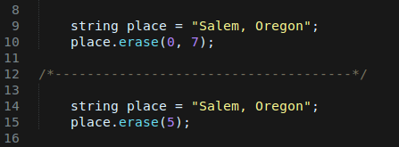
Removing Characters from a string Variable
Removes the first seven characters from the place variables, changing the variable’s contents to “Oregon”
Removes all of the characters rom the places variable, beginning with the character whose subscript is 5, changing the variable’s contents to “Salem”

Slide 21
Replacing Characters in a string Variable
The replace function replaces one sequence of characters in a string variable with another
Syntax is:
  string.replace(subscript, count, replacementString);
  subscript argument specifies where to begin replacing characters in string
  count argument indicates number of characters to replace
  replacementString argument contains replacement characters

Slide 22
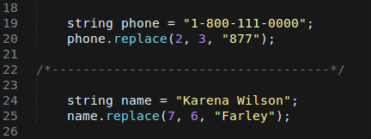
Replacing Characters in a string Variable
Replaces three characters in the phone variable, beginning with the character whose subscript is 2 with “877”; changes are made to be “1-877-111-0000’
Replace six characters in thee name variable, beginning with the characters whose subscript is 7, with “Farley”; changes are made to be “Karena Farley”

Slide 23
Inserting Characters within a string Variable
You can use the insert function to insert characters into a string variable
Syntax is:
  string.insert(subscript, insertString);
  subscript specifies where in string you want characters inserted
  insertString specifies characters to be inserted

Slide 24
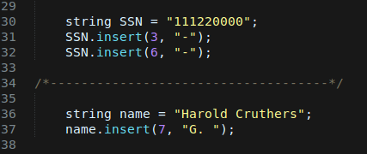
Inserting Characters within a string Variable
Insert how “ – “ in the SSN, one after the third number and another after the fifth number; changes to be “111-22-0000”
Inserts “G. “ between the first and last names stores in the name variable; changes to be “Harold G. Cruthers”

Slide 25
Concatenating Strings
String concatenation refers to the process of connecting (linking) strings together
You concatenate strings using the concatenation operator (+ sign)

Slide 26
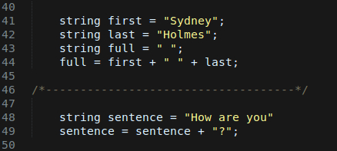
Concatenating Strings
Concatenates the contents of the first variable, a space, and the contents of the last variable; results are assigns to the full variable as “Sydney Holmes”
Concatenates the contents of the sentence variable and a question mark and the assigns the result “ How are you?”

Slide 27
Work Cited
Diane Zax, “An Introduction to Programming with C++, Sixth Edition”,
  Chapter 13 – String.
Towson University, Professor Robert Eyer, COSC 175,
  Chapter 13 Lecture Slides..

