Slide 1
Notes on sipXvxml
Dale R. Worley
August 10, 2004

Slide 2
Structure of sipXvxml
Classes
Threads
  System
  Per-call
Interfaces
  Outside world
  VXI
Call handling structures
Call setup
VXML PROMPT
Call teardown
Possible issues

Slide 3
Classes
Over 500 classes.
OsTaskBase (sipXportLib/main/include/os/OsTask.h:53)
OsTaskWnt (sipXportLib/main/include/os/wnt/OsTaskWnt.h:52)
OsTaskLinux (sipXportLib/main/include/os/linux/OsTaskLinux.h:51)
typedef class OsTaskWnt OsTask (sipXportLib/main/include/os/OsTask.h:
typedef class OsTaskVxw OsTask (sipXportLib/main/include/os/OsTask.h:
typedef class OsTaskLinux OsTask (sipXportLib/main/include/os/OsTask.
OsServerTask (sipXportLib/main/include/os/OsServerTask.h:35)
PsHookswTask (sipXcallLib/main/include/ps/PsHooksw
PsButtonTask (sipXcallLib/main/include/ps/PsButton
PsPhoneTask (sipXcallLib/main/include/ps/PsPhoneTa
CpCallManager (sipXcallLib/main/include/cp/CpCallM
CallManager (sipXcallLib/main/include/
CpCall (sipXcallLib/main/include/cp/CpCall.h:55)
CpPeerCall (sipXcallLib/main/include/c
MpStreamPlayer sipXmediaLib/main/include/mp/MpStre
SipUserAgentBase (sipXtackLib/main/include/net/Sip
SipUserAgent (sipXtackLib/main/include
SipUserAgentStateless (sipXtackLib/mai
CpGatewayManager (sipXcallLib/main/include/cp/CpGa

Slide 4
Threads
Most common container of a thread is an OsTask object.
Primary feature of OsTask is a virtual run() method which is the code the thread executes.
This allows a start() method to start it and a restart() method to start it over again.

Slide 5
Threads 2
Most important subclass of OsTask is OsServerTask.
run() method is a loop that reads messages from a message queue associated with the object.
Uses the virtual handleMessage() method to process them.

Slide 6
Threads 3
Many OsServerTask subclasses can have “listeners”.
Depending on the class, listeners are registered for particular subsets of the messages that can be received.
Generally used for upcalling to the call processing applications from the generic CpCall call handling.

Slide 7
System threads
The main thread, which starts and stops the system.
The heartbeat thread, which periodically diddles with a particular temporary file.
The media thread, associated with the unique MediaTask object.

Slide 8
System threads 2
The call manager thread group: CallManager, IvrCallListener, IvrDtmfListener, and IvrTelListener.
There are probably threads in the SIP user agent to listen for incoming SIP messages.

Slide 9
Per-call threads
CpPeerCall – contains SIP session state
ChannelThread – executes VXI
MpStreamQueuePlayer – plays prompts

Slide 10
Interfaces: Outside world
SIP stack for signaling.
RTP stack for media.
Uses HTTP to fetch configuration information, especially VXML that defines dialogs.
Runs as a process.
Twiddles a temporary file to provide “alive” signal to a watchdog process.

Slide 11
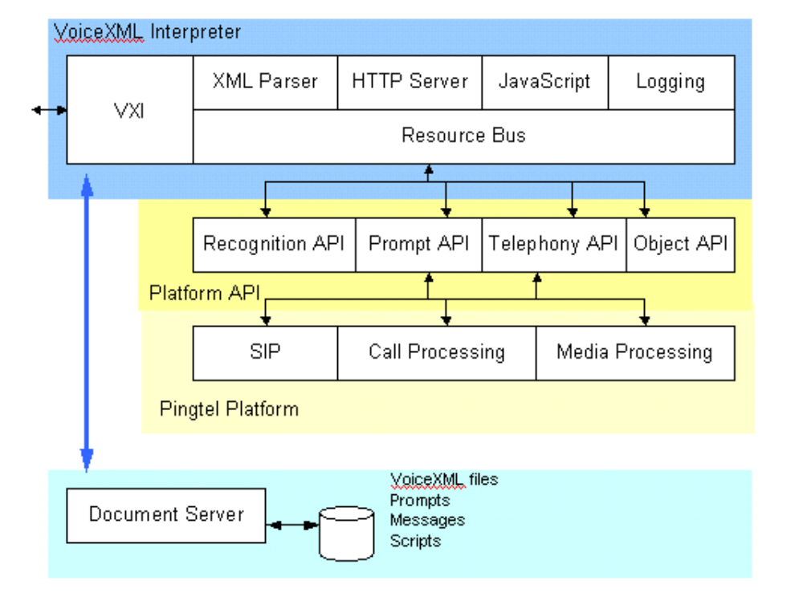
Interfaces: VXI

Slide 12
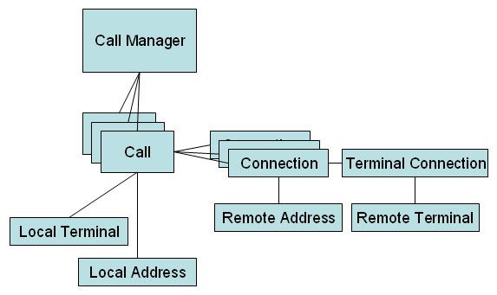
Call handling structures

Slide 13
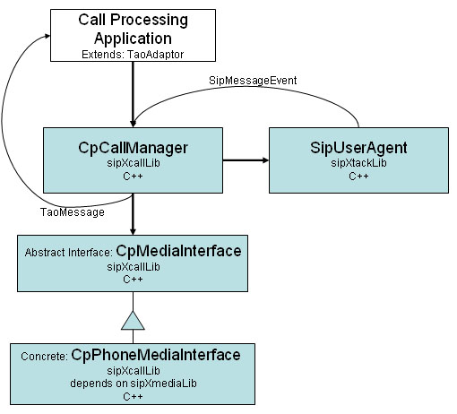
Call handling structures 2

Slide 14
Call setup
The SIP redirection server sends the call to the media server due to a rule in
sipXregistry/main/etc/mappingrules.xml.in:
<url>&lt;sip:{digits}@{mediaserver};play={voicemail}%2Fcgi-bin%2Fvoicemail%2Fmediaserver.cgi%3Faction%3Ddeposit%26mailbox%3D{digits}&gt;;q=0.1</url>
During code installation, mappingrules.xml.in is transformed into mappingrules.xml by replacing
${...} references with installation parameters. When the XML is parsed, XML character entities are
substituted generating the mapping result:
<sip:{digits}@{mediaserver};play={voicemail}%2Fcgi-bin%2Fvoicemail%2Fmediaserver.cgi%3Faction%3Ddeposit%26mailbox%3D{digits}>;q=0.1
This specifies that the url sip:...{digits} has preference value 0.1 (a low value), so it will be
tested after higher preference destinations have failed.
The redirection server substitutes the {...} references with their values. 'digits’ is the
destination extension number, 'mediaserver' is the IP address and port of the media server,
'voicemail' is the base URL of the voicemail URL space on the media server.
This SIP URL generates a SIP INVITE request. The “play=“ parameter is the URL for the VXML
document for the dialog that sipXvxml will have with the call.
The URL is
<voicemail>/cgi-bin/voicemail/mediaserver.cgi?action=deposit&mailbox=<digits>
(The extraction of parameters is done in the call to getfieldParameter at
IvrCallListener::handleStartVXIsession:284.) This CGI is generated in
sipXpbx/main/src/mediaservercgi/main.cpp.

Slide 15
Call setup 2
main() generates the unique CallManager object.
The CallManager registers with the SIP user agent to receive SIP_INVITE_METHOD messages.

Slide 16
Call setup 3
CallManager::handleMessage (and only it) is going to see SIP_INVITEs.
It looks up the user id, which seems to be the name called. If it is not valid, returns a "no such user" response.
Determines that a new CpCall should be created.

Slide 17
Call setup 4
Creates a new CpPhoneMediaInterface, with a host of sub-objects that appear to be a data-flow processing system for the media data stream.
Creates a new CpPeerCall, with sub-objects to represent the components of the session.
Starts the thread in CpPeerCall.
Duplicates CallManager’s listeners onto CpPeerCall.
Passes message to CpPeerCall.

Slide 18
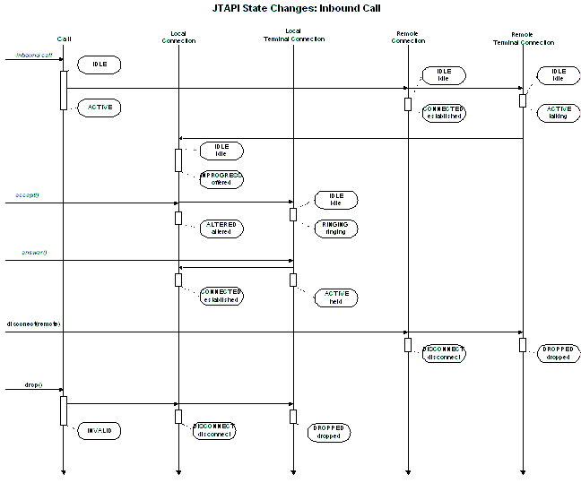
Call setup 5
CpPeerCall begins to handle the session state transitions.

Slide 19
Call setup 6
The IvrCallListener attached to the CpPeerCall sees the TERMINAL_CONNECTION_TALKING message and calls IvrCallListener::handleStartVXIsession.
Extracts the play parameter from the SIP requestUrl.
Appends "&from=<caller address>". Probably leaves an appended parameter which is the original extension called. Calls VXIProcessUrl.

Slide 20
Call setup 7
VXIProcessUrl assembles URL of VXML document from the 'url' parameter. If URL doesn’t contain 'http', prepend gblDefaultVxmlURL.
Creates a VXIMap, a ChannelThreadArgs, a VXIplatform, initializes them.
Create thread executing ChannelThread with arguments in ChannelThreadArgs object.

Slide 21
Call setup 8
The ChannelThread sets up a lot of stuff for VXI.
Calls VXIplatformProcessDocument to do the real work.
Which calls VXI::Run.

Slide 22
VXML processing – "PROMPT"
Wrapper around VXI sets up the resources needed by the API implementations that handle low-level actions for VXI.
VXI calls OSBpromptBeginSession, which calls CallManager::createPlayer to construct a "player" that knows how to output prompts.

Slide 23
VXML processing 2
CallManager::createPlayer posts a CP_CREATE_QUEUE_PLAYER message, to itself.
CallManager::handleMessage forwards the message to the CpCall designated by the callId which has been carried along in all these function calls.
CpCall::handleMessage calls the associated media interface CpPhoneMediaInterface, which does "new MpStreamQueuePlayer".

Slide 24
VXML processing 3
MpStreamQueuePlayer is an OsServerTask which will handle playing of prompts.
OSBpromptBeginSession stores the MpStreamQueuePlayer into the resource object which was passed into VXI.

Slide 25
VXML processing 4
To play a PROMPT element, the VXI engine calls the interface OSBpromptQueue.
OSBpromptQueue, via the resource object passed in from the outer wrapper, calls MpStreamQueuePlayer::add to queue the prompt on the queue of prompts to be played.

Slide 26
VXML processing 5
MpStreamQueuePlayer::add generates a new MpStreamPlayer and adds it to its queue of media sources to be played.
Note MpStreamPlayer is an OsServerTask, so has its own thread and message queue.
The MpStreamQueuePlayer adds the MpStreamPlayer as a listener for its messages.

Slide 27
VXML processing 6
Then calls MpStreamPlayer::realize, which
Sends a STREAM_REALIZE_URL/ BUFFER message to MpStreamQueuePlayer,
Waits for response, and
Starts the server task.
At this point, it seems to becomes a standard media processing task.

Slide 28
Call teardown
Tear-downs can come from either the local end (VXI signals end of processing) or the remote end (SIP BYE).
Starting with local termination:
VXI disconnects call by calling OSBtelDisconnect.
VXI closes down its ‘tel’ API by calling
OSBtelEndSession.

Slide 29
Call teardown 2
OSBtelDisconnect and OSBtelEndSession both call CallManager::drop.
CallManager::drop posts a CP_DROP message to the CallManager and returns.
CallManager::handleMessage passes the message to the related CpCall object based on the callId.

Slide 30
Call teardown 3
CpCall::handleMessage calls the hangUp function.
CpCall::hangUp sets some state variables, then calls onHook.
CpPeerCall::onHook calls hangUp on all the connections, then dropIfDead.

Slide 31
Call teardown 4
CpPeerCall::dropIfDead composes a CP_CALL_EXITED message to send to CallManager after CALL_DELETE_DELAY_SECS (20 seconds).
CallManager::handle Message calls removeCall, then call->requestShutdown.
CallManager::removeCall removes the call from callStack.

Slide 32
Call teardown 5
CpCall::requestShutdown posts OS_SHUTDOWN to the call.

Slide 33
Call teardown 6
Back to what happens after VXI returns:
Within the ChannelThread, VXI::Run returns.
VXIplatformProcessDocument closes down the three service processes/objects (recognizer, prompt, tel).
VXIplatformProcessDocument returns to the main routine for the ChannelThread.

Slide 34
Call teardown 7
ChannelThread removes IvrTelListener via gpTelListener->removeListener, then waits until gpTelListener->isCleanupInProgress(callId) is false.
Cleans up resources used by VXI.
The ChannelThread thread terminates.

Slide 35
Call teardown 8
An additional clean up thread is started for each call within IvrTelListener::doCleanUpCall.
doCleanUpCall calls VXICleanUpCall, which starts a CallCleanupThread .
Calls which have a CallCleanupThread are logged in the IvrTelListener via addToCleanupInProgress.
When CallCleanupThread is finished, it calls removeFromCleanupInProgress.

Slide 36
Call teardown 9
IvrTelListener::doCleanUpCall is invoked by IvrCallListener::handleMessage upon receiving CONNECTION_DISCONNECTED and CONNECTION_FAILED messages.

Slide 37
Possible scaling issues
Coding style
Inlining
malloc() contention
VXML processing
Disk access
Media stream processing
Lock contention
VXI efficiency
Number of threads

Slide 38
Coding style
Much of the code resembles Smalltalk or Java, with frequent allocation and manipulation of small string values.
OsReadLock lock(mConnectionMutex);
Connection* connection = NULL;
UtlString address;
int found = 0;
UtlDListIterator iterator(mConnections);
while ((connection = (Connection*) iterator())) {
Url remoteUrl(connectionAddress);
if (connection->isSameRemoteAddress(remoteUrl)) {
connection->getRemoteAddress(&address);
address.insert(0, "foreign-terminal-");
found = 1;
#ifdef TEST_PRINT
osPrintf("%s-set terminal: %s\n", mName.data(), address.data());
#endif
connectionList->append(new UtlString(address));
numConnections++;
}
}

Slide 39
Inlining
Many small methods seem to be suitable for inlining, but are not.

Slide 40
malloc() contention
Many malloc() implementations do not scale well. Some slow down with increasing processors.
Better allocators are available (e.g., see ACM PLDI 2004).
Minimizing the number of malloc()’s may be particularly useful.
Overrunning dynamic memory may be a problem.

Slide 41
VXML processing
VXML documents are produced using CGI routines, fetched via HTTP, then parsed.
This process might benefit from caching of the generated documents and/or parsed results.

Slide 42
Disk access
Scaling to 1,000 simultaneous users may tax the disk subsystem.
Caching prompts in memory might reduce overhead.

Slide 43
Media stream processing
Processing needed for 1,000 simultaneous media streams may tax processor power.

Slide 44
Lock contention
With the numerous threads and common resources, contention for locks could limit scalability.
Requires a careful inventory of locks and threads.

Slide 45
VXI efficiency
VXI itself needs to be checked for efficiency.

Slide 46
Number of threads
With each SIP session generating at least two threads, the scalability of the pthreads implementation becomes important.
Threads generated for individual VXML actions (e.g., PROMPT) are likely trouble spots.

Slide 47
Need to profile
As a rule, the efficiency bottleneck in a program is never where you expect it to be.

Slide 48
Stability issues
That the heartbeat thread checks up on malloc() looks suspicious – Use validating wrapper, memory reference tracer.
Need to be able to dump thread, lock, and message queue status to find deadlocked threads.
Would help to be able to log core dumps from customer installations.

Slide 49
Building a collegium of open-source developers
Open source developers become critical partners.
They need to be “marketed” and “sold to” like customers, except their needs are different.
Open source has strong first-mover effects.

Slide 50
Building a collegium of open-source developers 2
Possible ways to build critical mass:
  Attract IVR developers
  Integrate with voice-recognition software
  Explore conference bridging
As always, initial learning curve is important.
Need releases and documentation directed at developers as well as customers.

