Slide 1
Erhan cimen 10-D
S1F1R B1R SUNUMU <3

Slide 2
The aim of the movie is to protect the neighborhood from enemies.

Slide 3
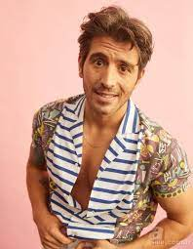
Cihangir Ceyhan
-Cihangir Ceyhan is a Turkish TV and movie actor. -February 6, 1989 (age 33); Adana Turkey one of the main characters

Slide 4
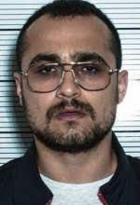
Savaş Satış
-He gives life to the character of Savaş in an Adana TV series. Battle Sale, 1.75 meters tall

Slide 5
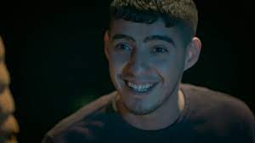
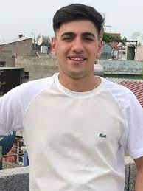
Cengo , Burak
-Cengizhan Yurdutek -An actor who played in the movie adana is now a tik tok actor adana
Burak Akyüz -An actor who played in the movie adana is now a tik tok actor
Burak Akyüz

Slide 6



Slide 7
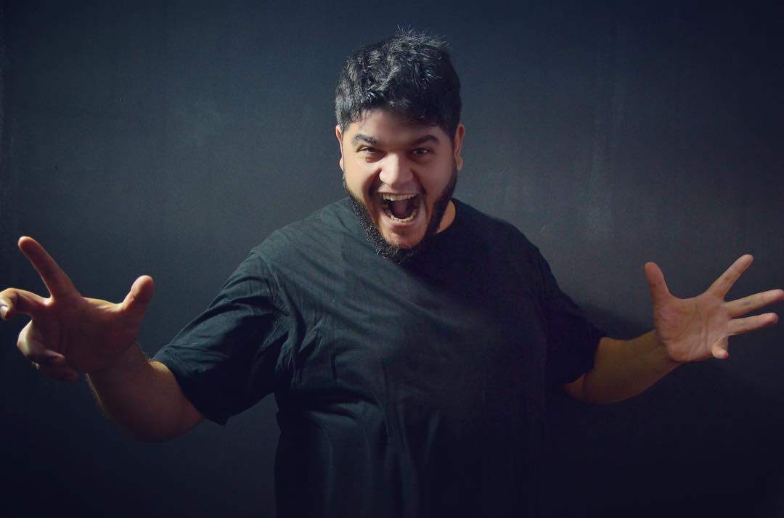
Burak Safak
famous actor who played in adana movie and a famous gourmet

Slide 8
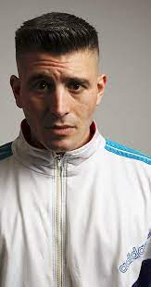
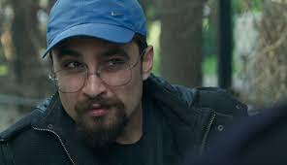
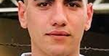
İlknur teacher is the best teacher İlknur teacher is the best teacher İlknur teacher is the best teacher İlknur teacher is the best teacher
Finish <3

