Slide 1

CAPSTONE PROJECT AI-Chatbot using machine learning
Presented By
Student Name: Siri Ramineni
College Name: IARE
Department: CSE
Email ID:siriramineni48@gmail.com
AICTE Student ID: STU658fbabb009391703918267

Slide 2
OUTLINE
Problem Statement
Proposed System/Solution
System Development Approach (Technology Used)
Algorithm & Deployment
Result (Output Image)
Conclusion
Future Scope
References

Slide 3
Problem Statement
In today's digital era, users expect seamless, personalized, and intelligent interactions with software systems. However, many existing chatbots operate on rigid, rule-based architectures that can only respond to predefined inputs. This leads to poor user experience when encountering unfamiliar or varied phrasing, limiting the chatbot’s usefulness. Additionally, these systems lack the ability to adapt or improve over time, making them insufficient for handling the diverse and evolving nature of human communication.

Slide 4
Proposed Solution
We propose an AI-powered Chatbot with Machine Learning capabilities that uses Natural Language Processing (NLP) and scikit-learn algorithms to:
Understand and classify user queries,
Provide relevant responses,
Learn continuously from interactions,
Handle unknown questions via similarity matching,
Save knowledge for future sessions.
The chatbot uses TF-IDF Vectorization and a Naive Bayes Classifier to identify the intent of user messages and respond accordingly. It stores its learning in persistent files, ensuring that it becomes more intelligent with every conversation

Slide 5
System Approach
Component | Technology Used
Programming Language | Python
NLP Toolkit | NLTK
Machine Learning | scikit-learn (TF-IDF, Naive Bayes)
Data Persistence | JSON, Pickle (for .pkl model)
Model Training | Dynamic, via user interactions
Interface (optional) | Streamlit or Console-based
Deployment (optional) | Localhost / Streamlit Cloud / Render

Slide 6
Algorithm & Deployment
Preprocessing & Feature Extraction
TF-IDF Vectorizer transforms user input into feature vectors.
Intent Classification
Multinomial Naive Bayes classifier predicts the category (e.g., greetings, jokes, tech).
Similarity Handling
Unknown inputs are matched with known messages using cosine similarity.
Response Generation
Based on the predicted category, the bot selects a suitable response from a JSON file.
Active Learning
Learns new mappings and stores them in chatbot_training_data.json.

Slide 7
Deployment
🧠 Deployment
Run with:
bash
python ml_chatbot.py (name saved for the python file)

Slide 8
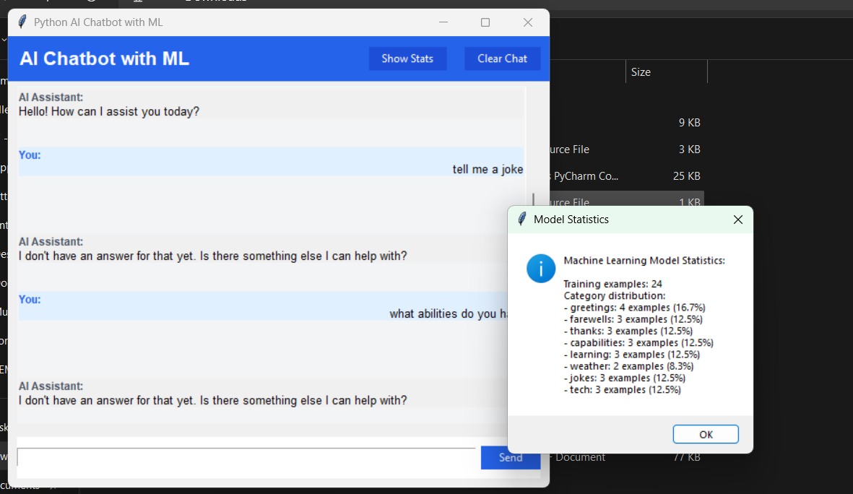
Result

Slide 9
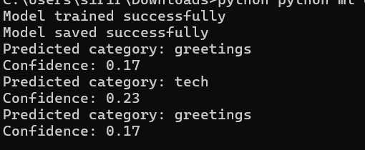

Slide 10
Conclusion
The enhanced AI Chatbot with Machine Learning represents a significant upgrade over traditional rule-based bots. It can classify user intents, generate meaningful responses, and most importantly, learn continuously from interactions. The use of scikit-learn’s Naive Bayes model makes it lightweight yet effective for educational and real-world applications. Persistent learning ensures long-term usability and personalization, making it an ideal starting point for conversational AI projects.

Slide 11
Future scope
Integrate with GPT APIs for more advanced understanding and natural replies.
Use Deep Learning models (RNNs, Transformers) for better context handling.
Add multilingual support for global usability.
Voice-to-text conversion using speech_recognition and gTTS for voice-based interaction.
UI enhancements using web frameworks like ReactJS, or mobile app integration.
Dashboard to analyze user queries and bot performance.

Slide 12
References
https://scikit-learn.org/stable/
https://www.nltk.org/
https://scikit-learn.org/stable/modules/naive_bayes.html
https://en.wikipedia.org/wiki/Cosine_similarity
https://scholar.google.com/scholar_lookup?title=A+Survey+on+Chatbot+Implementation+in+Customer+Service+Industry+through+Deep+Neural+Networks
GitHub Link: https://github.com/SIRI-RAMINENI/AI-Chatbot-Aicte-Project.git

Slide 13
Thank you

