Slide 1

ShopMERN
A Full-Stack E-Commerce Platform
Built with MongoDB · Express · React · Node.js
Project Submission · Sirichandana Vishwaroju

Slide 2
Project Overview
A complete e-commerce web application demonstrating the MERN stack
Objective
At a Glance
Design and implement a full-stack online store featuring authentication, product browsing, a shopping cart, order management, and a complete admin panel — exercising every layer of the MERN stack from database to UI.
3
Mongoose Models
18+
REST API Endpoints
14
React Pages
2
User Roles
Two-tier role system: Customers can browse, purchase, and track orders. Admins manage products, users, and view all orders.
ShopMERN — MERN Stack E-Commerce Platform
2 / 18

Slide 3
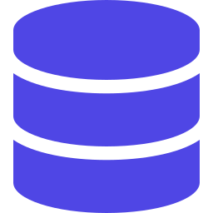
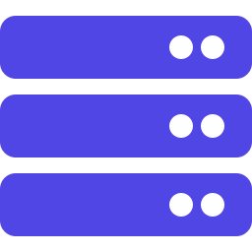


Technology Stack
MERN — MongoDB, Express, React, Node.js
MongoDB
Express
React 18
Node.js
NoSQL document database hosted on MongoDB Atlas, accessed via Mongoose ODM
Minimalist Node.js web framework powering the REST API and JWT-secured routes
Component-based UI built with Vite, React Router v6, and Context API
JavaScript runtime running the backend with bcrypt, JWT, and Mongoose
Tooling: Vite · Axios · React Toastify · bcryptjs · JSON Web Tokens · Concurrently · Nodemon · Morgan
ShopMERN — MERN Stack E-Commerce Platform
3 / 18

Slide 4
System Architecture
Three-tier architecture — clear separation between client, server, and database
FRONTEND
BACKEND
DATABASE
React + Vite
Express API
MongoDB Atlas
:5173
HTTP / Axios
:5000
Mongoose
Cloud
Routing & pages
Auth/Cart context
Axios + JWT header
JWT middleware
Mongoose models
Role-based routes
users
products
orders
JWT tokens issued at login flow through every authenticated request, verified by middleware before reaching controllers.
ShopMERN — MERN Stack E-Commerce Platform
4 / 18

Slide 5


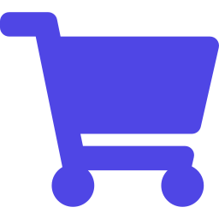
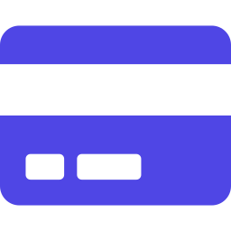


Key Features
Functionalities implemented across customer and admin experiences
JWT Authentication
Search & Pagination
Persistent Cart
Secure register/login with bcrypt-hashed passwords
Keyword filtering and paginated product listing
Add, update, remove items synced to localStorage
Checkout & Orders
Admin Panel
User Management
Shipping form, mock payment, order placement
Dashboard with stats, full CRUD on products
Admin views, roles, and user deletion
ShopMERN — MERN Stack E-Commerce Platform
5 / 18

Slide 6
Database Schema
Three Mongoose collections with relationships via ObjectId references
User
Product
Order
_id ObjectId
name String
email String (unique)
password String (bcrypt)
isAdmin Boolean
timestamps
_id ObjectId
user → User
name String
image String
brand String
category String
description String
price Number
countInStock Number
rating · numReviews
_id ObjectId
user → User
orderItems[] → Product
shippingAddress {}
paymentMethod String
itemsPrice · taxPrice
shippingPrice · totalPrice
isPaid · paidAt
isDelivered · deliveredAt
ShopMERN — MERN Stack E-Commerce Platform
6 / 18

Slide 7
REST API Endpoints
18 endpoints across users, products, and orders — auth-protected as needed
METHOD | ROUTE | ACCESS | DESCRIPTION
POST | /api/users/register | Public | Register new user
POST | /api/users/login | Public | Login & receive JWT
GET | /api/users/profile | Auth | Get / update profile
GET | /api/users | Admin | List all users
DELETE | /api/users/:id | Admin | Delete user
GET | /api/products | Public | List with search & pagination
GET | /api/products/:id | Public | Get single product
POST/PUT/DELETE | /api/products[/id] | Admin | Create / update / delete
POST | /api/orders | Auth | Create new order
GET | /api/orders/myorders | Auth | Current user's orders
PUT | /api/orders/:id/pay | Auth | Mark paid
PUT | /api/orders/:id/deliver | Admin | Mark delivered
GET | /api/orders | Admin | List all orders
ShopMERN — MERN Stack E-Commerce Platform
7 / 18

Slide 8
PART 2
Application Walkthrough
A guided tour through every feature with live screenshots

Slide 9
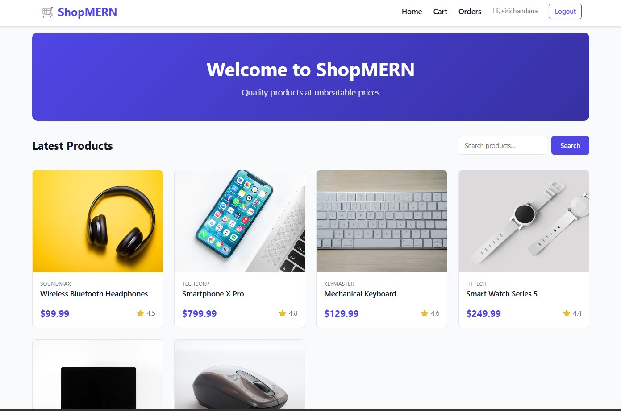
Home Page
Hero banner, product grid, and search — entry point of the application
Highlights
Branded hero banner with welcome message
Responsive product grid with image, brand, price, rating
Real-time search bar wired to backend keyword API
Sticky navbar with cart counter and user menu
ShopMERN — MERN Stack E-Commerce Platform
9 / 18

Slide 10
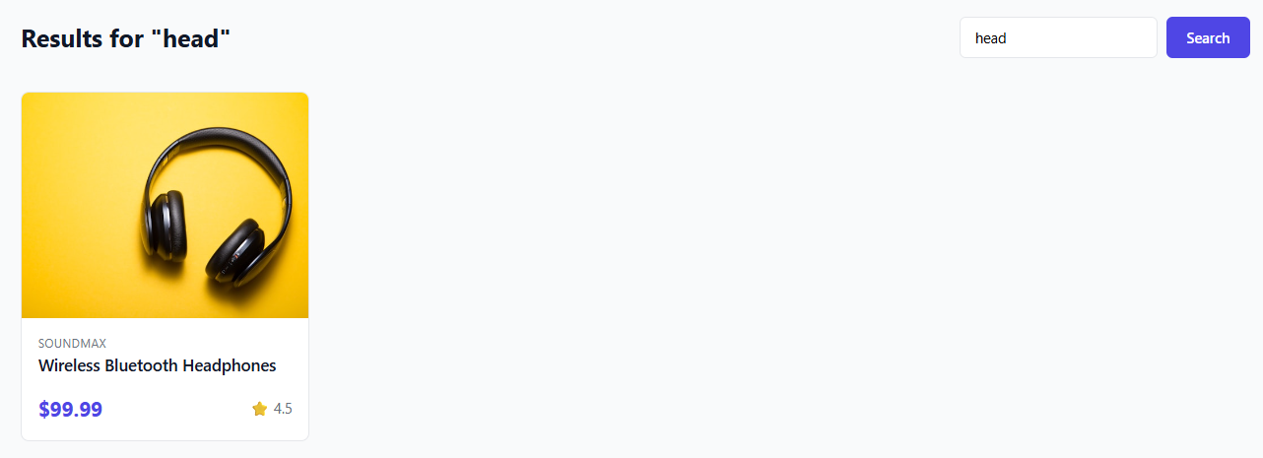
Product Search
Server-side keyword search using MongoDB regex matching
Highlights
Query parameter sent to GET /api/products?keyword=…
Backend matches case-insensitive regex on product name
Results render instantly using the same product grid
URL is sharable — search state lives in query string
ShopMERN — MERN Stack E-Commerce Platform
10 / 18

Slide 11
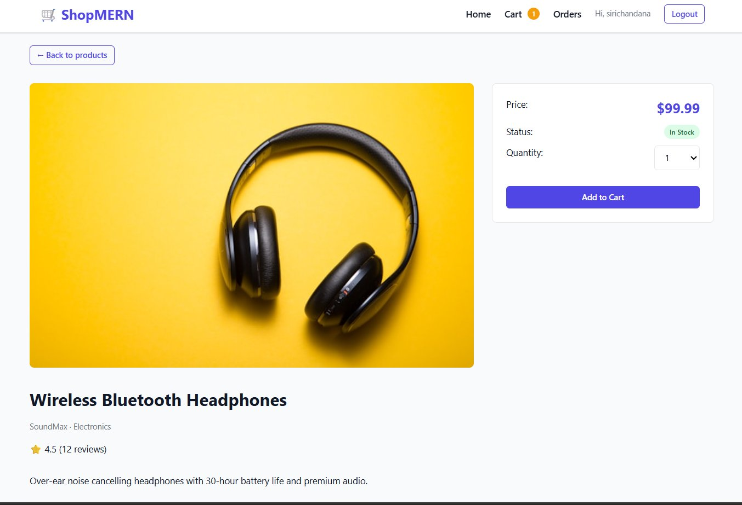
Product Detail Page
Detailed view with stock badge, quantity selector, and Add to Cart
Highlights
Fetched via GET /api/products/:id
Live stock badge (In Stock / Out of Stock)
Quantity selector capped by available stock
Adding to cart updates the navbar badge instantly
ShopMERN — MERN Stack E-Commerce Platform
11 / 18

Slide 12
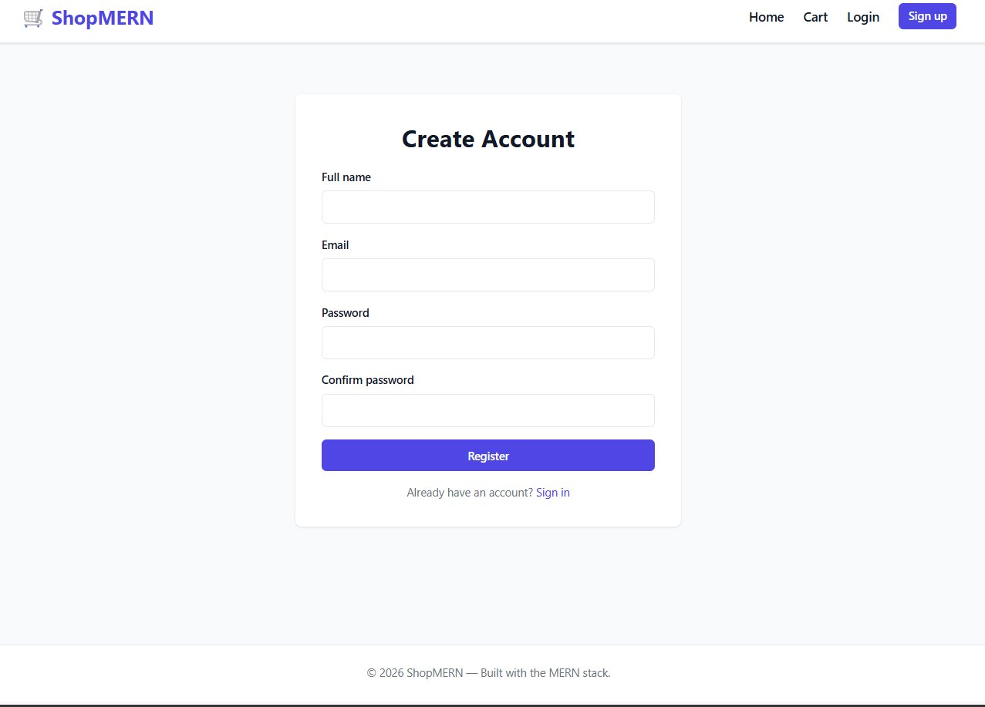
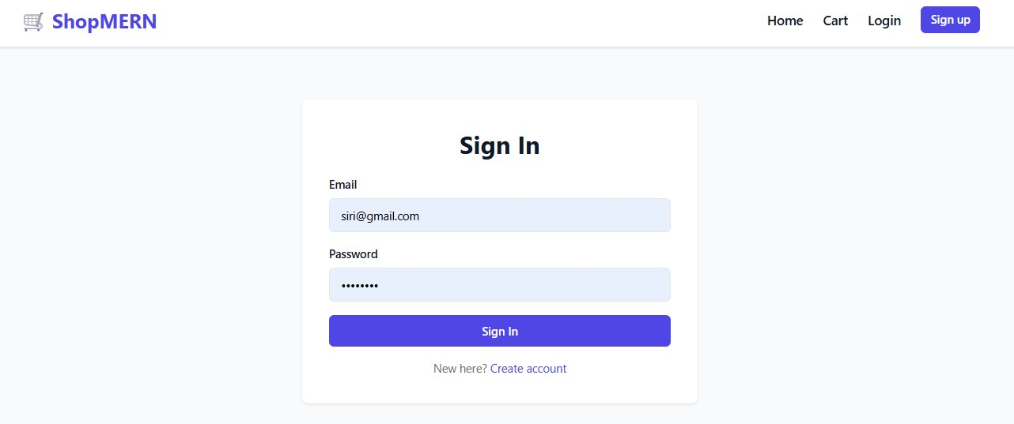
User Authentication
JWT-based register and login flow with bcrypt password hashing
Register
Login
Tokens are stored in localStorage and attached to every Axios request via an interceptor.
ShopMERN — MERN Stack E-Commerce Platform
12 / 18

Slide 13
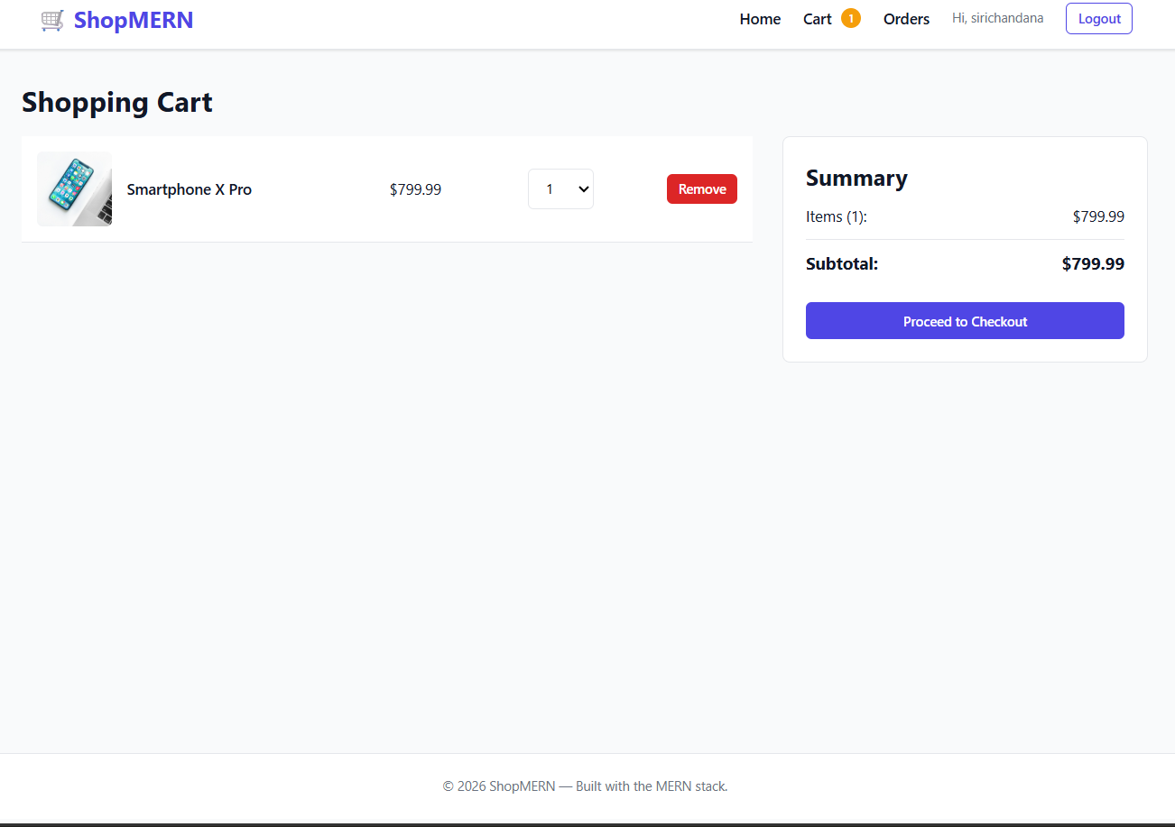
Shopping Cart
Persisted in localStorage so items survive page refreshes
Highlights
Cart state managed by React Context API
Quantity adjustments and item removal in real time
Live summary card with running subtotal
Synced to localStorage on every state change
ShopMERN — MERN Stack E-Commerce Platform
13 / 18

Slide 14
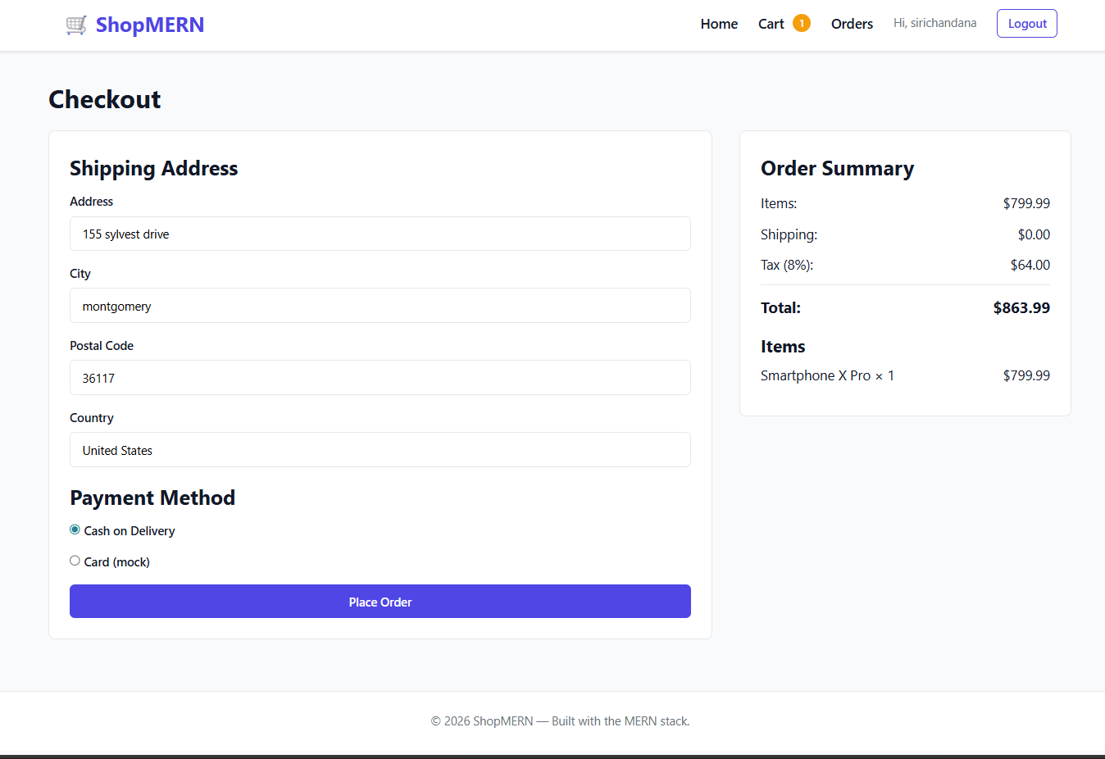
Checkout Flow
Shipping address, payment method selection, and order placement
Highlights
Form validation on shipping fields
Tax (8%) and shipping calculated dynamically
Free shipping over $100 threshold
Cash on Delivery / Card payment selector
ShopMERN — MERN Stack E-Commerce Platform
14 / 18

Slide 15
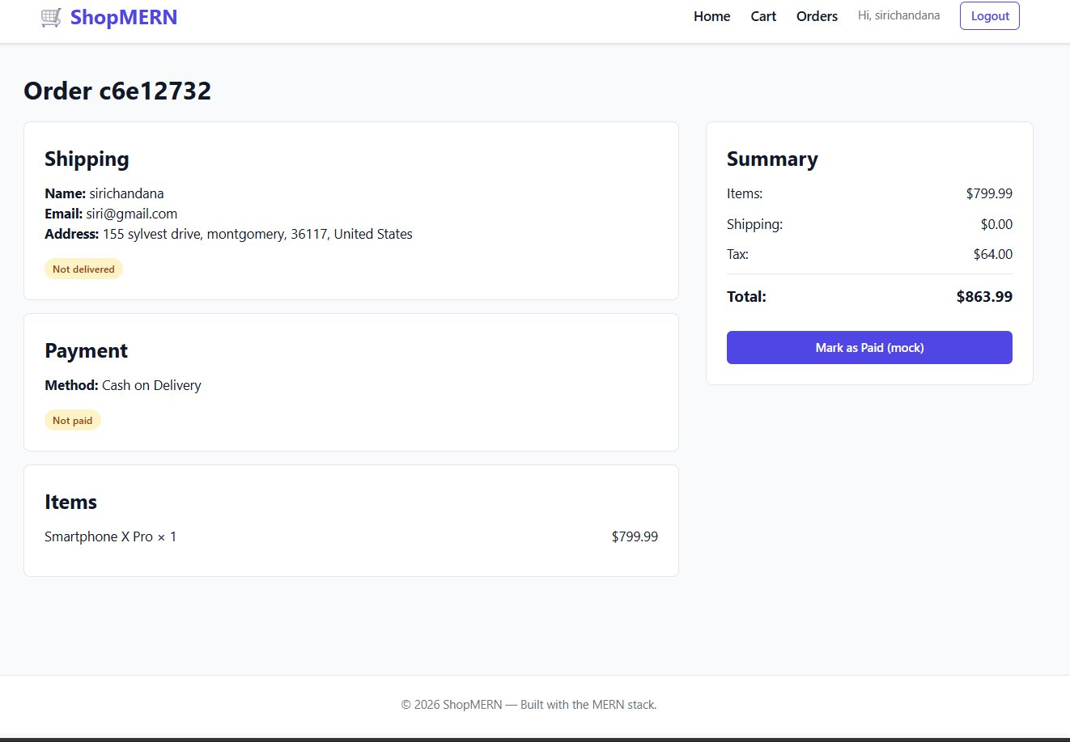
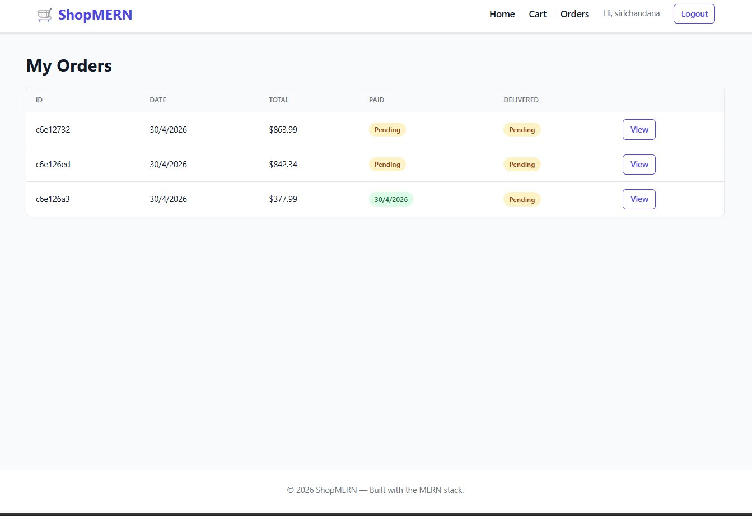
Orders Management (Customer)
Customers can view their order history and track payment / delivery status
Order Detail
My Orders
Mock 'Mark as Paid' button updates isPaid flag; admin can mark delivered.
ShopMERN — MERN Stack E-Commerce Platform
15 / 18

Slide 16
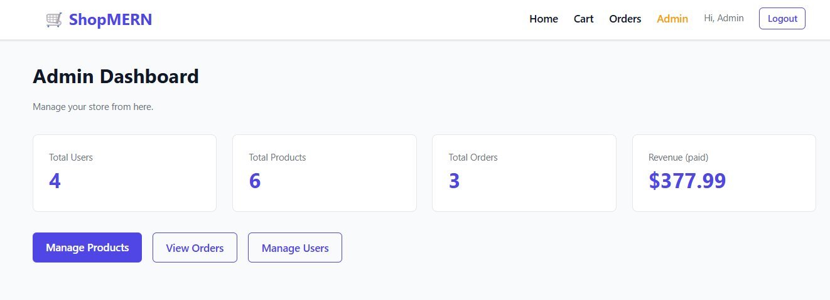
Admin Panel — Dashboard
Role-protected dashboard with key store metrics at a glance
Stat Cards
Total Users
Total Products
Total Orders
Revenue (paid only)
Quick links to Products, Orders, and Users management
Admin role check (isAdmin: true) gates this entire section via React route guards and Express middleware.
ShopMERN — MERN Stack E-Commerce Platform
16 / 18

Slide 17
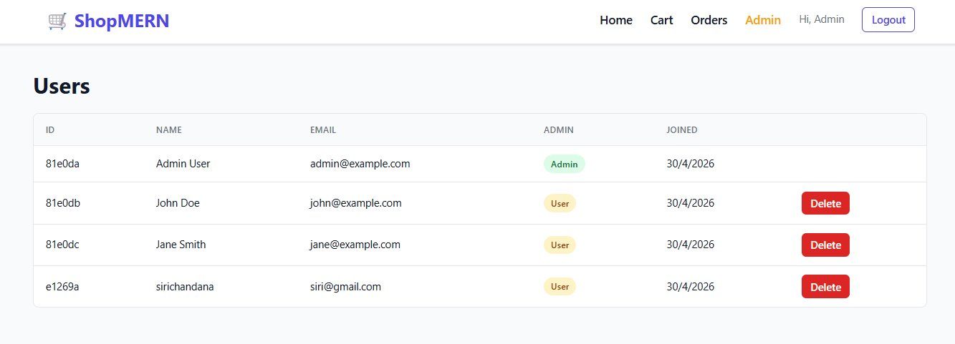
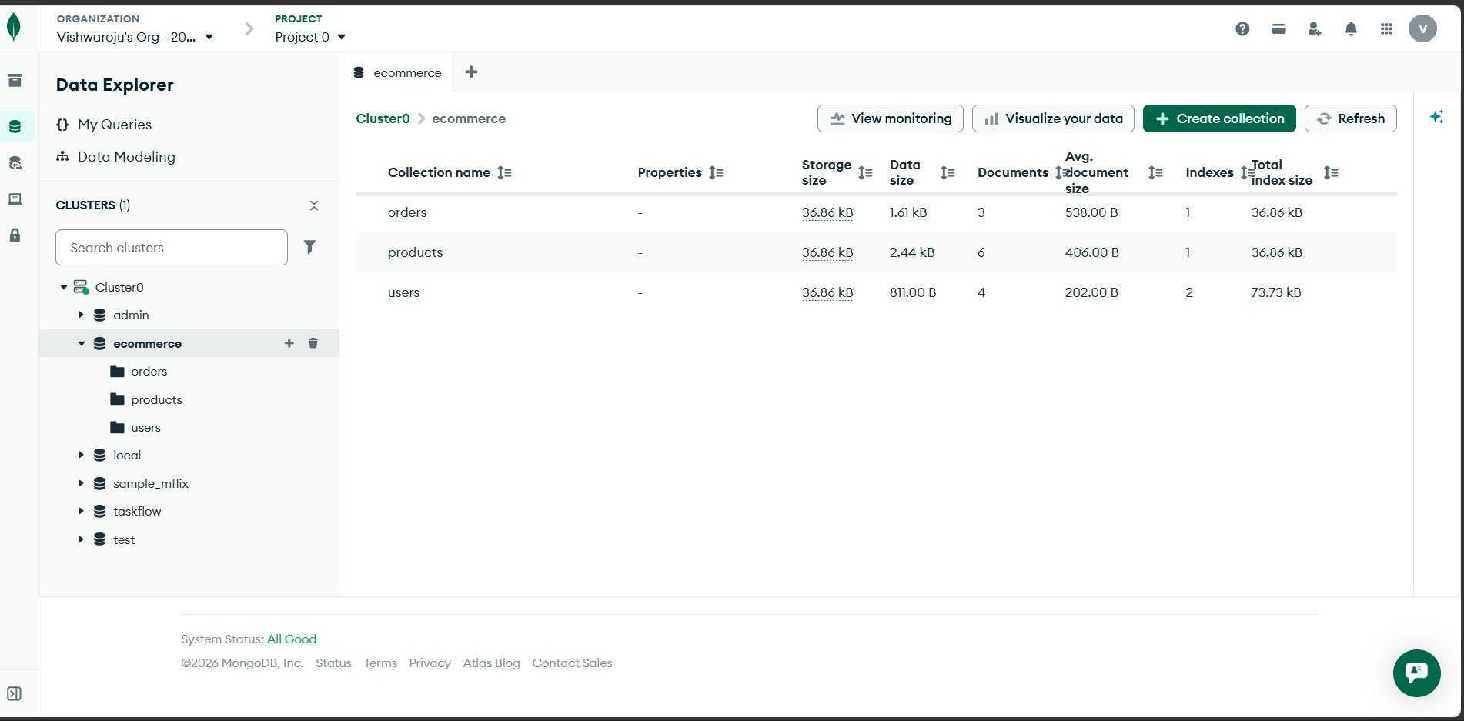
Admin Users & Live Database
Admin user management UI on the left — actual MongoDB Atlas collections on the right
Admin Users View
MongoDB Atlas — Live Collections
Data is persisted live to MongoDB Atlas — verifying end-to-end that the stack works.
ShopMERN — MERN Stack E-Commerce Platform
17 / 18

Slide 18



Conclusion
Full-Stack Coverage
Real Authentication
Production Patterns
End-to-end MERN implementation — schema design, REST API, React UI, and deployment-ready structure
Production-style JWT + bcrypt with role-based middleware and protected routes on both sides
Context API, Axios interceptors, async error handling, seeders, and cloud-hosted MongoDB Atlas
Thank You
ShopMERN — built with the MERN stack

