Slide 1
Object Oriented Programming Group 3
By Yilin, Casper, Jielin & Jayden

Slide 2
Client-Server Architecture
01
Client-Server Communication
02
TABLE OF CONTENTS
Open Source Libraries
03
04
Design Principle
05
Demonstration

Slide 3

01
Client-Server Architecture

Slide 4






Sprint Boot flow Architecture
Controller
Service
Repository Class Extending CRUD Services
Request
View(JSP)
Model
(Entity)
Client (Browser)
Response
Application Server
Enterprise Server

Slide 5

02
Client-Server Communication

Slide 6
Client-Server Communication
Call service logic
CRUD
methods
Controller
Service
Data Access Layer(Repository Class)
Request
CRUD Operations
Map the API
get/set methods
Send API
Client
Model
(Entity)
Create tables
Server rendered
Web page
View(JSP)
Application Server
Enterprise Server

Slide 7

03
OPEN SOURCE LIBRARIES

Slide 8


OPEN SOURCE LIBRARIES
org.springframework.boot
org.apache.tomcat.embed
An application framework and inversion of control container for the Java platform.
It is a modern server-side Java template engine for both web and standalone environments and to display HTML in browsers and also to work as static prototypes.
It acts as a web server and servlet container, used by Java web applications that don’t require full Java EE specifications.

Slide 9


OPEN SOURCE LIBRARIES
JSTL (JSP Standard Tag Library)
Project Lombok
A set of tags to simplify the JSP development, which consists of core tags, function tags, formatting tags, xml tags and sql tags
A java library that automatically plugs into the editor and build tools. It can generate getters and setters for those object automatically by using Lombok annotations
EG: @Data annotation

Slide 10
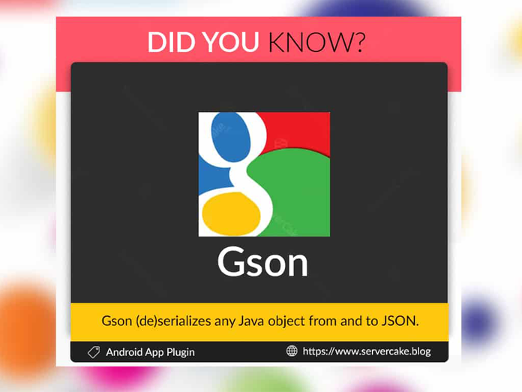

OPEN SOURCE LIBRARIES
Google Gson
Spring Boot Starter Mail
Open source Java library to serialize and deserialize Java objects to (and from) JSON
Starter for using Java Mail and Spring Framework's email sending support

Slide 11

04
Design Principle
How did the team design and layer the application?

Slide 12
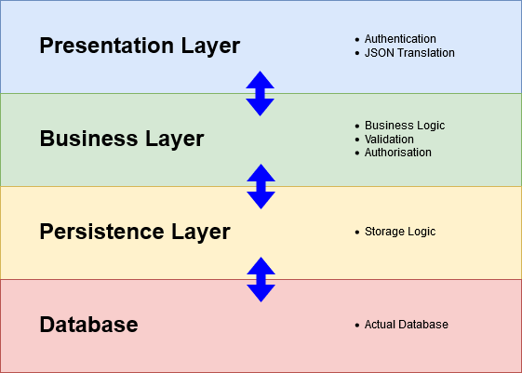
Application Layers
Controller
Service
Repository
Database
Notes:
https://anchormen.nl/blog/big-data-services/spring-boot-tutorial/

Slide 13
Design Principles
Single Responsibility Principle
This principle is not just applicable to a class, but also at the level of a package, a component, an application, or a service. Each of these should each have just one responsibility.
Maintain consistent standards
Spring boot have many simplified Annotations, Configuration and autoconfiguration mechanism
Easily maintain the standard of code throughout
Notes:
https://www.springboottutorial.com/software-design-solid-principles
TO do: any more principles?

Slide 14

05
Demo

Slide 15
THANKS
Q&A

