Slide 1

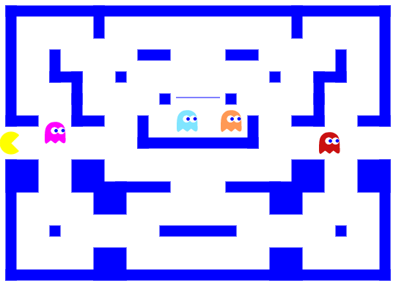

Settings:
Timer
Score
<Balls no>:
<MAX TIME>:
User Name
<Monsters no>:
Keys:

