Slide 1
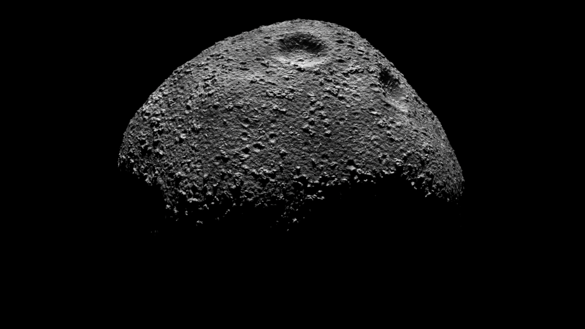
3D Reconstruction of small Solar System bodies using rendered and compressed images
Thesis Presentation
By Gabriel J. Schwarzkopf
Supervisor: Jaan Praks; Advisor: Andris Slavinskis

Slide 2
Table of Contents
Motivation
Theory
Implementation
Results
Conclusion

Slide 3
Motivation
Solar System formation
Limited Information from remote observations
In-situ more detailed information
Small sat flyby as compromise between number of targets and in-situ
Confirmed missions (Comet interceptor and Hera) and concepts (CASTAway and MANTIS)
Synthetic image creation because missing real images
Hapke model is empirical and has problems
SISPO provides solution

Slide 4
Theory - Rendering
Rendering
Path tracing
Shaders
Composition

Slide 5
Theory – Computer Vision
Computer Vision
Pinhole camera
SfM

Slide 6
Implementation
Blender
Procedural terrain generation

Slide 7
Implementation
Compression
PNG and JP2000

Slide 8
Implementation
SfM
Complete SfM pipeline from images to textured model with OpenMVG/OpenMVS

Slide 9
Results
Images
3D models
Compression effects
Reconstruction algorithms (which algo under which conditions)
Profiling

Slide 10
Conclusion
Compression reduced data substantially, JPEG2000 works well
SfM Both incremental necessary, global never
First step for sispo
Many things to do

Slide 11
Thank you for your attention!

