Slide 1
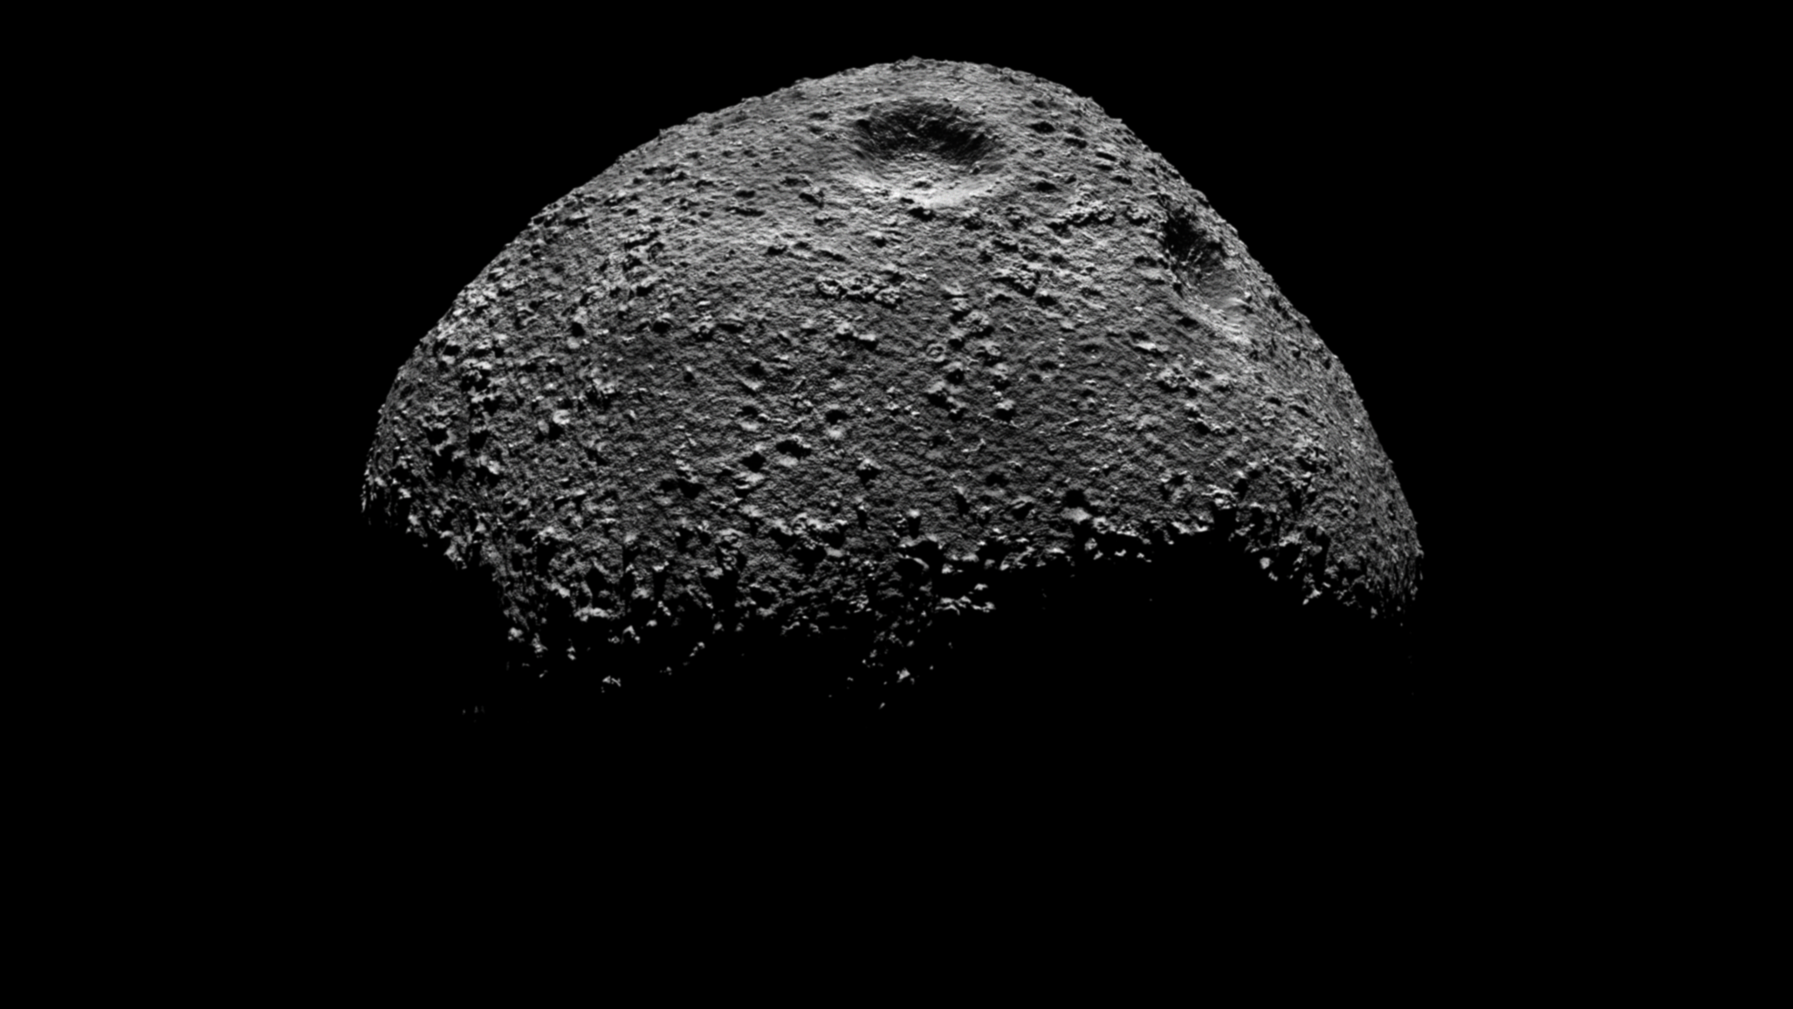
3D Reconstruction of small Solar System bodies using rendered and compressed images
Thesis Presentation
By Gabriel J. Schwarzkopf
Supervisor: Jaan Praks; Advisor: Andris Slavinskis
1/ 13

Slide 2
Table of Contents
Motivation
Theory
Implementation
Results
Conclusion
2/ 13

Slide 3
Motivation
Solar System formation
Limited Information from remote observations
In-situ more detailed information
Small sat flyby as compromise between number of targets and in-situ
Confirmed missions (Comet interceptor and Hera) and concepts (CASTAway and MANTIS)
Synthetic image creation because missing real images
Hapke model is empirical and has problems
SISPO provides solution
3/ 13

Slide 4
Theory - Rendering
Rendering
Path tracing
Shaders
Composition
4/ 13

Slide 5
Theory – Computer Vision
Computer Vision
Pinhole camera
SfM
5/ 13

Slide 6
Implementation
Blender
Procedural terrain generation
6/ 13

Slide 7
Implementation
Compression
PNG and JP2000
7/ 13

Slide 8
Implementation
SfM
Complete SfM pipeline from images to textured model with OpenMVG/OpenMVS
8/ 13

Slide 9
Results
Images
3D models
Compression effects
Reconstruction algorithms (which algo under which conditions)
Profiling
9/ 13

Slide 10
Conclusion
Compression reduced data substantially, JPEG2000 works well
SfM Both incremental necessary, global never
First step for sispo
Many things to do
10/ 13

Slide 11
Thank you for your attention!
11/ 13

Slide 12
12/ 13

Slide 13
13/ 13

