Slide 1
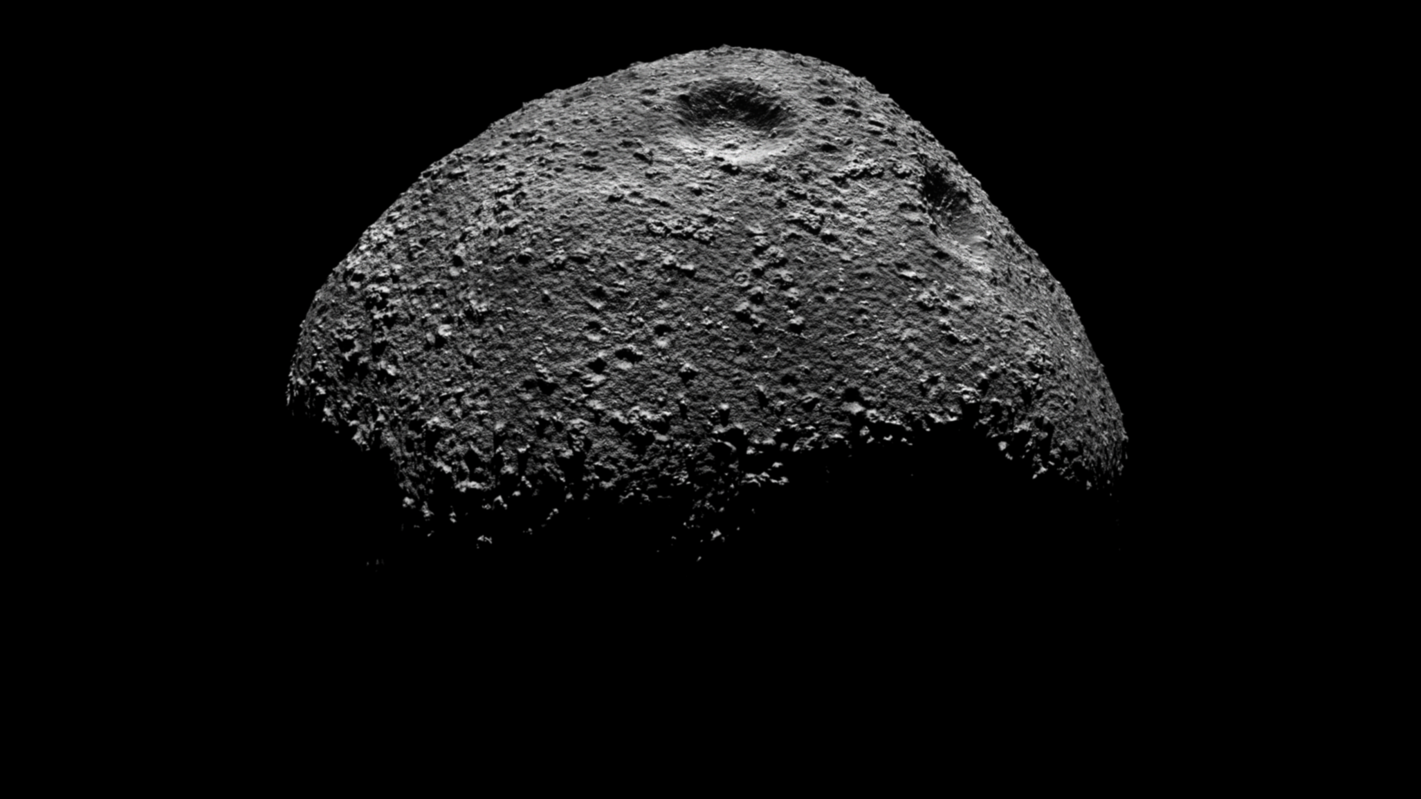
3D
Masterthesis Presentation
By Gabriel J. Schwarzkopf

Slide 2
Table of Contents
Theory
Implementation
Results
Conclusion

Slide 3
Theory
Computer Vision
Pinhole camera
SfM
Rendering
Path tracing
Shaders
Composition

Slide 4
Implementation
Blender
Procedural terrain generation
Compression
PNG and JP2000
OpenMVG/OpenMVS
Complete SfM pipeline from images to textured model

Slide 5
Results
Images
3D models
Compression effects
Reconstruction algorithms?
Profiling

Slide 6
Conclusion
Compression reduced data substantially, JPEG2000 works well
First step
Many things to do

Slide 7
Thank you for your attention!

