Slide 1
PHASE-ONE PROJECT
Done by : Curtis Kariuki

Slide 2
Table of Contents
The table of contents of this presentation are:
Purpose for the presentation
Data analysis and Presentation
Conclusion
Appendix

Slide 3
Purpose for the presentation
This presentation was constructed in order to help Microsoft join the fun of creating original video content.
In this they constructed a new movie studio for this purpose.
But they didn’t know on how to create movies and breach into the movie industry.
This presentation is used to display the findings of example what movies genres are excelling at the Box Office or the runtimes of movies according to the audience that the new head of Microsoft can use to plan and run the studio.
The whole analysis of the findings was revolving around the problem on how to generate revenue.

Slide 4
Data Analysis and Presentation
What is data analysis ?
This is the process of inspecting, cleaning , transforming and modelling data to draw meaningful insights
What is data presentation ?
This is the process of visually and effectively communication insights derived from data analysis
Now the data analysis and presentation was carried out on the following files in order to come up with conclusion and recommendations that can be presented to the New Head of Microsoft:
Imdb.titles.basics
Imdb.title.ratings
Bom.movie_gross
In the next slides we are going to discuss about the files.

Slide 5
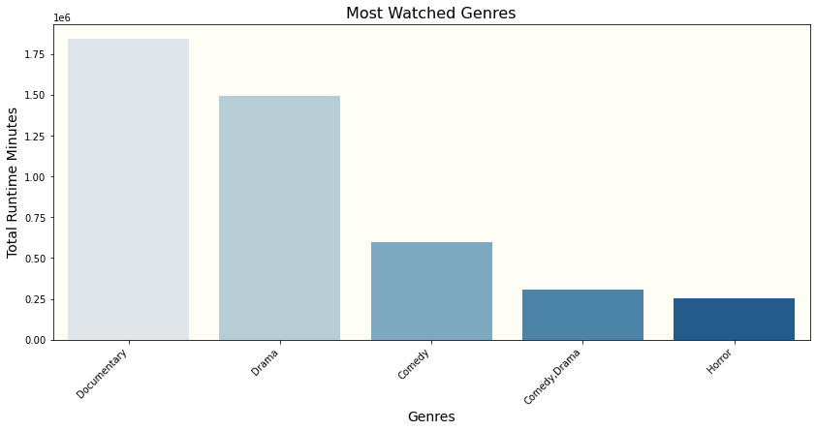
The imdb.title.basics file
In this analysis we extracted the top 5 most watched genres.
From the analysis done in this file, the data obtained from it is that the documentaries genre is the most watched genre with a total number of 1,842,001 people.

Slide 6
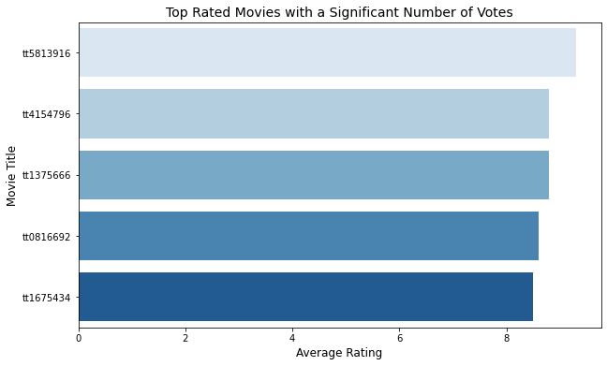
The imdb.title.rankings file
In this analysis the data that was extracted Top 5 highest rated movies which had a significant number of votes above 100,000.
From the analysis carried out in this file it was found out that a movie can have a lot of viewers and still be able to get a high ranking rate like the 3rd ranked movie in the graph is called “Interstellar” which had a total number of views of 1,841,066 and still obtain a rating of 8.8.

Slide 7
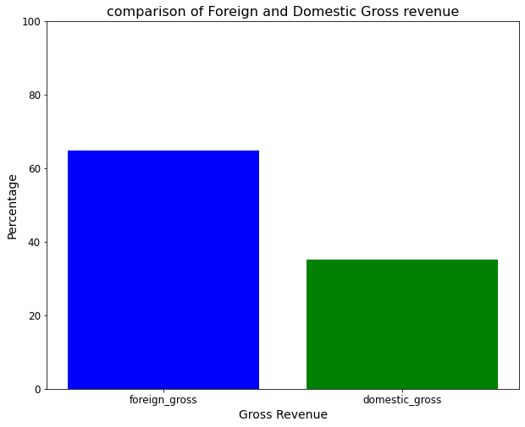
The BOM.MOVIE_GROSS FILE
In this analysis the data extracted was the comparison of the foreign_gross against domestic_gross.
From the analysis carried out the foreign_gross had a higher percentage than the domestic_gross with a percentage of 64.86% against 35.13%.

Slide 8
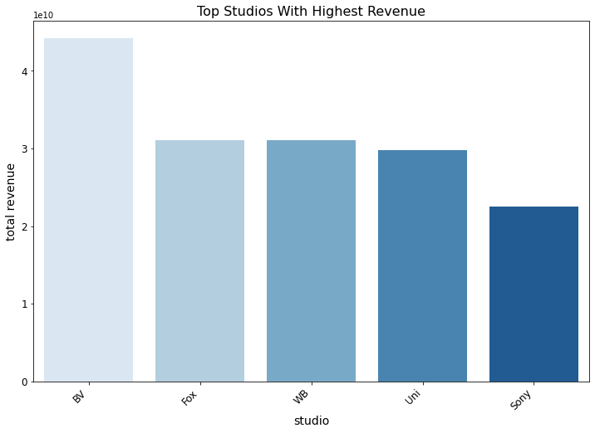
In continuation the bom.movie_gross file another analysis was done.
In this analysis the data obtained was the top 5 studio company which was able to generate the most total gross revenue and the BV Studio came on top.

Slide 9
Conclusion
Now that we have seen the analysis and presentation done in the files we can now be able to come up with recommendations that will help navigate Microsoft through this industry.
The recommendations for Microsoft are:
Microsoft produces movies that are going to perform well internationally thus enable them to increase revenue.
Microsoft can collaborate with studios like BV and Fox in producing a video or film due to the studios having a high total gross revenue displaying their success in the industry.
Microsoft can invest in production of the documentation genre due to majority of people seem to be interested in that genre which will have guaranteed that revenue will be generated.
Microsoft can also diversify their portfolio in production of genre and going into the second most like genre which is drama which will enable them increase their revenue by targeting several big audiences.
Microsoft should invest in producing a high quality films that will return a positive feedback and will have more audiences thus lead to increase in their revenue.

Slide 10
APPENDIX
Here are we reach the climax of the presentation, I would like to provide additional data sets that can be used to go into details like; production cost, the actors, directors who have produced the best films so as to have an in-depth of the movie industry and gain more insights:
name.basics
title.akas
title.pricipals
tmdb.movies
tn.movies_budget

Slide 11
Thank-YOU
WE HAVE COME TO THE END OF THE PRESENTATION

