Slide 1
Arduino Workshop
Special Interest Group Robotics -
eHacks
Getting Started with Arduino and the Arduino IDE

Slide 2


What is Arduino?
Arduino is an open source hardware platform
Simple and easy to use
Cheaper than some other platforms

Slide 3
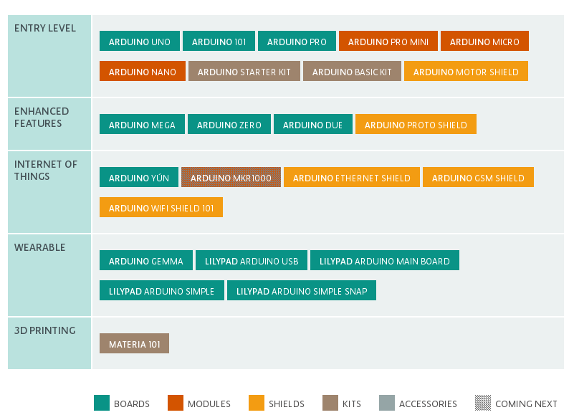
Arduino Boards

Slide 4
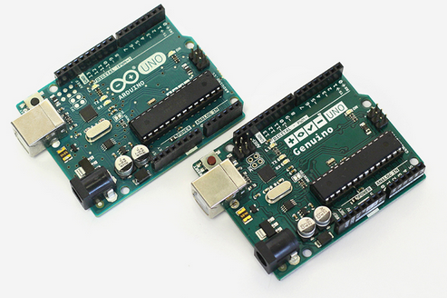
The Hardware
This workshop will focus on the Arduino UNO R3 microcontroller
8 bit Atmega 328P microcontroller
16 Mhz clock, 32 KB flash memory, 2 KB ram, 1 KB of EEPROM
5V
14 digital I/O (6 PWM), 6 analog input
$25

Slide 5
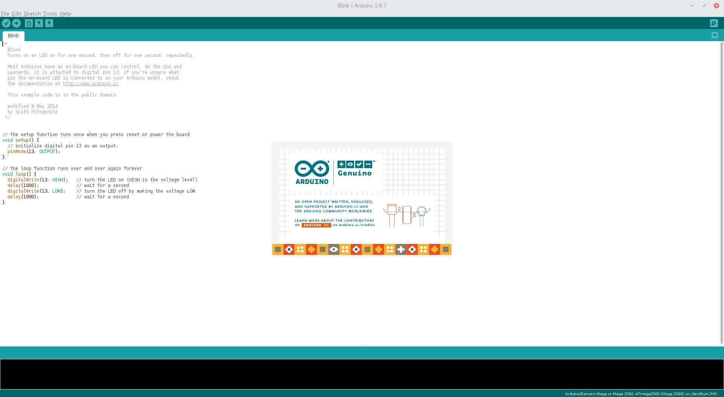
The Software
Arduino IDE v 1.6.7
Opensource IDE written in Java available on Windows, Mac, Linux, BSD and more
Verify, compile, upload, library management, serial plotter, and serial monitor
Fritzing also has a code editor and can upload to Arduino boards

Slide 6
Getting Started
Download the IDE from https://www.arduino.cc/en/Main/Software
Install any required drivers if using cheap Arduino knockoffs – Windows and Mac only
Connect to your Arduino UNO using a printer cable
Start the IDE
Select the proper Arduino model from Tools→Board
Select the proper port from Tools → Port

Slide 7
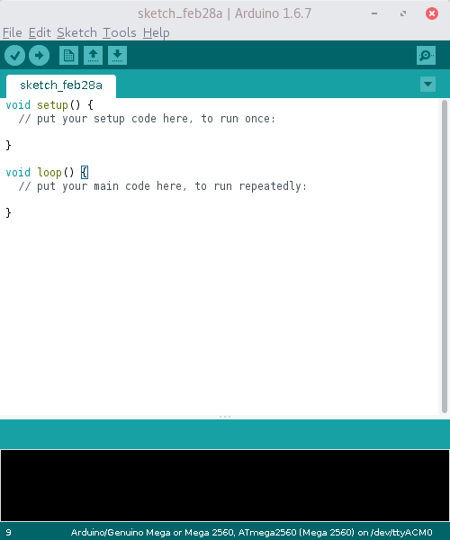
Parts of an Arduino Program
Setup – function is run once at startup
Should be used to set pin modes, connect to serial, initilization
Loop – runs repeatedly after setup until the Arduino looses power
Procerdural code goes here
Arduino uses a C based language, though there is no main function.
The IDE loads generic Arduino libraries for you, no need to include them.

Slide 8
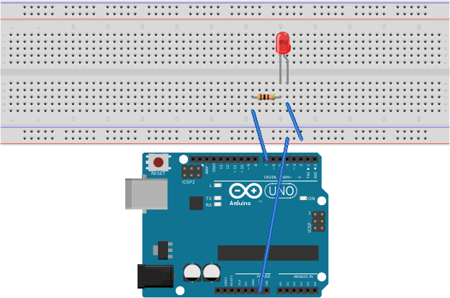
Hello World
In the world of microcontrollers, blinking an LED is considered a Hello World
Hardware Setup:

Slide 9
Hello World
Program
void setup()
{
// Set Pin 7 to output
pinMode(7, OUTPUT);
}
void loop()
{
// Write a HIGH signal to Pin 7 turing the LED on
digitalWrite(7, HIGH);
// delay is in miliseconds
delay(1000);
// Write a LOW signal to Pin 7 turning the LED off
digitalWrite(7, LOW);
delay(1000);
}

Slide 10
Read and Write Analog
Besides Digital I/O Arduino also supports Analog
There are two main Analog functions, analogRead and analogWrite.
analogRead takes one parameter, the port to read from. This function returns an integer value from 0 – 1023
analogWrite takes two parameters, the port to write to and an integer value to send. Unlike the return value from analogRead, the value parameter has a range of 0 - 255

Slide 11
Fading an LED
int ledPin = 9; // LED connected to digital pin 9
void setup() {}
void loop() {
// fade in from min to max in increments of 5 points:
for (int fadeValue = 0 ; fadeValue <= 255; fadeValue += 5) {
// sets the value (range from 0 to 255):
analogWrite(ledPin, fadeValue);
// wait for 30 milliseconds to see the dimming effect
delay(30);
}
// fade out from max to min in increments of 5 points:
for (int fadeValue = 255 ; fadeValue >= 0; fadeValue -= 5) {
// sets the value (range from 0 to 255):
analogWrite(ledPin, fadeValue);
// wait for 30 milliseconds to see the dimming effect
delay(30);
}
}
The LED connection should be moved to PIN 9
This code is borrowed from https://www.arduino.cc/en/Tutorial/Fading
Big thank you to Tom Igoe and David A. Mellis

Slide 12
Debugging your code
It is not possible to print debugging information to the screen as an Arduino has no screen
We use Serial to see debugging information
Another option is to use an LCD display connected to the Arduino

Slide 13
Serial Communication
Use the RX and TX pins on the Arduino or the printer cable connection to your computer
Steps:
  Initialize the connection using a baudrate
    We will be using 9600 as the baudrate
  Wait for the connection to be established
  Send data or Receive data from serial
  Read data from Serial Monitor in Arduino IDE

Slide 14
Hello World with Serial
void setup()
{
// Set Pin 7 to output
pinMode(7, OUTPUT);
Serial.begin(9600);
}
void loop()
{
// Write a HIGH signal to Pin 7 turing the LED on
digitalWrite(7, HIGH);
// delay is in miliseconds
Serial.write(„LED is ON“); // write to serial port
delay(1000);
// Write a LOW signal to Pin 7 turning the LED off
digitalWrite(7, LOW);
Serial.write(„LED is OFF“); // write to serial port
delay(1000);
}
Program
A few caveates:
You may want to wait for the serial connection by adding a while loop after the initial serial connection:
while(!Serial);
Checking if the serial connection is still available can and should also be done: Serial.available()
Now open the Arduino IDE‘s Serial Monitor (Tools→Serial Monitor) and watch the results

Slide 15
Reading from Serial
A Serial connection can also be used to send commands to an Arduino
void loop() // Setup is the same as before
{
char command = 0; //char to hold command byte
//if a byte is waiting in the serial buffer
if (Serial.available() > 0)
{
command = Serial.read(); //read the byte and store it.
}
switch(command)
{
case ‚H‘:
digitalWrite(7, HIGH); // Turn on LED
break;
case ‚L‘:
digitalWrite(7, LOW); // Turn off LED
break;
}
}
You may wish to flush the buffer at the end of loop:
Serial.flush();
To test, open the Serial Monitor and try sending H and L

Slide 16
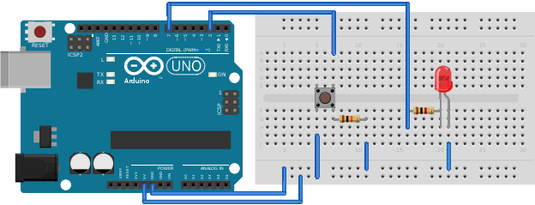
Reading the state of a PIN
Besides using PINs as output, they can also be used as input.
We will use a push button to turn on the LED

Slide 17
Reading the state of a PIN
void setup()
{
// setup pins as input or output
pinMode(7, OUTPUT);
pinMode(2, INPUT);
}
void loop()
{
// read the state of the button
if(digitalRead(2) == HIGH)
{ // turn on the LED since the button is pressed
digitalWrite(7, HIGH);
}else
{ // turn off the LED since the button is not pressed
digitalWrite(7, LOW);
}
}
You may want to put a delay after writing to pin 7.
If the goal is to just turn on an LED when a button is pressed, don‘t use an Arduino as a simple circuit would suffice.

