Slide 1

Getting started with Robotics using…

Slide 2
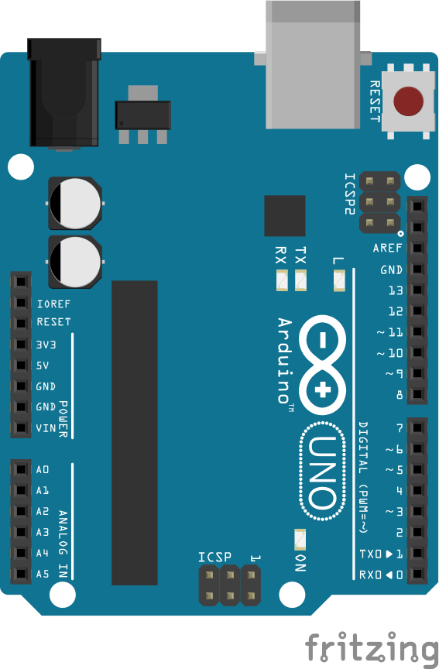
What is Arduino?
Arduino is a low power, low cost computing platform. Arduino allows users to write programs that can control physical hardware and electronic circuits seamlessly.

Slide 3
Why choose Arduino for robotics?
Arduino has many different platforms to choose from, all of which can be programmed with the same language and IDE.
Arduino programs, called sketches, are universally compatible with other official Arduino platforms. This means a sketch you write for your UNO will work fine on an Arduino Mega. The only thing to keep in mind is I/O as not all Arduino board have the same amount or types of I/O.
Arduino is inexpensive so it’s great for those looking to break into the realm of robotics without a huge financial commitment.

Slide 4
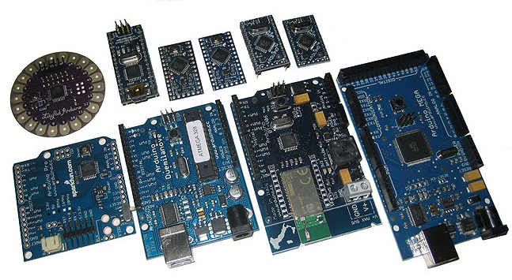
Arduino comes in many flavors!

Slide 5
Which platform do I choose?
There is no one answer to this question.
If you’re concerned about weight and power you might want to choose a smaller board like a mini, nano, or Lilly pad.
If size and power aren’t concerned and you’re just wanting a good place to begin the Arduino UNO is the most popular and widely used platform.
If you think you’re going to need a lot of I/O you might look at the Mega.
Ask the forums!

Slide 6
I have a board, what else do I need?
The only other thing you need to begin your journey into the wonderful world of Arduino is the Arduino IDE. This is available for free from the Arduino homepage: http://www.Arduino.cc/
Other useful pieces of software:
Fritzing which is used to make circuit diagrams and prototype layouts.
Processing which can be used to create nice GUI and data logging programs for your Arduino sketches.
Arduino Companion which is an app for Android and IOS that lets you browse Arduino example code, documentation, and libraries.

Slide 7
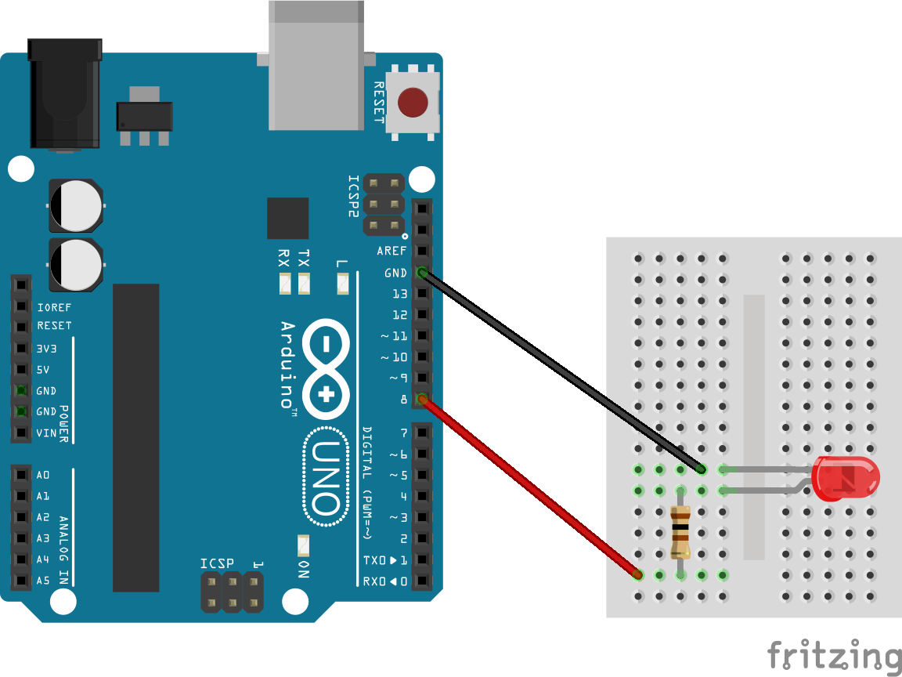
Your first sketch

Slide 8
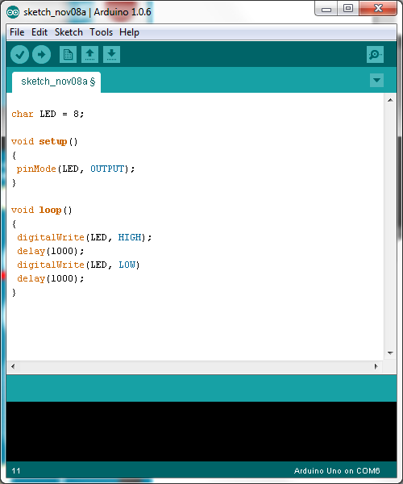

Slide 9
So I can blink a light… big deal!
You’re thinking too small. Sure, in this case you merely used your Arduino to blink a light. But this same code could be used to consistently pulse a laser, to turn on a buzzer, speaker, or even be used as a control signal for an entire circuit.

Slide 10
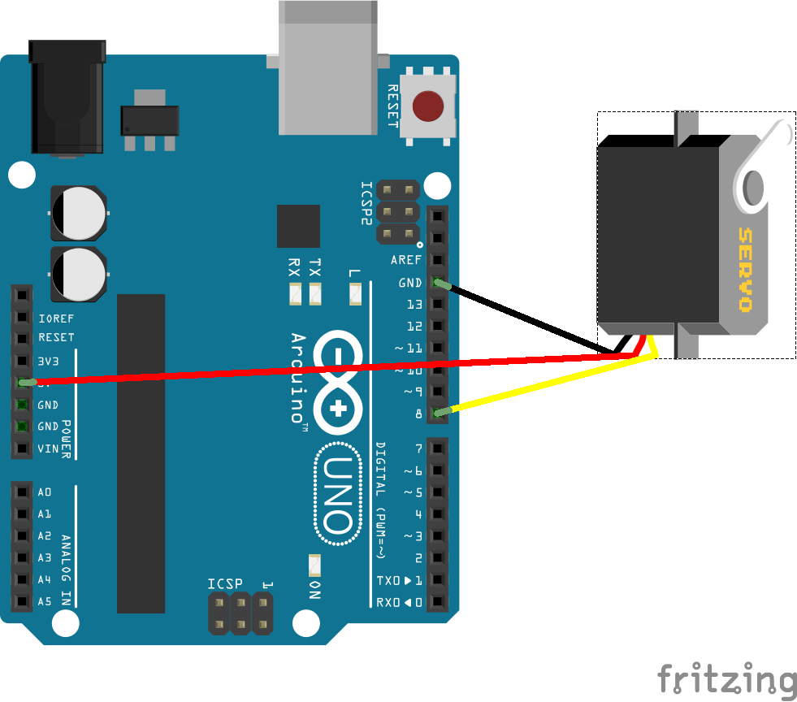
Your second sketch

Slide 11
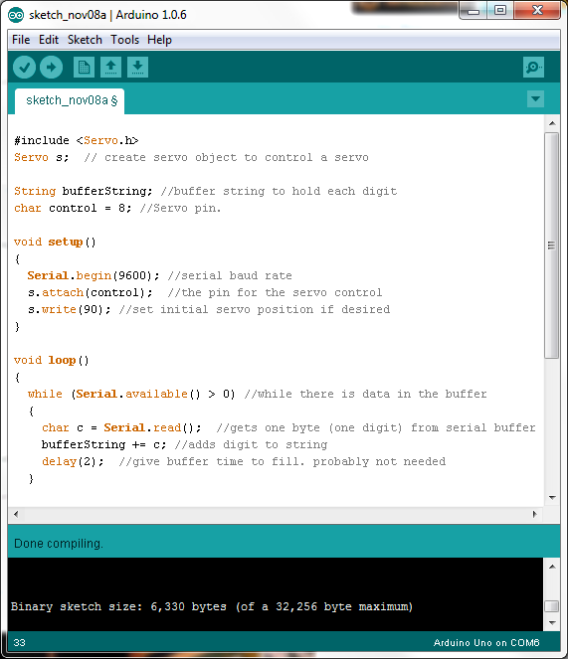

Slide 12
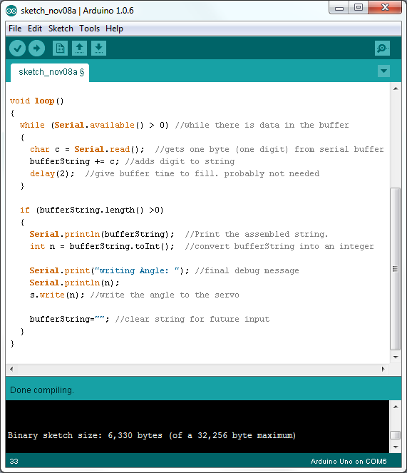

Slide 13
More complex projects await
This second sketch that you now understand only open the doors into what you can do with Arduino for robotics. Controlling motors will be crucial for most robotic projects.
Next you should learn how to interface with different kinds of sensors, you can then use these sensors to create more unique and intelligent robots.
You also know how to use Serial communication. This is very useful as many other chips and sensors use Serial to convey information. Even your PC can be used as a good source of Serial communication as you saw earlier.

Slide 14
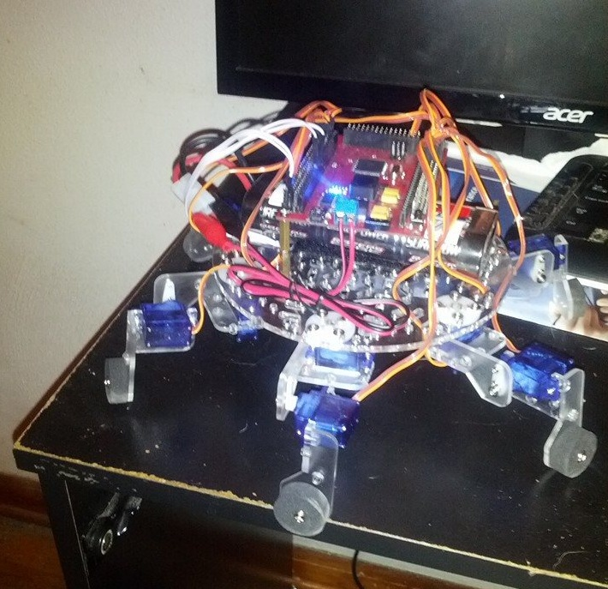
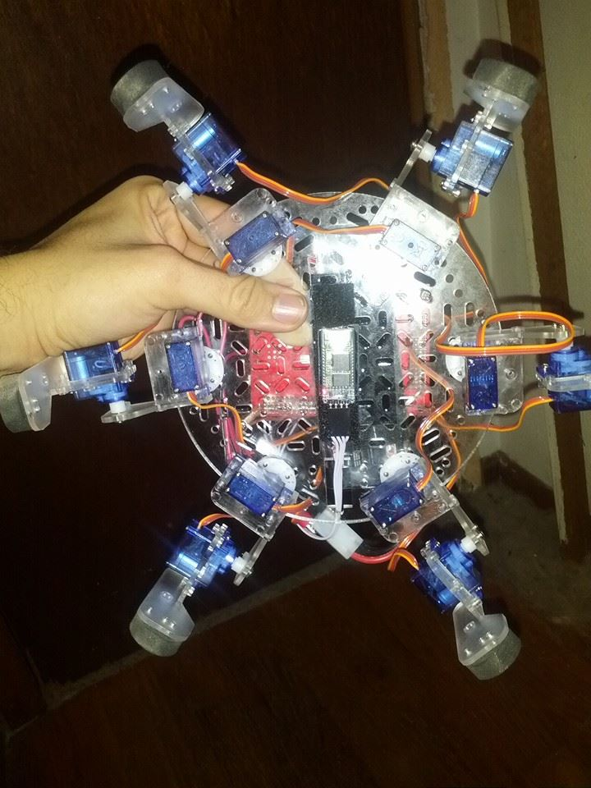
Examples

Slide 15
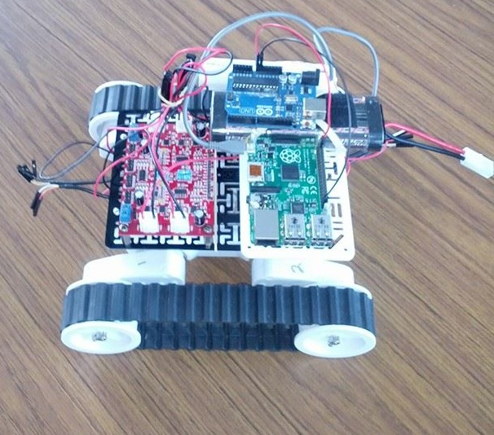
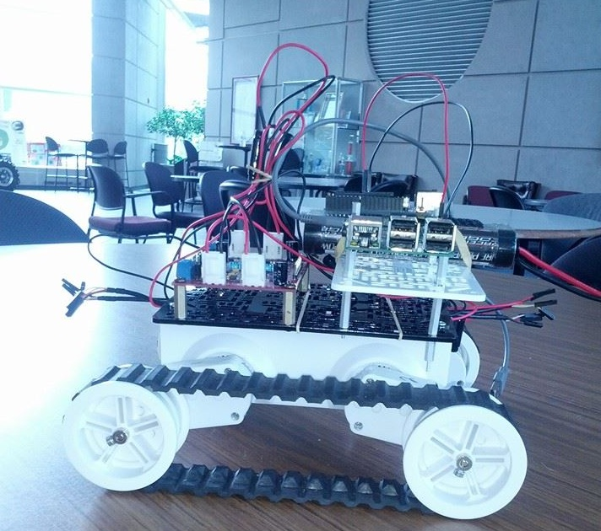

Slide 16
More tutorials to come!
Contact me if you are interested in learning more about Arduino and how you can use it to get into robotics. This has been a very rudimentary introduction and if there is interest I would be happy to give more detailed examples and tutorials to help you all get into robotics. If I get a large enough response I will keep these tutorials coming.
Contact information:
borabut@siue.edu
bryan.orabutt@gmail.com

