Slide 1
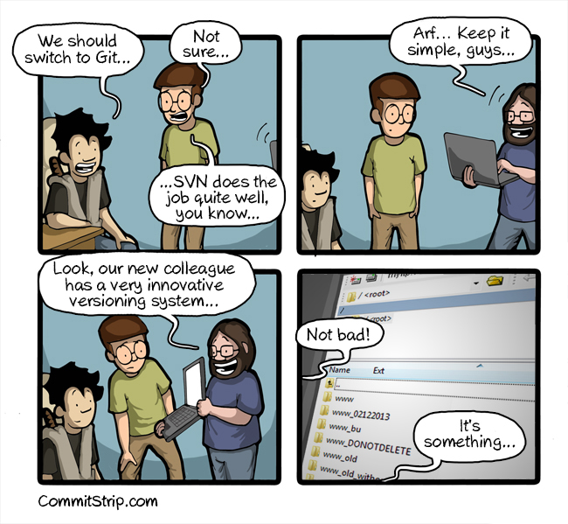

ARC Git Workshop Spring 2017
Source : http://www.commitstrip.com/en/2013/11/05/git-svn-ou/

Slide 2
What is Git?
« I've met people who thought that git is a front-end to GitHub. They were wrong, git is a front-end to the AUR. » – Linus Torvalds
«Git is a version control system (VCS) for tracking changes in computer files and coordinating work on those files among multiple people. It is primarily used for software development, but it can be used to keep track of changes in any files. As a distributed revision control system it is aimed at speed, data integrity, and support for distributed, non-linear workflows. »
Sources : https://wiki.archlinux.org/index.php/Git and https://en.wikipedia.org/wiki/Git

Slide 3
Git tracks changes
Git can track changes to files, not the files themselves
The changes are stored in a git repository
Git repositories can be created locally and do not depend on a remote server

Slide 4
Git Terminology
Repository – The directory containing the project that git is tracking; both local and remote
Commit – Recording the changes you made
Push – Updating the repository with your commits
Pull – Updating the local repository from a remote repository
Clone – Creating a local repository from a remote repository

Slide 5
Git a repository
A git repository can be initialized in a local repository using ‘git init’
  git init creates an empty git repository
  Git may ask for identity information

Slide 6

The life of a change
When a change to a file is ready to be saved in the repository history, it needs to be staged
Staging changes tells Git to ‘add’ the changes with the next commit
Commits are ‘collections’ of changes
Image Source : https://git-scm.com/about/staging-area

Slide 7
Staging changes
Before the repository stores changes, they must be moved from unstaged (‘workspace’) to staged
git add <files..> or git add
  <files...> can be a list of files or directories
  Not specifying a file or directory adds all files/directories in the current directory
  -u tells git to ignore untracked files

Slide 8
Moving and Deleting Files
When you move or delete a file, Git has to be told about the changes which can be a multistep process.
Git has shortcuts for both moving and deleting files.
git rm and git mv
git rm \*.c (removal of all .c files, notice the \* for Gits builtin file name expansion)

Slide 9
I don’t want these changes
Changes can be removed from the staging area by using git rm with the cached flag for new files
  git rm –cached <files...>
  This command removes files from the staging area
Or by using git reset for existing files
  git reset HEAD – <files...>
  This command removes changes to <files..> from the staging area
  ASCIINEMA Git rm and git reset

Slide 10

Commits?
Commits are pointers to changes
  Git is based on Trees, it uses branches and commits
  The latest commit in a branch is called the HEAD
  I prefer to think of commits as « changes I wish to save»
  Commits can be identified via their hash

Slide 11
But what are branches ?
Branches are seperate ‘time lines’ or ‘independent lines’ of development
All branches start off of the master branch and all new repositories have a master branch (unless it is deleted after initialization)
Commits on one branch are independent of other branches until either a pull or merge between the branches

Slide 12
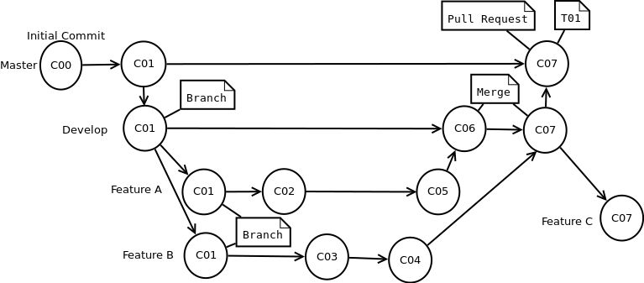
Differences between branches
A new branch contains all of the prior commits of the Parent branch at the time of its creation

Slide 13
Theres more on Branches?
Creating a branch is done via the git branch command
  git branch <branchname>
  The branch is created locally, and has not been checked-out
  In order to ‘checkout’ the branch use the git checkout command
  git checkout <branch or commit hash>

Slide 14
Checkout a branch ?
Checkingout a branch can be thought of as switching to it.
  In reality the checkout command changes which commit the HEAD pointer is pointed at
  Checkout can also be used to look at a different commit in a branch via git checkout <commit hash>

Slide 15
Merging branches
Merging two branches creates a new commit with the changes of the other branch applied to it
  The merge command takes the OTHER branch as a paramater.
  Merging attempts to keep the changes from both branches
  To merge b1 into b2
    git checkout b2
    git merge b1

Slide 16
Merge Conflicts (I quit)
If a file has differences between the two branches, the merge will fail
Git must be told how to handle the situation
Using the mergetool, you can specify which changes to keep and what to ignore
  I hate vimdiff, get meld

Slide 17
Remote Repositories
Git is at its most useful when working in teams remotely
To grab a remote repository, use the clone command
To grab the latest commits from a remote repository use the pull command
To share your commits with the remote repository, use the push command

Slide 18
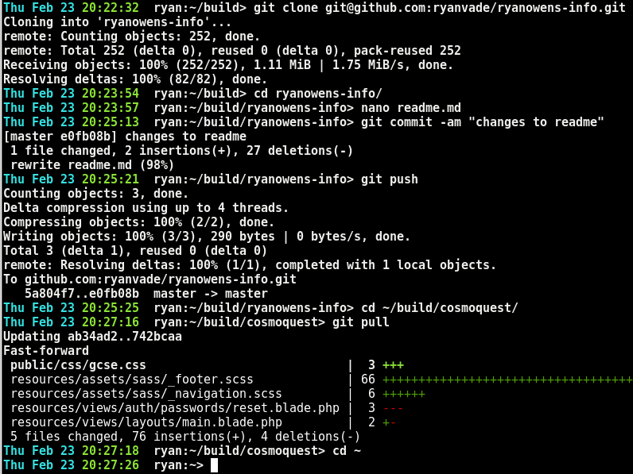
Clone, Pull and Push

