Slide 1
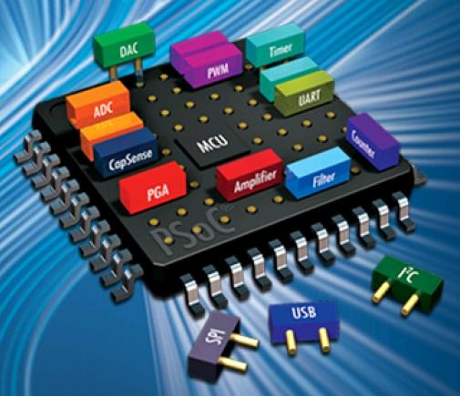
PSoC 1
SIG-R WORKSHOP INTRO TO PSoC 1

Slide 2
What is a PSoC?
8-Bit Microcontroller
PSoC stands for Programmable System on Chip
CPU, RAM, ROM, I/O all on one chip hence “System on Chip”
Programmable hardware, 24 GPIOs, Nominal 24 MHz Clock
Advantages: Used in the SIUE curriculum, highly configurable
Disadvantages: Prior knowledge needed to access more capabilities
(Not as intuitive as an Arduino)

Slide 3
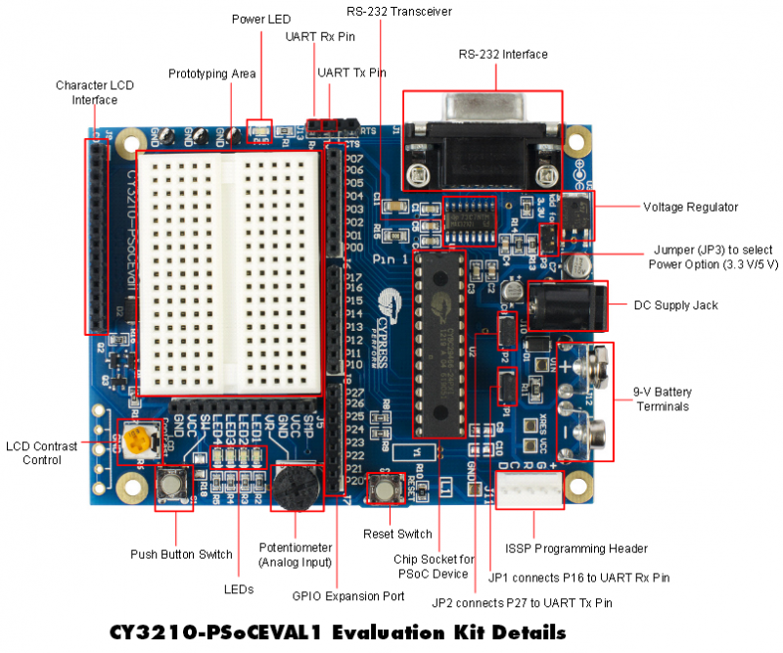
Hardware

Slide 4
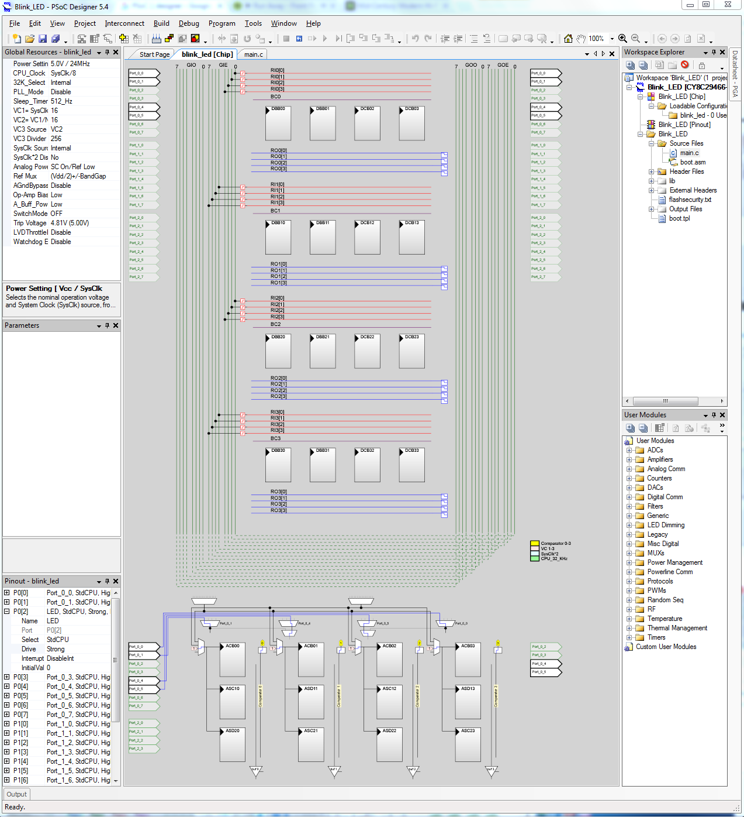
PSoC DESIGNER
Global Resources
Module Parameters
Pinout
Workspace Explorer
User Modules

Slide 5
PSoC DESIGNER
Pins
Digital Blocks
Analog Blocks

Slide 6
TIME TO BLINK!
#include <m8c.h>
#include "PSoCAPI.h“
#define DELAY 30000
#define LED_PIN 0b00000100
void main(void)
{
int delay = 0;
while (TRUE)
{
PRT0DR ^= LED_PIN;
for(delay = 0; delay < DELAY; delay++);
}
}
Blinking an LED is the “Hello World” of microcontrollers
This code will not only blink an LED but introduce:
Programming the PSoC
Bitwise Operation
Reading Port State
Software Delays

Slide 7
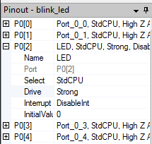
Configuring the Hardware
Writing the program is only half the battle
Within the chip editor, changes have to be made to set drive modes and make connections.
Set the pin Drive to Strong (Output)
Other modes that will be useful:
High Z (Digital Input)
High Z Analog (Analog Input)

Slide 8
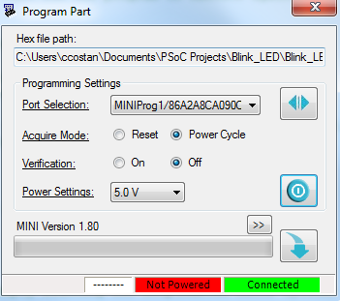
Programming the PSoC
Build → Generate/Build <ProjectName> Project
Program → Program Part
Hit the Program Button

Slide 9
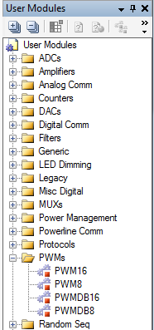
Adding a Module
Modules are used to provide the PSoC with more functionality
Some modules include DAC(Digital Analog Converter), ADC(Analog Digital Converter, PWM(Pulse Width Modulation), LCD
Add the PWM Module to the project
User Modules → PWMs → PWM8
Right click PWM8 and click Place

Slide 10
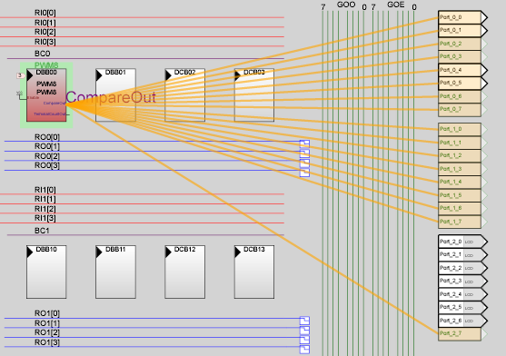
Routing a Module
In the chip editor, connections have to be made to hook up the hardware module to the GPIO
This is made easy by Shift-Clicking the node that needs to be connected
Notes:
VC1 Divider = 16, VC2 Divider = 16, VC3 Divider = 256, PWM Period = 182, This gives 2 Hz, 91 Pulse Width for 50% DC

Slide 11
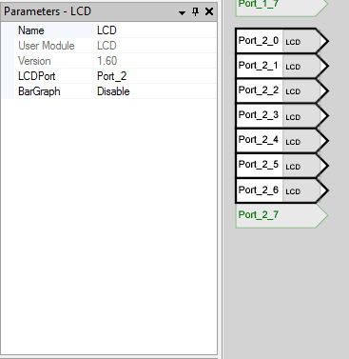
Placing the LCD
The LCD is great for debugging
When placing the LED seven GPIOs will be sacrificed
In the Module Parameter window select LCDPort and make it Port_2
Port_2_0 – Port_2_6 are now all being used by the LCD and aren’t available anymore

Slide 12
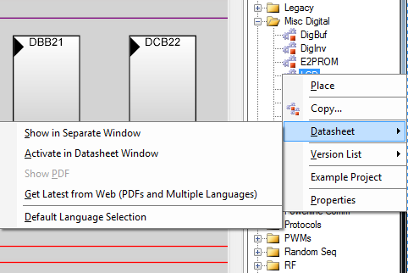
DATASHEETS!!!
To use any module you need to be familiar with its data sheet
Module Parameters explained within
Programming API for the module included
Examples included!!

Slide 13
PSoC Nitpicks
P10 and P11 are used to program the PSoC and when things are connected to those sometimes it will not program properly. Avoid if possible.
Programs written in a newer version of the Designer aren’t always backwards compatible with a previous version
PSoC Programmer might need to be fiddled with to get it to program

Slide 14
PSoC Links
Blink Tutorial 4th video - http://www.cypress.com/documentation/application-notes/an75320-getting-started-psoc-1
PSoC Designer - http://www.cypress.com/products/psoc-designer

