Slide 1

Seasonal Agriculture Performance Analysis
Siva Naik Vasireddy Venkatadri Institute of Technology
AICTE STU ID: ____________________

Slide 2

PROBLEM STATEMENT
Agricultural performance is influenced by seasonal environmental conditions, farming practices, resource availability and market conditions. Raw data does not clearly show how performance changes across seasons. This project analyzes the dataset to identify seasonal patterns, trends, relationships and variations.

Slide 3
Project Description
This project analyzes 4,000 farm records covering seasons, crops, locations, environmental conditions, resource usage and economic performance. The workflow includes data exploration, cleaning, seasonal comparison, statistical analysis and visualization to derive evidence-based agricultural insights.

Slide 4

WHO ARE THE END USERS?
Farmers and agricultural planners
Agricultural researchers and analysts
Resource and irrigation planners
Government and policy stakeholders
Agri-business and market decision-makers

Slide 5

Technology Used
Python – data analysis and processing
Pandas & NumPy – data cleaning, transformation and statistics
Matplotlib & Seaborn – visualization
Jupyter Notebook – analysis documentation
CSV dataset – source data

Slide 6
RESULTS
Dataset & Analysis Overview
4,000
Farm records
3
Seasons
8
Crop categories
8
States
Key analytical focus: seasonal performance, environmental variation, resource efficiency, crop profitability and regional differences.

Slide 7
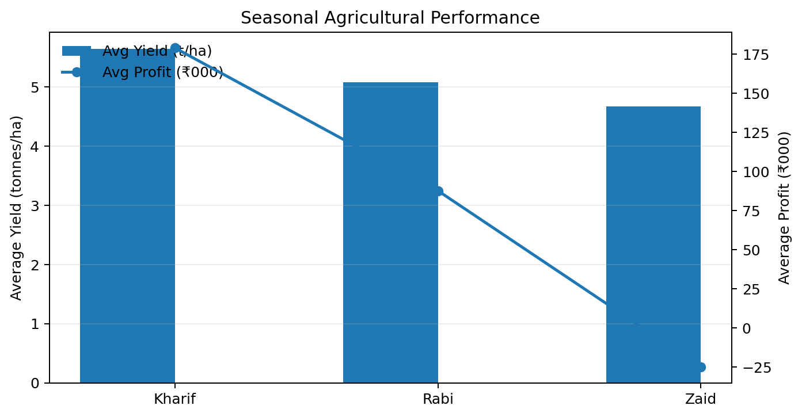
RESULTS
Seasonal Performance
Kharif shows the highest average yield and average profit among the three seasons in the dataset.

Slide 8
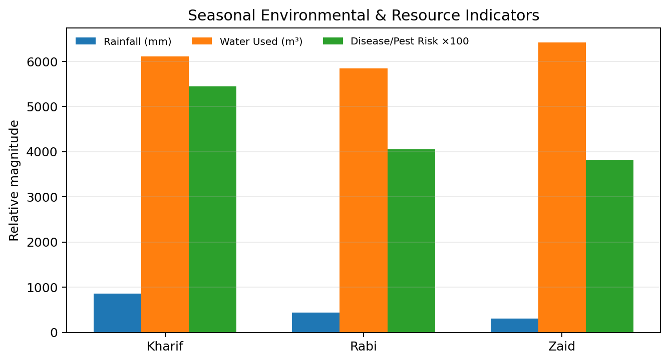
RESULTS
Environmental & Resource Variation
Rainfall, water use and disease/pest risk vary across seasons, supporting seasonal comparison of operating conditions.

Slide 9
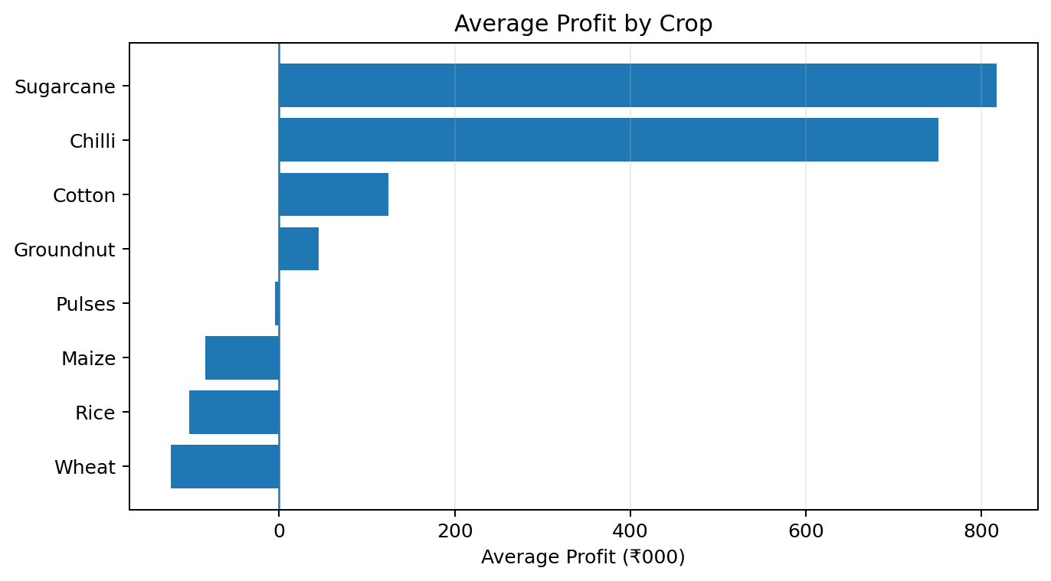
RESULTS
Crop-Level Economic Performance
Average profitability differs substantially by crop, indicating that crop choice is an important analytical dimension.

Slide 10
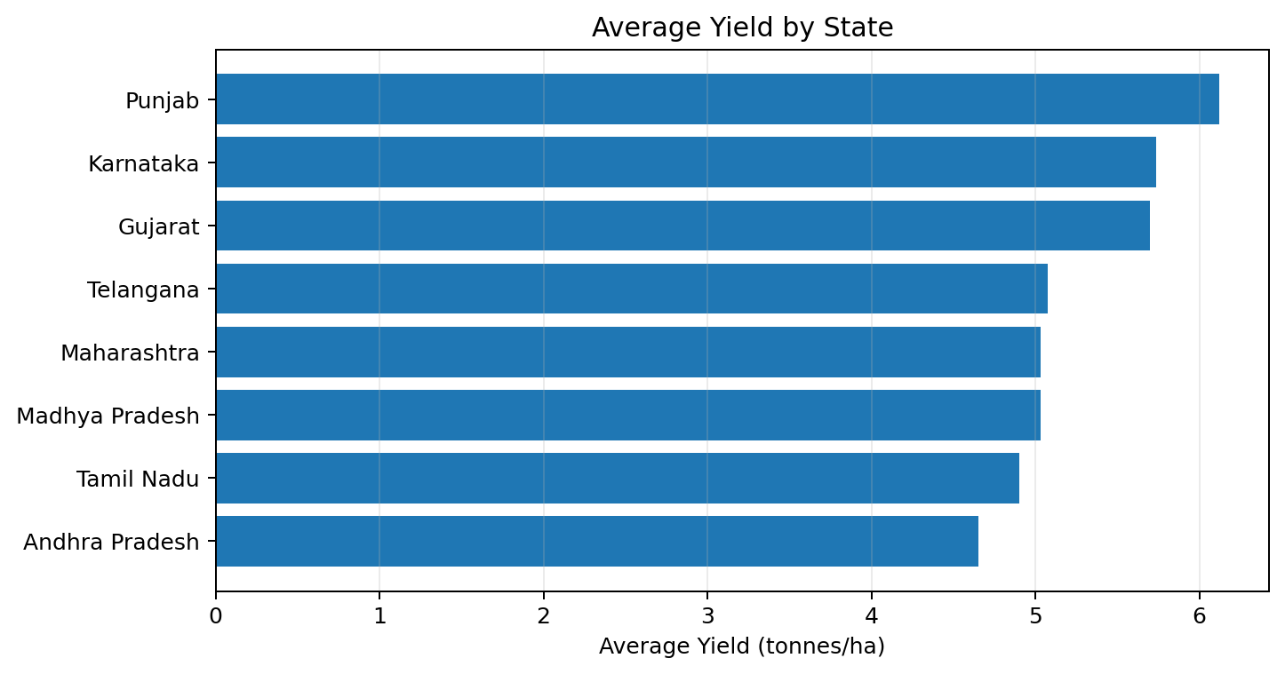
RESULTS
Regional & Water-Efficiency Insights
Average yield varies across states; water efficiency should be considered alongside production when comparing performance.
Observed association: yield vs. water-efficiency correlation ≈ 0.92; this is correlation, not proof of causation.

Slide 11
Future scope
Build interactive Power BI/Tableau dashboards for seasonal monitoring
Add predictive models for yield and profitability forecasting
Explore weather and soil relationships in greater depth
Develop crop- and region-specific recommendations
Extend analysis with larger and real-time agricultural datasets

Slide 12
GitHub Link
GitHub repository: Add your project repository link here

Slide 13
VOIS Course Completion Certificate Course Name – Data Visualization

Slide 14
Thank you
.
.

