Slide 1
Java Basics

Slide 2
AGENDA
Introduction to Java
JDK, JRE and JVM
Byte Code V/S Machine Code
Java Basic Syntax
Hello World Program
Data Types
Variables
Java Operators
Access Modifiers
Scanner Class
Control Statements

Slide 3
Introduction to Java
Java is a class-based, object-oriented programming language.
It is intended to let application developers Write once, run anywhere (WORA), meaning that compiled java code can run on all platforms that supports java without need of recompilation.
Java was widely used for developing applications for desktop, web and mobile devices.
Java is known for its simplicity, robustness and security features.

Slide 4
Introduction to Java
Features of Java
Platform Independent
Object-oriented Programming
Simplicity
Robustness – Garbage Collector
Security
Distributed
Multithreading
Portability
High Performance

Slide 5
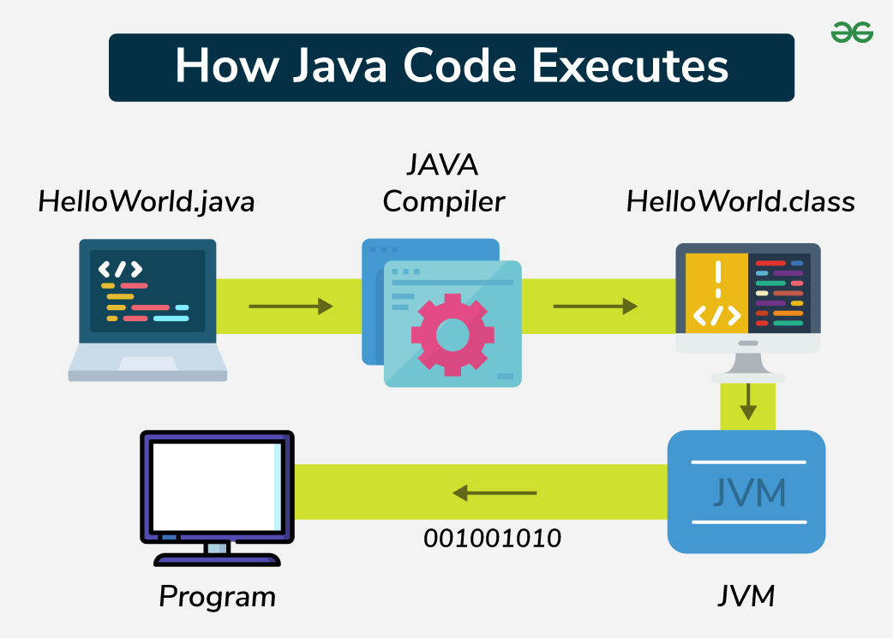
Introduction to Java
Execution of Java Code

Slide 6
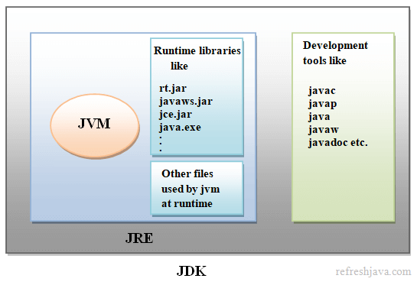
JDK, JRE and JVM

Slide 7
JDK, JRE and JVM
JDK (Java Development Kit)
It provides the environment to develop and execute (run) the java program.
JDK is a kit that include two things
Development Tools (provides environment to develop java applications)
JRE (to execute your java program).
JRE (Java Runtime Environment)
It is an installation package that provides an environment to only run (not develop) the java program onto the machine.
JRE is only used by those who only want to run java programs that are end-users of your system.

Slide 8
JDK, JRE and JVM
JVM (Java Virtual Machine)
It is very important part of both JDK and JRE because it is contained or builtin in both.
Whatever Java program you run using JDK and JRE, goes into JVM and JVM is responsible for executing the java program line by line.
Hence, it is also known as "Interpreter".

Slide 9
Byte Code V/S Machine Code
Byte Code | Machine Code
Byte code consists of binary, hexadecimal etc. and it is not executable by the CPU. | Machine code consisting of binary instructions that are directly executed by the CPU.
Byte code is considered as the intermediate-level code. | Machine code is considered as the low-level code.
Byte code is non-runnable code generated after the compilation of source code. | Machine code is a set of instructions in machine language or in binary format.
Byte code is less specific towards machine than the machine code. | Machine code is more specific towards machine than the byte code.
It is platform independent as it is dependent on the JVM. | It is platform dependent because object code of one platform cannot be run on different operation system.

Slide 10
Java Basic Syntax
Terminology | Description
Class | The class is a blueprint (plan) of the instances of a class (object). It can be defined as logical template to create the objects.
Object | The object is an instance of a class. It is an entity that has state and behaviour.
Method | The behaviour of an object is called as method. By using method, we can divide complex problem in small chunks.
Instance | Every object has its own unique set of instance variables. The state of an object is generally created by the values that are assigned to these instance variables.

Slide 11

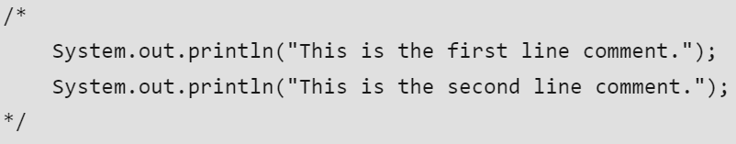

Java Basic Syntax
Comments in Java:
There are three types of comments in Java.
Single line comment (ctrl + /)
Multi line comment (ctrl + shift + /)
Documentation comment

Slide 12
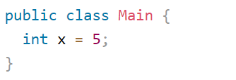
Java Basic Syntax
Class
Java is object-oriented programming language.
Everything in java is associated with classes and objects, along with its attributes and methods.
Class is like an object constructor, or a "blueprint" for creating objects.
To create a class, use the keyword called "class"
Example
In real life car is an object. The car has attributes, such as weight and color, and methods, such as drive and brake.

Slide 13
Java Basic Syntax
public static void main(String[] args)
The main method is the entry point into the java application.
This is where the processing starts.
public = Access modifier allows the method to be accessed from anywhere.
static = This keyword allows the methods to be called without creating instances.
void = This is the return type indicates that the method doesn't return any value.
String[] args = This array stores command-line arguments that user can input when they run the program.

Slide 14
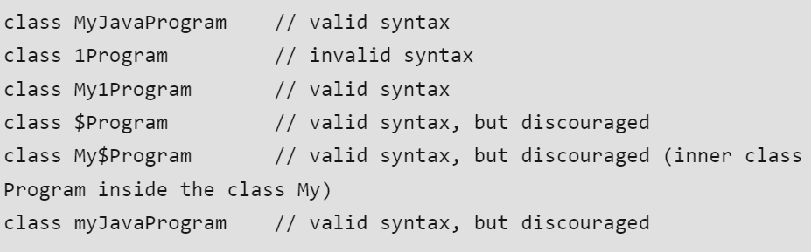
Java Basic Syntax
Class Name:
The first letter of the class name should be in uppercase.
If several words are used to form the name of the class, each inner word's first letter should be in uppercase.

Slide 15

Java Basic Syntax
Method Name:
All method names should start with the lowercase.
If several words are used to form the name of the class, each inner word's first letter should be in uppercase.
Underscores are allowed but not recommended.
Also allowed are digits and currency symbols.

Slide 16
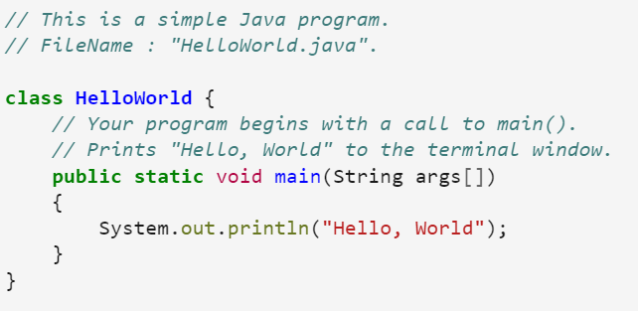
Hello World Program

Slide 17
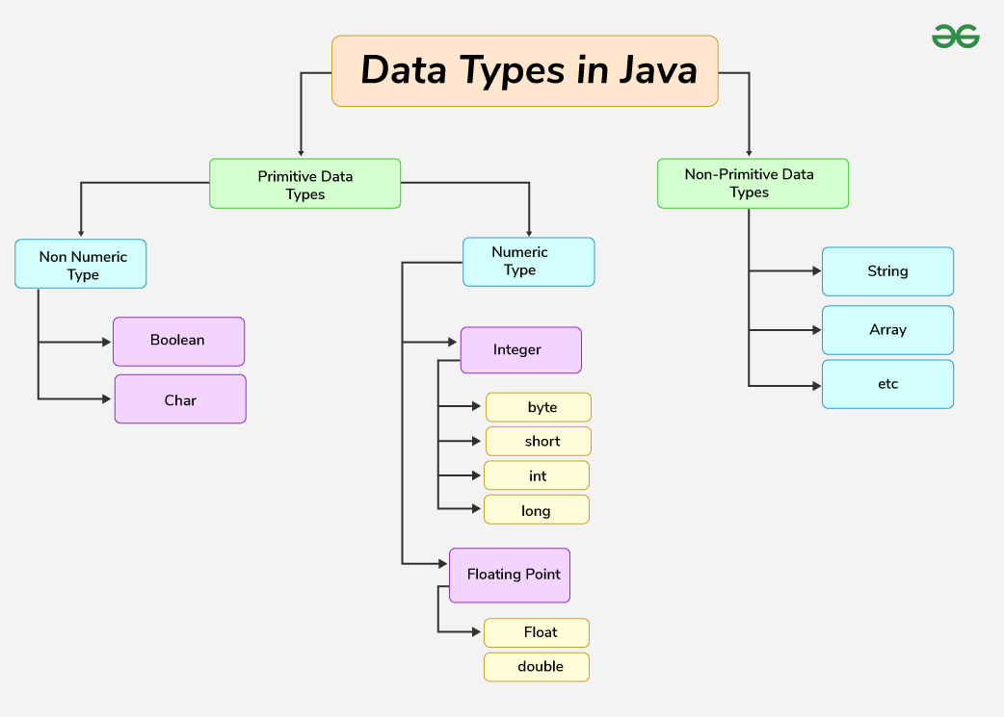
Data Types

Slide 18
Primitive Data Types
Data Type | Description | Default | Size | Range of Values
boolean | true or false | false | 8 bits | true, false
byte | Twos-complement integers | 0 | 8 bits | -128 to 127
char | Unicode character | \u0000 | 16 bits | ASCII Values
short | Twos-complement integers | 0 | 16 bits | -32,768 to 32,768
Int | Twos-complement integers | 0 | 32 bits | -2,147,483,648 to 2,147,483,647
long | Twos-complement integers | 0 | 64 bits | -9,223,372,036,854,775,808 to 9,223,372,036,854,775,807
float | IEEE 754 floating point number | 0.0 | 32 bits | upto 7 decimals
Double | IEEE 754 floating point number | 0.0 | 64 bits | upto 16 decimals

Slide 19
Non-Primitive Data Types
The Reference Data Types will contain a memory address of variable values because the reference types won't store the variable values directly into the memory.
They are String, Arrays, Objects, Interface etc. String name = "Hello"

Slide 20
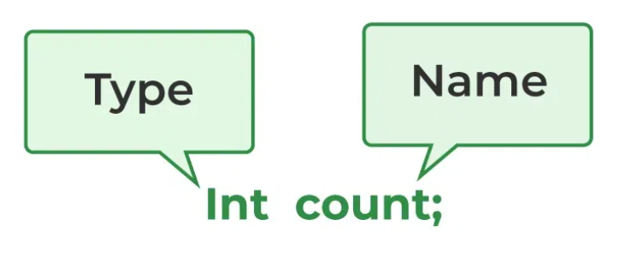
Variables
Java variable is a name given to the memory location.
It is the basic unit of storage in a program.
Value store in the variable can be changed during program execution.
In Java, all variables must be declared before use.
Declare a Variable

Slide 21
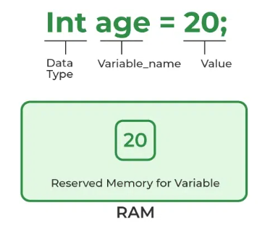
Variables
Initialize the variables
Data Type : Type of the data can be stored in this variable.
Variable_Name : Name given to the variable.
Value : It is the initial value store in the variable.

Slide 22
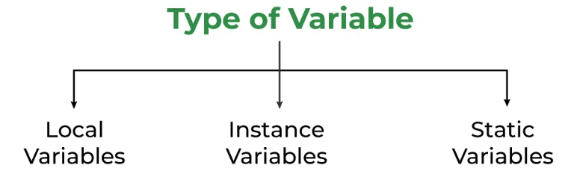
Variables
Types of Variables
Local Variable: Scope of these variables exists within the block.
Instance Variable: These variables are declared in a class, these variables are created when object of the class is created.
Static Variable: These variables are similar to instance variables. The difference is they declared using keyword static within the class and outside of any constructor, method, or block.

Slide 23
Java Operators
Operators in java are the symbols used for performing specific operations in Java.
Types of operators in java
Arithmetic Operators (+, -, *, /, %)
Unary Operators (increment(++), decrement(--), logical not(!)) => +=2
Assignment Operators (=, +=, -=, *=, /=, %=) =
Relational Operators (==, !=, >, >=, <, <=)
Logical Operators (AND(&&), OR(||), NOT(!))
Ternary Operator (condition ? if true : if false)
Bitwise Operators (&, |, ^, ~)
Shift Operators (<<, >>, >>>)
Instance of Operator (instance of used for type checking )

Slide 24
Access Modifiers
Access Modifier | Description
public | The code is accessible for all classes and packages in a same project.
private | The code is accessible within the declared class.
protected | The code is accessible in the same package and subclasses.
default | The code is only accessible in the same package. This is used when you don't specify a modifier.

Slide 25
Non - Access Modifiers
Non-Access Modifier | Description
final | Attributes or methods cannot be overridden / modified.
static | Attributes or methods belongs to the class, rather than the object.
abstract | Can only be used inside abstract class and can be used on methods. Abstract methods doesn't have a method body.

Slide 26
Scanner Class
In Java, Scanner is a class which is available in the java.util package.
This class is used to obtain input from the user.
Scanner class helps you to take standard input stream in java.
So, we need methods to extract the data from the stream.
Below are the methods used for extracting data:
nextBoolean() = Used for reading boolean value.
nextByte() = Used for reading byte value.
nextDouble() = Used for reading double value.
nextFloat() = Used for reading float value.
nextInt() = Used for reading int value.
nextLine() = Used for reading String value.
nextShort() = Used for reading short value.

Slide 27
Control Statements
Decision Making in programming is similar to decision making in real life.
A Programmer has to use control statements to control the flow of execution of a program based on certain conditions.
Java's Control Statements are
If statement
If-else statement
Nested-if statement
If-else-if statement
Switch-case statement

Slide 28
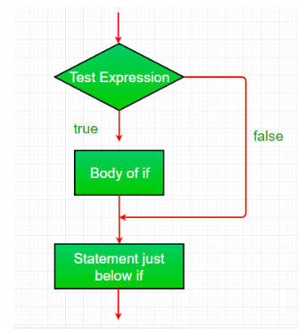
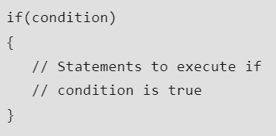
Control Statements
If Statement
The if statement is the most simple decision-making statement.
It will decide whether a certain statement or block of statements will be executed or not.
If a certain condition is true then a block of statements is executed otherwise not.
Syntax:

Slide 29
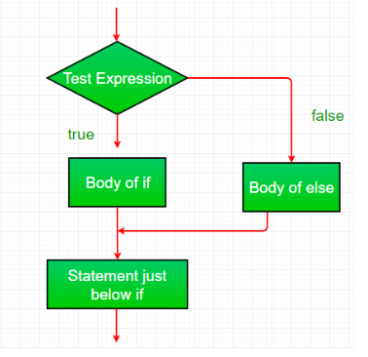
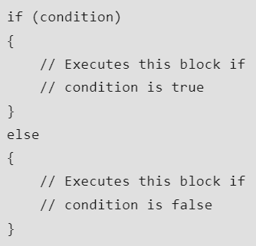
Control Statements
If-else Statement
It will decide whether a certain statement or block of statements will be executed or not.
If a certain condition is true then if block statements are executed.
If a certain condition is false, then else block statements are executed.
Syntax:

Slide 30
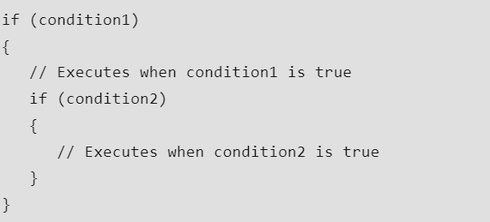
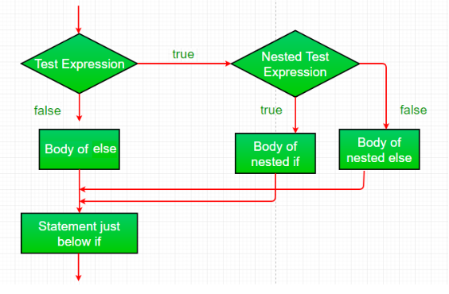
Control Statements
Nested-if Statement
Nested if statements mean an if statement inside another if statement.
Java allows to nest the statements within if statements.
Syntax:

Slide 31
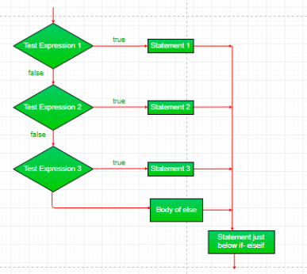
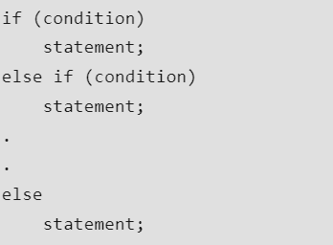
Control Statements
If-else-if Ladder
Here, a user can decide among multiple options.
As soon as one if condition is true, rest of the ladder will be bypassed.
If none if conditions are true then else block will be get executed.
Syntax:

Slide 32
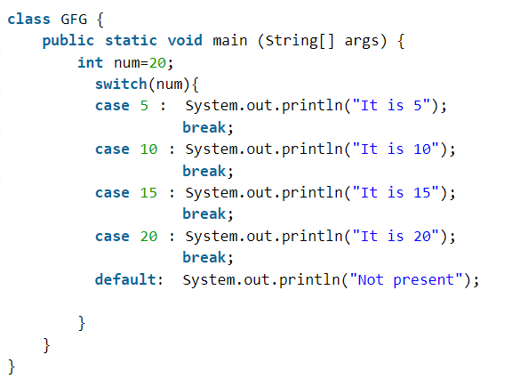
Control Statements
Switch Case
Switch case is an multiway branch statement.
It provides easy way to dispatch the execution to different parts of the code based on the value of the expression.

Slide 33
Thank You

