Slide 1
Loops and Strings

Slide 2
AGENDA
Jump Statements
Loops
Importance of Loops
Strings
String Methods
Immutable Strings

Slide 3
Loops Statements
Looping in programming language is a feature which facilitates the execution of a set of instructions / functions repeatedly until the condition become false.
Java provides three ways for execution of the loops.
for loop
while loop
do-while loop
While all these ways provide similar basic functionality, they differ in their syntax and condition checking time.

Slide 4
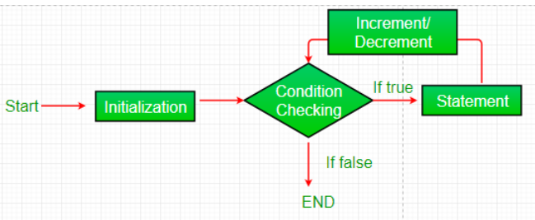
For Loop
For loop helps set of code repeatedly.
it is recommended when the number of iterations is fixed.
SYNTAX
for(init;condition;inc/dec){ = 1 , <=10 , I+=2
//statements to be executed or body
}
Init
The init expression is used for initializing a variable, and it is executed only once.
Condition
It executes the condition statement for every iteration. If it evaluates the condition to be true, it executes the body of the loop. The loop will continue to run until the condition becomes false.
Incr/Decr:
It is the increment or decrement statement applied to the variable to update the initial expression.

Slide 5
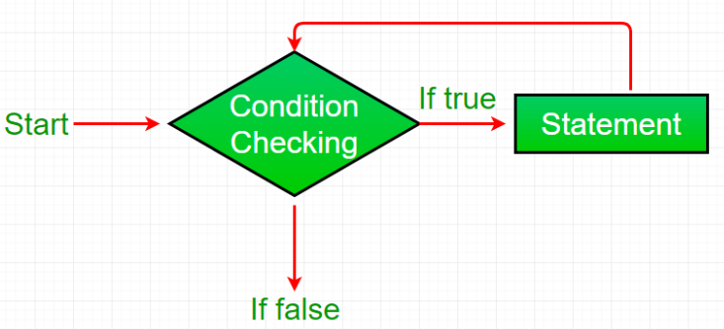
While Loop
The while loop is a control flow statement in java that allows a block of code to be executed repeatedly as along as given condition is true.
It is recommended when number of iterations is not known in advance.
SYNTAX
//Initialization
while(condition){
//statements to be executed or body
Incr/decr;
}
The Condition of while loop is boolean expression that is evaluated at the beginning of each iteration.

Slide 6
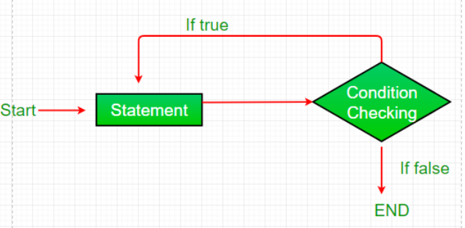
Do-While Loop
The do-while loop is a control flow statement in java that is similar to the while loop but with one key difference: the code inside the loop is executed at least once, even if the condition is initially false.
It is recommended when the code inside the loop must be expected at least once, regardless of the value of the condition.
SYNTAX
do{
//statements to be executed or body
Incr/decr;
}
while(condition);

Slide 7
Nested Loops
Nested loops are the loops within loops, where the inner loop is executed multiple times for each iteration of outer loop.
It is commonly used in programming to perform repetitive tasks on a two-dimensional or multi-dimensional arrays.
SYNTAX
for(init;condition;incr/decr){
for(init;condition;incr/decr){
//inner loop code
}
//outer loop code
}

Slide 8
Jump Statements
Java supports 3 types of Jump statements.
break
continue
return
These 3 statements transfer control to another part of the program.
break : Used to terminate the loop, switch case statements.
continue : Used to skip the iteration of the loop statements.
return : Used to explicitly return value from a method.

Slide 9
Importance of Loops
Efficiency
Flexibility
Code Readability
Reducing code duplication.

Slide 10
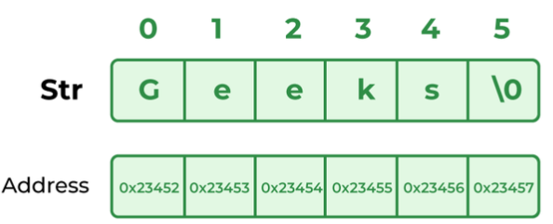

Strings
In Java, a String is an object that represent a sequence of characters.
Java provides a robust and flexible API for handling strings, allowing for various operations such as concatenation, comparison and manipulation.
String
Strings are the type of objects that can store the character of values.
Every character is stored in 16 bits i,e. UTF 16-bit encoding.
A String acts as same as array of characters in Java.
String Declaration and Initialization :

Slide 11


Strings
Ways of creating a String
There are two ways to create a String in Java.
String Literal
Using New Keyword
Syntax
String Literal
Using New Keyword

Slide 12
String Methods
Method Name | Description | Return Type
length() | Returns the number of characters in a string | Int
charAt(int i) | Returns the character at i^{th} index | Char
Substring(int I) | Returns the substring from i^{th} index character to end | String
concat(String s) | Concatenates specified string to the end of the string | string
indexOf(String s) | Returns the index within the string of the first occurrence of the specified string | Int
Equals(Object o) | Compares the string to the specified object | boolean
Trim() | Returns the copy of strin by removing whitespace at both ends | string
Replace(char a, char b) | Returns new string by replacing all occurrences of a with b | string

Slide 13
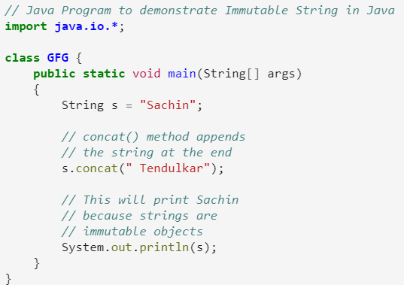
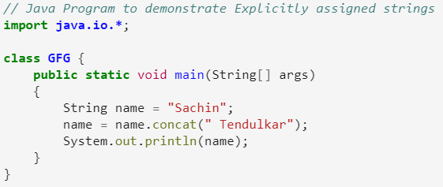
Immutable Strings
In Java, string objects are immutable.
Immutable simply means unmodifiable or unchangeable.
Once a string is created its data or state can't be changed but a new string object is created.
Example:
Description:
Here 'Sachin' is not changed but a new object is created with 'Sachin Tendulkar'.
That's why Strings are immutable.
But if we explicitly assign it to the reference variable, it will refer to the "Sachin Tendulkar" object.
Output: Sachin
Output: Sachin Tendulkar

Slide 14
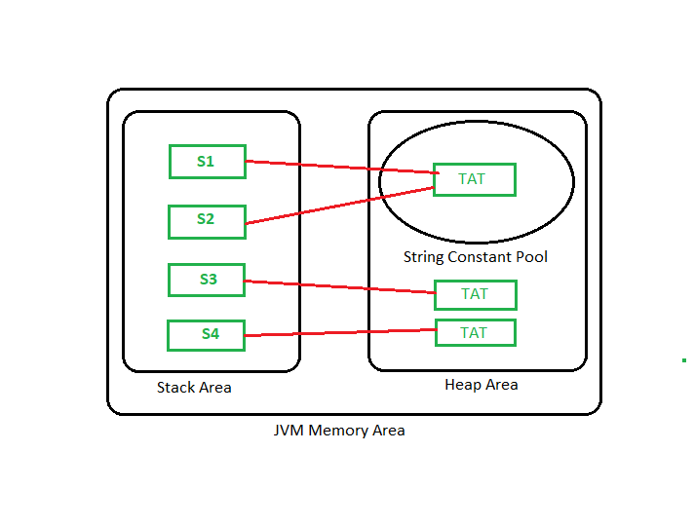
Immutable Strings

Slide 15
Thank You

