Slide 1
PL/SQL

Slide 2
AGENDA
PL/SQL Introduction
PL/SQL Environment
WHY PL/SQL?
Basic Syntax
Data Types
Variables
Operators
Control and Loops statements
Strings and Arrays
Procedures and Cursors
Functions
Triggers

Slide 3
PL/SQL Introduction
The PL/SQL programming language was developed by Oracle corporation in the late 1980s as procedural extension language for SQL and the Oracle relation database.
PL/SQL is a completely portable, high-performance transaction-processing language.
PL/SQL provides built-in, interpreted and OS independent programming environment.
PL/SQL can also be directly called from the command-line SQL*Plus interface.
PL/SQL's general syntax is based on Pascal programming language.

Slide 4
PL/SQL Introduction
Features of PL/SQL
PL/SQL is tightly integrated with SQL.
It offers extensive error checking.
It offers numerous data types.
It offers variety of programming structures.
It supports structured programming through functions and procedures.
It supports object-oriented programming
It supports the development of web applications and server pages.

Slide 5
PL/SQL Environment
PL/SQL is not a standalone programming language; It is a tool within the Oracle Programming environment.
SQL*Plus is a interactive tool that allows you to type SQL and PL/SQL statements at the command prompt.
These commands are then sent to the database for processing. Once statements are processed, the result are sent back and displayed on screen.
To run the PL/SQL programs, you should have the ORACLE RDBMS Server installed in your machine. This will take care of execution of the SQL Commands.

Slide 6
WHY PL/SQL?
PL/SQL is tightly integrated with oracle database. It allows you to embed SQL statements directly into your PL/SQL code, facilitating seamless interaction with database.
PL/SQL provides LOOPS, Conditional Statements and Exception Handling, allowing you to write complex business logic.
It supports creation of procedures, functions, packages and triggers, prompting modularity and reusability of code.
PL/SQL Programs execute with the privileges of their owner, allowing for fine-grained access control. It supports the principle of least privilege, enhancing database security.

Slide 7
Basic Syntax
PL/SQL is block structured language; this means that the PL/SQL programs are divided and written into logical blocks of code.
Every PL/SQL statement ends with a semicolon (;).
PL/SQL can be nested within other PL/SQL blocks using BEGIN and END.
Each block consists of three sub-parts:
Blocks | Description
Declarations | This section starts with keyword DECLARE. It is an optional section and defines all variables, cursors, subprograms, and other elements to be used in the program.
Executable Commands | This section is encloses between the keywords BEGIN and END and it is a mandatory section. It should have atleast one executable line of code, which may be just a NULL command.
Exception Handling | This section starts with the keyword EXCEPTION. This optional section contains exceptions that handle errors in the program.

Slide 8
Basic Syntax
SYNTAX
EXAMPLE
DECLARE
<declarations section>
BEGIN
<executable command(s)>
EXCEPTION
<exception handling>
END;
DECLARE
message varchar2(20) := 'Hello, World';
BEGIN
dbms_output.put_line(message);
END;
The END; line signals the end of PL/SQL block.

Slide 9
Basic Syntax
PL/SQL Identifiers
Identifiers are Constants, Variables, Cursors, Exceptions, Procedures and reserved words.
The Identifiers consists of a letters optionally followed more letters, numerals, dollar sign, underscores and number signs and should not exceed 30 characters in length.
By Default, Identifiers are not case sensitive. So you can use integer or INTEGER to represent a numeric value.
You cannot use reserve keyword as an identifier.
PL/SQL Comments
PL/SQL supports single-line and multi-line comments.
Single line comments starts with delimiter -- (double hyphen.)
Multi line comments are enclosed in between /* and */

Slide 10
Data Types
PL/SQL variables, constants and parameters must have a valid data type.
Category | Description
Scalar | Single values with no internal components, such as Number, Date, or Boolean.
Large Object (LOB) | Pointers to large objects that are stored separately from other data items, such as text, graphic images, video clips, and sound waves.
Composite | Data items that have internal components that can be accessed individually. For example, collections and records.
Reference | Pointers to other data items.

Slide 11
Data Types
Scalar Data Types
Data Type | Description
Numeric | Numeric values on which arithmetic operations are performed.
Character | Alphanumeric values that represent single characters or strings of characters.
Boolean | Logical values on which logical operations are performed.
Datetime | Dates and times.

Slide 12
Data Types
Sub Types of Numeric Data Type
Data Type | Description
INT | ANSI specific integer type with maximum precision of 38 decimal digits.
NUMBER(P, S) | Stores fixed or floating-point numbers.
BINARY_INTEGER | Integer values (-2,147,483,648 to 2,147,483,647)
PLS_INTEGER | Optimized for better performance
FLOAT | Floating point numbers.

Slide 13
Data Types
Sub Types of Character Data Type
Data Type | Description
CHAR(n) | Fixed-length string.
VARCHAR2(n) | Variable-length string (Preferred over VARCHAR)
CLOB | Character Large Object for Large text data.
Sub Type of Boolean Data Type
Data Type | Description
BOOLEAN | Stores TRUE, FALSE, or NULL. (Not supported in SQL)

Slide 14
Data Types
Sub Types of Date/Time Data Type
Data Type | Description
DATE | Stores date and time.
TIMESTAMP | Stores date and time with fractional seconds.
INTERVAL | Represents a period between two timestamps.

Slide 15
Data Types
Reference Data Types
Data Type | Description
REF CURSOR | Stores a pointer to a query result set.
UROWID | Stores row addresses (used with object tables.)

Slide 16
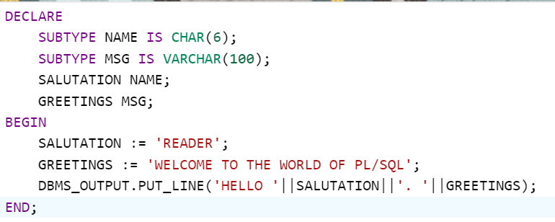

User Defined Data Types
Example for User Defined Data Type

Slide 17
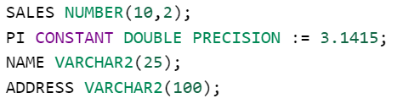
Variables
PL/SQL Variables
A Variable is nothing but a name given to a storage area that our programs can manipulate.
Each variable in PL/SQL has specific data type, which determines the size and layout of the variable's memory.
SYNTAX
variable_name [constant] datatype [NOT NULL] [:= | DEFAULT initial_value];
Variable Declarations

Slide 18
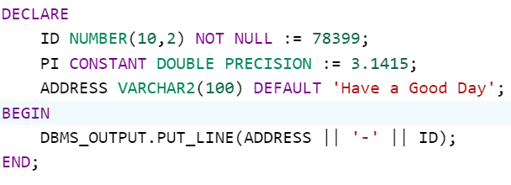
Variables
Initializing Variables
Whenever you declare a variable, PL/SQL assigns it a default value of NULL. If you want to initialize a variable with a value other than NULL value you can do by using:
The DEFAULT keyword
The assignment operator

Slide 19
Operators
Arithmetic Operators
+ | Add two operands
- | Subtracts second operand from the first
* | Multiplies Both Operands
/ | Divides Numerator by De-numerator
** | Exponential operator, raises one operand to the power of other
Comparison Operators
LIKE | Search for a pattern
IN | Tests set membership
BETWEEN | Tests whether a value lies in specified range

Slide 20
Operators
Relational Operators
= | < | > | <= | >= | != or <>
Logical Operators
AND | If both operands are true then condition is true
OR | If any of two operands is true then condition is true
NOT | If a condition is true the Not operator will make it false

Slide 21
Control Statements
PL/SQL CONTROL STATEMENTS
The IF statement has 3 forms
IF THEN
IF THEN ELSE
IF THEN ELSIF
The CASE statement which allows you to execute a sequence of statements based on a selector.
SEARCHED CASE statement which has no selector, and it's WHEN clause contains search conditions that yield boolean values.
Nested IF-THEN-ELSE

Slide 22
Loops
PL/SQL LOOPS
The Loop statements allows us to execute a statement or group of statement multiple times.
PL/SQL provides the following types of loops to handle looping requirements
BASIC LOOP
FOR LOOP
WHILE LOOP
NESTED LOOPS
LABELING A PL/SQL LOOP
PL/SQL Loops can be labeled. The label should be enclosed in double angle brackets (<< and >>).
You may use the label in the EXIT statement to exit from the loop.

Slide 23
Loops
LOOP CONTROL STATEMENTS
Loop Control statements change execution from its normal sequence.
When execution leaves a scope, all automatic objects that were created in that scope are destroyed.
PL/SQL supports the following control statements.
EXIT statement = Completes the loop and pass to the statement immediately after the END LOOP.
CONTINUE statement = Causes the loop to skip the remainder of its body and immediately retest its condition prior to reiterating.
GOTO statement = Transfers the control to the labeled statement. Though it is not advised to use GOTO statement in your program.

Slide 24
Strings
PL/SQL String Functions
FUNCTIONS | PURPOSE
ASCII(X) | Returns the ASCII value of X.
TRIM([trim_char FROM) x) | Trims the characters from the left to right of x.
CONCAT(X, Y) | Concatenates the string x and y and return the appended string.
INITCAP(X) | Converts the initial letter of each word to uppercase.
LENGTH(X) | Returns the number of characters in string x.
LOWER(X) | Converts the letters in word x to lowercase and returns the string.
UPPER(X) | Converts the letters in word x to uppercase and returns the string.
SUBSTR(X, start, [, length]) | Returns a substring of x that begins at the position specified by start. An optional length for the substring may be supplied.
REPLACE(X, Y, Z) | Replaces String (Y) from String (X) with String (Z).

Slide 25
Arrays
PL/SQL VARRAY
PL/SQL programming language provides a data structure called VARRAY, which can store fixed-size sequential collection of elements of same type.
Each element in VARRAY has an index associated with it. Index numbering will start from 1. It also has the maximum size that can change dynamically.
Maximum size can be altered using the ALTER TYPE.
SYNTAX TO CREATE VARRAY TYPE
CREATE OR REPLACE TYPE varray_type_name IS VARRAY(n) of <element-type>
Where,
varray_type_name = Valid attribute name
n is the number of elements(maximum) in the varray.
element_type is the data type of elements of the varray.

Slide 26
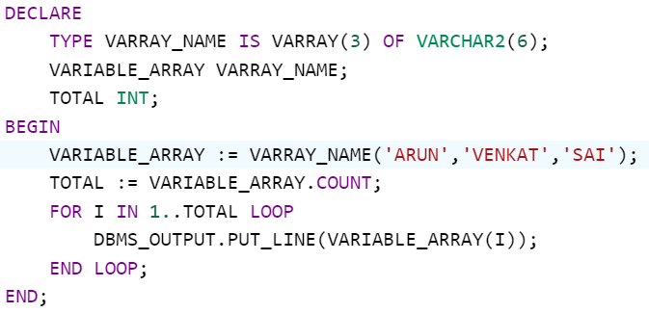
Arrays
PL/SQL VARRAY
EXAMPLE OF VARRAY
First Element
Last Element
Number[1] | Number[2] | Number[3] | ... | Number[n]

Slide 27
Arrays
METHODS OF COLLECTIONS TYPE
METHODS | DESCRIPTION
EXTEND(N) | Extends the VARRAY by N elements.
TRIM(N) | Trims the VARRAY to N elements.
FIRST, LAST | FIRST returns the index of the first element and LAST returns the index of the last element.
COUNT | Returns the number of elements in the VARRAY..
LIMIT | Returns the maximum number of elements that VARRAY can hold.
EXISTS(index) | Checks if an element exists at the specified index.

Slide 28
Procedures
PL/SQL Procedures
PL/SQL sub programs are named PL/SQL blocks that can be invoked with a set of parameters.
PL/SQL provides two kinds of sub programs.
Procedures
Functions
A Procedure is created with the CREATE OR REPLACE PROCEDURE statement.
These sub programs do not return any value directly; mainly used to perform an action.
SYNTAX
CREATE [OR REPLACE] PROCEDURE procedure_name
[(parameter_name [IN | OUT | IN OUT] type [, ...])]
{IS | AS}
BEGIN
<procedure_body>
END procedure_name;

Slide 29
Procedures
From Syntax:
procedure_name = Name of the procedure
[OR REPLACE] = Allows the modification of an existing procedure.
The optional parameter list contains name, mode and types of the parameters.
IN represents the value that be passed from outside.
OUT represents the parameter that will be used to return a value outside of the procedure.
Procedure-body contains the executable part.
The AS keyword is used instead of the IS keyword for creating a standalone procedure.

Slide 30
Procedures
Executing an Standalone Procedure
A Standalone procedure can be called in two ways -
Using the EXECUTE keyword.
Calling the name of a procedure from a PL/SQL Block.
SYNTAX: EXECUTE procedure_name;
Deleting an Standalone Procedure
A Standalone procedure is deleted with the DROP PROCEDURE statement -
SYNTAX: DROP PROCEUDRE procedure_name;

Slide 31
Cursors
PL/SQL Cursors
Oracle creates a memory area, known as context area, for processing an SQL Statement, which contains all the information needed for processing the statement; for example, the number of rows processed, etc.
A Cursor is a pointer to this context area. PL/SQL Controls the context area through this cursor.
A Cursor holds the rows returned by SQL Statement.
The Set of rows the cursor holds is referred to as the active set.
You can name a cursor so that it could be referred to in a program to fetch and process the rows.
There are two types of cursors
Implicit Cursors
Explicit Cursors

Slide 32
Cursors
Declaring the cursor
CURSOR c_customers IS SELECT id,name,address FROM CUSTOMERS;
Opening the cursor
OPEN c_customers;
Fetching the cursor
FETCH c_customers INTO c_id, c_name, c_address;
Closing the cursor
CLOSE c_customers;

Slide 33
Cursors
Implicit Cursors
Implicit Cursors are automatically created by oracle whenever an sql statement is executed. Programmers cannot control these implicit cursors.
Whenever an DML statement (INSERT, UPDATE AND DELETE) is issued, an implicit cursor associated with these queries.
For INSERT, cursor holds the data that needs to be inserted and for UPDATE, DELETE cursor holds the number of records affected.
You can refer the most recent implicit cursor as the SQL Cursor, which is always has attributes.
Attributes | Description
%FOUND | Returns True if DML commands affect one or more rows or SELECT INTO statement also.
%NOTFOUND | The logical opposite of %FOUND attribute.
%ISOPEN | Always returns false for implicit cursors, because oracle close cursor after executing sql statements.
%ROWCOUNT | Returns number of rows affected by INSERT, UPDATE AND DELETE.

Slide 34
Cursors
Explicit Cursors
Explicit Cursors are programmer-defined cursors for gaining more control over the context area.
An explicit cursor should be defined in a declaration section of the PL/SQL block.
It is created on SELECT statement which returns more than one row.
SYNTAX
CURSOR cursor_name IS select_statement;
Working with Explicit Cursor includes the following steps:
Declaring the cursor for initializing the memory.
Opening the cursor for allocating the memory.
Fetching the cursor for retrieving the data.
Closing the cursor to release the allocated memory.

Slide 35
Functions
PL/SQL Functions
Functions is a standalone PL/SQL subprogram.
Like PL/SQL procedure, functions have a unique name by which it can be referred.
These are stored as PL/SQL database objects.
The main difference between procedure and function is that a function must return a value, and on other hand a procedure may or may not return a value.
If you want to remove your created function from the database, you should use the following syntax: DROP FUNCTION function_name.
SYNTAX
CREATE [OR REPLACE] FUNCTION function_name
[(parameter_name [IN | OUT | IN OUT] type [, ...])]
{IS | AS}
<declaration_part>
BEGIN
<execution_part>
END;

Slide 36
Thank You

