Slide 1
Introduction to Agile
INTERNAL
28 Oct 2016

Slide 2
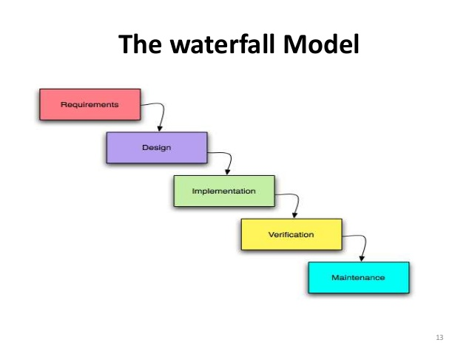
Waterfall Model
The waterfall model is a sequential design process, used in software development processes, in which progress is seen as flowing steadily downwards (like a waterfall) through the phases of conception, initiation, analysis, design, construction, testing, production/implementation and maintenance.
- <number> -

Slide 3
Waterfall continues...
Disadvantages of waterfall model:
Once an application is in the testing stage, it is very difficult to go back and change something that was not well-thought out in the concept stage.
No working software is produced until late during the life cycle.
High amounts of risk and uncertainty.
Not a good model for complex and object-oriented projects.
Poor model for long and ongoing projects.
Not suitable for the projects where requirements are at a moderate to high risk of changing.
When to use the waterfall model:
This model is used only when the requirements are very well known, clear and fixed.
Product definition is stable.
Technology is understood.
There are no ambiguous requirements
Ample resources with required expertise are available freely
The project is short.
- <number> -

Slide 4
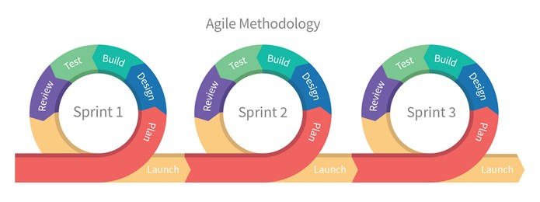
What is Agile
Agile methodology is an alternative to traditional project management, typically used in software development. It helps teams respond to unpredictability through incremental, iterative work cadences, known as sprints. Agile methodologies are an alternative to waterfall, or traditional sequential development.
- <number> -

Slide 5

Agile Flavors
Scrum : Its primary goal is to deliver software that, after each and every iteration, provides the highest business value. Scrum is based on a 30-day iteration called a "Sprint."
XP :Extreme Programming (XP) is one of the more well known Agile methodologies. As its name suggests it is a programmer-centric methodology that emphasizes technical practices to promote skillful development through frequent delivery of working software.
FDD :
Feature-Driven Development -is a software development process that relies on the repetition of a very short development cycle: first the developer writes an (initially failing) automated test case that defines a desired improvement or new function, then produces the minimum amount of code to pass that test.
Feature-Driven Development (FDD) is a lightweight agile framework that focuses on delivering working software in short iterations, with an emphasis on developing features that provide value to the client
- <number> -

Slide 6
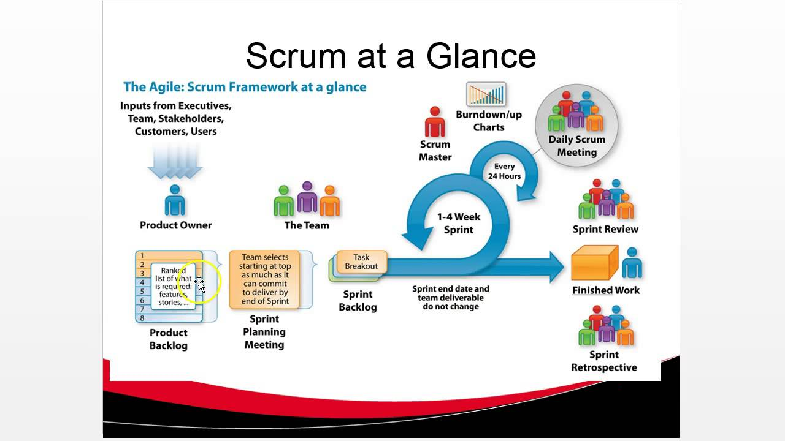
What is Scrum
- <number> -

Slide 7
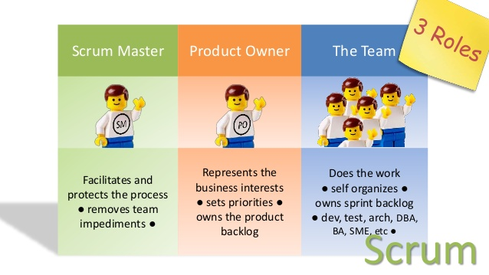
Roles in Scrum
- <number> -

Slide 8
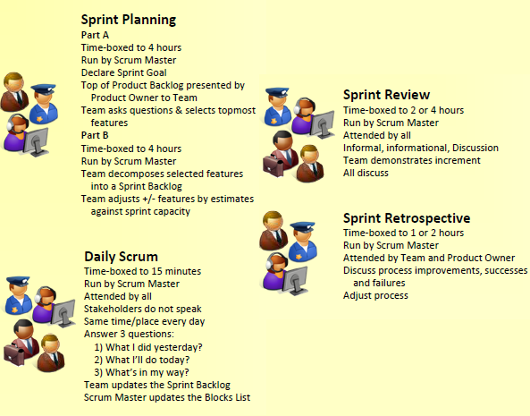
Meetings in Scrum
- <number> -

Slide 9
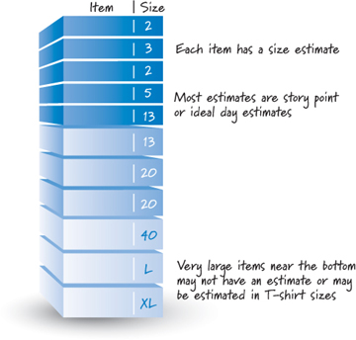
Product Backlog
Scrum Product Backlog is simply a list of all things that needs to be done within the project. It replaces the traditional requirements specification artifacts. These items can have a technical nature or can be user-centric e.g. in the form of user stories.
- <number> -

Slide 10
User Story
• Detailed requirements in agile software development are captured in the form of User Stories, from the point of view of the user rather than the organization or project.
• It captures who, what and why of the requirement from the users perspective.
o Ex. As a customer <role>, I want to <action> so that I can <reason or goal>.
• User stories are short and concise statements.
• They are recorded on sticky notes, index cards etc so that they can be stuck on walls or tables to be rearranged or used during discussion.

Slide 11
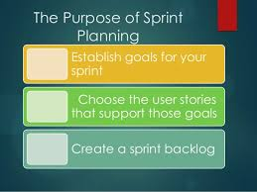
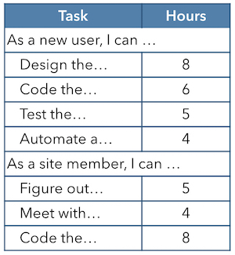
Sprint Planning
- <number> -

Slide 12
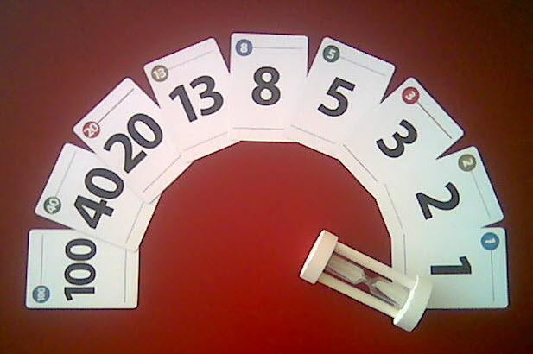
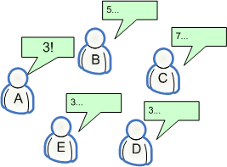
Story Point Estimation – Planning Poker
- <number> -

Slide 13
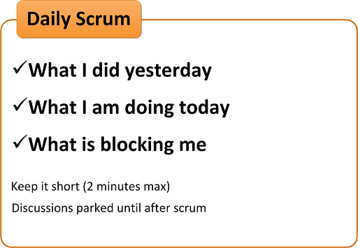
Daily Scrum
- <number> -

Slide 14
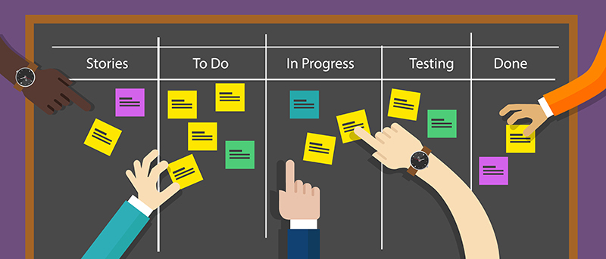
Sprint Burn down Chart
- <number> -

Slide 15
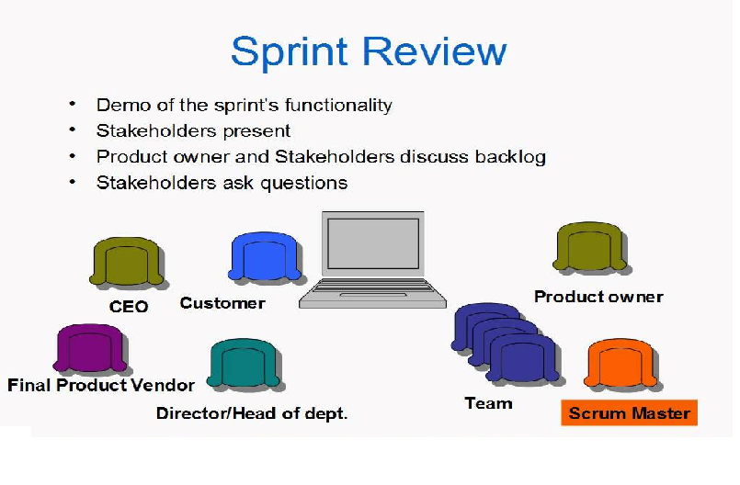
Sprint Review
- <number> -

Slide 16
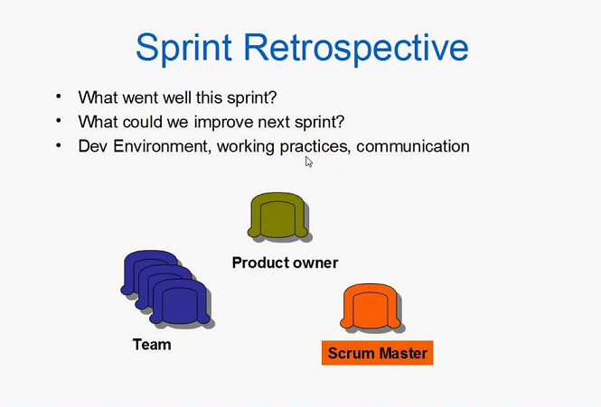
Sprint Retrospective
- <number> -

Slide 17
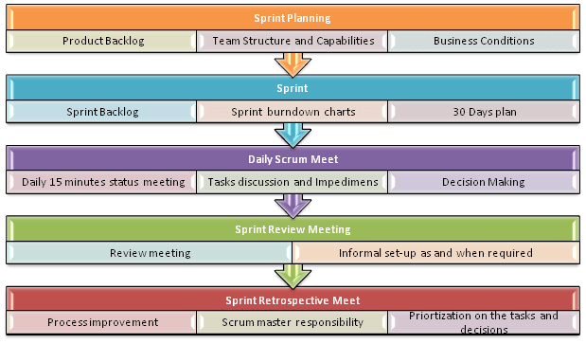

Slide 19
Happy Learning !

