Slide 1
Capstone Project BIGDATA ENGINEERING
By
siva

Slide 2
Business Objectives
Technology-wise Objective : Creating an End-to-End Data Pipeline
by integrating all technology.
Business objective : To analysis the data why Employee’s
Leaving and what are the various factors
affect for the employee’s detention

Slide 3
Data Description
This dataset has total 6 tables (Records) –
Employees (300024),
Salaries (300024),
Titles (7),
Dept_Emp (331603 -> 300024),
Dept_Manager (24) and
Departments (9).

Slide 4
Data Description
Titles (titles.csv):
title_id – Unique id of type of employee (designation id) – Character – Not Null
title – Designation – Character – Not Null
Employees (employees.csv):
emp_no – Employee Id – Integer – Not Null
emp_titles_id – designation id – Not Null
birth_date – Date of Birth – Date Time – Not Null
first_name – First Name – Character – Not Null
last_name – Last Name – Character – Not Null
sex – Gender – Character – Not Null
hire_date – Employee Hire date –Date Time -Not Null
no_of_projects – Number of projects worked on – Integer – Not Null
Last_performance_rating – Last year performance rating – Character – Not Null
left – Employee left the organization – Boolean – Not Null
Last_date - Last date of employment (Exit Date) – Date Time
Salaries (salaries.csv):
emp_no – Employee id – Integer – Not Null
Salary – Employee’s Salary – Integer – Not Null
Departments (departments.csv)
dept_no - Unique id for each department – character – Not Null
dept_name – Department Name – Character – Not Null
Department Managers (dept_manager.csv)
dept_no - Unique id for each department – character – Not Null
emp_no – Employee number (head of the department ) – Integer – Not Null
Department Employees (dept_emp.csv)
emp_no – Employee id – Integer – Not Null
dept_no - Unique id for each department – character – Not Null

Slide 5
Technology Stack
MySQL (to create database - RDBMS)
Linux Commands (to run .sh file)
Sqoop (Transfer data from MySQL Server to HDFS/Hive)
HDFS (to store the data)
Hive (to create database)
Impala (to perform the EDA)
SparkSQL (to perform the EDA)
SparkML (to perform model building)

Slide 6
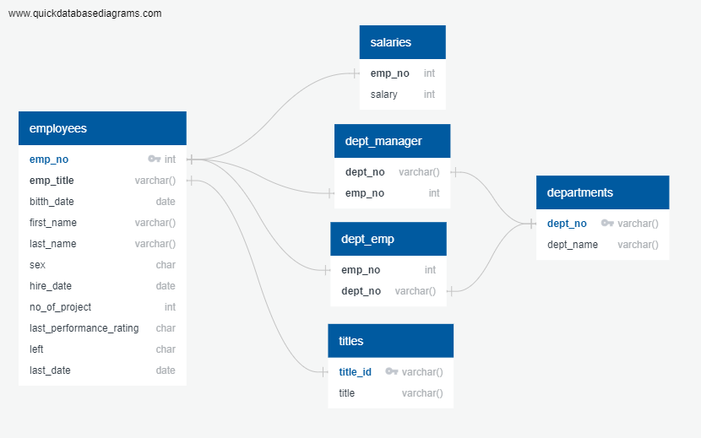
ER Diagram

Slide 7
Pipeline Architecture
1. Loading Data [.csv files]
2. Creating MySQL Tables & Inserting Data
3. Transferring Data + Metadata from MySQL to HDFS Warehouse Using sqoop
5. Performing EDA in Impala
6. Performing EDA with Spark SQL
7. Building RF Classifier Model and Logistic Regression Model with Spark ML
4. Creating Hive Tables

Slide 8
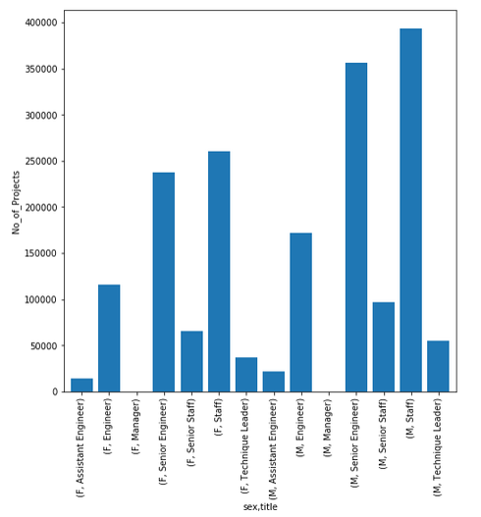
Output how may project’s done by each department(male and female)

Slide 9
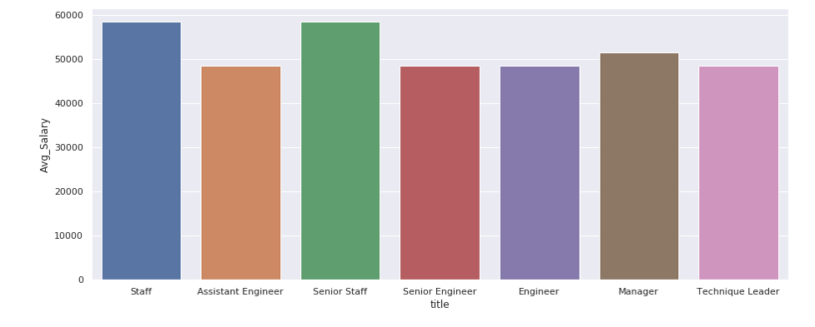
Output Average salary per title in bar graph

Slide 10
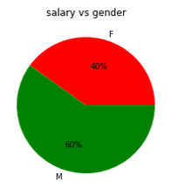
Outputs : salary distribution amoung male’s and female’s

Slide 11
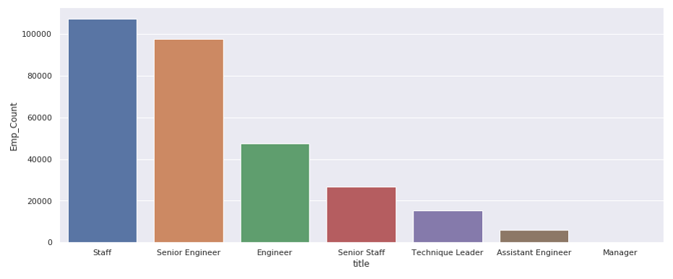
Output : Employees across various titles

Slide 12
Ml model for classification algorithm
Random Forest Classifier Model
Accuracy =
0.9000555834925744
Error =
0.09994441650742
Logistic Regression Model
Accuracy =
0.9004101154357617
Error =
0.09958988456423834

Slide 13
Challenges Faced
Creating ML Pipeline as OneHotEncoding does not contain fit method in Spark 2.4.0
Debuging the lost of error
Pipeline creation
Data formatting and etc.

