Slide 1


K.RAMAKRISHNAN COLLEGE OF TECHNOLOGY
(AUTONOMOUS), TRICHY.
CURRENCY CONVERTER
PRESENTED
Name: M.SIVARAJ
Reg No. 2303811710421152
SUPERVISOR
Mr.A.MALARMANNAN,M.E., AP/CSE

Slide 2
OBJECTIVE
Design and develop a currency converter application that allows users to convert amounts between different currencies in real-time using the latest exchange rates.

Slide 3
PROJECT INTRODUCTION
The currency converter application in Java addresses several key issues: it utilizes static exchange rates, supports only a limited number of currencies (USD, EUR, GBP), and has minimal input validation and error handling.

Slide 4
PROBLEM STATEMENT
A currency converter application is needed to simplify the process of converting amounts between different currencies using the latest exchange rates. The application should allow users to select a source currency, a target currency, and input an amount to calculate the equivalent value in real-time. It must support multiple currencies and fetch accurate rates from a reliable exchange rate API. The interface should be user-friendly and responsive, enabling quick and secure conversions across devices. Additionally, it should handle scenarios like API failures gracefully and provide optional offline support using previously cached rates. The system must ensure accuracy in calculations, manage rounding errors, and include comprehensive documentation and testing to ensure reliability.

Slide 5
METHODOLOGIES
Requirements Gathering
Stakeholder Analysis: Identify the needs of end users (travelers, businesses, etc.) and stakeholders.
Feature Prioritization: Define essential features like real-time updates, multi-currency support, offline mode, and user interface. Tools: Interviews, surveys, use case diagrams.
2.Design Methodology
System Design: Use a modular architecture for easier maintenance (e.g., separating the user interface, API integration, and business logic).
Design the database schema to store currency data and conversion history if needed. User Interface (UI) Design: Follow Human-Centered Design (HCD) principles for a simple and intuitive user experience. Use wireframes or prototypes to test UI layouts. Tools: Figma, Adobe XD, UML diagrams, or Entity-Relationship Diagrams

Slide 6
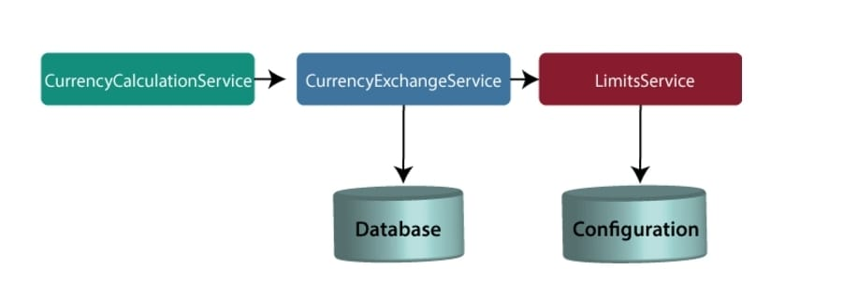
ARCHITECTURE OF THE PROPOSED SYSTEM

Slide 7
LIST OF MODULES
MODULE DESCRIPTON
User Interface Module
Purpose: Handle user interactions and display results.
Components: Input Fields: Amount to convert From Currency (input or dropdown) To Currency (input or dropdown)
Buttons: Convert (to initiate conversion) Reset (to clear inputs)
Output Display: Area for conversion results Area for error messages.
Conversion Logic Module
Purpose: Perform the actual currency conversion.
Components: convertCurrency(double amount, String fromCurrency, String toCurrency): Converts the given amount using stored exchange rates.
validateCurrency(String currency): Checks if the currency code is valid.
3.Data Management Module
Purpose: Manage currency exchange rates.
Components: Data Structure: A Map<String, Double> to store currency codes and their corresponding exchange rates.
Methods: loadExchangeRates(): Loads static rates or retrieves live rates from an API.
getExchangeRate(String currency): Returns the exchange rate for a specified

Slide 8
MERITS
Convenience and Time-Saving:
A currency converter eliminates the need for manual calculations and lookups of exchange rates. Users can quickly and accurately convert currencies, saving time and reducing the risk of human error.
2.Real-Time Accuracy:
By leveraging live exchange rate APIs, the application provides up-to-date and precise conversion rates, ensuring users have reliable information for financial decisions or transactions.

Slide 9
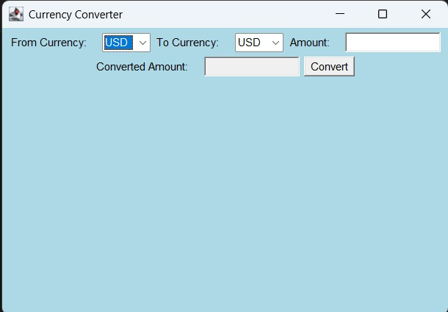
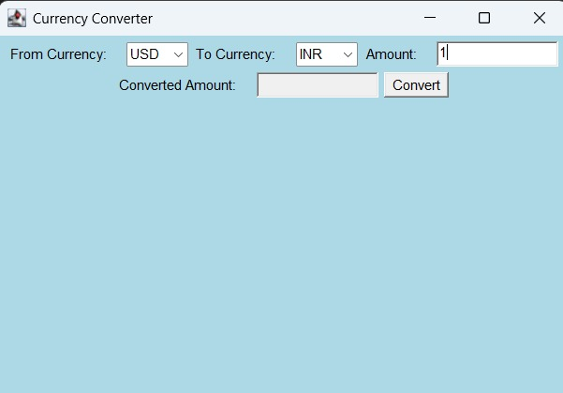
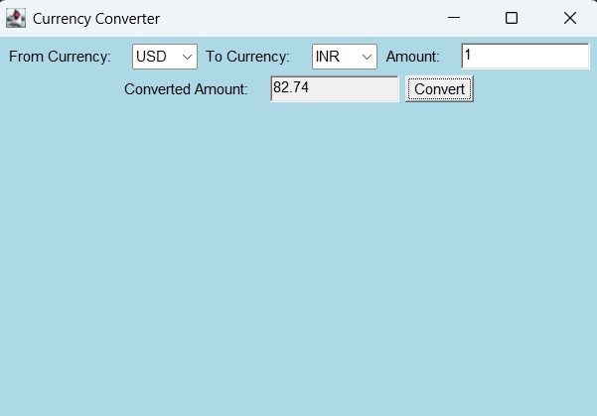
RESULTS AND DISCUSSION

Slide 10
QUERIES ?

