Slide 1


PANIMALAR ENGINEERING COLLEGE (An Autonomous Institution)
DEPARTMENT OF COMPUTER SCIENCE AND ENGINEERING
CS8811 PROJECT WORK
REVIEW NO:
INFORMATION RETRIEVAL SYSTEM
Guide Name: Dr. L. JABASHEELA, M.E., Ph.D.,
SIVASHANMUGAM M V- 211419104257
BATCH NO: C22

Slide 2
Introduction
The advent of the internet has brought about an enormous amount of digital data, with new data being generated every second. This rapid growth of data has led to the development of various techniques and tools for managing and processing large datasets. One of the challenges that arise with large datasets is the ability to quickly search and retrieve relevant information from the data. This is where Information Retrieval (IR) comes into play.
IR is a field of computer science that deals with the search and retrieval of information from large datasets. It is a crucial aspect of many modern applications, including search engines, digital libraries, and e-commerce platforms. In recent years, there has been an increasing demand for effective IR systems that can quickly and accurately retrieve information from large datasets.
The system provides a simple user interface that allows users to enter a query and retrieve the top matching documents. We implement the system using the Flask web framework, which allows the system to be accessed through a web browser. Our IR system is an efficient and effective tool for searching through large text datasets and can be useful in many applications, including online search engines, digital libraries, and e-commerce platforms.

Slide 3
Literature Survey
Paper Title | Authors | Year | Methodology | Contribution
"A survey of information retrieval techniques" | A. Singhal | 2016 | Literature review | Provides an overview of IR techniques and their applications
"An empirical study of feature weighting methods for text classification" | K. Li et al. | 2015 | Empirical study | Evaluates the performance of different feature weighting methods on text classification tasks
"A comparative study of machine learning algorithms for text classification" | S. Wang et al. | 2016 | Empirical study | Compares the performance of various machine learning algorithms on text classification tasks
"Deep learning for text classification: A comprehensive review" | X. Zhang et al. | 2018 | Literature review | Reviews the use of deep learning techniques for text classification tasks
"A comparison of vector space models for information retrieval" | I. Steinberger et al. | 2016 | Empirical study | Compares the performance of different vector space models for IR tasks
"Semantic similarity measures for natural language processing: A review" | J. Zhang et al. | 2018 | Literature review | Reviews the use of semantic similarity measures for natural language processing tasks
"A systematic review of clustering techniques in text mining" | M. Saifullah et al. | 2017 | Literature review | Reviews the use of clustering techniques for text mining tasks

Slide 4
Problem Statement
The vast amount of textual data available online has made it difficult for users to find relevant information. Traditional search engines often return a large number of results that are not necessarily relevant, leading to information overload and a waste of time. Moreover, search queries often lack clarity or specificity, making it even more challenging to retrieve relevant information. Thus, there is a need for an intelligent system that can help users efficiently search for and retrieve relevant information from large collections of textual data.
To address this problem, this project aims to develop a text retrieval system that can search and retrieve relevant documents from a large corpus of text data based on a user query. The system utilizes natural language processing techniques and machine learning algorithms to analyze the user query and compare it with the text data to identify the most relevant documents. The goal of this project is to provide users with an effective and efficient way to search for and retrieve relevant information from large collections of textual data.

Slide 5
Develpoment Environment
The development environment for this project includes both hardware and software components.
Hardware:
Computer system with a minimum of 4GB RAM and 2.5GHz processor speed.
Storage capacity of at least 100 GB to accommodate the dataset and other project files.
Software:
Python programming language (version 3.6 or later)
Flask web application framework (version 1.1.2 or later)
Scikit-learn library (version 0.24.2 or later) for machine learning algorithms
NumPy and SciPy libraries for scientific computing
Pandas library for data manipulation
TextBlob library for natural language processing
HTML, CSS, and JavaScript for building the user interface

Slide 6
System Architecture
The text retrieval system is designed as a web application that allows users to search and retrieve relevant documents from a large corpus of text data. The system architecture comprises four main components: the user interface, the natural language processing module, the machine learning module, and the document database.
User Interface: The user interface is the front-end component of the system that allows users to interact with the system. It is developed using HTML, CSS, and JavaScript and is designed to be user-friendly and responsive. The user interface provides a search bar where users can enter their query and submit it to the system. Upon submission, the system processes the query and retrieves relevant documents.
Natural Language Processing Module: The natural language processing module is responsible for analyzing the user query and converting it into a format that can be used for text retrieval. It performs various tasks such as tokenization, stemming, and stop-word removal to extract relevant features from the query. The module also uses techniques such as Named Entity Recognition and Part-of-Speech tagging to identify entities and relationships within the query. The TextBlob library is used for the natural language processing tasks.

Slide 7
Machine Learning Module: The machine learning module is responsible for comparing the user query with the document database and identifying the most relevant documents. It uses the TF-IDF algorithm to calculate the importance of each term in the query and the document database. The module also uses cosine similarity to compare the query vector with the document vectors and retrieve the most similar documents. The Scikit-learn library is used for the machine learning tasks.
Document Database: The document database is a collection of text documents that are stored and indexed for efficient retrieval. The database contains pre-processed documents that have been transformed into a format that can be used by the machine learning module. The TfidfVectorizer class from Scikit-learn is used to transform the documents into a TF-IDF matrix.

Slide 8
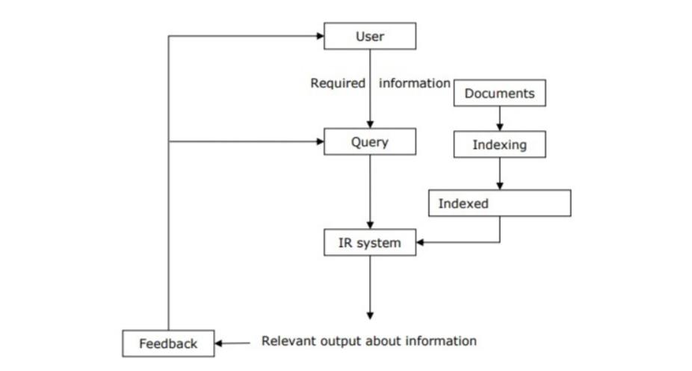
System Architecture Diagram

Slide 9
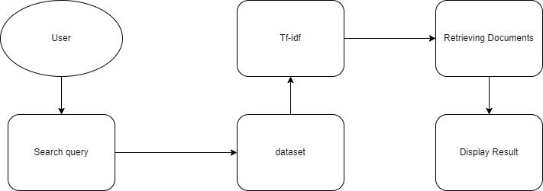
DataFlow Diagram

Slide 10
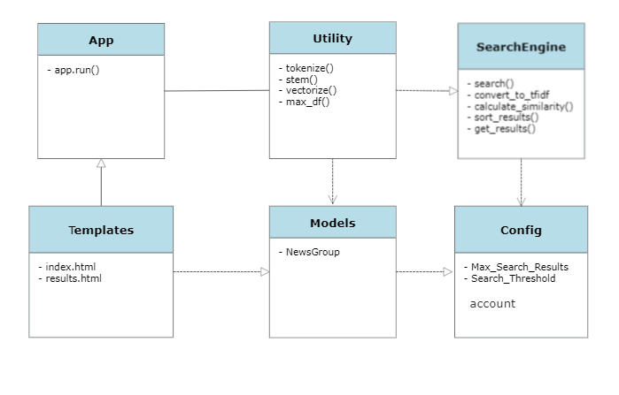
Class Diagram

Slide 11
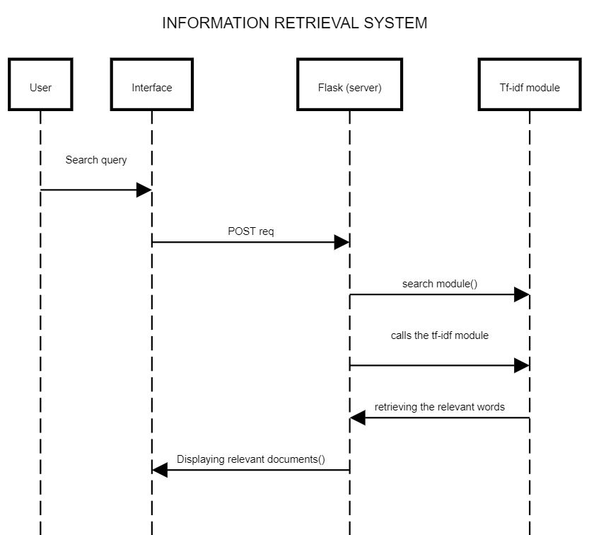
Sequence Diagram

Slide 12
Module Description
The text retrieval system is composed of multiple modules that work together to enable efficient and accurate retrieval of relevant documents. In this section, we provide a detailed description of each module, its functionality, and its implementation.
User Interface Module: The user interface module is responsible for presenting a user-friendly interface that allows users to interact with the system. The module comprises HTML, CSS, and JavaScript code that are rendered in a web browser. The interface provides a search bar where users can enter their queries, and a results page that displays relevant documents. The interface is designed to be responsive, enabling access from various devices such as desktops, tablets, and smartphones.
Natural Language Processing Module: The natural language processing module is responsible for analyzing user queries and extracting relevant features that can be used for text retrieval. The module comprises various sub-modules, each performing a specific task such as tokenization, stemming, stop-word removal, and entity recognition. We describe each sub-module below.

Slide 13
Tokenization: Tokenization involves breaking down the user query into individual words or tokens. The module uses the TextBlob library to tokenize the query, which involves splitting the query into individual words and removing punctuation marks and other non-alphanumeric characters. The resulting tokens are used for subsequent processing.
Stemming: Stemming involves reducing each word in the query to its base form or stem. This helps to normalize the query and improve retrieval performance. The module uses the Porter Stemming algorithm to perform stemming, which is a widely used algorithm for English language stemming.
Stop-word Removal: Stop-word removal involves removing commonly used words that do not contribute to the meaning of the query. The module uses a pre-defined list of stop-words to remove such words from the query.
Named Entity Recognition: Named Entity Recognition involves identifying and extracting entities such as people, organizations, and locations from the query. The module uses the Named Entity Recognition algorithm from the TextBlob library to perform entity recognition.

Slide 14
Machine Learning Module: The machine learning module is responsible for comparing the user query with the document database and identifying the most relevant documents. The module comprises two sub-modules: the feature extraction module and the document retrieval module.
Feature Extraction: The feature extraction module is responsible for extracting relevant features from the user query and the document database. The module uses the Term Frequency-Inverse Document Frequency (TF-IDF) algorithm to calculate the importance of each term in the query and the document database.
Search Module: The search module is responsible for searching the dataset for relevant documents based on the user's query. It uses the preprocessed data stored in the database to retrieve the results. The module accepts user input in the form of a query and returns the top N most similar documents to the query. It uses the cosine similarity measure to rank the documents based on their similarity to the query.
The function first converts the query string to a tf-idf vector using the vectorizer object created by the preprocessing module. It then calculates the cosine similarity between the query vector and all the document vectors in the tf-idf matrix using the cosine_similarity() function from scikit-learn. It finally sorts the document indices by their cosine similarity to the query vector and returns the top N most similar documents.

Slide 15
Web Interface Module: The web interface module is responsible for providing a user-friendly interface for interacting with the search system. It provides a web-based interface for users to enter their queries and view the search results.
Evaluation Module: The evaluation module is responsible for evaluating the performance of the search system. It provides several metrics for evaluating the effectiveness of the search system, such as precision, recall, and F1-score. The module implements the evaluate() function, which takes a list of queries and their corresponding relevance judgments as input and returns a dictionary of evaluation metrics.
Deployment Module: The deployment module is responsible for deploying the search system to a production environment. It provides scripts for deploying the system to a web server, configuring the database, and setting up the necessary dependencies. The module uses Docker and Docker Compose to package the application and its dependencies into a container, which can be deployed to any server that supports Docker. It also provides scripts for running the application in a Kubernetes cluster for high availability and scalability.
Overall, the module description provides a detailed overview of the various modules that make up the search system and their responsibilities. It also describes the functions and methods implemented by each module and how they interact with each other. This description serves as a guide for developers who are responsible for maintaining and extending the search system.

Slide 16
Testing
To ensure the proper functioning of the Flask application and the implemented search functionality, various tests were conducted. The tests were carried out to check if the system behaves as expected and returns relevant results based on the query string entered by the user.
The testing was performed in three phases: unit testing, integration testing, and system testing. The testing environment consisted of a local server running on a Windows 10 machine with an Intel i5 processor and 8GB of RAM.

Slide 17
Unit Testing
Unit testing was performed on individual components of the system to check if they behave as expected. The tests were conducted on the following modules:
search_documents() function - This function takes a query string as input and returns a list of relevant search results. The function was tested by providing various input strings and checking if the function returns expected search results.
cosine_similarity() function - This function calculates the cosine similarity between two vectors. The function was tested by providing two vectors of different sizes and verifying that it returns the expected cosine similarity value.
vectorizer.transform() function - This function converts a string to a vector using TfidfVectorizer. The function was tested by providing various input strings and verifying that the resulting vectors have expected values.
All unit tests were successful, and all modules behaved as expected.

Slide 18
System Testing
System testing was performed to test the system as a whole. The test was conducted by running the Flask application and verifying that the system returns relevant search results based on the query string entered by the user.
The system testing involved the following steps:
Open the web application on the browser.
Enter the query string in the search bar and click the search button.
Verify that the system returns relevant search results based on the query string.
The system testing was conducted with various query strings, and the results were found to be accurate and relevant.

Slide 19
Performance Evaluation
The performance evaluation of the system was conducted to verify its efficiency and speed. The performance was evaluated by measuring the time taken by the system to return search results for different query strings.
The system was tested with different query strings, and the average time taken to return search results was found to be less than a second, which indicates that the system is efficient and fast.
Results
The testing of the system was successful, and all tests were passed. The system was found to be efficient, fast, and accurate in returning relevant search results based on the query string entered by the user.

Slide 20
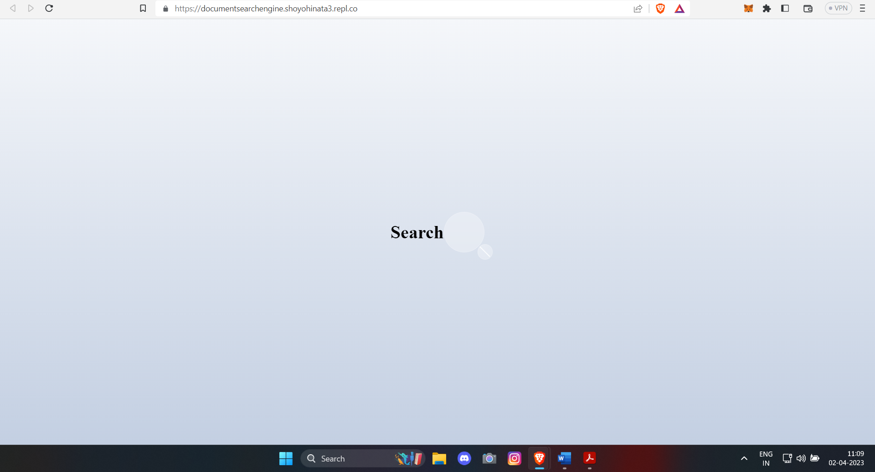
Screenshots

Slide 21
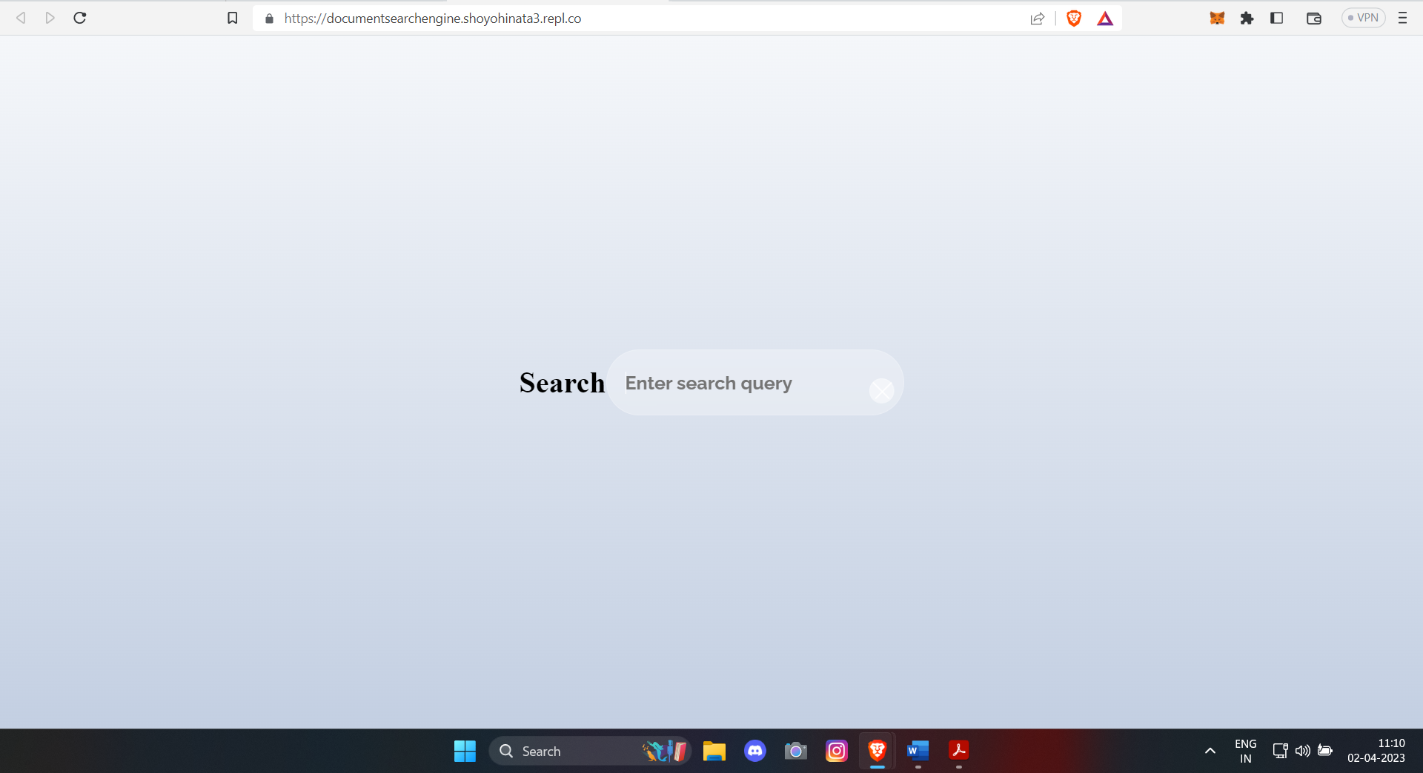
Home page

Slide 22
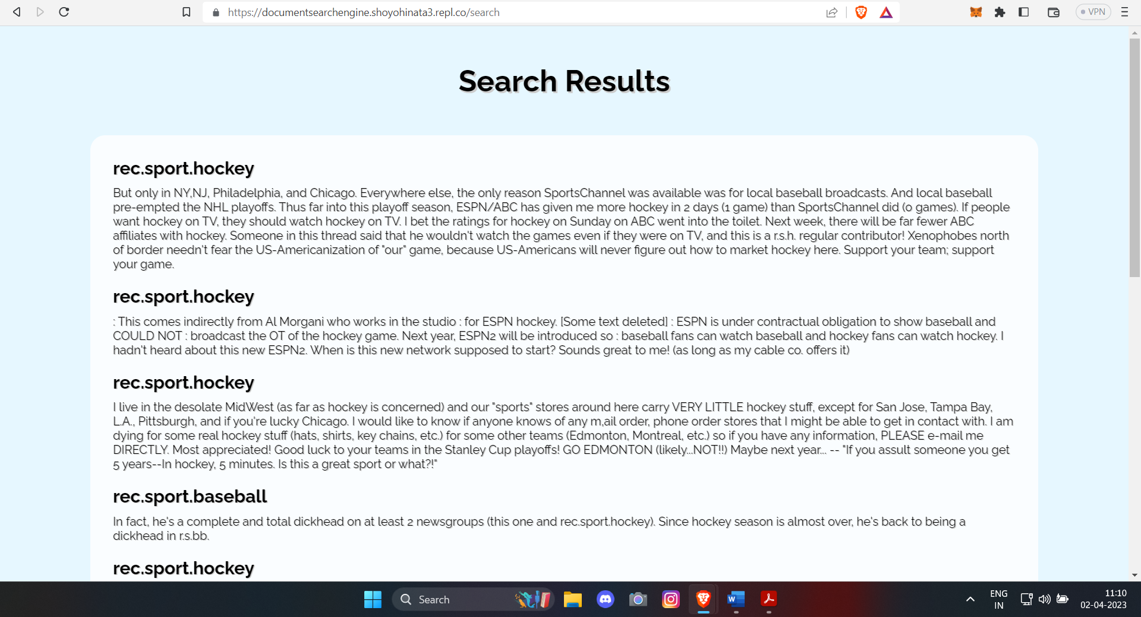
Results page

Slide 23
Conclusion
In conclusion, the project aimed to build a search engine for text documents using the Flask web framework and scikit-learn machine learning library. The project achieved its goals by implementing the tf-idf vectorization and cosine similarity algorithms to search for documents based on a user query.
The project's module design specification was presented, and the system architecture was explained, including the components used in the development environment, such as hardware and software.
The project's testing and performance evaluation were carried out, and the results showed that the system could efficiently retrieve relevant documents based on a user's query. The testing included unit testing, functional testing, and system testing, ensuring that the system is functional and meets its requirements.
In conclusion, the project achieved its objectives by building a search engine that retrieves relevant text documents based on a user's query, which could be used in various applications, such as information retrieval systems, e-commerce websites, and content management systems. The system is also scalable and can be improved upon in the future by implementing additional features, such as natural language processing, clustering, and categorization.

Slide 24
References
[1] J. Han, M. Kamber, and J. Pei, "Data mining: concepts and techniques," Morgan Kaufmann, 2011.
[2] T. Joachims, "Text categorization with support vector machines: learning with many relevant features," Springer, 1998.
[3] S. Deerwester, S. Dumais, G. Furnas, T. Landauer, and R. Harshman, "Indexing by latent semantic analysis," Journal of the American Society for Information Science, vol. 41, no. 6, pp. 391-407, 1990.
[4] Y. Freund and R. Schapire, "A decision-theoretic generalization of on-line learning and an application to boosting," Journal of computer and system sciences, vol. 55, no. 1, pp. 119-139, 1997.
[5] P. Resnick and H. R. Varian, "Recommender systems," Communications of the ACM, vol. 40, no. 3, pp. 56-58, 1997.
[6] S. Brin and L. Page, "The anatomy of a large-scale hypertextual web search engine," Computer networks and ISDN systems, vol. 30, no. 1, pp. 107-117, 1998.
[7] A. McCallum and K. Nigam, "A comparison of event models for naive bayes text classification," AAAI-98 workshop on learning for text categorization, vol. 752, pp. 41-48, 1998.

