Slide 1
SIVASUBRAMANIAN.E 422521205310 B.TECH IT
Final Project

Slide 2
PROJECT TITLE
FACE EMOTION DETECTION
- USING CNN

Slide 3


AGENDA
Emotions play a crucial role in human interactions, influencing communication, decision-making, and overall well-being.
Understanding emotions accurately can lead to more effective human-computer interactions, personalized user experiences, and improved mental health support.
Face emotion detection, a branch of computer vision and machine learning, offers a promising avenue for automating emotional understanding.
3/21/2024 Annual Review

Slide 4

PROBLEM STATEMENT
Despite the importance of emotions in daily life, accurately detecting and interpreting them remains challenging, especially in real-time and diverse contexts.
Traditional methods of emotional analysis, such as self-reporting and manual observation, are often subjective, time-consuming, and prone to biases.
The need for automated, objective, and scalable solutions for emotion detection is evident, particularly in fields like healthcare, education, and marketing.

Slide 5

PROJECT OVERVIEW
Face emotion detection aims to automatically recognize and classify emotions expressed by individuals in images or videos.
This involves identifying facial expressions, such as happiness, sadness, anger, fear, disgust, and surprise, among others.
Challenges include variations in facial expressions across cultures, ages, genders, and environmental conditions, as well as occlusions and subtle nuances in expression.

Slide 6

WHO ARE THE END USERS?
Psychologists and Researchers
Healthcare Professionals
Educators and Trainers
Customer Experience Analysts

Slide 7

YOUR SOLUTION AND ITS VALUE PROPOSITION
CNN Utilization: Leveraging Convolutional Neural Networks (CNNs), our solution is optimized for detecting a wide range of facial expressions, benefiting from their ability to automatically learn hierarchical features from images.
Real-Time Inference: Our solution enables real-time emotion detection from live or recorded facial video streams, facilitating timely analysis and response in applications such as interactive interfaces, video analytics, and surveillance systems.
Value Proposition: By offering high accuracy, real-time performance, enhanced user experiences, versatility, and a commitment to continuous improvement, our CNN-based face emotion detection solution adds significant value across various domains and use cases, enhancing engagement, satisfaction, and understanding.

Slide 8

THE WOW IN YOUR SOLUTION
Unprecedented Accuracy: Our CNN-based solution achieves unmatched precision in facial expression detection. Through extensive training on vast datasets, it accurately captures subtle facial cues, ensuring precise emotion recognition.
Real-Time Performance: Unlike conventional methods prone to latency, our solution delivers instant emotion detection. With optimized model architecture and efficient deployment, it swiftly analyzes facial expressions for responsive applications.
Adaptability and Generalization: Our solution's robustness extends to diverse environments, demographics, and lighting conditions. It adeptly detects emotions across varied scenarios, showcasing exceptional adaptability and generalization
3/21/2024 Annual Review
8

Slide 9
MODELLING
Teams cam add wireframes
Frameworks:
NumPy
Pandas
Seaborn
Matplotlib
OpenCV (cv2)
TensorFlow
Keras
Model:
Convolutional Neural Network (CNN) implemented using Keras.Sequential model with layers:
Conv2D
MaxPooling2D
Dropout
Flatten
Dense
9

Slide 10
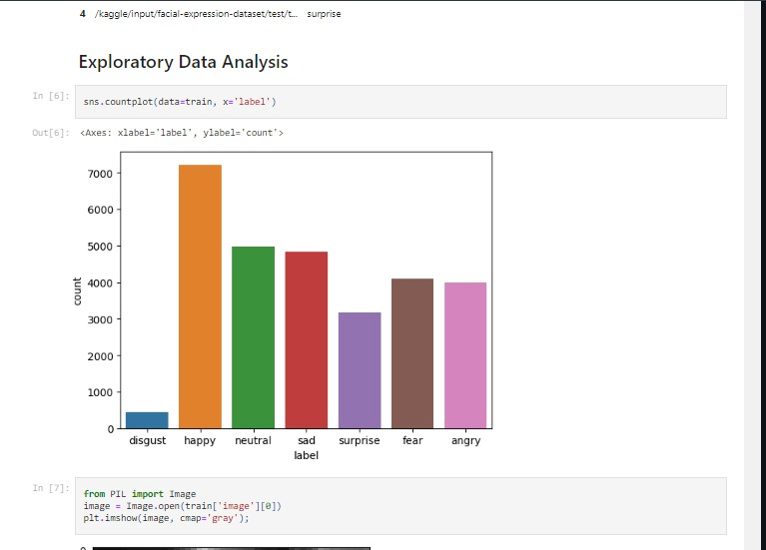
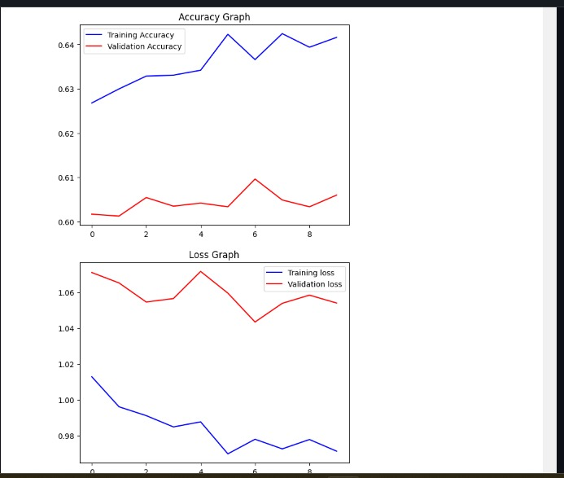
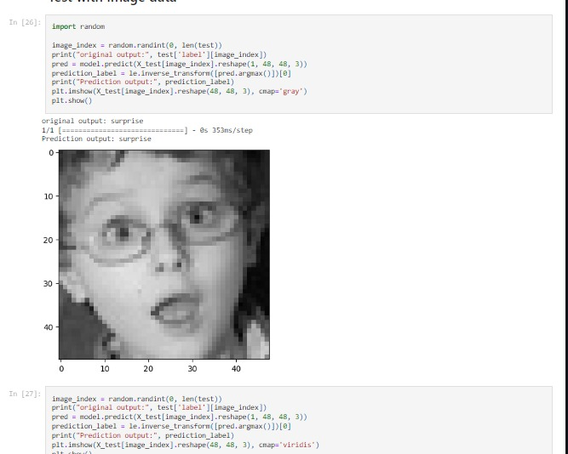
RESULTS
Github: https://github.com/SIVASUBRAMANIAN-E/TNSDC_Genai.git
10

