Slide 1
AI-Based Wild Animal Detection and Deterrent System
Guided by:
PROJECT BY:
Mr. R. Varun Prakash BE, ME, (PhD)
Sivabalan R 23BEC120
Abinesh M A 23BEC093

Slide 2
Problem Description:
Animal intrusion is a major issue in agricultural and residential areas
Wild boars cause severe crop damage in rural areas
Traditional methods like fencing and manual guarding is inefficient and risky
Existing deterrents are not adaptive or intelligent
Need for an intelligent, automated, and reliable monitoring system

Slide 3
Objective:
Develop a vision-based AI system for animal intrusion detection
Use computer vision for real-time monitoring
Provide instant alerts to users
Trigger automated deterrent system
Build low-cost prototype solution

Slide 4
Proposed Solution:
Use YOLO model for real-time detection
ESP32-CAM for live video capture
Flask GUI for monitoring
ESP32-WROOM for hardware control
Adaptive sound-based deterrent system
If animal is detected:
Send alert notification to user
Activate sound system to scare animals

Slide 5
Software Requirements:
Python (Flask)
YOLO (Ultralytics)
Arduino IDE
Serial Communication
Gmail SMTP (email alert)

Slide 6
HARDWARE COMPONENTS
Component | Purpose
ESP32-CAM | Video capture
ESP32-WROOM | Hardware control
Piezo buzzer | Deterrent sound
LED | Detection indication
Laptop | AI processing

Slide 7
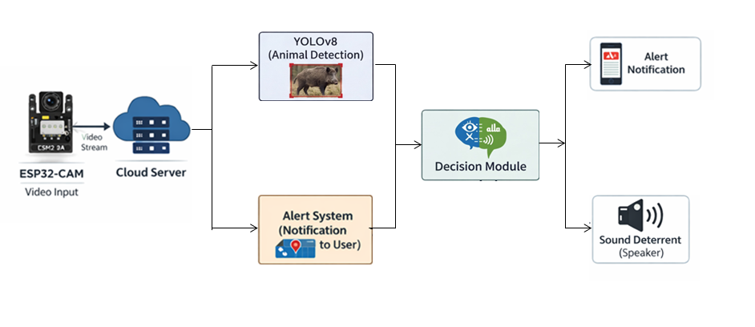
System Architecture:

Slide 8
WHY YOLO?
Real-time detection
Faster than traditional CNN methods
High accuracy
Single-pass detection
Lightweight enough for live video

Slide 9
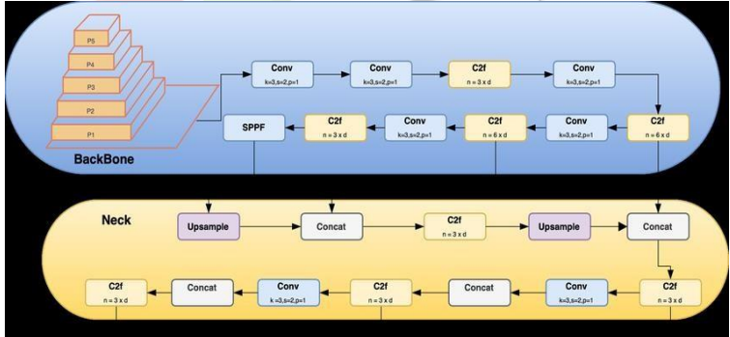
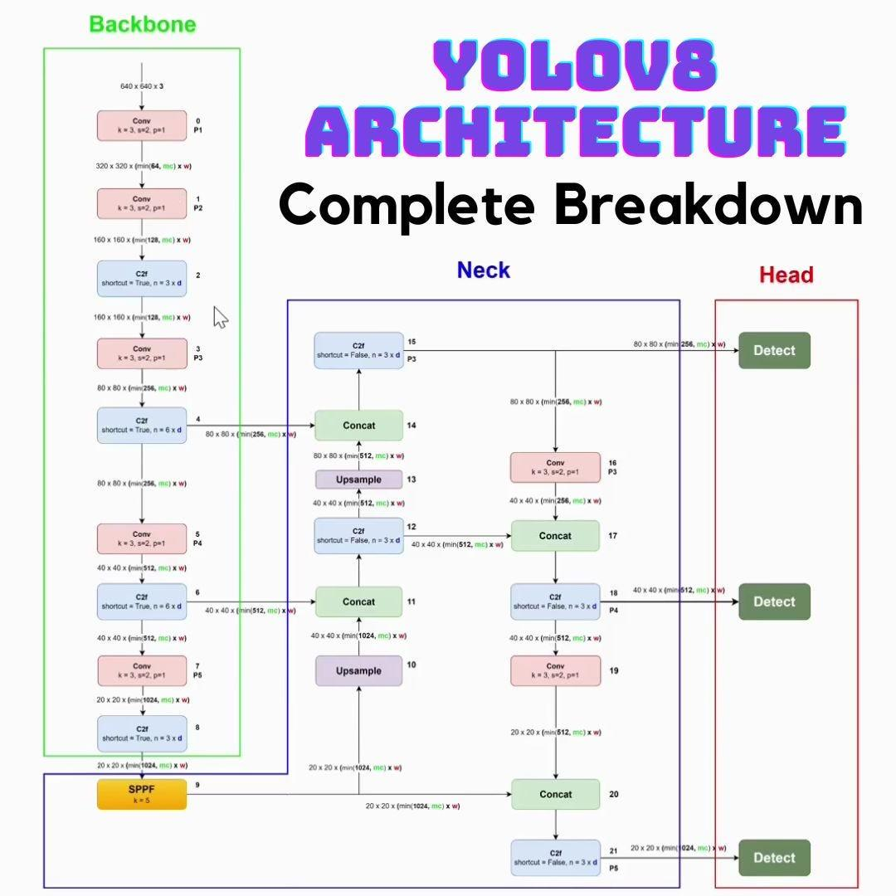
YOLO Architecture

Slide 10
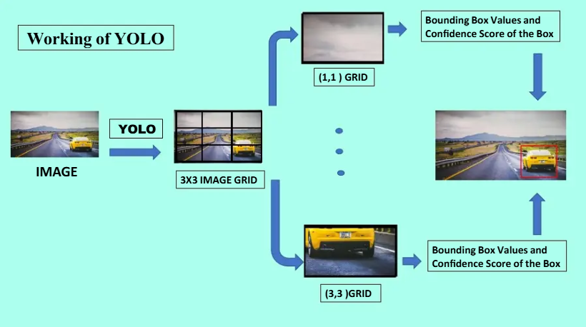

Slide 11
How model Works ?
Camera captures live video
YOLO model detects pig
GUI displays detection
Signal sent to ESP32
Deterrent system activated
Email alert sent

Slide 12
Dataset & Training
Dataset contains wild boar/pig images ~1800
Images collected from online datasets and custom sources
Trained using YOLOv8 model
Training performed using Google Colab
Model optimized for real-time detection
Epochs ~ 50

Slide 13
MODEL PERFORMANCE
Metric | Value
Precision | 0.85
Recall | 0.83
mAP50 | 0.89
 | Predicted Animal | Predicted Non-Animal
Actual Animal | 90 (TP) | 10 (FN)
Actual Non-Animal | 12 (FP) | 68 (TN)

Slide 14
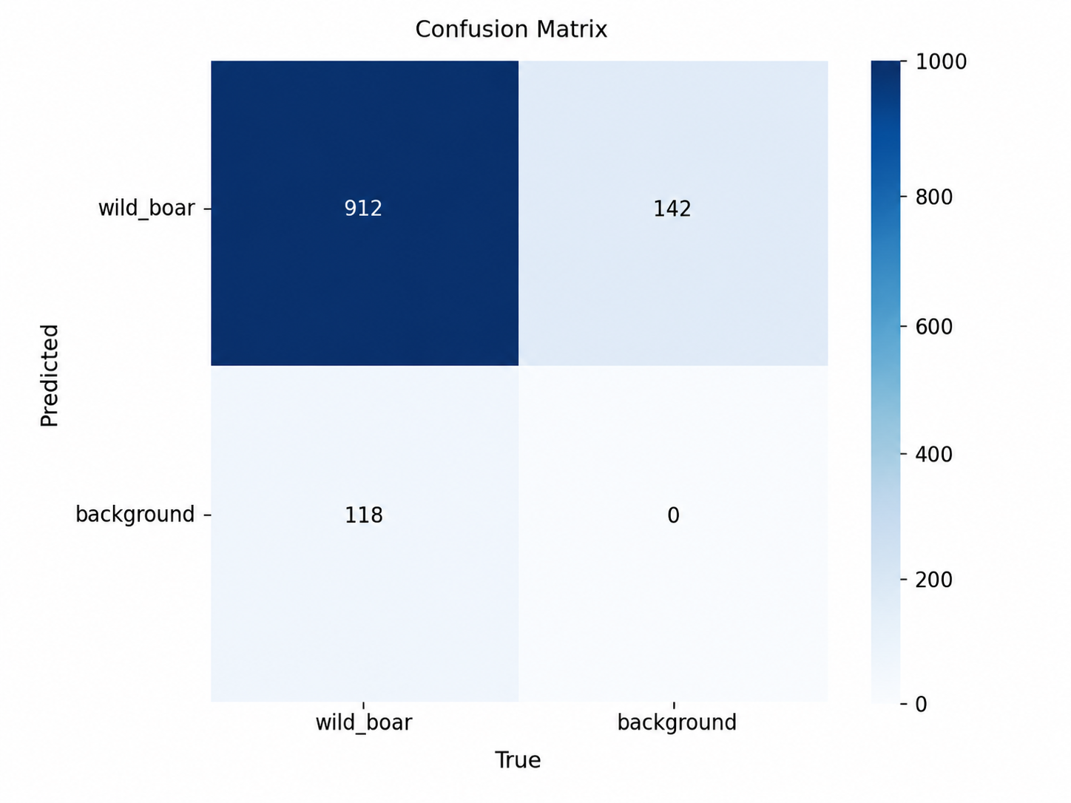

Slide 15
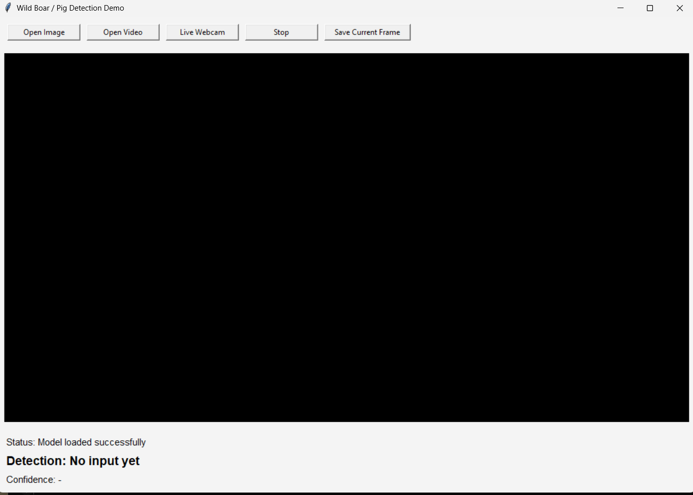
Implementation / GUI
Supports:
Image input
Video input
Live webcam
Displays:
Detection status
Confidence level
Bounding box output
Option to save detected
frame

Slide 16
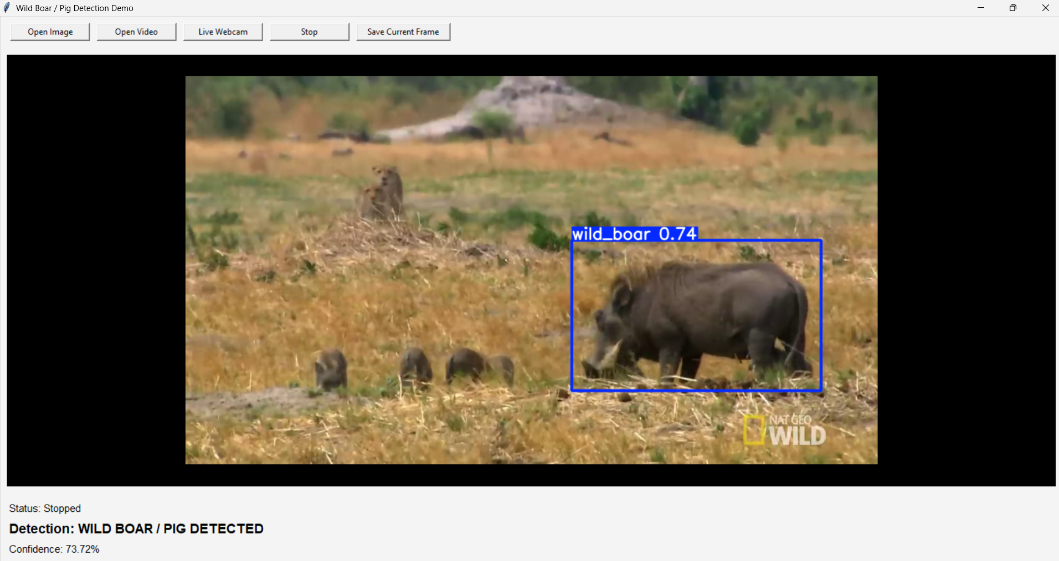
Output Results
Model detects pig with bounding box
Displays confidence score
GUI updates detection status
Example:
“Pig Detected” shown on screen
Confidence: ~74%
Works in real-time video/webcam

Slide 17
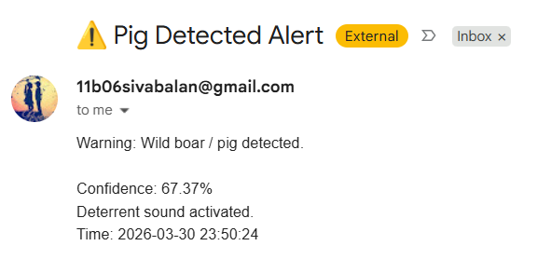
Alert & Deterrent System
LED indicates detection
Buzzer generates frequency variation
Laptop plays predator sound
Continuous deterrent until object disappears
Email alert sent to user

Slide 18
Future scope:
Use high-power ultrasonic transducers
Edge AI deployment (Jetson Nano / Raspberry Pi)
Solar-powered system
Mobile app integration
Multi-animal detection

Slide 19
CONCLUSION

Slide 20
THANK YOU

Slide 21
LIMITATIONS
Performance depends on lighting conditions
Current system uses standard buzzer instead of true ultrasonic emitter
Requires stable WiFi connection

