Slide 1
Project Mira
AI-Powered Project Intelligence Assistant
Capstone Project | Applied Agentic AI for PMs / TPMs
Sivakumar Ganesan
Nexora Pvt. Ltd. • Client: ABCDE Ltd.

Slide 2
The Problem
3–4 hours
spent creating structured project plans from scratch
1–2 hours / week
compiling status reports from raw task boards
Inconsistent risks
ad-hoc assessments, critical blockers found too late
No grounding
manual work depends on individual memory and fatigue
Project Mira | Capstone | 2

Slide 3
Solution Overview
Mira is a multi-agent project intelligence assistant that turns project data into grounded, auditable artifacts in seconds.
Project Plan
Generation
Risk
Assessment
Weekly Status
Reporting
Built with: n8n • GPT-4o-mini • Langfuse • Google Drive
Key Design Principles: Grounding • Refusal of vague inputs • Full observability
Project Mira | Capstone | 3

Slide 4
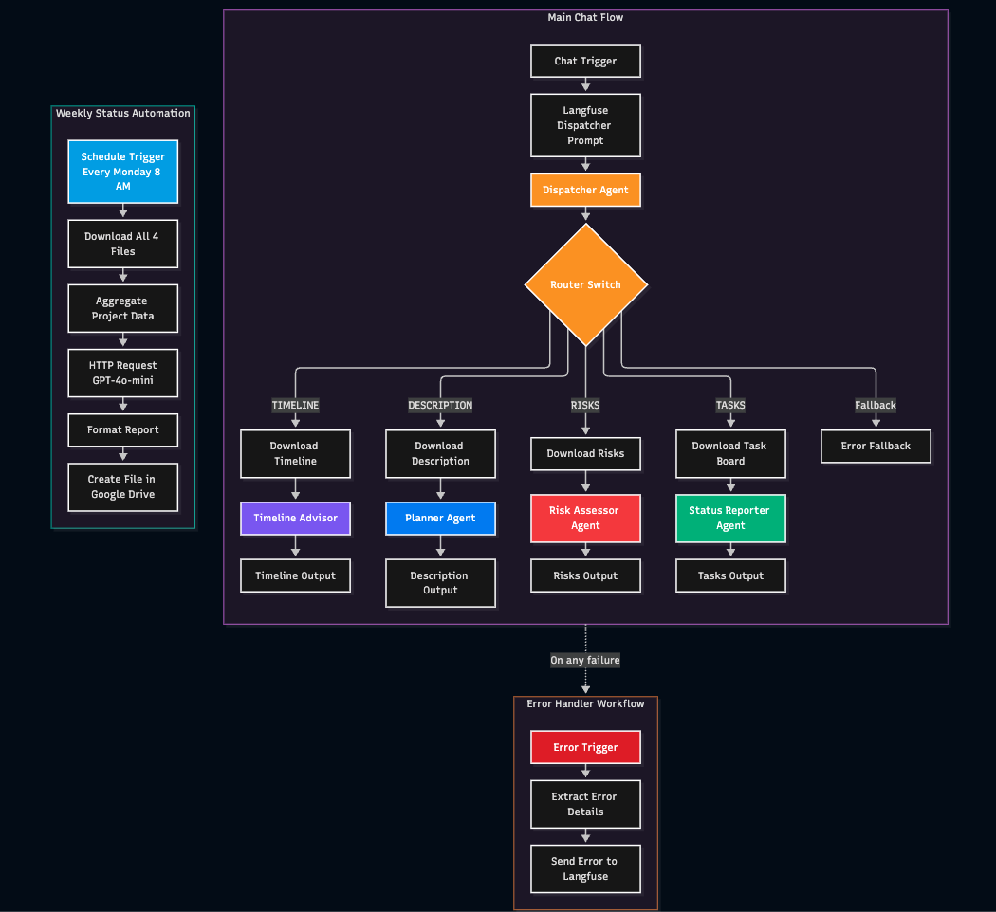
Architecture – Router Pattern
Project Mira | Capstone | 4

Slide 5
Guardrails & Trust Mechanisms
1. Vague Input Refusal
T2, T4, T6, T9 correctly ask for clarification instead of inventing content
2. Direct File Grounding
Each specialist agent receives only the relevant source file — no cross-contamination
3. Blocker Detection
Status agent must surface blocked task T024 (security review)
4. Full Observability
Every generation traced in Langfuse with tokens, cost, latency, and I/O
5. Error Handler
Separate workflow captures failures and logs them to Langfuse
Project Mira | Capstone | 5

Slide 6
Baseline Evaluation Results
12
11
1
~2s
Tests Run
Pass
Partial
Avg Latency
Key Highlights
• Vague Input Rejection (T2, T4, T6, T9): 4/4 (100%) — major improvement after guardrail updates
• Blocker Detection (T8): Correctly identified T024 as Blocked
• Core capabilities (Plan, Risk, Status): Produce usable grounded output
• Known gaps: T10 exact counts & T7 top-3 ranking still imperfect — documented honestly
Project Mira | Capstone | 6

Slide 7
Cost Analysis & Production Metrics
Cost per Run
3 Production Metrics
~$0.000069
1. Output Groundedness (≥95%)
2. Vague Input Rejection (100%)
3. Status Accuracy / Blockers (100%)
GPT-4o-mini • ~205 tokens/run
1 user × 15 queries/day ≈ $0.02 / month
Even at team scale, LLM cost is negligible compared with 3–4 hours of manual planning time saved per project.
Source: Actual Langfuse traces collected during baseline testing
Project Mira | Capstone | 7

Slide 8
What Worked & What Broke
✓ What Worked
✗ Still Limited
• Router pattern fit the varied request types
• T10 exact deterministic counts incomplete
• Vague-input guardrails (after updates)
• T7 top-3 risk ranking inconsistent
• Fast responses (~2s) + very low cost
• Occasional mis-routing to wrong agent
• Langfuse observability on every run
• Specialist prompts needed careful tuning
• Blocker detection (T024) worked reliably
• File injection can override vague refusal
• Core plan / risk / status generation usable
• Chose stability over chasing perfect scores
Project Mira | Capstone | 8

Slide 9
Key Learnings
01
Guardrails need dual placement
Both Dispatcher and specialist agents need refusal rules — one is not enough.
02
Direct grounding works for small data
Passing the relevant CSV/TXT is simple and effective when datasets are small and structured.
03
Observability is non-negotiable
Langfuse traces made routing and grounding failures visible and fixable.
04
Honesty beats perfection
Documenting known gaps is stronger than breaking working flows to chase 100% scores.
Project Mira | Capstone | 9

Slide 10
Project Mira
Grounded • Observable • Cost-efficient
Thank you
Questions?

