Slide 1

Dynamic Customer Segmentation in Retail using Clustering
Siyabulela Malinga
Project Site
4370961@myuwc.ac.za
University Of The Western Cape
Notes:
Good day. This presentation is about Dynamic customer segmentation in retail using clustering.

Slide 2
outline
Background and Introduction
Literature review
Aim & Objectives
Proposed Methodology (incl. Dual Dataset Approach, Extended Segmentation Layers, Interface Development)
Potential Outcome
Timeline
Acknowledgements
References
Notes:
This slide shows the structure of the presentation. I will start with the background, then move to the literature review, aim and objectives, methodology, expected outcomes, timeline, acknowledgements and references.

Slide 3
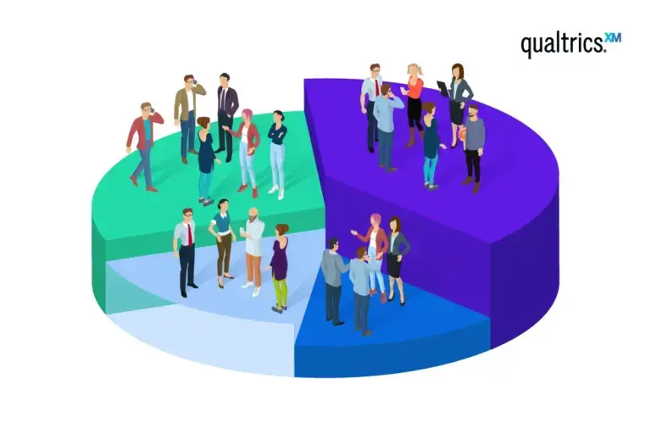
Background
Customer Segmentation: Dividing a business’s customers into distinct groups based on shared
characteristics, behavior :
To tailor marketing strategies [1].
Improve consumer satisfaction and loyalty [1].
Enhanced business’s competitiveness [2].
Types of segmentation
Figure 1: Customer segmentation visualization
Geographic segmentation (location, region, and city/town/state).
Demographic segmentation (age, gender, occupation, and socio-economic group).
Behavioral segmentation (benefits sought, loyalty status, readiness to buy, and early adopters) .
Psychographic segmentation (lifestyle, attitude, education level, class, and personality) [1].
Firmographic segmentation (Industry/sector, Company size, Business location, Company age, Ownership type ).
Notes:
Customer segmentation means dividing customers into smaller groups based on shared characteristics or behaviour. The slide also shows common segmentation types such as geographic, demographic, behavioural, psychographic and firmographic segmentation. The main idea is to help the business understand customers better and target them more effectively.

Slide 4
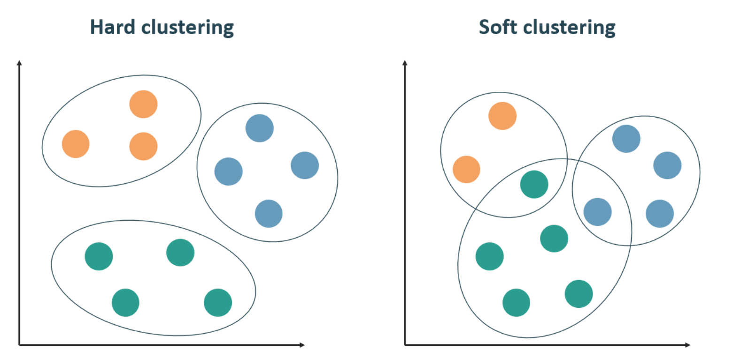
Clustering
Clustering is one of the main techniques used in Unsupervised learning which is a type of machine learning where the algorithm works with data that has no known categories or outcomes [2,5].
In hard clustering, each data point belongs to exactly one cluster. Membership is binary either a point is in a cluster or it isn’t [5].
Soft clustering assigns probabilities or degrees of membership to multiple clusters for each data point [2].
This study will mainly use soft clustering approach.
Figure 2 : Clustering types comparison visualization

Slide 5
Summary of literature
Table 1 : Overview of related work on clustering techniques
Ref | Main Focus / Topic | Dataset Used | Methodology / Model Used | Key Findings / Contributions | Limitations / Gaps Identified
H. Şentürk et al. (2024) [3] | Retail customer profiling using clustering methods. | Textile retail e-commerce dataset with 38,975 customers over one year. | RFM scoring with K-means, AGNES, and DBSCAN. | Demonstrates that conventional clustering can identify practical customer groups such as loyal, potential, new, and lost customers. | Snapshot-based and conventional; does not adapt continuously over time.
S. Sobantu and O. E. Isafiade (2025) [4] | Dynamic customer segmentation for automating continuous transactional updates. | South African pharmacy retail transactional dataset (55,150 records; 7 variables). | Cascaded RFM, Modified Dynamic Fuzzy C-Means (MDFCM), Crespo’s Dynamic Fuzzy C-Means (CDFCM). | proposes a cascaded RFM-based dynamic segmentation framework and shows MDFCM improves as the number of clusters increases. | Customer segmentation in this study remains static and does not fully demonstrate how customer segments change over time.
M. Alves Gomes and T. Meisen (2023) [5] | Review of customer segmentation methods for personalized targeting in e-commerce. | Literature review of 105 publications (2000-2022). | Structured review of segmentation process, variables, algorithms, and evaluation practices. | Strong review anchor showing that segmentation literature is dominated by RFM, manual feature handling, and clustering approaches such as k-means. | Review study only; does not propose a single dynamic segmentation framework.
(continued)
Notes:
This table summarises the first group of studies reviewed. Most studies use RFM and clustering methods such as K-means, AGNES and DBSCAN. The key gap is that many of these methods are static and do not update continuously over time.

Slide 6
Summary of literature cont.
Table 1 (continued)
Ref | Main Focus / Topic | Dataset Used | Methodology / Model Used | Key Findings / Contributions | Limitations / Gaps Identified
B. Türkmen (2022) [6] | Machine learning for customer segmentation in online retail. | Online retail data. | K-means, Hierarchical Clustering, DBSCAN, and traditional RFM-based grouping. | Provides a comparative view of unsupervised retail segmentation methods and their practical marketing usability. | Mainly static and comparative; does not solve continuous adaptation over time.
N. N. Son et al. (2025) [7] | Geodemographic market targeting in major localized cities. | Vietnam demographic dataset covering 11,165 administrative units. | Principal Component Analysis (PCA), K-means clustering, geodemographic modelling. | Supports the argument that segmentation can move beyond basic RFM and include richer contextual demographic variables. | Relies mainly on demographic and census-type data; lacks transactional and behavioral updating.
C. P Ufeli et al. (2025) [8] | Customer segmentation with mixed-type variables using dimensionality reduction. | Retail dataset with 3,900 customers. | Factor Analysis of Mixed Data (FAMD), K-means, Agglomerative Clustering. | Shows that mixed numerical and categorical customer variables can improve segmentation quality and reveal richer customer groups. | Still a static clustering setup; does not address real-time or continuous updating.
(continued)
Notes:
This table summarises the first group of studies reviewed. Most studies use RFM and clustering methods such as K-means, AGNES and DBSCAN. The key gap is that many of these methods are static and do not update continuously over time.

Slide 7
Summary of literature cont.
Table 1 (continued)
Ref | Main Focus / Topic | Dataset Used | Methodology / Model Used | Key Findings / Contributions | Limitations / Gaps Identified
A. Ashraf et al. (2025) [9] | Framework for customer segmentation to improve marketing strategies. | Online retail dataset. | RFM features with K-means, Mini-Batch K-means, Spectral Clustering, and Fuzzy K-means. | Useful framework-oriented source linking customer segmentation directly to marketing decision support. | Remains centered on conventional static clustering over RFM features.
C. Rungruang et al. (2024) [10] | Interpretable RFM-based customer segmentation. | Online Retail II dataset (UCI Machine Learning Repository). | RFM model combined with Formal Concept Analysis (FCA). | Useful for feature engineering and RFM extension because it improves interpretability and knowledge representation. | Still limited by the traditional RFM structure and is not fully dynamic.
R. Sharma et al. (2023) [11] | Broad review of e-commerce and digital transformation, covering trends, consumer behavior | Secondary data from academic journals, government reports, industry publications, and economic analyses, framed around the Indian economy. | Mixed-method study combining qualitative and quantitative secondary-data analysis | Shows that digital transformation can improve operational efficiency, market reach, and customer experience. | no primary transactional dataset or cluster-validation experiment is reported, and the scope is partly India-centered.
(continued)
Notes:
This continued table shows more recent studies. These studies add richer variables, mixed data types and different clustering approaches. However, many still focus on static segmentation rather than continuous customer movement.

Slide 8
Summary of literature cont.
Table 1 (continued)
Ref | Main Focus / Topic | Dataset Used | Methodology / Model Used | Key Findings / Contributions | Limitations / Gaps Identified
R. S. Cordova (2024) [12] | Big-data-driven customer segmentation in online retail. | Online Retail Ecommerce Dataset; UK-based retailer transaction data | Descriptive analytics, data cleaning, feature engineering, exploratory data analysis, descriptive statistics, and K-means clustering in Python. | Shows that online retail transaction data can support practical customer segmentation; identifies country, product, hourly, daily, and monthly sales patterns, and finds that some clusters have higher sales frequency and sales value. | Claims dynamic, real-time, and demographic-rich segmentation, but the implemented study is mostly static and transaction-based; no true streaming or online update mechanism is shown.
M. Sivaguru and M. Punniyamoorthy (2020) [13] | Dynamic customer segmentation using a modified dynamic fuzzy c-means (MDFCM) clustering algorithm. | Retail supermarket dataset with eleven new data updates. | compares MDFCM against CDFCM and FDFCM; validates using Xie-Beni, WSSE, RMSE, Kwon, and Tang indices. | Finds that MDFCM is the most effective algorithm among the compared methods for DCS and demonstrates its usefulness through a proposed dynamic customer segmentation framework. | The study tested MDFCM using only one retail supermarket dataset with only 11 time cycles/updates. Because of this, the results do not fully prove that MDFCM will work well in many other industries or larger customer datasets. it did not strongly show how managers can interpret clusters for marketing decisions.
This study | Customer segmentation in online retail sector | SoCosmetic Retail Business Dataset and UK-based retailer transaction data | Cascaded RFM, K means, MDFCM | Study still in progress | Study still in progress
Notes:
In This part of the summary of literature we find dynamic and big-data-related studies. It shows that dynamic fuzzy clustering is useful for updating customer segments. And we also position this study as a work in progress using Cascaded RFM, K-means and MDFCM.

Slide 9
Related Work
Feature Representation Methods
Customer representation in segmentation is achieved by constructing and organizing variables that capture meaningful patterns in customer behavior and improve the quality and interpretability of clustering results [5], [7].
RFM Representation (Recency, Frequency, Monetary Value) RFM is the most widely used customer representation framework in retail segmentation because it converts transaction histories into interpretable behavioral indicators describing how recently a customer purchased, how often they buy, and how much they spend [3], [5], [6], [9].
Cascaded RFM Representation - Cascaded RFM was chosen to overcome the static nature of traditional RFM and better support continuous customer updates in dynamic segmentation [4].
Mixed-Type Representation Using FAMD - FAMD was chosen because it can represent customers using both numerical and categorical variables, enabling richer profiling [8].
PCA-Based Representation - PCA was chosen to reduce redundancy among correlated variables and create a more compact representation before clustering [7].
FCA-Based Representation - FCA enhances the interpretability of customer representation by organizing feature relationships and segment structures in a more explainable way [10].
Notes:
In related retail studies . RFM is the main feature representation method because it describes how recently, how often and how much customers buy. Other methods such as cascaded RFM, FAMD, PCA and FCA help make the customer profile richer and more understandable.

Slide 10
Segmentation Methods
Related Work cont.
Table 2 : Overview of segmentation methods in recent studies
K-means | K-means is the most frequently used segmentation method across the reviewed studies and is widely applied in retail customer segmentation because it is simple, efficient, and effective for partitioning customers into distinct groups based on similarity [3], [6], [8], [9].
Fuzzy C-Means (FCM) approach | Fuzzy clustering allows customers to belong to multiple groups with different degrees of membership, making it more flexible than hard clustering. In the reviewed literature, this is especially important in dynamic settings, where MDFCM is used to update clusters as new transactional data arrives over time [4].
Hierarchical clustering | Hierarchical clustering is used to reveal layered or nested customer group structures and is often applied alongside other clustering methods for comparison or interpretability [6], [8], [10].
RFM-based / Threshold-based Segmentation | Commonly used as a baseline customer grouping approach, but often limited by static rules and manual thresholds [3], [4], [5], [6], [10].
Notes:
summarises the segmentation methods found in the literature. K-means is commonly used because it is simple and effective. Fuzzy clustering is more flexible because customers can have degrees of membership, which is useful for dynamic segmentation.

Slide 11
Limitations of Conventional Segmentation Models
Constrained Variables: Despite its efficiency, the standard RFM model is constrained to only three factors and does not naturally disclose segments based on crucial demographic characteristics and long-term purchase history [3], [4].
01
Static, Rigid Thresholds: Existing literature highlights that traditional RFM models often oversimplify customer behavior by relying on user-defined threshold parameters that fail to update seamlessly over an unlimited number of time cycles [3].
02
The Need for Automation: There remains a significant gap in creating completely automated approaches for Dynamic Customer Segmentation (DCS) that eliminate the need for manual intervention when building and updating models [3], [4].
03
Notes:
This slide highlights three limitations of conventional segmentation. Standard RFM uses only three variables
traditional thresholds can be rigid,
and customer segmentation systems still use manual updates.
These limitations support the need for a more automated and dynamic approach.

Slide 12
AIM & Objectives
Problem: While traditional segmentation heavily relies on static demographic and geodemographic models to target generalized local and national markets [6], modern retail requires continuous, behavioral tracking to stay competitive [4].
Aim: Promoting Dynamic Customer Segmentation in the retail sector by moving beyond static,
snapshot-based analysis towards a real-time, automated understanding of consumer behavior.
objectives
Develop Cascaded Framework: To design and implement a system that integrates the baseline RFM model with continuous behavioral and demographic variables, successfully moving beyond the constraints of static numerical coding [3].
Enhance Marketing Strategy: To provide the resulting adaptive system through an interface that simulates customer segmentation from different potential economic scenarios and allows retailers to anticipate and respond to shifting consumer trends, ultimately optimizing customer retention and personalized value delivery.
Notes:
Aim and objectives The problem is that traditional segmentation is often static, while modern retail needs continuous tracking of customer behaviour. The aim is to promote dynamic customer segmentation that updates over time. The objectives focus on building a cascaded framework and supporting better marketing decisions through an interface.

Slide 13
Methodology
Feature Engineering Cascaded RFM Aggregation
Dual Data Exploration Raw customer transaction data
Data Cleaning Remove missing, duplicate, and invalid records
Time Slicing Split data into chronological batches
Database Creation
Customer profile table
Time Cyle results table
Data Preprocessing Log Transformation &
Standardization
Data Synthesis
Generating Geographic and Demographic variables
Synthesized data integration with customer Profile
Dynamic Loop until nth cycle iteration
Dashboard Interface
Model Evaluation
Xie Beni Index
Migration rare
Segment change
+
Final Segments Produce adaptive customer groups
Model Evaluation
Dynamic Updates Use MDFC for sequential cluster adaptation
Initial K-means Build the starting cluster structure
Results to database
Results to database
Psychographic segmentation
Pyschographic segmentation
Figure 3 : Diagram of the methodology steps
Notes:
The methodology kicks of with dual data exploration, data cleaning , time slicing , feature engineering , other data preprocessing steps , and now them model development stelps
And finally produces final clustered segments with dashboard interface

Slide 14
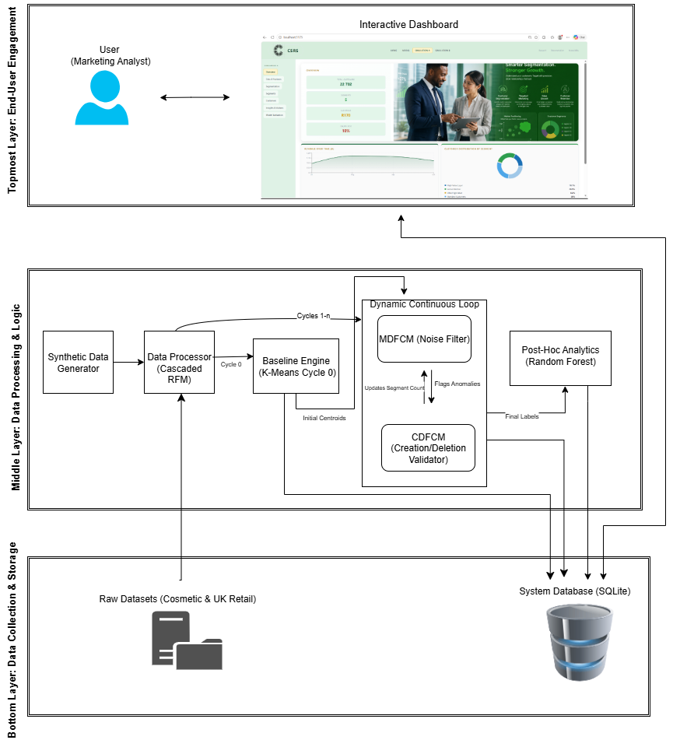
System Architecture
Top most layer
End User Engagement
Middle Layer
Data Processing & logic
MDFCM Cluster
Bottom layer
Data Collection & storage
Notes:
Shows the complete Customer Segmentation pipeline from raw datasets to dashboard insights.
Separates the system into data storage, processing/model logic, and user engagement layers.
K-means creates Cycle 0 baseline clusters, while MDFCM update segments dynamically.
The database stores segmentation results, customer states, migration records, and evaluation scores.

Slide 15
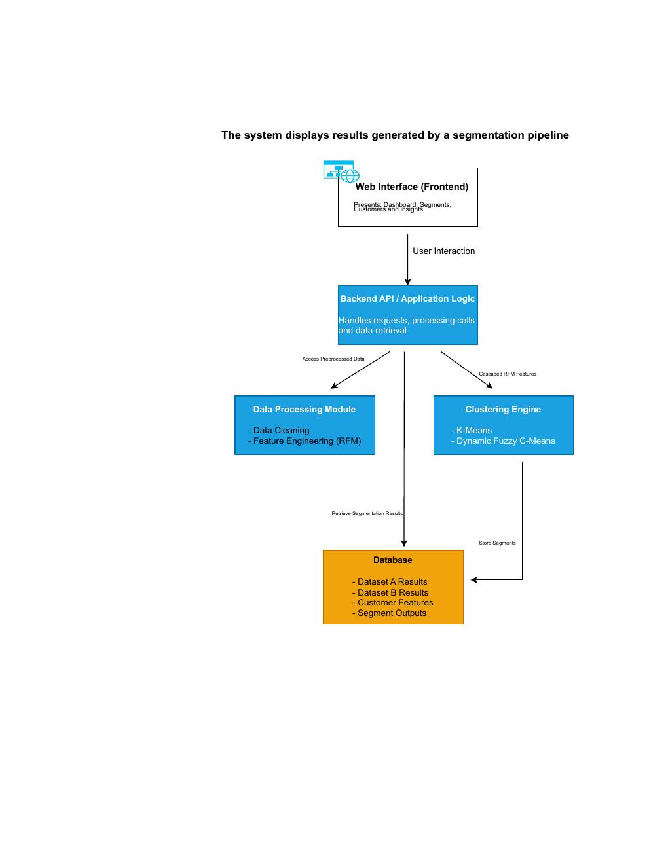
Component Diagram (Summarised Steps)
Shows the technical components of the Dynamic Customer Segmentation system.
The frontend displays dashboards, segments, customers, and insights.
The backend manages requests, processing calls, and data retrieval.
Data processing creates RFM features, while the clustering engine produces segment outputs.
The database stores customer features, model results, and final segment outputs.
Notes:
This diagram breaks the system into its main technical components. The frontend presents the dashboard and customer insights, while the backend handles requests and connects the interface to the processing modules. The data processing module prepares the features, the clustering engine performs segmentation, and the database stores the customer features and segment outputs.

Slide 16
Sequence diagram
System Loop: The main Python controller iterating through the months.
Data Processor: Handles the Cascaded RFM logic, log transformations, and scaling.
K-Means Engine: The static algorithm used only for Cycle 0.
Hybrid Dynamic Engine: The combined MDFCM logic.
RF Analytics: The Random Forest model for feature importance.
Database: SQLite storage.
Notes:
This sequence diagram shows how the system runs month by month.
The Python controller manages the loop,
the data processor prepares RFM features,
K-means handles the first cycle,
and the hybrid dynamic section source code updates later cycles.
The database stores everything for later use.

Slide 17
Methodology
17
Pipeline A – Dataset A Cosmetic Retail
Dual Data Exploration Raw customer transaction data
Data Collection ➔ Cleansing ➔ Dynamic Time Slicing ➔ Cascaded RFM Feature Engineering ➔ Data Synthesis (Injecting Geographic, Demographic, & Psychographic profiles) ➔ K-Means Model ➔ Dynamic Loop (MDFCM Model) ➔ Evaluation measures➔ Dashboard Output
Dataset A – Cosmetic Retail business (Simulation A)
Dataset B – UK Online Retail / UCI (Simulation B)
B2C
B2B
Pipeline A – Dataset B UK Online Retail
Geographic, Demographic, Behavioral and Psychographic segmentation
Firmographic segmentation
Data Collection ➔ Cleansing ➔ Dynamic Time Slicing ➔ Cascaded RFM Feature Engineering ➔ K-Means Model ➔ Dynamic Loop (MDFCM Model) ➔ Evaluation measures➔ Dashboard Output
Pipeline A
Pipeline B
Figure 3 : Diagram of the methodology steps
Notes:
This slide introduces our dual dataset approach in the methodology.
Dataset A represents a cosmetic retail business dataset,
while Dataset B is the online wholesalers retail dataset.
The two pipelines allow the study to compare customer segmentation in different retail contexts.

Slide 18
Dual Dataset Approach
The model is applied to two separate retail datasets.
Dataset A – Cosmetic Retail SA business (Simulation A)
Cosmetic South African retail point-of-sale transaction records covering Jan to Dec 2024.
206148 transaction records | 22,702 unique customers
Business relationship type : B2C (business to everyday consumers)
Data Synthesis
4 demographic variables: Name, contact details, ID number and Gender
Geographic variable: Residential address or Region
Psychographic variables
Dataset B – UK Online Retail (Simulation B)
UK-based non-store online retail transaction records from 01/12/2010 to 09/12/2011.
541,909 transaction records | 4,339 unique customers
Business relationship type : B2B (business to business)
Notes:
Here, the two datasets are explained in more detail. Dataset A is a South African cosmetic retail simulation with customer transactions and synthesized profile variables.
Dataset B is the UK online retail dataset that has transactional records

Slide 19
Dual Dataset features
Dataset A – Cosmetic Retail
Dataset B – UK Online Retail
Features | Data Type | Description
StoreNo | Numeric | Store number
Stock Keeping Unit (SKU) | Numeric | SKU Number code. A unique number is assigned to each distinct product
Quantity | Numeric | the quantities of each product (item) per transaction
InvoiceDate | Date | the day and time when each transaction was generated
UnitPrice | Continuous | product price per unit
Supplier Cost | Continous | Supplier Price
PersonID | Numeric | Customer Identification. Nominal, special integral value assigned to each customer.
Features | Data Type | Description
InvoiceNo | Categorical | a 6-digit integral number uniquely assigned to each transaction. If this code starts with letter ‘c’, it indicates a cancellation
StockCode | Categorical | a 5-digit integral number uniquely assigned to each distinct product
Description | Categorical | product name
Quantity | Integer | the quantities of each product (item) per transaction
InvoiceDate | Date | the day and time when each transaction was generated
UnitPrice | Continuous | product price per unit
CustomerID | Categorical | a 5-digit integral number uniquely assigned to each customer
Country | Categorical | the name of the country where each customer resides
Table 3 : Two Dataset Features and description tables side by side
Notes:
This slide compares the features in both datasets. Dataset A includes cosmetic retail variables such as store number, SKU, quantity and supplier cost. Dataset B includes invoice number, stock code, description, quantity, invoice date, unit price, customer ID and country.
Which are different but they convey they same info

Slide 20
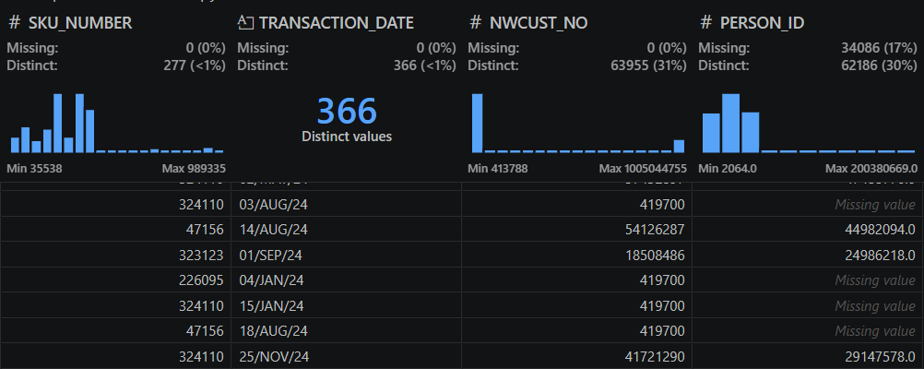
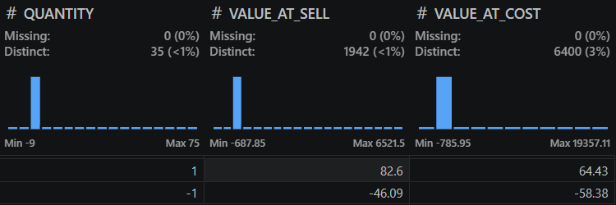

DATASET A
Data Cleaning
Data + Code Snippets
Handling Missing Data
Missing PERSON_IDs were exclusively linked to a single catch-all account (NWCUST_NO = 419700),
Missing values were removed since they represented non-member shoppers.
Handling Returns
The dataset contained rows with negative quantities (e.g. -1,-2,-9) and negative sales values
Filtered out negative sales
Notes:
This slide focuses on cleaning Dataset A. Missing customer IDs linked to non-member shoppers were removed.
Negative quantities and sales values were also filtered out because they represent returns and could distort customer behaviour.

Slide 21
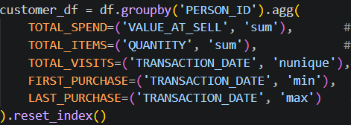
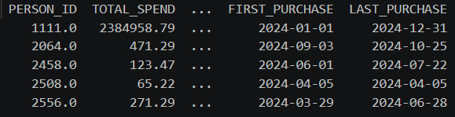
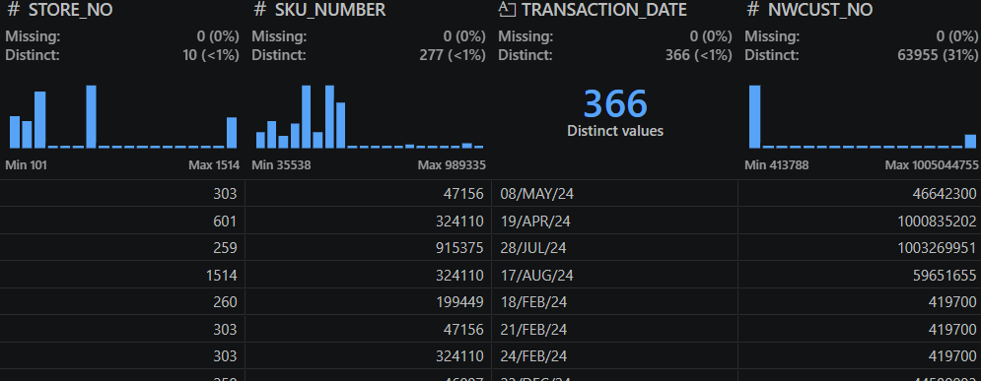
DATASET A
Data Cleaning
Dates Validation
Dates were formatted as raw text strings (e.g., 08/MAY/24), which prevents chronological sorting and time-based math.
Standardized the format into intelligent DateTime objects using Pandas (pd.to_datetime).
Aggregate from transaction-level to customer-level
Converting the dataset from "one row per scanned item" to "one row per unique PERSON_ID" to analyze individual customer behavior
Code Snippet
Data + Code Snippets
Notes:
This slide shows more data cleaning for Dataset A. The dates were converted into proper DateTime format so that chronological sorting and time-based calculations could work correctly.
The data was also aggregated from transaction level to customer level.

Slide 22
Time Slicing
GOAL: Simulates real-world retail environments where data arrives in monthly streams.
FUNCTION SplitIntoDynamicCycles (CleanedData, BaselineMonthCount):
SystemBatches = Create Empty Dictionary
UniqueMonths = Extract unique (Year, Month) combinations from CleanedData Sort UniqueMonths chronologically (Oldest to Newest)
BaselineMonths = Extract the first 'BaselineMonthCount' from UniqueMonths
Cycle_0_Data = Filter CleanedData WHERE TransactionMonth IN BaselineMonths
SystemBatches["Cycle_0"] = Cycle_0_Data
FOR EACH Month IN RemainingMonths:
MonthlyBatch = Filter CleanedData WHERE TransactionMonth EQUALS Month
SystemBatches["Cycle_" + CycleNumber] = MonthlyBatch
CycleNumber ++
Chronological Sorting: All transactions were strictly ordered by timestamp to prevent "data leakage" (accidentally using future data to predict the past).
Cycle 0 (The Baseline):
Pipeline A (Cosmetic): First 2 months of transactions.
Pipeline B (UK Retail): First 3 months of transactions.
Cycles 1–n (The Update Batches): Every subsequent calendar month is packaged into a separate batch to trigger the MDFCM dynamic loop.
System Dictionary: Transactions are stored in a dictionary structure (cycles), allowing the system loop to "call" data one month at a time.
Integrity Check: Verified that cycle end-dates and start-dates are contiguous with zero overlap.
Notes:
time slicing. The purpose is to simulate a real retail environment where data arrives monthly. Cycle 0 becomes the baseline, and each later month becomes an update batch for the dynamic model.

Slide 23
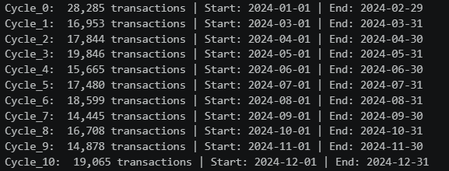
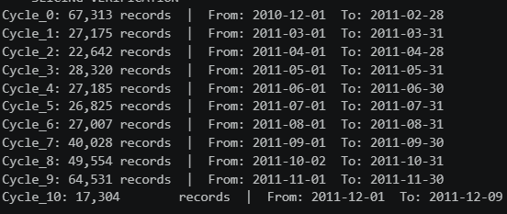
Time Slicing
Pipeline A (Cosmetic Retailer)
Pipeline B (UK Retailer)
Notes:
Visualization for the time slicing for both pipelines.

Slide 24
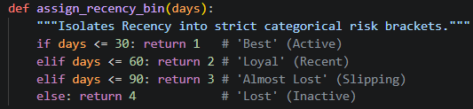
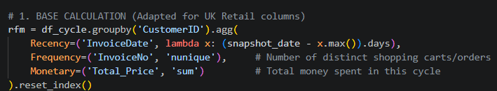

Feature engineering
Recency Isolation (The "Risk Anchor")
Recency is isolated into strict 30-day "At-Risk" buckets.
High Monetary value (Total Spend) should not be allowed to mask a customer who has been inactive for months.
The Base RFM Calculation
Transitions the dataset from raw, row-by-row transactions into unified, customer-level profiles for the specific cycle.
Recency Calculation:
(lambda x) Calculates the exact number of days since the customer’s last purchase.
Uses the dynamic snapshot date (the end of that specific time cycle) rather than a static end-of-year date, ensuring Recency is perfectly accurate for the continuous dynamic loop
The Cascaded RFM creation
Decomposed Structural Pairing:
Creates interaction features to capture complex behavioral interactions:
R-F Pair: Links loyalty to visit timing.
R-M Pair: Links profitability to recency.
F-M Pair: Calculates total purchase power per visit.
Notes:
Recency is treated as a risk anchor because inactive customers can become at-risk even if they spent a lot before. Cascaded RFM also creates interaction
features like RF, RM and FM to capture deeper customer behaviour.

Slide 25
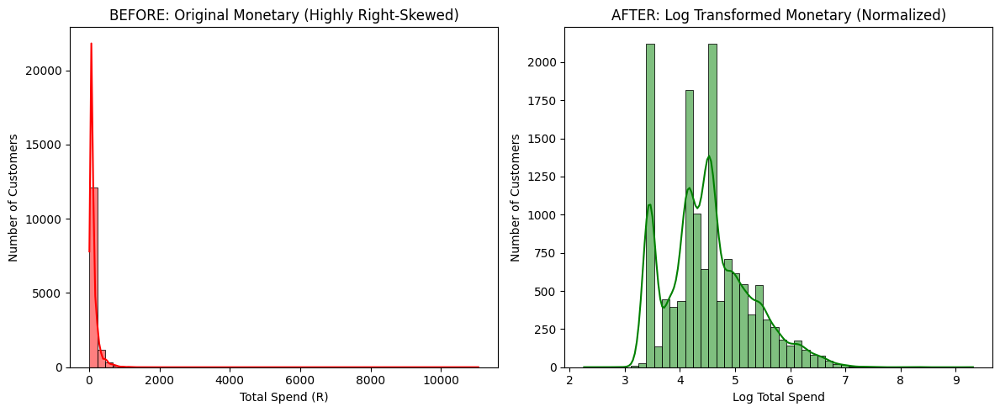
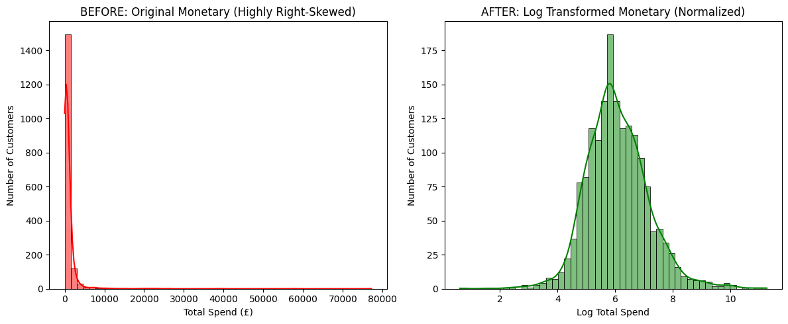
Preprocessing
Preprocessing
Normalization (The Log Transformation)
We use Log Transformation to handle extreme outliers in customer spending
Without normalization, the An outlier "pulls" the mean so far to the right that the algorithm can't see the patterns in average customers.
The Formula is log(1 + x) to compute the Log Transformation
Before Transformation: The data is unreadable. 99 % of the population is trapped in a single bar because the x-axis is forced to stretch to a high value.
After Transformation: The "hidden" patterns are revealed. We can now see that the most common (modal) log-spend is around 4.5 (which is roughly R90 in real money).
Dataset A (Cosmetic Retailer)
Dataset B (UK Retailer)
Notes:
log transformation. It is used because customer spending often has extreme outliers. After transformation, the patterns among normal customers become
easier for
the model to see.

Slide 26
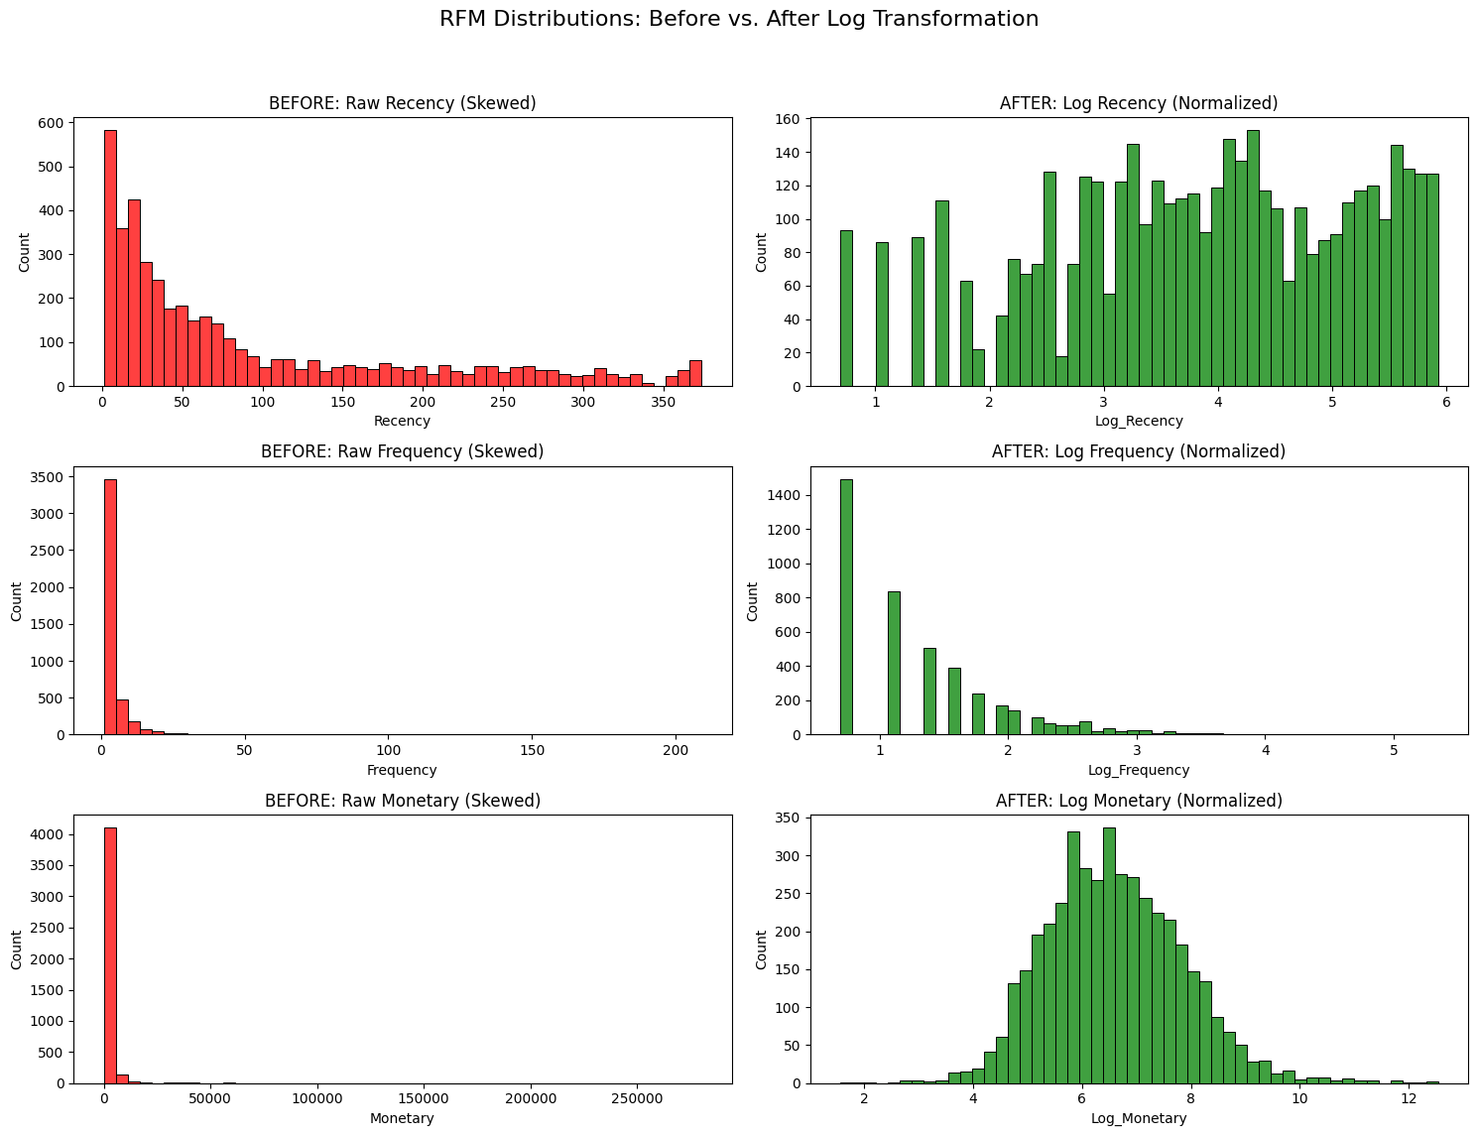
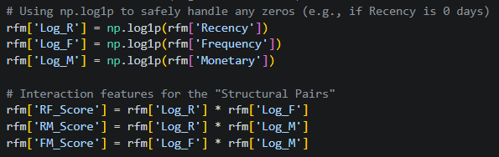
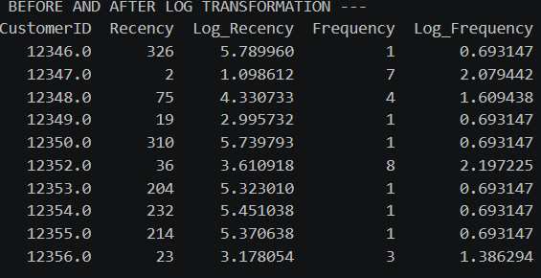

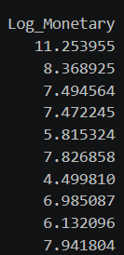
Preprocessing
Normalization (The Log Transformation)
Before and after log Transformation (value comparison)
Notes:
This slide compares values before and after log transformation. Before transformation, very large values can dominate the scale. After transformation, the data becomes more balanced and easier to use in clustering.

Slide 27
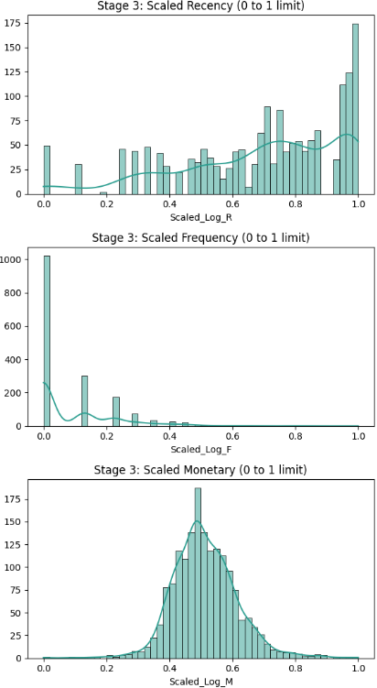
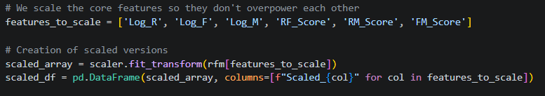
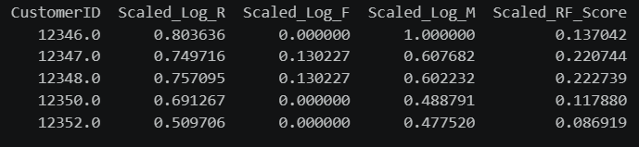
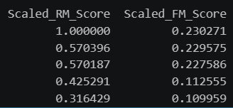
Preprocessing
Standardization
We use Standardization to ensure that large monetary values do not accidentally overpower smaller metrics like visit frequency in the models.
Standardization via Min Max Scaling: Algorithms like K-Means and MDFCM rely on Euclidean Distance.
Raw scales are incompatible (e.g., Recency in days vs. Monetary in Rands/Pounds).
Forced all features into a shared range of [0, 1].
Benefit: Ensures that "Spend" does not mathematically overpower "Visit Frequency" simply because the numbers are larger.
Notes:
This slide explains standardization. Because K-means and MDFCM use distance, all features must be placed on a similar scale. Min-max scaling changes the values to a range between 0 and 1 so that monetary value does not overpower other variables.

Slide 28
Database Creation
Final Segments &
Dashboard Interface
Dynamic Loop
Data Synthesis
Initial Baseline
Model Development
Dynamic Loop
Final Segments &
Dashboard Interface
Notes:
And now to the core section of the methodology the model development

Slide 29
Initial Baseline
Dynamic Loop
Final Segments &
Dashboard Interface
Database Creation
Data Synthesis
K determination with Elbow Method
Kmeans on time cycle 0
Evaluation measures on Kmeans implementation
Cross profiling Geo and Pyschographic variables on cycle 0
Results to Database Baseline Table
Iterate monthly cycles
MDFCM on time cycle 1-n
Track customer migration
Segment Resolution
Evaluation measures on MDFCM implementation
Cross profiling Geo and Pyschographic variables on cycle 1-n
Creation of Database Tables
Customer table
Data preprocessing results table
Time cycle 0 segmentation results table
Dynamic loop results table
Data Synthesis
Generating
Geographic and Demographic variables
Synthesized data integration with customer Profile
Final Segment Resolution
Dashboard Integration & Data Fetching
Customer visualization
Notes:
We now look at Database creation, data synthesis initial baseline Dynamic Loop final segments dashboard interface

Slide 30
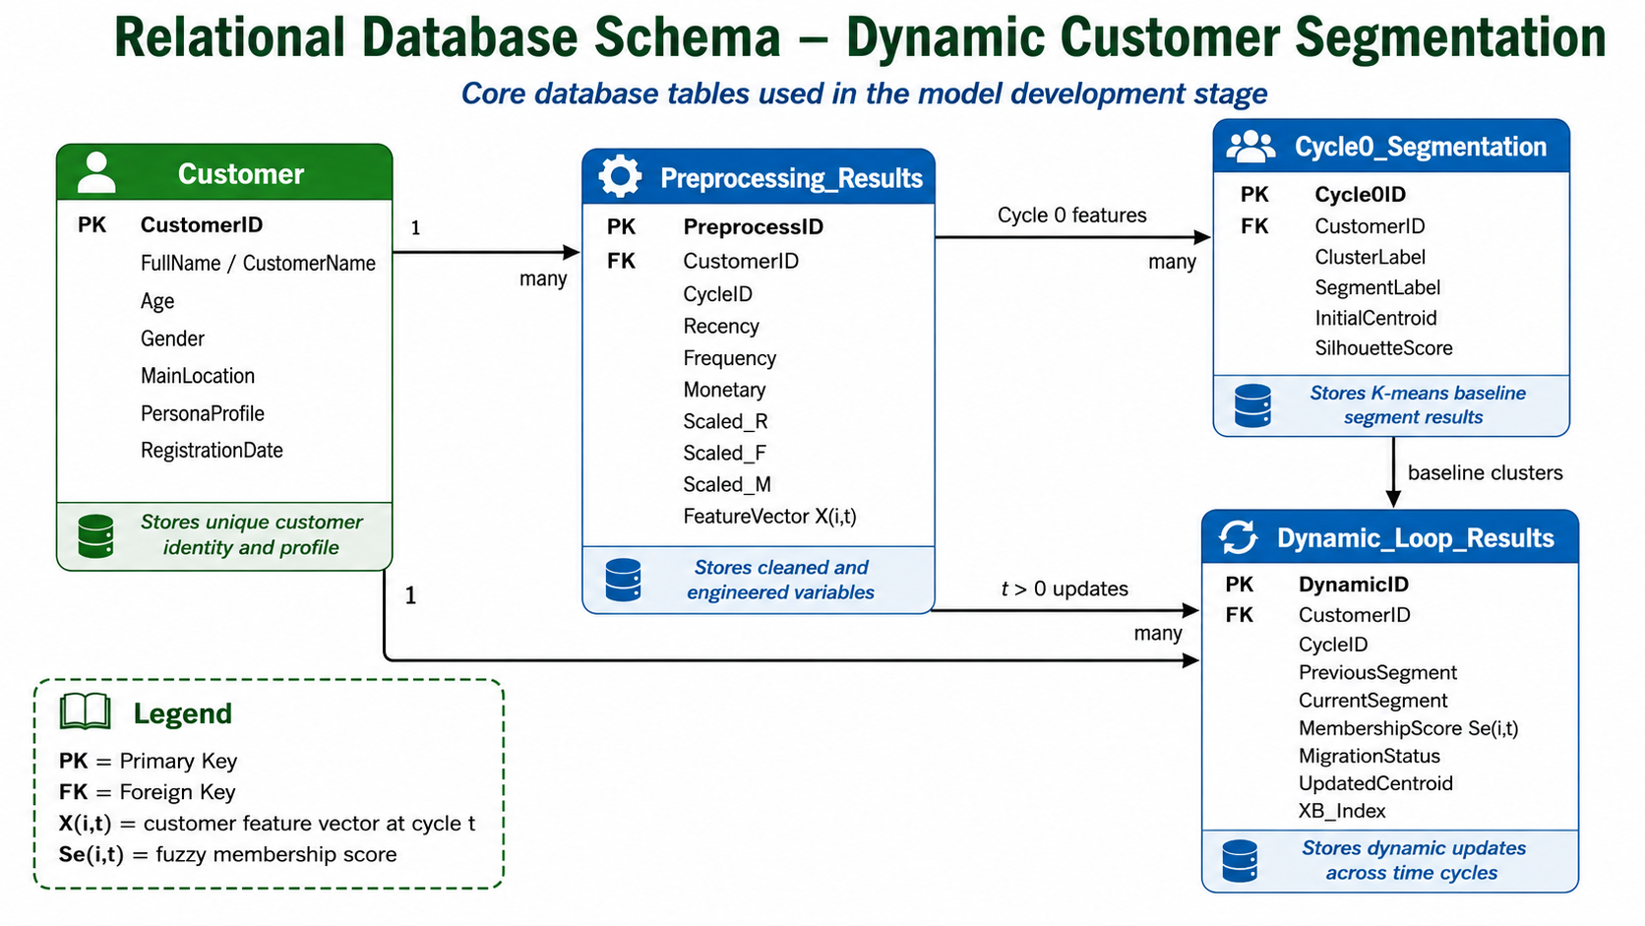
Database Creation - Relational Database Tables
SQLite relational database Tables
SQLite library is used to create the relational database because it allows the system to store customer states, historical RFM scores, time-cycle batches, and segmentation outputs without requiring a separate database server
Notes:
The database was created to serve as the memory layer of the dynamic customer segmentation system. Since the model operates across sequential time cycles, customer-level features, baseline clusters, dynamic updates, and customer migration records must be stored and retrieved efficiently.
this DATABASE allows the model to retrieve previous centroids, previous segment labels, and previous RFM values when processing a new monthly batch.

Slide 31
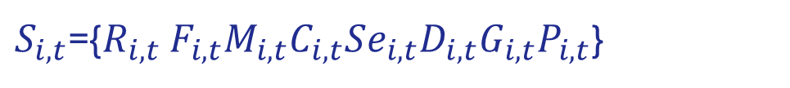
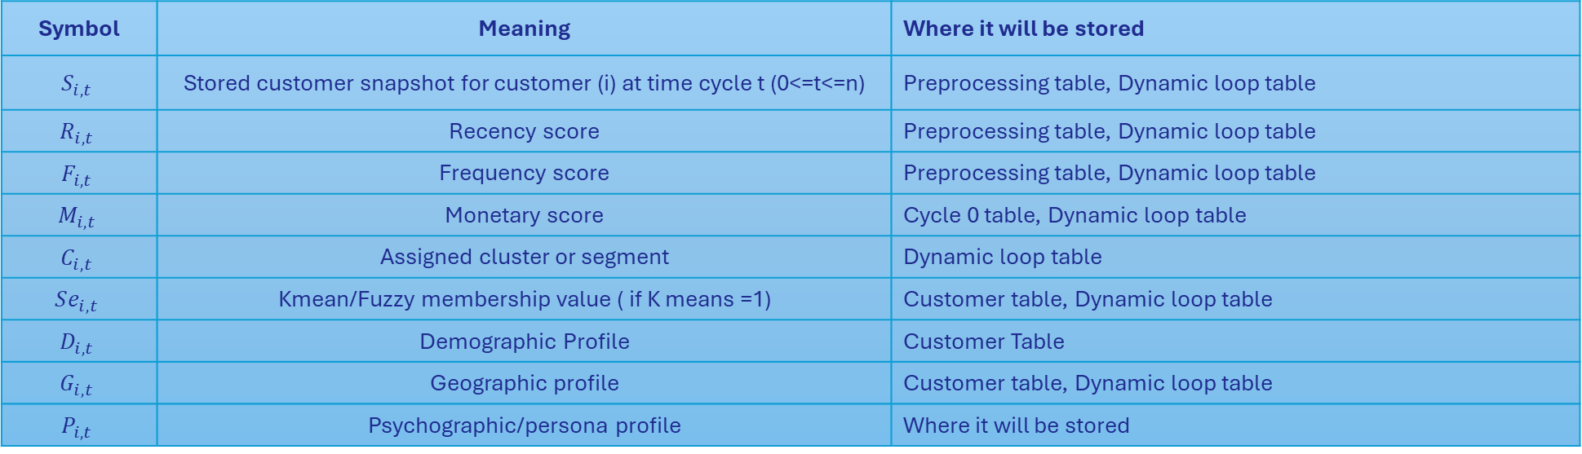
Database Creation - Customer Dynamic Snapshot
$S_{i,t}$​={$R_{i,t}$ $F_{i,t}M_{i,t}C_{i,t}Se_{i,t}{D_{i,t}G}_{i,t}P_{i,t}$​}
Symbol | Meaning | Where it will be stored
$$S_{i,t}$$ | Stored customer snapshot for customer (i) at time cycle t (0<=t<=n) | Preprocessing table, Dynamic loop table
$$R_{i,t}$$ | Recency score | Preprocessing table, Dynamic loop table
$$F_{i,t}$$ | Frequency score | Preprocessing table, Dynamic loop table
$$M_{i,t}$$ | Monetary score | Cycle 0 table, Dynamic loop table
$$C_{i,t}$$ | Assigned cluster or segment | Dynamic loop table
$$Se_{i,t}$$ | Kmean/Fuzzy membership value ( if K means =1) | Customer table, Dynamic loop table
$$D_{i,t}$$ | Demographic Profile | Customer Table
$$G_{i,t}$$ | Geographic profile | Customer table, Dynamic loop table
$$P_{i,t}$$ | Psychographic/persona profile | Where it will be stored
Example of a Customer Dynamic Snapshot -Customer 1001 is analyzed in Cycle 0
S_{1001,0}​ = {12 , 8, 2500, 1, 1.00, Fezeka Female 28, CapeTown, LoyalCareBuyer}
The same Customer Customer 1001 is analyzed in Cycle 1
S_{1001,1}​ = {45,2,450,3,0.72, Fezeka Female 28, CapeTown,AtRiskBuyer}
Notes:
A snapshot record OF a customer’s RFM values, segment, membership strength and profile information at a specific time cycle. The example shows a customer moving from a loy al segment to an at-risk segment as their buying activity decreases.
Customer 1001 moved from Segment 1 to Segment 3.
Their frequency dropped.
Their spending dropped.
Their recency increased.
Therefore, they migrated from Loyal/High Value to At-Risk.
THIS IS THE EXAMPLE OF THE SIMPLEST SNAPSHOT RECORD YOU COULD FIND

Slide 32
Database Creation – DB Algorithm
Input:
Cleaned transaction dataset D
Customer profile variables P
Time cycles T = {0, 1, 2, ..., n}
Step 1: Create Customer table
Store unique CustomerID and profile variables.
Step 2: Create Data_Preprocessing_Results table
Store cleaned RFM, cascaded RFM, scaled and transformed features.
Step 3: Create Time_Cycle_0_Segmentation table
Store K-means baseline labels, centroids and evaluation metrics.
Step 4: Create Dynamic_Loop_Results table
For each time cycle t = 1 to n:
Store MDFCM updated clusters.
Store fuzzy membership values.
Store customer migration status.
Store updated centroids and validation scores.
Step 5: Link all tables using CustomerID and CycleID.
Return:
Database ready for model execution and dashboard retrieval.
Loading
Output:
Relational database containing customer states
and segmentation history
Receiving
Notes:
This slide shows the database algorithm. The system creates the customer, preprocessing, baseline and dynamic loop tables, then links them using customer and cycle IDs. This makes it possible to store and retrieve customer history across time.

Slide 33
Data Synthesis - Purpose
Obtained Segmentation layer – Behavioral variables
Why Data Synthesis?
To enrich customer understanding
To improve decision-making and targeting
Segmentation layer | Example variables
Demographic | Name and Surname, Age, gender, ID-derived profile and contact details
Geographic | Region, province, city, residential area and climate season
Psychographic | Lifestyle/persona profile
The synthesized variables are linked to each unique customer ID and stored in the customer profile table for use in segment profiling and dashboard interpretation.
Notes:
Data synthesis was used to enrich the transactional dataset with additional customer descriptors that were not fully available in the original data.
Why Data Synthesis?
DATA SYNTHESIS HELPS US understand CUSTOMERS BEYOND WHAT THEY BUY we get to know who are they.
This helps to create more meaningful customer segments, allowing the business to design better marketing strategies, retention actions, and personalized offers.
synthetic customer-profile variables make the dataset more realistic for a cosmetic business. Demographic variables such as name, contact details, age, and gender help simulate how a business would personalize communication and understand customer groups. Geographic variables such as region and climate zone are also important because cosmetic needs can differ according to environmental conditions. For example, customers in hot or humid areas may need sunscreen or oil-control products, while customers in dry areas may need moisturizers and hydrating skincare. These variables enrich the segmentation output and make the final customer profiles more useful for business decision-making.
So in simply terms
Age - Supports age-group profiling
Gender - Helps describe segment composition
Region / residential area - Supports location-based targeting since one of the datasets belongs to cosmetic business
Persona profile - Helps interpret customer lifestyle or preference pattern

Slide 34


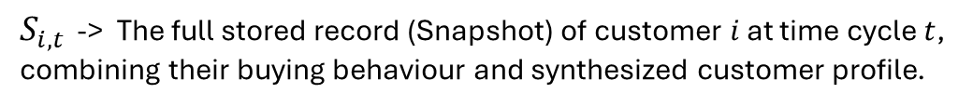


Data Synthesis - Generation
Algorithm
$$CustomerIDi​→Pi​=Di​,Gi​,Psyi​$$
Input:
Cleaned transaction dataset D
Unique customer IDs C = {c1, c2, ..., cn}
Behavioural features B(i,t)
Output:
Enriched customer profile dataset S(i,t)
Step 1: Extract unique CustomerID values from D.
Step 2: For each CustomerID:
Generate demographic variables:
Age
Gender
Generate geographic variables:
Region / Location
Generate psychographic variables:
PersonaProfile
Step 3: Store synthesized variables in the Customer table.
Step 4: Merge synthesized profile variables with RFM and cascaded RFM features.
Step 5: Construct enriched feature vector (snapshot):
S(i,t) = B(i,t) ⊕ P(i)
Step 6: Save enriched customer records to the preprocessing results table.
Return:
Final feature set ready for K-means and dynamic fuzzy clustering.
Symbol | Meaning
CustomerID_{i} | Unique customer identifier
P_{i} | Synthesized customer profile
D_{i} | Demographic variables
G_{i} | Geographic variables
Psy_{i} | Psychographic/persona variables
$B_{i,t}$​ = [$R_{i,t}$ $F_{i,t}M_{i,t}{RF}_{i,t}{RM}_{i,t}{FM}_{i,t}$​]
For dataset A :
$P_{i}$​=[${Name}_{i}$​,${Contact}_{i},{Age}_{i},{Gender}_{i},{Region}_{i},{Climate}_{i}{Persona}_{i}$]
For dataset B :
$P_{i}$​=[${Country}_{i}]$
Resulting snapshot :
${\text{S}}_{i,t}$=$B_{i,t}$​⊕ $P_{i}$​
$S_{i,t }$-> The full stored record (Snapshot) of customer $i$ at time cycle $t$, combining their buying behaviour and synthesized customer profile.
Notes:
The behavioural feature vector concatenated with the the synthesized profile vector providing us the final enriched customer vector

Slide 35
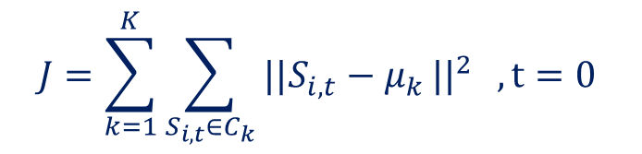
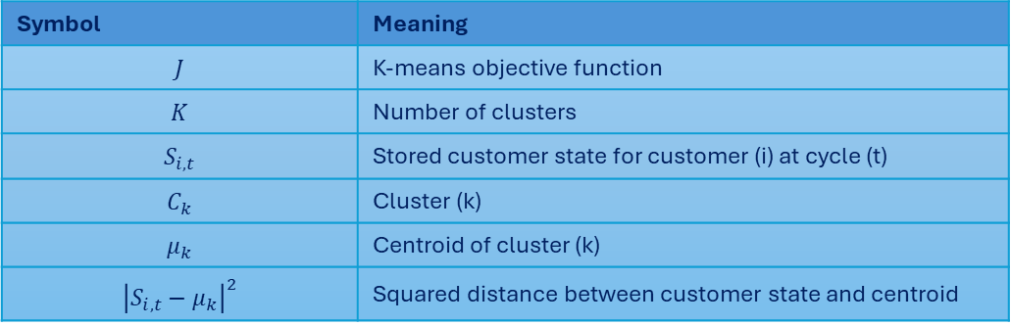
Initial Baseline K-means
K-means is applied to Cycle 0 to create the initial customer segment structure.
Purpose | Explanation
Starting clusters | Creates the first customer groups before dynamic updates begin
Initial centroids | Stores the first cluster centres used as reference points
Baseline segment labels | Converts numeric clusters into business-friendly groups
Comparison point | Allows later cycles to detect customer movement or migration
Input for dynamic loop | Provides the starting structure for MDFCM/CDFCM updates
The K-means model partitions customers into $K$clusters by minimizing the within-cluster squared distance between each customer feature vector and its assigned cluster centroid.
K-means Mathematical Representation
Symbol | Meaning
$$J$$ | K-means objective function
$$K$$ | Number of clusters
$$S_{i,t}$$ | Stored customer state for customer (i) at cycle (t)
$$C_{k}$$ | Cluster (k)
$$μ_{k}$$ | Centroid of cluster (k)
$${\left|S_{i,t}−μ_{k}\right|}^{2}$$ | Squared distance between customer state and centroid
$$J=\sum_{k=1}^{K}{\sum_{S_{i,t}∈C_{k}}{\left.||S_{i,t}−μ_{k}\right.{||}^{2}}} , t=0$$
Notes:
In this phase, K-means is used to create the first baseline segmentation structure. This is done only on Cycle 0, which represents the first chronological batch of customer data. The aim is not yet to track migration, but to create the first set of clusters and centroids. These centroids act as the starting reference points for the dynamic loop. Later, MDFCM and use this baseline structure to update segments as new monthly data arrives.

Slide 36
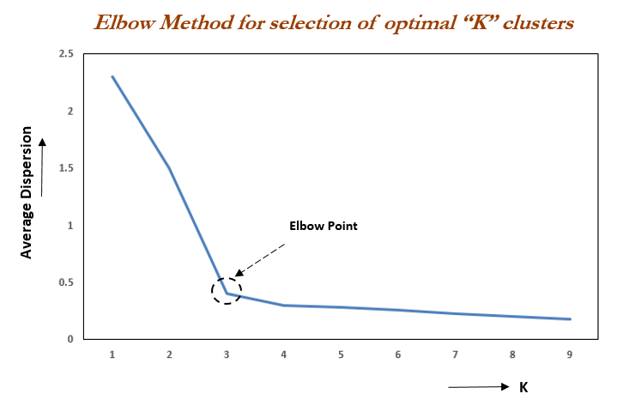
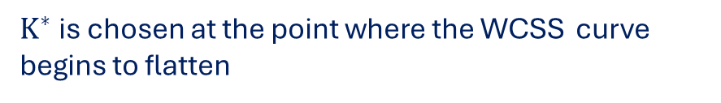
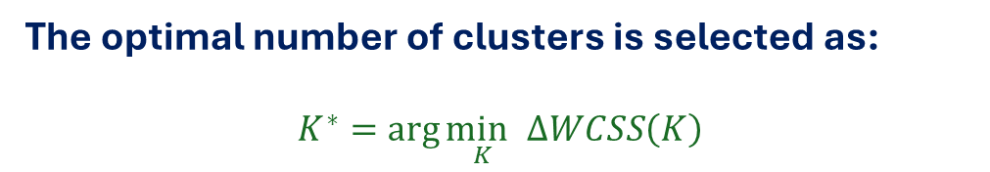
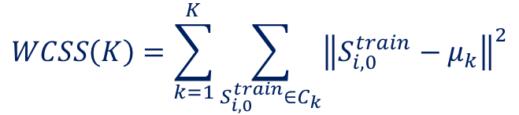
Initial Baseline K-means - Determining the Number of Clusters K
The optimal number of clusters is selected using the Elbow Method
The Elbow Method tests different values of $K$ we choose to test between 2 to 10 values of K and calculates the Within-Cluster Sum of Squares (WCSS) :
$$WCSS\left(K\right)=\sum_{k=1}^{K}{\sum_{S_{i,0}^{train}∈C_{k}}{{\left\|S_{i,0}^{train}−μ_{k}\right\|}^{2}}}$$
Elbow Method Decision Rule
The optimal number of clusters is selected as:
$$K^{∗}=\arg{\underset{K}{\min{ }}}ΔWCSS\left(K\right)$$
$K^{∗}$is chosen at the point where the WCSS curve begins to flatten
Elbow point = optimal $K^{∗}$
Notes:
If K is too small: Clusters are too broad and customers are grouped too generally. If K is too large: Clusters become too fragmented and harder to interpret. Optimal K: Balances compactness and interpretability.
The elbow point is the value of K where the WCSS curve starts to flatten. Before this point, adding more clusters gives a strong improvement. After this point, adding more clusters only gives a small reduction in WCSS. This is why the elbow point is selected as the optimal K. The goal is to avoid too few clusters, which would be too general, and too many clusters, which would make the results difficult to interpret.

Slide 37

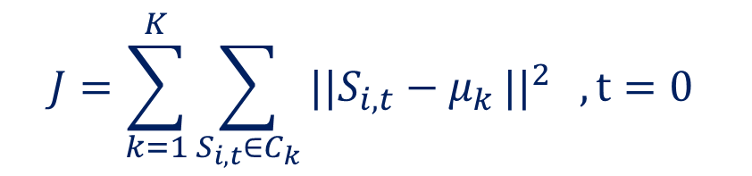
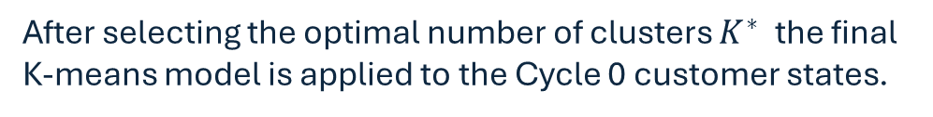
Initial Baseline K-means - Final K-means Baseline Model
The Full algorithm
Applying Final K-means Using Selected $K^{∗}$
Step 1: Load Cycle 0 customer states from the preprocessing table.
Step 2: Select training features.
If Dataset A:
Use RFM, cascaded RFM, and selected encoded profile variables.
Exclude name and contact details.
If Dataset B:
Use RFM and cascaded RFM features only.
Step 3: Apply required encoding, transformation, and scaling.
Step 4: For each candidate K:
Run K-means on Cycle 0 training features.
Calculate WCSS(K).
Step 5: Plot WCSS values against K.
Step 6: Select K* at the elbow point.
Step 7: Run final K-means using selected K*.
Step 8: Store baseline outputs in Cycle0_Segmentation:
CustomerID
ClusterLabel
SegmentLabel
InitialCentroid
WCSS
SelectedK
Return:
Baseline K-means segmentation ready for final evaluation and dynamic updating.
After selecting the optimal number of clusters $K^{∗}$the final K-means model is applied to the Cycle 0 customer states.
$$J=\sum_{k=1}^{K}{\sum_{S_{i,t}∈C_{k}}{\left.||S_{i,t}−μ_{k}\right.{||}^{2}}} , t=0$$
The algorithm follows these steps:
1. Initialize K* centroids.
2. Assign each customer data points to the nearest centroid.
3. Recalculate each centroid using assigned customers.
4. Repeat until cluster assignments stabilize.
5. Store final labels and centroids.
The final K-means outputs are stored in the Cycle0_Segmentation Database table.
Notes:
Once the optimal K has been selected, I then apply the final K-means model using that K value. Each customer is assigned to the nearest centroid based on the selected training features. The centroids are then recalculated, and the process repeats until the cluster assignments stop changing. The output of this stage is the final baseline cluster label for each customer and the centroid for each cluster.
Storing these outputs is important because the dynamic model needs a baseline reference when it updates customer segments in later time cycles.

Slide 38
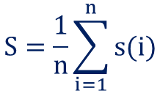
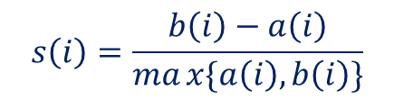
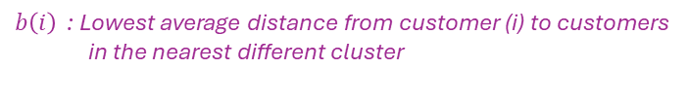

Initial Baseline K-means – Output and Evaluation
Model Evaluation Using Silhouette Score
The algorithm pseudocode
Input:
Final K-means cluster labels
Cycle 0 training customer states S(i,0)^train
Selected number of clusters K*
Output:
Average Silhouette Score S
Step 1: For each customer i:
Calculate a(i):
Average distance between customer i
and all customers in the same cluster.
Step 2: Calculate b(i):
Lowest average distance between customer i
and customers in the nearest different cluster.
Step 3: Calculate silhouette score:
s(i) = [b(i) - a(i)] / max[a(i), b(i)]
Step 4: Calculate average silhouette score:
S = mean of all s(i)
Step 5: Interpret final model quality:
If S is close to 1:
Clusters are well separated.
If S is close to 0:
Clusters overlap.
If S is negative:
Some customers may be misclassified.
Return:
Final baseline K-means validation score.
The Silhouette Score is used to evaluate the quality of the final K-means baseline clusters after the optimal K* was selected and the model was applied.
$$s\left(i\right)=\frac{b\left(i\right)−a\left(i\right)​}{max{\{a\left(i\right),b\left(i\right)}\}}$$
$s\left(i\right) :$Silhouette score of customer (i)
$a\left(i\right)$ : Average distance from customer (i) to customers in the same cluster
$b\left(i\right)$ : Lowest average distance from customer (i) to customers
in the nearest different cluster
$max{\{a\left(i\right),b\left(i\right)\}}$ : Normalizes the score between (-1) and (1)
It measures:
Cohesion | How close a customer is to other customers in the same cluster
Separation | How far a customer is from customers in the nearest other cluster
Average Silhouette Score formula
Final model score
$$S=\frac{1}{n}\sum_{i=1}^{n}{s(i)}$$
Close to (1) | Customers are well matched to their own cluster
Around (0) | Clusters overlap or customers lie between clusters
Less than (0) | Customers may be assigned to the wrong cluster
Notes:
the Silhouette Score is calculated to evaluate cluster quality. A higher score indicates that customers are close to members of their own cluster and far from customers in other clusters. This confirms whether the baseline segmentation is meaningful before it is passed into the dynamic segmentation loop.
This metric checks both cohesion and separation. Cohesion means how close a customer is to other customers in the same cluster, while separation means how far that customer is from the nearest alternative cluster. The score ranges from negative one to one. A score close to one means the clusters are well separated, a score around zero means the clusters overlap, and a negative score suggests that some customers may have been assigned to the wrong cluster. This evaluation confirms whether the Cycle 0 baseline is strong enough before it is used in the dynamic segmentation phase.

Slide 39
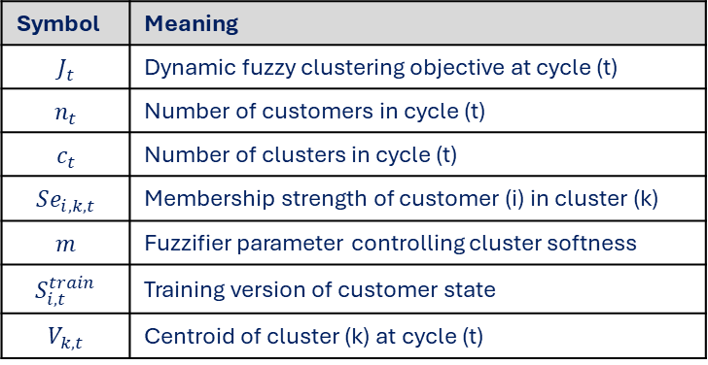

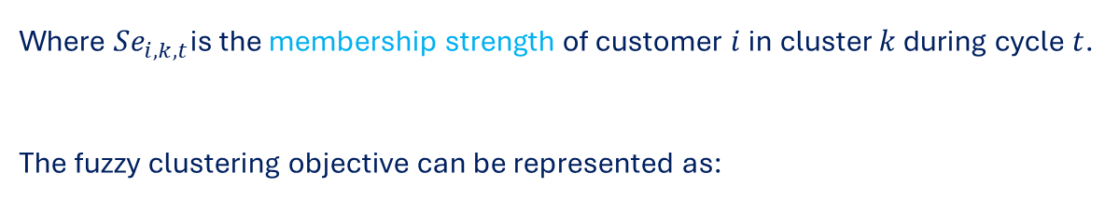
Dynamic Loop : Purpose & Dynamic Fuzzy formula
The dynamic loop updates customer segments after the initial K-means baseline has been created at Time Cycle 0.
instead of clustering customers once, the system processes new time cycles sequentially:
$$t=1,2,3,…,n$$
Step | Purpose
Loads new monthly transactions | Captures recent customer behaviour
Recalculates RFM and cascaded RFM | Updates behavioural features
Applies dynamic fuzzy clustering | Allows customers to belong to clusters by membership strength
Tracks customer migration | Detects whether customers stayed, moved, or shifted risk level
Stores updated results | Saves dynamic outputs for dashboard visualization
Dynamic Fuzzy formula
$$Se_{i,k,t}∈\left[0,1\right]$$
Symbol | Meaning
$$J_{t}$$ | Dynamic fuzzy clustering objective at cycle (t)
$$n_{t}$$ | Number of customers in cycle (t)
$$c_{t}$$ | Number of clusters in cycle (t)
$$Se_{i,k,t}$$ | Membership strength of customer (i) in cluster (k)
$$m$$ | Fuzzifier parameter controlling cluster softness
$$S_{i,t}^{train}$$ | Training version of customer state
$$V_{k,t}$$ | Centroid of cluster (k) at cycle (t)
Where $Se_{i,k,t}$is the membership strength of customer $i$in cluster $k$ during cycle $t$.
The fuzzy clustering objective can be represented as:
$$J_{t}=\sum_{i=1}^{n_{t}}{\sum_{k=1}^{c_{t}}{{\left(Se_{i,k,t}\right)}^{m}\left.||S_{i,t}^{train}−V_{k,t}\right.{||}^{2}}}$$
Notes:
The dynamic loop is the part of the methodology where the system becomes adaptive. After K-means creates the Cycle 0 baseline, each new time cycle is processed in sequence.
The model recalculates the customer’s current behaviour, compares it with previous segment structures, and updates the customer’s segment.
This allows the system to track changes such as a loyal customer becoming at-risk or a low-value customer becoming more active.
The full stored customer state 𝑆_(𝑖,𝑡)represents the complete customer record stored in the database, including behavioural, demographic, geographic, psychographic, and identification variables. However, only the model-ready subset 𝑆_(𝑖,𝑡)^𝑡𝑟𝑎𝑖𝑛is used during clustering. This training version excludes non-clustering identifiers such as names and contact details, while retaining the behavioural and encoded profile variables needed to calculate distances, centroids, memberships, and segment assignments.

Slide 40
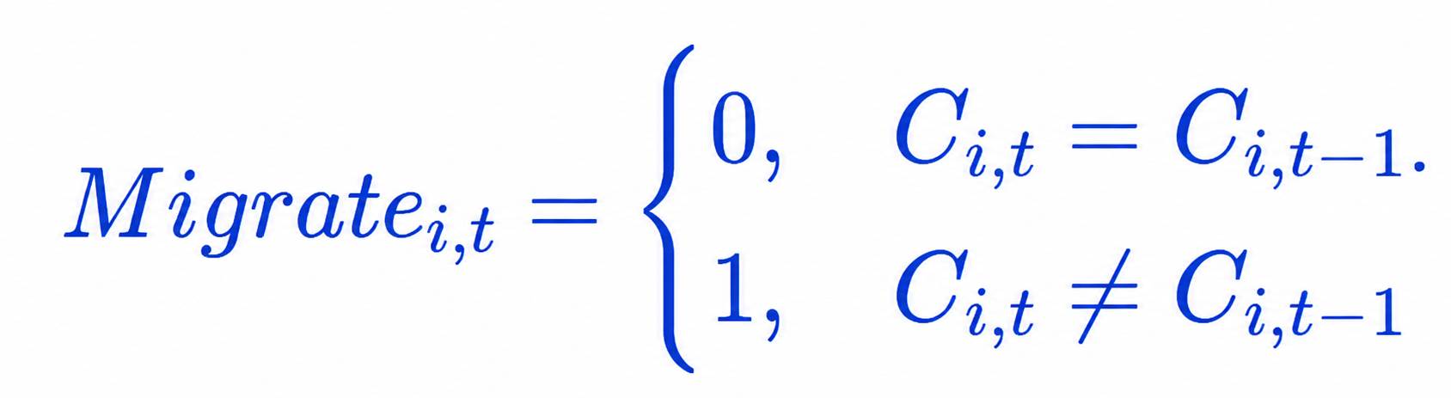

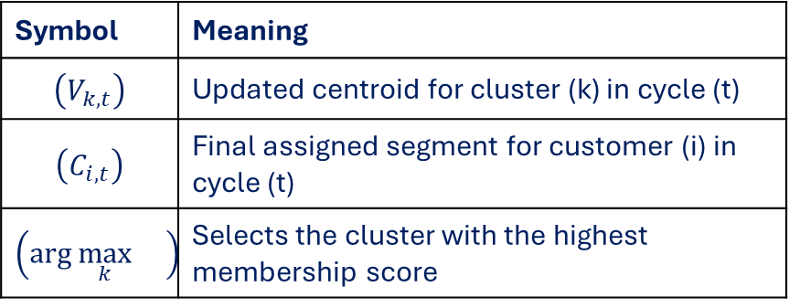
Dynamic Loop : Centroid and Membership Updating
At each cycle, the centroid is updated using the customer membership strengths:
$$V_{k,t}=\frac{\sum_{i=1}^{n_{t}}{{\left(Se_{i,k,t}\right)}^{m}S_{i,t}^{train}}}{\sum_{i=1}^{n_{t}}{{\left(Se_{i,k,t}\right)}^{m}}}$$
Symbol | Meaning
$$\left(V_{k,t}\right)$$ | Updated centroid for cluster (k) in cycle (t)
$$\left(C_{i,t}\right)$$ | Final assigned segment for customer (i) in cycle (t)
$$\left(\arg{\max_{k}{}}\right)$$ | Selects the cluster with the highest membership score
Each customer is then assigned to the segment where they have the strongest membership:
$$C_{i,t}=\arg{\max_{k}{S}e_{i,k,t}}$$
Customer Migration Tracking
Previous segment | Current segment | Migration meaning
High-Value Loyal | High-Value Loyal | Stable
High-Value Loyal | At-Risk | Negative migration
Low-Value | Frequent Buyer | Positive migration
New Buyer | Loyal Buyer | Growth migration
Customer migration is detected by comparing the previous segment with the current segment.
0 : Customer remained in the same segment
1 : Customer migrated to a different segment
Notes:
This slide explains centroid and membership updating. Customers with stronger membership have more influence on the updated centroid. The model then assigns each customer to the segment where they have the highest membership score and checks whether they migrated.
The centroid update formula shows that customers with stronger membership have more influence on the updated cluster centre.
After the fuzzy memberships are calculated, each customer is given a final segment label based on the cluster where they have the highest membership score.
So the model still stores a clear final segment, but it also keeps the membership score behind that decision.
Migration tracking is one of the most important outputs of the dynamic loop. The system compares a customer’s segment in the current cycle with their segment in the previous cycle. If the segment stayed the same, the customer is stable. If the segment changed, the customer has migrated. This allows the business to identify positive movement, such as customers becoming more valuable, and negative movement, such as loyal customers becoming at-risk.

Slide 41
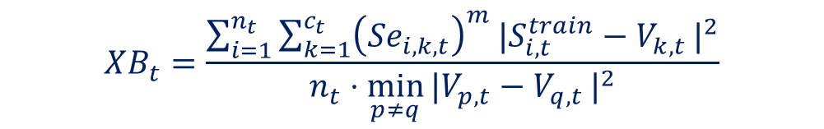
Dynamic Loop : Model Evaluation
The dynamic loop is evaluated after each cycle to check whether the updated clusters remain valid.
The Xie-Beni Index will be used for model evaluation
Evaluating the fuzzy clustering compactness and separation:
$$XB_{t}=\frac{\sum_{i=1}^{n_{t}}{\sum_{k=1}^{c_{t}}{{\left(Se_{i,k,t}\right)}^{m}\left.|S_{i,t}^{train}−V_{k,t}\right.|^{2}}}}{n_{t}⋅\min_{p≠q}\left.|V_{p,t}−V_{q,t}\right.|^{2}}$$
Lower XB values generally suggest better fuzzy clustering because customers are compact within clusters and centroids are well separated.
The other intuitive evaluation metrics that will be observed
Migration rate | Measures how many customers changed segment
Segment size change | Shows whether clusters grow or shrink
Business interpretability | Checks whether clusters make sense for actions
Notes:
After each dynamic update, the model must be evaluated. Because this stage uses fuzzy clustering, Ive gathered that Xie-Beni Index is suitable because it considers both compactness and separation. The numerator measures how close customers are to their fuzzy cluster centres, while the denominator checks how far the cluster centres are from one another. A lower Xie-Beni value usually means better fuzzy clustering.
The other intuitive evaluation metrics that will be observed
I can also track migration rate and segment size changes, and also check intuitutively whether customer movement makes business sense.

Slide 42
Dynamic Loop : Output Table & Algorithm
Algorithm
Output field | Meaning
CustomerID | Links result to the customer
CycleID | Shows the time cycle/month
PreviousSegment | Segment from previous cycle
CurrentSegment | Updated segment after MDFCM
MembershipScore Se(i,t) | Strength of membership in assigned segment
MigrationStatus | Stable, positive migration, or negative migration
UpdatedCentroid | New centroid after dynamic update
XB_Index | Fuzzy clustering validation score
PersonaProfile | Dataset A persona label
ClimateZone | Dataset A climate/location profile
Step 1: For each time cycle t = 1 to n:
Load new transaction data for cycle t.
Step 2: Recalculate behavioural features:
R(i,t), F(i,t), M(i,t)
RF(i,t), RM(i,t), FM(i,t)
Step 3:
Construct training customer state S(i,t)^train.
Step 4: Pass S(i,t)^train and previous centroids V(k,t-1)
into the MDFCM / dynamic fuzzy clustering engine.
Step 5: Calculate membership scores Se(i,k,t).
Step 6: Update cluster centroids V(k,t).
Step 7: Assign final segment:
C(i,t) = cluster with highest Se(i,k,t)
Step 8: Track migration:
Compare C(i,t) with C(i,t-1).
Step 9: Resolve segment labels:
Convert clusters into business-friendly segment names.
Step 10: Evaluate dynamic results:
Calculate Xie-Beni Index.
Calculate migration rate.
Track segment size changes.
Step 11: If Dataset A:
Update geographic/climate profile.
Update psychographic persona.
Step 12: Save results to Dynamic_Loop_Results table.
Return:
Final dynamic segmentation history for dashboard visualization.
Input: Cycle 0 baseline centroids V(k,0) Cycle 0 segment labels C(i,0) Monthly time cycles T = {1, 2, ..., n} Stored customer states S(i,t)
Output: Updated segment labels Membership scores Se(i,k,t) Migration records Updated centroids Dynamic evaluation scores
Notes:
These outputs allow the dashboard to show how customer segments evolve across time, which segments are growing or shrinking, and which customers require targeted retention or personalization actions.

Slide 43
Final Segments : Final Segment Resolution
After the dynamic loop has processed all time cycles, the system converts the final model outputs into business-readable customer segments.
At this stage
Purpose | Explanation
Finalize segment labels | Convert numeric clusters into meaningful business categories
Summarize segment behaviour | Describe each group using RFM, spending, migration, and membership scores
Cross-profile customers | Add demographic, geographic, climate, and psychographic interpretation where available
Prepare dashboard outputs | Store final segment results for visualization and user interaction
Support business actions | Link each segment to marketing, retention, or personalization strategies
How Final Segments Are Resolved
The final segment label is assigned using the customer’s current segment, membership score, migration status, and RFM pattern:
$$S_{i,t}^{final}=S_{i,t}⊕\left[C_{i,t},Se_{i,k,t},Migrate_{i,t}, \right]$$
Notes:
Final segment resolution transforms model outputs into business-friendly customer groups. Instead of displaying only cluster numbers, the system interprets each segment using RFM behaviour, membership strength, migration status, and profile variables. These final segment labels are then stored and fetched by the dashboard for visualization and decision support.
In dynamic customer segmentation final interpretation is important because managers need to observe movement, creation, and elimination of segments over time before choosing marketing strategies.

Slide 44
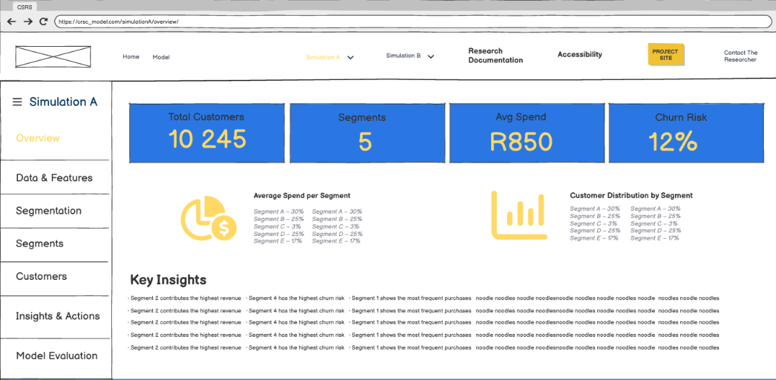
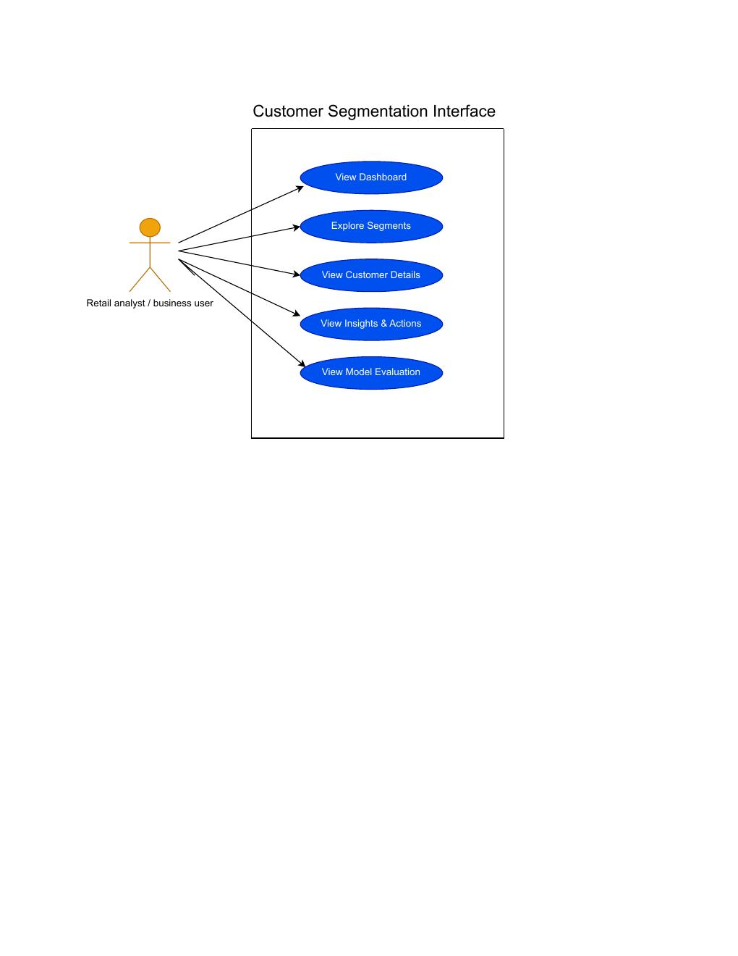
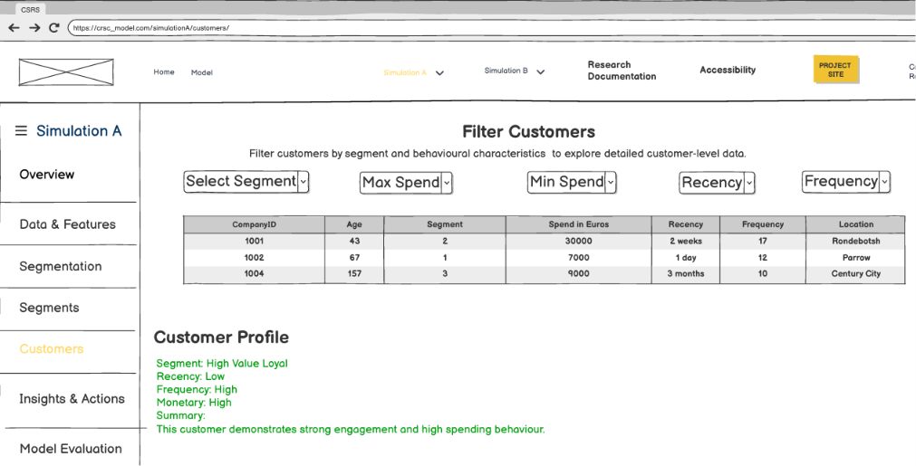
Dashboard Interface : Dashboard Interface
The dashboard retrieves the final outputs from the database and displays them in a user-friendly interface.
Customer Visualization
Customer-level visualization allows the user to filter and inspect individual customers.
Notes:
The interface wireframe includes a Home page, Model overview, and dedicated Simulation A and Simulation B dashboards each with 7 sub-sections:
Overview
Data & Features
Segmentation
Segments
Customers
Insights & Actions
Model Evaluation.
Feature
Purpose
Segment filter
View customers by final segment
Spend/frequency filters
Identify high-value or low-activity customers
Customer profile card
Show individual RFM behaviour and segment label
Migration status
Show whether the customer stayed, improved, or declined
Recommended action
Suggest retention, loyalty, or personalization strategy

Slide 45
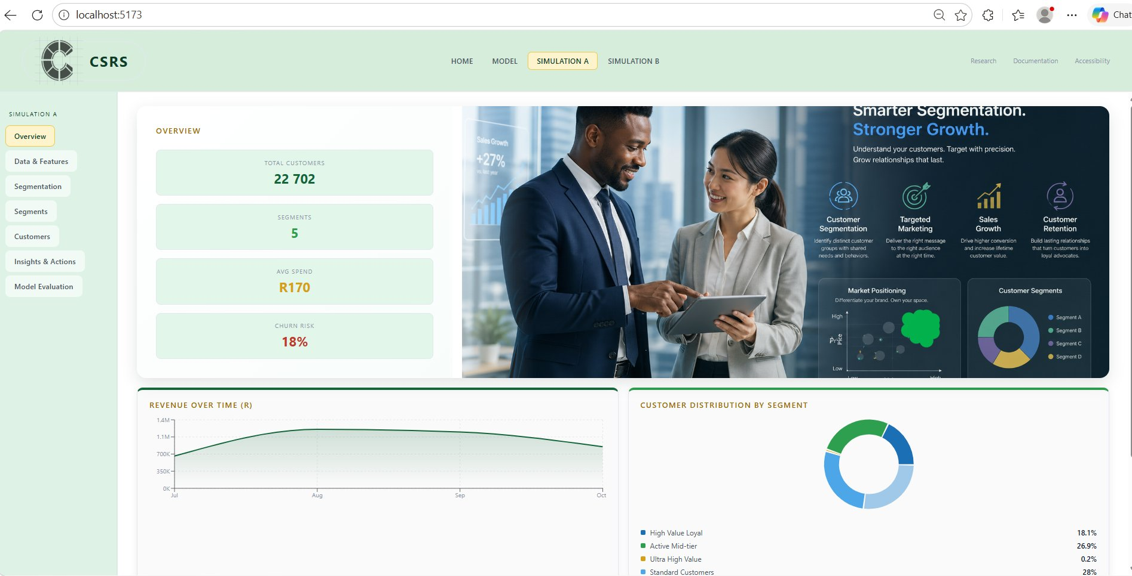
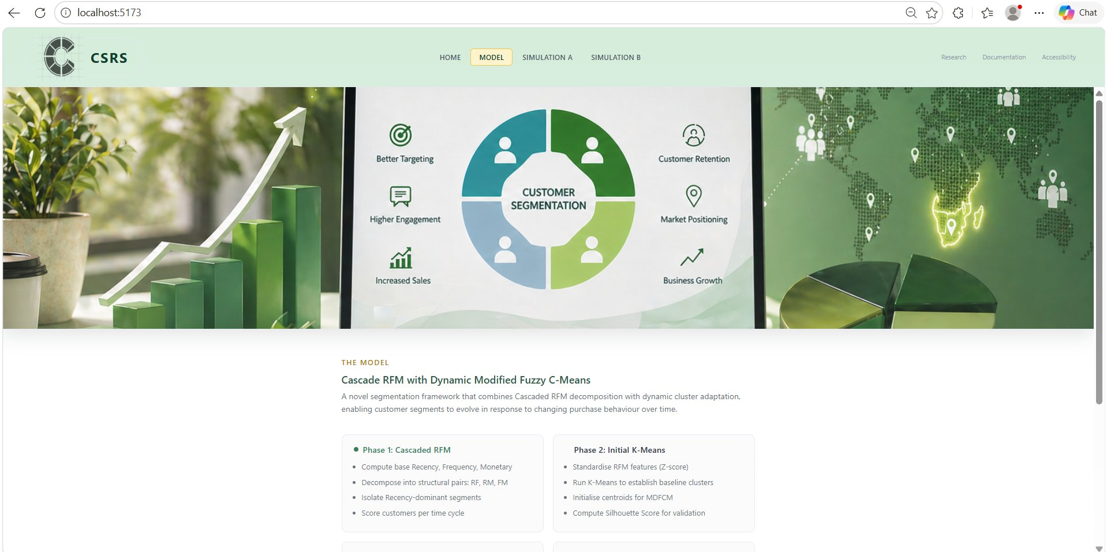
Dashboard Interface : Interface Development
A React-based web interface (CSRS) was developed using the wireframe designs as well as the other planning
diagrams shown in the previous slides to visualize segmentation results from both simulations (Pipelines).
Figure: Simulation A overview (left) | Model page (right)
Notes:
A React-based web interface (CSRS) was developed from the wireframe designs show in the previous slides to visualise segmentation results from both simulations (Pipelines).

Slide 46
Potential OUTCOME
Adaptive Time-Sliced Segmentation: Development of a self-updating segmentation framework that can detect and respond to behavioral changes across sequential transaction batches with reduced manual intervention [4].
Richer Customer Profiles: Demonstration that combining Cascaded RFM with additional behavioral and geographic indicators can reduce the limitations of standard RFM and produce more descriptive customer profiles [4], [5].
Actionable Business Intelligence: Translation of evolving customer segments into targeted retention, personalization, and campaign strategies that support more informed retail decision-making [3], [9].
Interactive Segmentation Interface: Development of a interface for visualizing customer segments, tracking cluster updates over time, and improving interpretation of segmentation outputs.

Slide 47
Timeline
Link to the Project site : https://siyabulela11.github.io/Customer-Segmentation-Project/
Phase | Tasks / Activities | Duration | Expected Outcome
1. Definition (Term1) | Definition of problem statement, aim, objectives, and research questions | Week 1 | Approved project scope
2. Literature Review (Term1) | Review customer segmentation concepts, clustering methods, feature engineering, related retail studies and finding the literature gap | Weeks 2-3 | Historically used segmentation methods and tools, Literature gaps
3. Data Collection & Understanding (Term1) | Obtain dataset, inspect variables | Week 4 | Dataset description and variables understanding
4. Data Cleaning & Preprocessing (Term2) | Handle missing values, duplicates, cancellations/returns, and standardize variables where needed | Weeks 5 | Cleaned and analysis-ready dataset
5. Feature synthesis and Engineering (Term2) | Synthesize demographic and geographic features and create segmentation features | Week 8 | Final feature set for segmentation
6. Model Development (Term2) | Apply segmentation methods | Weeks 10-12 | Customer segments generated
7. Model Evaluation & Interpretation (Term3) | Compare segment quality, interpret cluster characteristics, profile customer groups | Week 13 | Final segmentation results and discussion
8. Interface Development (Term2- Term3) | Develop simple interface to display segment outputs, graphs, and customer group comparisons | Week 10 - 24 | Segmentation interface
9. Report Final Edits (Term3) | Compile methodology, results, discussion, conclusions, and references | Weeks 18-20 | final report
10. Final Review & Submission (Term3) | Proofread, fix formatting, and submit report/project | Week 21-22 | Submitted project
11. Presentation Preparation (Term3) | Design slides, refine visuals, summarize findings, and prepare speaking points | Week 23-26 | Final presentation
Table 8: Timeline of the research project

Slide 48
Acknowledgements
Prof. Isafiade & Mr Sobantu - for their supervision, guidance, and support throughout this study
ChatGPT and Google Gemini - for assistance with idea refinement, concept clarification, and language support
UWC Library Resources - for research support and access to academic materials
EBSCO Databases - for access to relevant scholarly literature
Kaggle and the UCI Machine Learning Repository - for accessible research datasets
Online Retail Dataset - created by Daqing Chen, School of Engineering, London South Bank University

Slide 49
References
[1] TechTarget, “What is customer segmentation?,” SearchCustomerExperience, 2021. [Online]. Available: https://www.techtarget.com/searchcustomerexperience/definition/customer-segmentation. [Accessed: Mar. 10, 2026].
[2] V. L. Miguéis, A. S. Camanho, and J. Falcão e Cunha, “Customer data mining for lifestyle segmentation,” Expert Systems with Applications, vol. 39, no. 10, pp. 9359–9366, Aug. 2012, doi: 10.1016/j.eswa.2012.02.133.
[3] H. Şentürk, E. Geçici, and S. Alp, “Customer segmentation with clustering methods in the retail industry,” Istanbul Aydin Universitesi Sosyal Bilimler Dergisi, vol. 16, no. 4, pp. 551-573, Oct. 2024, doi: 10.17932/IAU.IAUSBD.2021.021/iausbd_v16i4004.
[4] S. Sobantu and O. E. Isafiade, “Cascaded RFM-based fuzzy clustering model for dynamic customer segmentation in the retail sector,” in Communications in Computer and Information Science, vol. 2326, 2025, pp. 53-73, doi: 10.1007/978-3-031-78255-8_4.
[5] M. A. Gomes and T. Meisen, “A review on customer segmentation methods for personalized customer targeting in e-commerce use cases,” Information Systems and e-Business Management, vol. 21, no. 3, pp. 527-570, Jun. 2023, doi: 10.1007/s10257-023-00640-4.
[6] B. Türkmen, “Customer segmentation with machine learning for online retail,” The European Journal of Social and Behavioural Sciences, vol. 31, no. 2, pp. 111-136, Apr. 2022, doi: 10.15405/ejsbs.316.
[7] N. N. Son, C. B. Anh, T. H. Le, and V. A. Duc, “From national to local: A geodemographic segmentation model for market targeting in Vietnam’s major cities,” Sustainable Futures, vol. 9, p. 100132, 2025, doi: 10.1016/j.sftr.2025.100132.
[8] C. P. Ufeli, M. U. Sattar, R. Hasan, and S. Mahmood, “Enhancing customer segmentation through factor analysis of mixed data (FAMD)-based approach using K-means and hierarchical clustering algorithms,” Information, vol. 16, no. 6, p. 441, 2025, doi: 10.3390/info16060441.
[9] A. Ashraf, C. A. Rayed, N. A. Awadallah, and H. M. Sabry, “A framework for customer segmentation to improve marketing strategies using machine learning,” Procedia Computer Science, vol. 260, pp. 616-625, 2025, doi: 10.1016/j.procs.2025.03.240.
[10] C. Rungruang, P. Riyapan, A. Intarasit, K. Chuarkham, and J. Muangprathub, “RFM model customer segmentation based on hierarchical approach using FCA,” Expert Systems with Applications, vol. 237, p. 121449, 2024, doi: 10.1016/j.eswa.2023.121449.
[11] R. Sharma, S. Srivastva, and S. Fatima, “E-commerce and digital transformation: Trends, challenges, and implications,” International Journal for Multidisciplinary Research (IJFMR), vol. 5, no. 5, pp. 1–9, Sep.–Oct. 2023.
[12] R. S. Cordova, “Customer segmentation in the online retail industry using big data analytics,” Journal of Theoretical and Applied Information Technology, vol. 102, no. 22, pp. 8312-8324, Nov. 2024.
[13] M. Sivaguru and M. Punniyamoorthy, “Modified dynamic fuzzy c-means clustering algorithm – Application in dynamic customer segmentation,” Applied Intelligence, vol. 50, no. 6, pp. 1922–1942, 2020, doi: 10.1007/s10489-019-01626-x.
Notes:
This slide lists the references used in the study. These sources support the background, literature review, methodology and model choices. The references also show that the project is grounded in recent customer segmentation research.

Slide 50
Thank you
Siyabulela Malinga
4370961@myuwc.ac.za
Supervisor: Prof Isafiade
oisafiade@uwc.ac.za
Co-Supervisor: Mr Sobantu
4109102@myuwc.ac.za
Notes:
Thank you for listening. This is the end of the presentation, and the contact details of the student and supervisors are shown on the slide.

