Slide 1

TECHNICAL UNDERWRITING FOR AI RISK · UAE + KSA
Insurance can't price
what it can't measure.
SIYAJ measures how AI systems behave and turns the evidence into underwriting, building AI liability coverage with founding capacity partners.

Slide 2
AI is moving into production. Coverage is moving out.
01 · THE COVERAGE GAP
The companies deploying AI carry new liabilities. Their policies were written before agents could act.
EXCLUSIONS
PROOF OF DEMAND
THE OPENING
Carriers are writing AI out
Specialists show it can be written
None of it is built for the Gulf
AIG, W. R. Berkley and Great American have sought permission to exclude AI-related claims from standard corporate liability policies.
Armilla writes up to USD 25m per organisation as a Lloyd's coverholder. Testudo, AIUC and Munich Re aiSure are also writing AI risk.
The specialists sit in London and North America. Gulf AI deployers still rely on generic wordings that are silent on AI.

Slide 3
One evidence base, two markets served.
02 · TWO SIDES
The same technical evidence answers both questions: is this AI safe to deploy, and safe to insure?
FOR AI COMPANIES
FOR CARRIERS AND CAPACITY PROVIDERS
Turn how your AI behaves into something an insurer will stand behind.
A new line, assessed by people who test the systems themselves.
Unstick enterprise deals
Submissions that arrive tested
Answer liability and AI-security questions with tested evidence.
Every risk scored, tiered and explained, with probe evidence behind each number.
Sell into regulated sectors
An appetite you co-design
Have an answer when banks, insurers and government ask who carries the risk.
Founding partners set limits, controls, exclusions and thresholds.
First in line for cover
Portfolio discipline from day one
Readiness assessment now; cover through licensed partners as the programme opens.
Model-provider concentration, retesting and a full evidence trail.

Slide 4
From AI system to covered risk.
03 · HOW IT WORKS
Questionnaires tell an underwriter what a company believes. Tests show what its AI actually does.
01
02
03
04
Submit
Test
Underwrite
Cover and monitor
Use case, autonomy, data, model provider, limit sought and controls in place.
Behavior probes on the staging agent with synthetic Gulf data.
Technical score, tier and box decision with reasons and conditions.
A licensed carrier issues the policy; we retest after material change.
A licensed carrier always issues the policy. SIYAJ provides the evaluation and, once licensed, underwrites within delegated authority.

Slide 5
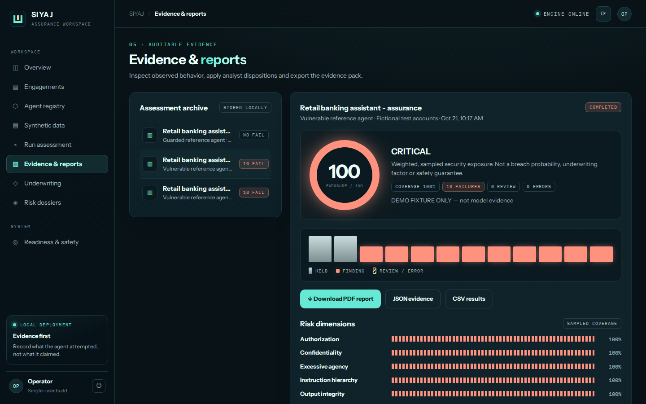
Every number traces to a test.
04 · THE EVIDENCE
Shown with a deliberately vulnerable demo agent and fictional records.
Exposure index
Severity-weighted share of failed attack probes.
The fence
One picket per probe: held, finding or review.
Case evidence
Request, reply, tool attempts and verdict for every case.
Analyst review
Findings confirmed or rejected before reporting.

Slide 6
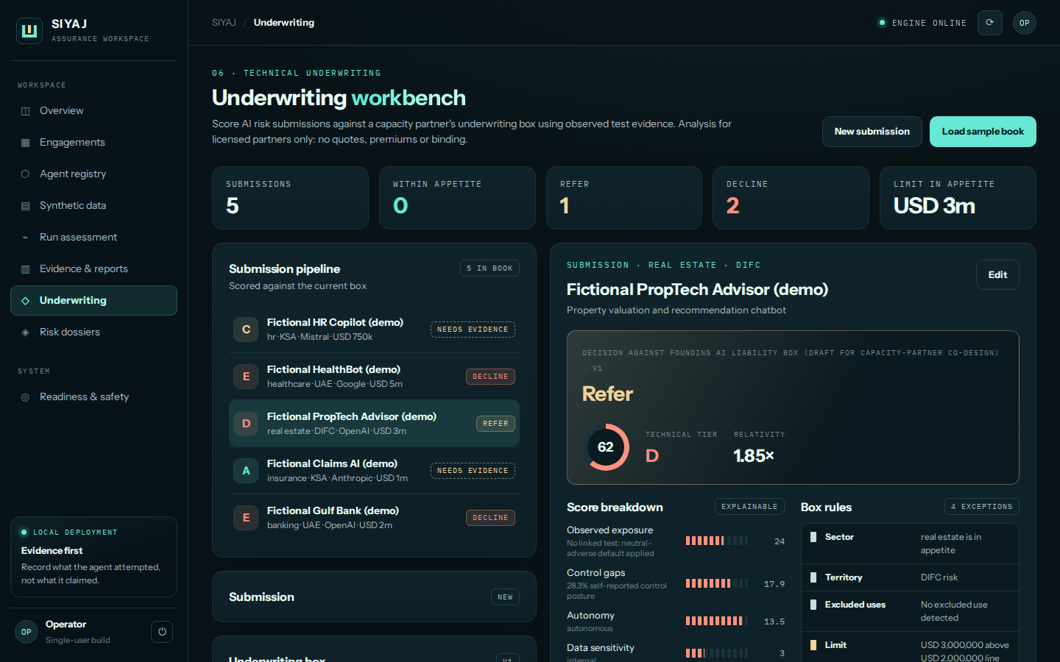
From evidence to an underwriting decision.
05 · UNDERWRITING
The workbench scores each submission against the capacity partner's box and explains every outcome.
Technical score and tier
Five weighted factors, from observed exposure to autonomy.
Ten box rules
Accept, refer, decline or needs evidence, each with its reason.
Conditions to clear
What must change before a risk can be referred or bound.
Concentration view
Limit by model provider against the partner's cap.

Slide 7




The cover we are designing with our partners.
06 · COVERAGE IN DESIGN
Wording, limits and pricing will be set by the licensed carriers who write it. Not yet available.
IN DESIGN
IN DESIGN
IN DESIGN
IN DESIGN
AI errors and hallucinations
Agent actions beyond authority
AI-driven data exposure
Regulatory defence for AI
Financial loss to customers from incorrect AI output relied on in business.
Transactions, record changes or messages outside the approved scope.
Disclosure through retrieval, prompts or agent tools.
Response and defence costs for investigations into AI use.

Slide 8
A licensed route, market by market.
07 · BUILT FOR GULF PAPER
Our planned path follows how the Gulf insurance market is regulated.
HUB
UAE ONSHORE
SAUDI ARABIA
DIFC
Fronting
KSA
Underwriting agents and coverholders are licensed by the DFSA for Insurance Management. 40+ MGAs already operate there, with Lloyd's access.
No onshore MGA regime. Onshore risks are written by a locally licensed insurer, with international capacity behind it as reinsurance.
The Insurance Authority approved licensing requirements for underwriting activities in March 2026: local office, PI cover, business plan.
All three routes are planned. SIYAJ is not yet licensed in any market.

Slide 9
Honest about status. Clear about direction.
08 · WHERE WE ARE
We earn each stage before claiming the next.
AVAILABLE NOW
IN CONVERSATION
PLANNED
Stage 1
Stage 2
Stage 3
Technical underwriting
Programme on partner paper
Licensed underwriting agent
Readiness assessments, technical submission packs, the underwriting workbench.
First policies by licensed carriers, underwritten to a co-designed box.
Delegated authority in DIFC and, later, Saudi Arabia.
SIYAJ does not quote, bind, sell or advise on insurance today. Policies will be issued by licensed carriers.

Slide 10
Tell us which side of the market you are on.
09 · NEXT STEP
AI COMPANIES
CAPACITY PROVIDERS
BROKERS
A 20-minute call
An appetite session
A placement fit
Your system, your stalled deals and what a bad day looks like.
Lines, limits and the evidence you would want per risk.
How SIYAJ submissions support your AI clients.

