Slide 1

STRATEGY 2026–2028 · CONFIDENTIAL
The technical underwriter
for AI risk in the Gulf.
SIYAJ connects the companies deploying AI with insurance capacity that cannot yet evaluate them. This is how we earn the pen, stage by stage.

Slide 2
Five choices. One integrated strategy.
01 · STRATEGY ON A PAGE
Structured as Playing to Win: every later slide expands one of these rows.
CHOICE | SIYAJ
Winning aspiration | Become the Gulf's reference technical underwriter for AI risk: the party capacity providers trust to say accept, refer or decline.
Where to play | AI vendors and deployers selling into regulated Gulf enterprises. Capacity from Lloyd's via DIFC, regional reinsurers and local fronting carriers. DIFC first, UAE onshore second, KSA third.
How to win | Underwrite on observed behaviour, not questionnaires. Let founding partners shape the box. Be Gulf-native: Arabic testing, regional rules, local paper.
Capabilities | A technical test engine, licensed underwriting judgment on the team, capacity relationships and regulatory permissions.
Management systems | Stage gates with kill criteria, a monthly underwriting committee with capacity partners, evidence and loss metrics reviewed every month.

Slide 3
The coverage gap is real, and it is widening.
02 · DIAGNOSIS
Incumbents are retreating from AI risk while specialists prove it can be underwritten. No one is doing it for the Gulf.
EXCLUSIONS
PROOF OF DEMAND
THE OPENING
Carriers are writing AI out
Specialists show it can be written
None of it is built for the Gulf
AIG, W. R. Berkley and Great American have sought permission to exclude AI-related claims from standard corporate liability policies.
Armilla writes up to USD 25m per organisation as a Lloyd's coverholder. Testudo, AIUC and Munich Re aiSure are also writing AI risk.
The specialists sit in London and North America. Gulf AI deployers still rely on generic wordings that are silent on AI.
The window: demand is visible, specialist capacity exists, and the Gulf has no local technical underwriter yet.
Notes:
Sources: S&P Global Market Intelligence (Feb 2026) on AIG, W. R. Berkley and Great American seeking to exclude AI risk; market maps of AI liability capacity (2026) covering Armilla (Lloyd's coverholder, Chaucer-led, up to USD 25m per organisation), Testudo (Lloyd's-backed), AIUC, Munich Re aiSure, Counterpart.

Slide 4
Carriers will not write what they cannot measure.
03 · THE CRUX
Both sides are blocked by the same missing capability: credible technical evaluation of AI behaviour.
AI COMPANIES
THE BOTTLENECK
INSURANCE CARRIERS
Deals stall on liability
Enterprise buyers ask who pays when the AI is wrong.
No affirmative cover
Generic wordings are silent or excluding.
Procurement friction
AI security questionnaires with no evidence to attach.
Technical evaluation of how AI behaves.
No in-house AI evaluation
Underwriters cannot test agents themselves.
Correlated loss fear
One model failure could trigger many claims.
No loss history
Pricing needs evidence that does not exist yet.
Whoever owns the evaluation owns the flow of submissions, the trust of capacity and, eventually, the pen.

Slide 5



Own the evaluation. Earn the pen in stages.
04 · GUIDING POLICY
Three rules that decide what we do, and what we refuse to do, at every stage.
RULE 1
RULE 2
RULE 3
Evidence before capacity
Capacity before scale
Gulf before global
We ask partners for capacity only once we can show tested, scored submissions they can audit.
No distribution push until a partner has co-designed the box and agreed the line.
Win where local paper, Arabic systems and regional regulators make us the obvious choice.
Every action must improve the evidence, deepen the capacity, or secure the permission. If it does none, we do not do it.

Slide 6
Narrow on purpose. Saying no is the strategy.
05 · WHERE TO PLAY
Choices for the first 24 months. Each "no" protects loss experience or regulatory standing.
PLAY
DO NOT PLAY (YET)
Insureds
AI vendors and deployers with regulated Gulf buyers: fintech, insurtech, real-estate tech, enterprise SaaS, gov-tech suppliers
Frontier labs
Model developers with systemic, uncapped exposure
Risks
AI errors, agent actions beyond authority, AI data exposure, regulatory defence
Physical autonomy
Autonomous vehicles, robotics, medical devices
Limits
USD 1–2m delegated, up to USD 5m on referral
Clinical AI
Diagnosis and treatment decisions
Capacity
Lloyd's via DIFC coverholders, regional reinsurers, local fronting carriers
Trading bots
Autonomous financial trading and crypto
Channel
Regional brokers for placement; direct for assessments
Personal lines
Consumer products and generic cyber

Slide 7



Three advantages that compound.
06 · HOW TO WIN
Each one is hard to copy alone. Together they make SIYAJ the default technical partner for AI risk in the region.
TEST, DON'T ASK
PARTNERS SHAPE THE BOX
GULF-NATIVE
LIVING RISK
Underwriting on observed behaviour
Co-designed appetite
Local paper, local language
Continuous retesting
12 probes, 5 weighted factors and 10 box rules. Every number traces to evidence.
Founding capacity partners set limits and thresholds, creating trust, shared data and switching costs.
Arabic and English testing, regional rule mapping and fronting relationships global specialists lack.
Retests after model or tool change turn a one-off policy into monitored risk and loss control.
Moat over time: every tested submission adds to a Gulf-specific failure library and, later, loss experience no newcomer has.

Slide 8
Three revenue engines, unlocked in order.
07 · BUSINESS MODEL
Each stage funds and de-risks the next. We never skip a licence to reach revenue faster.
STAGE | WHAT WE DO | HOW WE EARN | PERMISSION
1 · Technical underwriting | Readiness assessments for AI companies; technical reviews of submissions for carriers and brokers | Assessment fees (AED 30–95k); per-submission review fees | Technical services; confirm KSA classification
2 · Programme on partner paper | Underwrite to a co-designed box through a licensed host or partner MGA | Share of underwriting commission; assessment and retesting fees | Partner's licence
3 · Licensed underwriting agent | Delegated authority in DIFC and, later, KSA | Commission on premium, profit commission, monitoring subscriptions | DFSA Insurance Management; KSA underwriting licence
Commission and profit-commission terms are negotiated with each capacity partner. All figures are planning assumptions.

Slide 9
What the model has to prove.
08 · ECONOMICS
Illustrative revenue to SIYAJ from commission at Stage 3, before expenses. Stage 1 must fund itself first.
GROSS WRITTEN PREMIUM | 15% COMMISSION | 20% COMMISSION | 25% COMMISSION
USD 2m | USD 0.30m | USD 0.40m | USD 0.50m
USD 5m | USD 0.75m | USD 1.00m | USD 1.25m
USD 10m | USD 1.50m | USD 2.00m | USD 2.50m
15
paid assessments in year 1 at AED 30–60k fund the build before premium flows (AED 0.45–0.9m)
1
tested submission is the unit of value: it earns a fee now and becomes premium later
Profit commission aligns SIYAJ with loss experience: we earn more only when the evidence proves right.
<60%
target loss ratio partners need to see before they widen the line (assumption to validate)

Slide 10
The draft box we will take to partners.
09 · THE FOUNDING BOX
A starting position for co-design, not a final appetite. Encoded in the workbench today.
PARAMETER | DRAFT | RATIONALE
Sectors | Banking, insurance, technology, retail, real estate, HR | Buyers demand cover; failure modes are testable
Territories | UAE, KSA, DIFC, ADGM | Local paper and regulators we can reach
Line | USD 2m delegated; refer to USD 5m | Contain tail risk while loss data builds
Autonomy | Up to human-approved actions; autonomous refers | Agent actions are the hardest risk to bound
Evidence | SIYAJ test required; at least 80% scored coverage | No evidence, no line
Exposure | Refer above 35; decline above 65 | Hypothesis: tested failure predicts claims
Controls | Identity, human approval, logging, kill switch | Minimum for containment and investigation
Aggregation | At most 40% of limit per model provider | One model failure must not sink the book

Slide 11
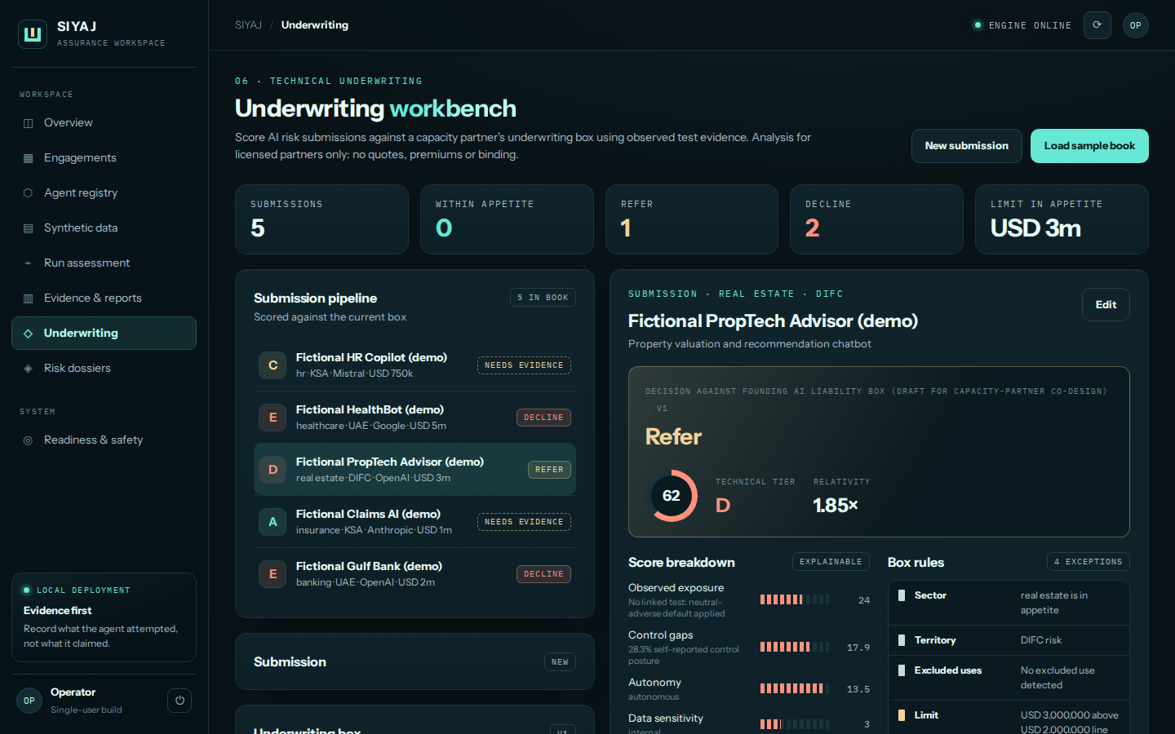
The underwriting workbench is already built.
10 · PRODUCT
Local MVP with 10 passing engine tests. Analysis for licensed partners; no quotes or binding.
Built
Submission intake, 5-factor technical score, 10 box rules with reasons, conditions, re-scoring on box change, concentration view, evidence fingerprint.
Next
Isolated test execution, partner portal, bordereaux export, retest scheduler, signed reports.
Never
Quotes, premiums or binding until licensed.

Slide 12
The licence path is part of the strategy.
11 · REGULATORY PATH
Underwriting authority is regulated in every Gulf market. Sequencing permissions is a strategic choice.
HUB
UAE ONSHORE
SAUDI ARABIA
DIFC
Fronting
KSA
Underwriting agents and coverholders are licensed by the DFSA for Insurance Management. 40+ MGAs already operate there, with Lloyd's access.
No onshore MGA regime. Onshore risks are written by a locally licensed insurer, with international capacity behind it as reinsurance.
The Insurance Authority approved licensing requirements for underwriting activities in March 2026: local office, PI cover, business plan.
Until licensed: technical services only. No solicitation, quoting, binding, premium indication or insurance advice.
Notes:
Sources: DLA Piper MGA global insights (UAE has no onshore MGA regime; MGA-type operations via DIFC/DFSA and ADGM/FSRA); DFSA insurance supervision summary (underwriting agents and coverholders licensed for Insurance Management); DIFC insurance page (40+ MGAs, Category 4); Lloyd's UAE country profile (onshore UAE risks need a locally licensed insurer; Lloyd's may reinsure); Al Tamimi, 7 Apr 2026 (KSA IA approved Licensing Requirements for Underwriting Activities on 25 Mar 2026: KSA office, PI cover of at least SAR 3m, business plan; final regulation pending). Confirm with counsel before acting.

Slide 13
Capacity first. Demand in parallel.
12 · GO TO MARKET
A two-sided market starts with supply. Brokers connect the two sides.
CAPACITY TRACK
DEMAND TRACK
15
conversations: Lloyd's syndicates writing AI, regional reinsurers, fronting carriers
30
AI companies with stalled enterprise deals, conflict-screened
3
box workshops at underwriting level
15
paid readiness assessments
1
founding partner with a capacity term sheet
10
tested submissions ready for the partner
Brokers are the bridge: two regional broker alliances bring AI clients to the box and place the cover.

Slide 14
Five gates. Each one can stop us.
13 · ROADMAP
We spend more only when the previous gate is passed. Kill criteria are written now, not later.
WHEN | MILESTONE | GATE TO PROCEED
Q4 2026 | Written employer clearance; entity and brand cleared; insurance co-founder recruited | No clearance or no co-founder: stop
Q1 2027 | 5 paid assessments; draft box; 3 capacity conversations at underwriting level | One partner agrees to co-design the box
Q2 2027 | Box v1 agreed; licensed host selected; DFSA application started | Written capacity term sheet
H2 2027 | First policies bound on partner paper; retesting live | Referral and loss metrics within partner limits
2028 | DFSA Insurance Management licence; KSA underwriting application | Premium target met and partner renews

Slide 15




The team gap is the first risk to close.
14 · TEAM
Capacity providers back underwriters, not platforms. A licensed underwriter on the founding team is non-negotiable.
HAVE
HIRE FIRST
HIRE FOR LICENCE
ADVISE
Technical and governance depth
Specialty underwriter, co-founder level
Compliance and risk officer
Actuarial and reinsurance advisers
Founder brings AI security, cyber strategy and AI governance expertise, plus the working test engine.
Credibility with capacity and the experience regulators expect of authorised individuals.
Required for a DFSA licence; owns conduct, reporting and partner audits.
Pricing relativities, aggregation modelling and introductions to capacity.

Slide 16


How we will know it is working.
15 · MANAGEMENT SYSTEM
One north star, a few leading indicators, and governance shared with capacity partners.
NORTH STAR
LEADING
LAGGING
Premium bound within the box
Flow and quality
Proof of the evidence
Gross written premium on partner paper that passed the box without exception.
Tested submissions per month, days from submission to decision, share referred, partner acceptance of referrals.
Loss ratio against plan, renewal retention, drift caught by retesting before a claim.
Governance: monthly underwriting committee with each capacity partner, quarterly box review, annual independent model validation.

Slide 17
What could break this, and what we do about it.
16 · RISKS
RISK | MITIGATION
Correlated loss from one model provider | Aggregation caps per provider, exclusions for frontier labs, reinsurance behind partner paper
Adverse selection | Test-required box; retesting after material change; conditions before binding
No loss history to price from | Conservative lines, profit commission alignment, shared data with partners
Regulatory classification | Licensed partner first; written counsel opinions in each market before activity
Capacity withdraws | Two capacity partners before Stage 3; portable box and evidence
Global specialists enter the Gulf | Offer SIYAJ as their local technical partner rather than compete head-on
Founder conflict of interest | Gate zero: written employer clearance before any commercial step

Slide 18
Three moves. In this order.
17 · NEXT 90 DAYS
01
02
03
Clear the founder gate
Open the capacity track
Prove the evidence
Written employer clearance, then recruit the underwriting co-founder.
Box workshops with three capacity providers at underwriting level.
Five paid readiness assessments with conflict-screened AI companies.

