Slide 1

CREDIT SCORE
ANALYSIS & PREDICTION
Reporter: Ruolin Zhao, Siqi Yu
(Group 28)

Slide 2
contents
01
Dataset Description
Anaylsis
02
Q1:What is the relationship between age and credit score ?
Q2:What is the relationship between annual income and credit score ?
Q3:What is the relationship between installment amount and credit score ?
03
APP Demo
Prediction
04
Machine Learning

Slide 3
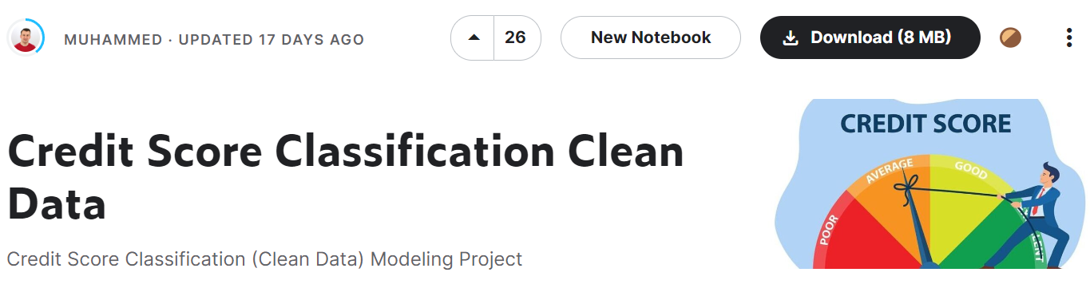
Dataset Description
这里输入简单的文字概述
Problem Statement
You are working as a data scientist in a global finance company. Over the years, the company has collected basic bank details and gathered a lot of credit-related information. The management wants to build an intelligent system to segregate the people into credit score brackets to reduce the manual efforts.
.
Task
Given a person’s credit-related information, build a machine learning model that can classify the credit score.
这里输入简单的文字概述这里输入简单字概述这里输入简单简单的文字概述这里输入简单的文字概述简单的文字概述这里输入简单的文字概述这里输入简单的文字概述这里输入简单的文字概述这里输入简单的文字概述这里输入这里输入简单的文字概述这里输入简单字概述
https://www.kaggle.com/datasets/clkmuhammed/creditscoreclassification

Slide 4
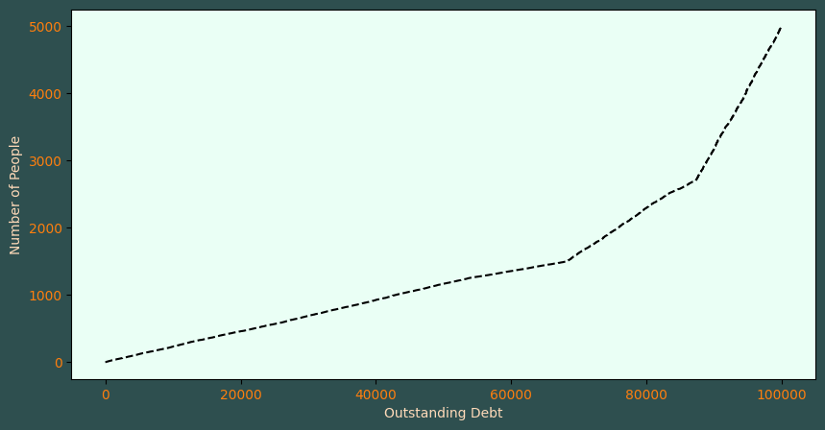
Analysis-Intro
Why do financial institutions need to assess a person's credit score to decide whether to lend?
People tend to borrow large loans.
If credit scores are not evaluated, unpredictable losses will be caused to financial institutions

Slide 5
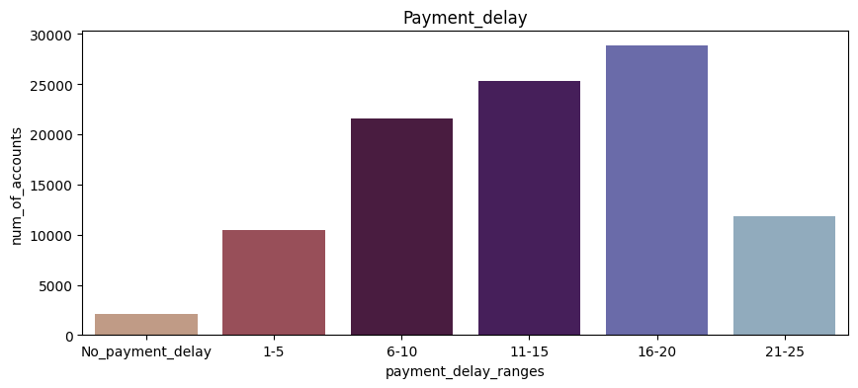
Analysis-Q1
What is the pament delay days’s distribution ?
Age is proportional to credit score.

Slide 6
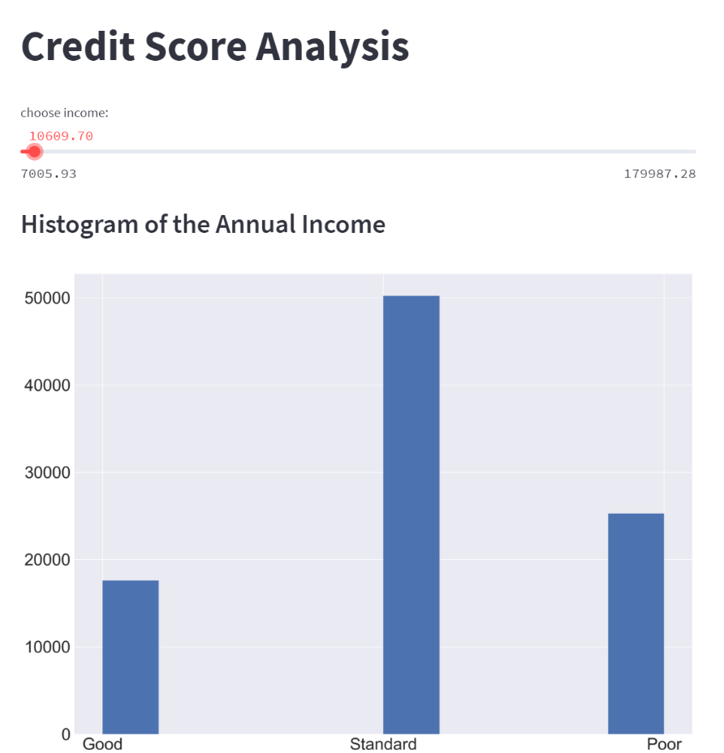
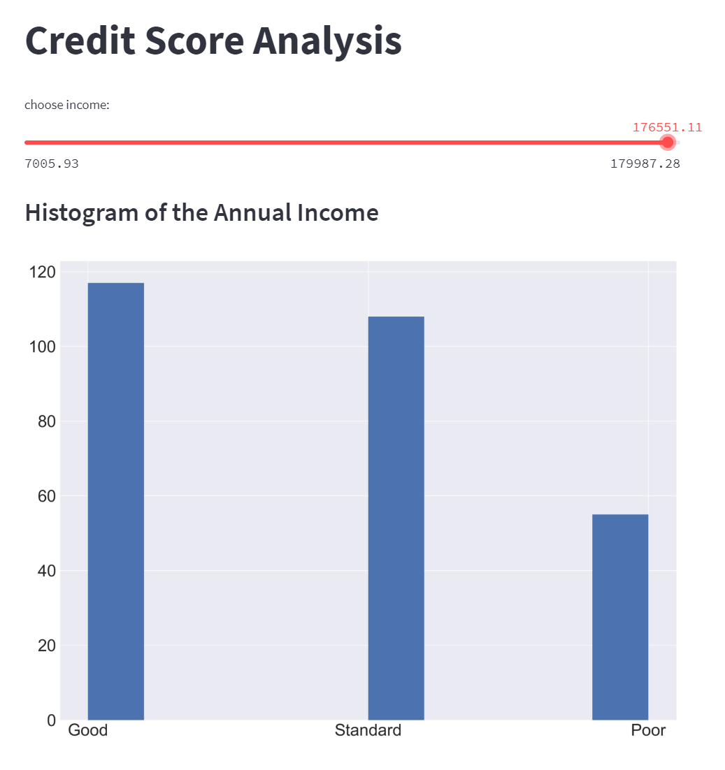
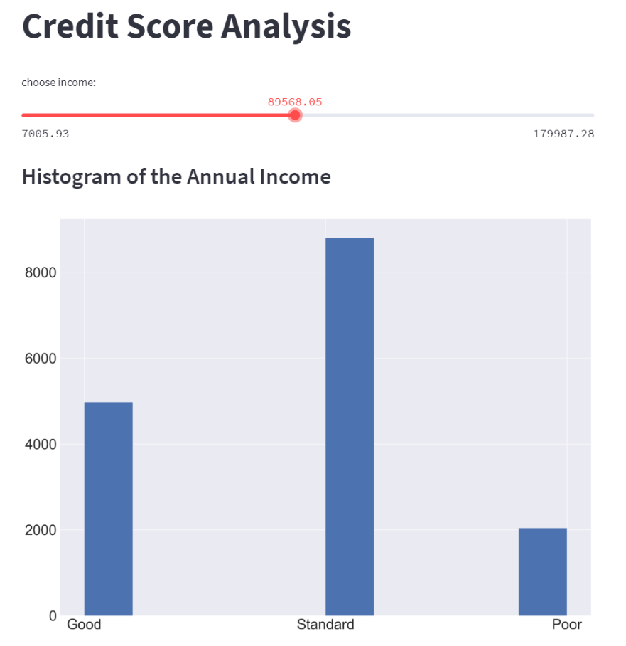
Analysis-Q2
What is the relationship between annual income and credit score ?
High income people usually show higher credit scores.

Slide 7
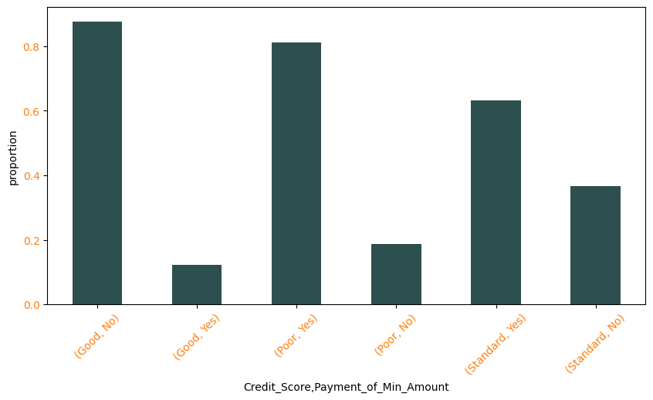
Analysis-Q3
What is the relationship between installment amount and credit score ?
People with low credit score tend to pay only the minimum amount on each repayment date.
People with high credit score usually do not choose to pay the minimum amount on each repayment date.

Slide 8
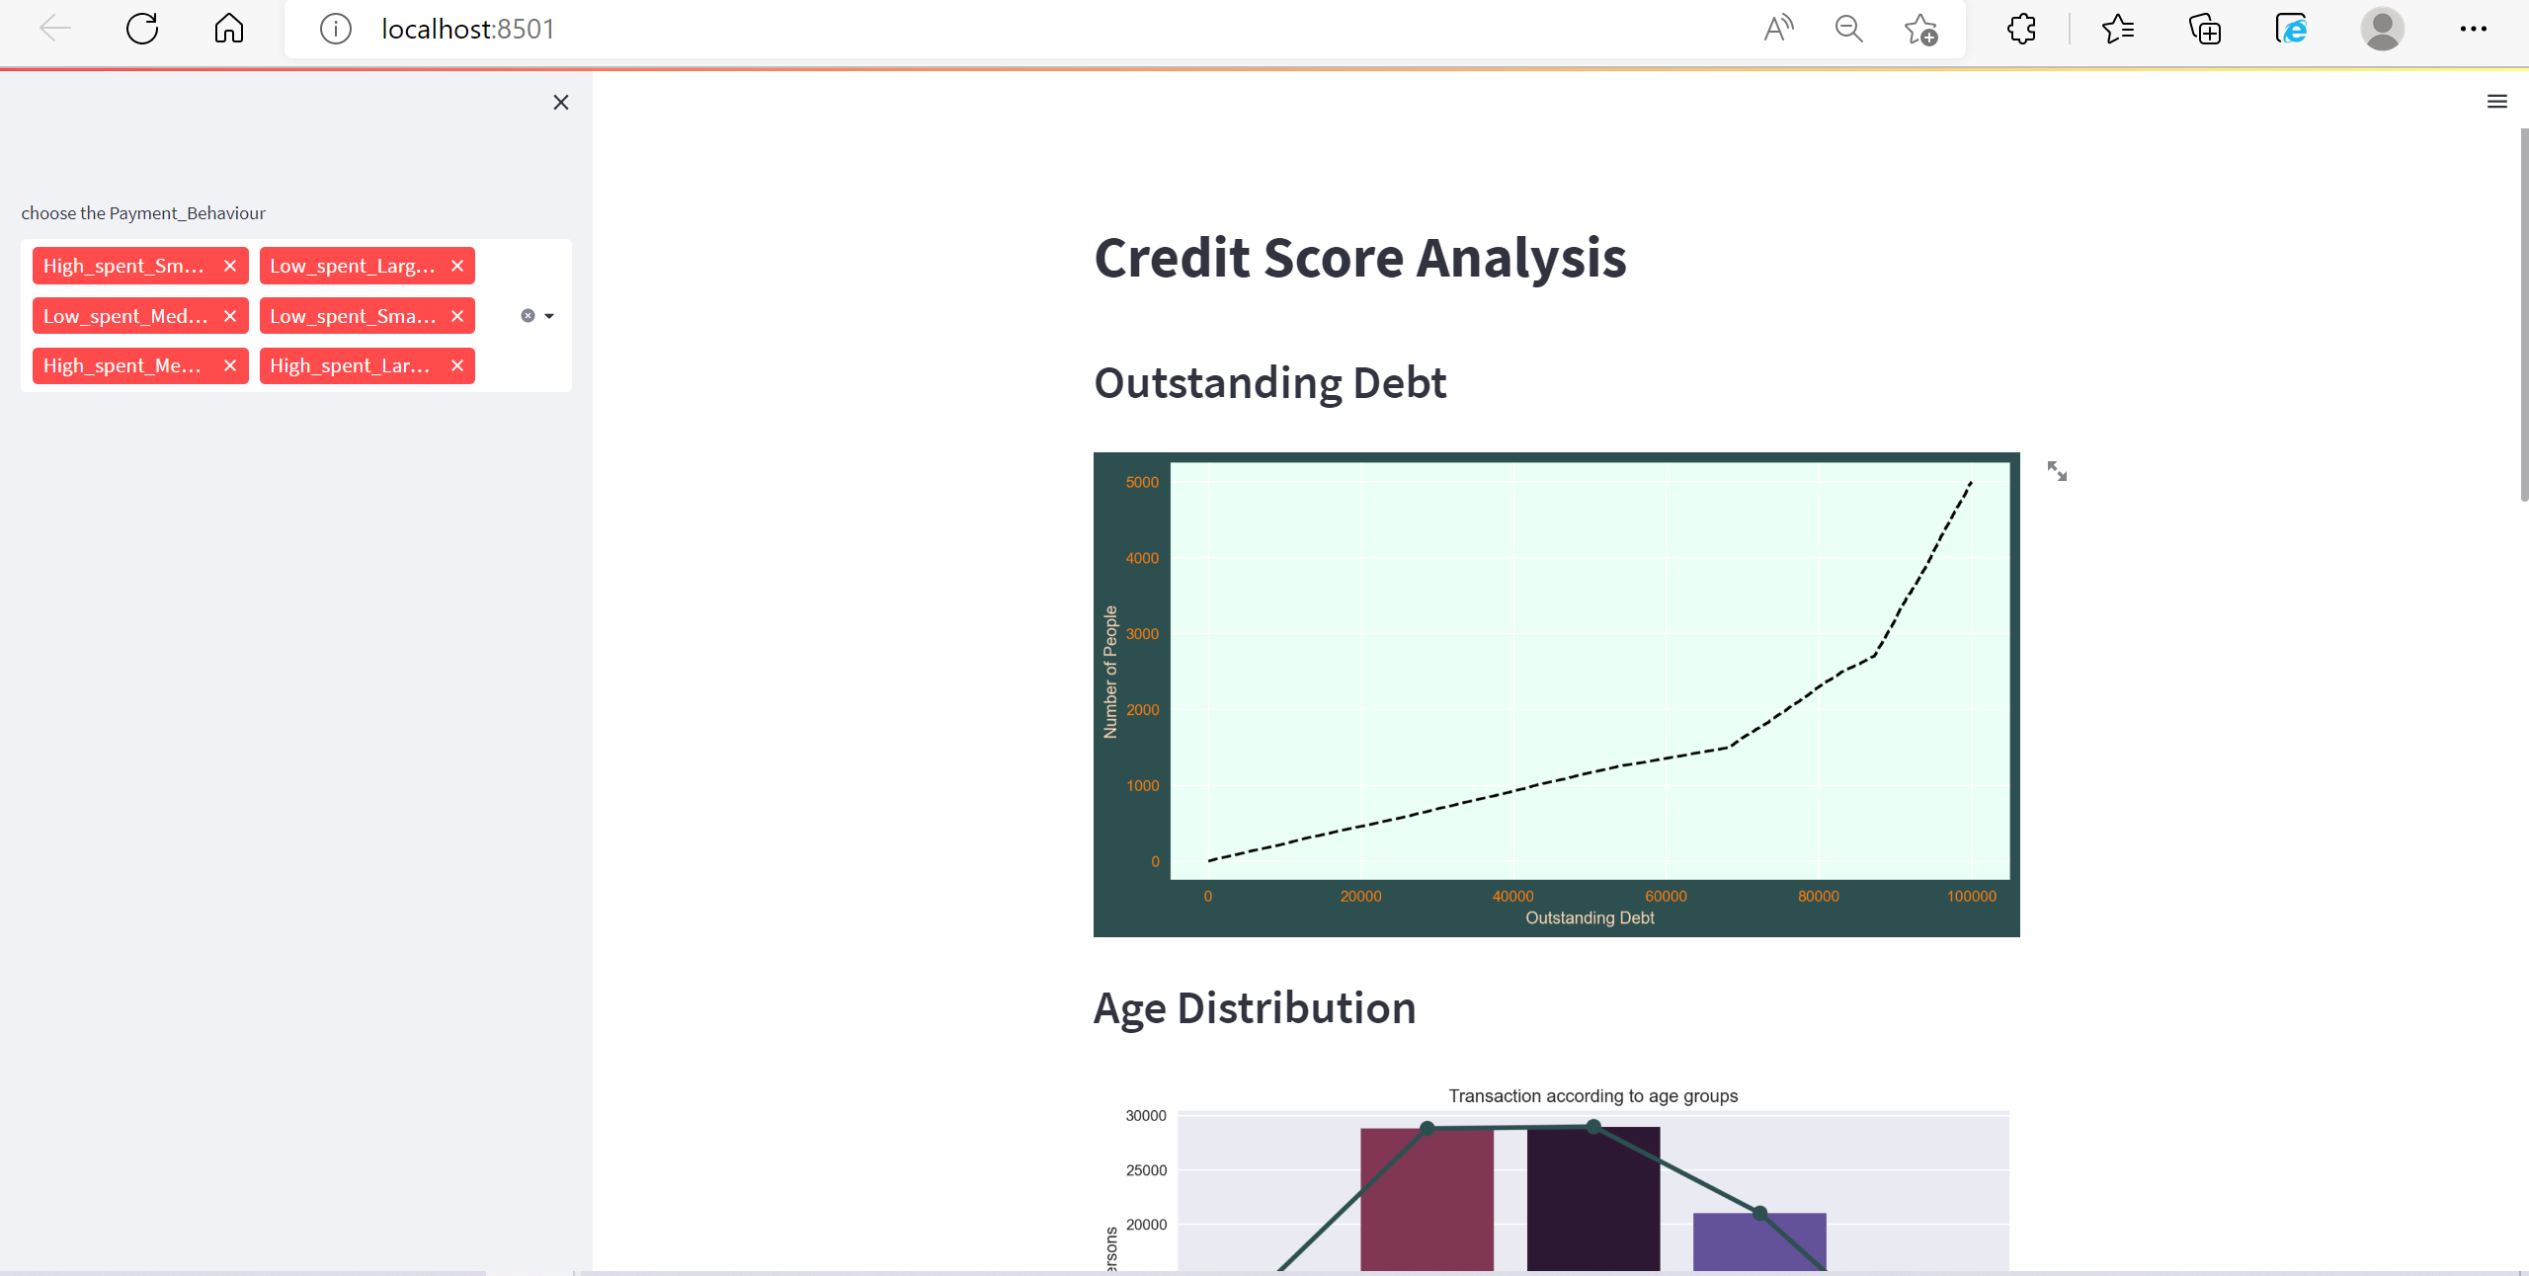
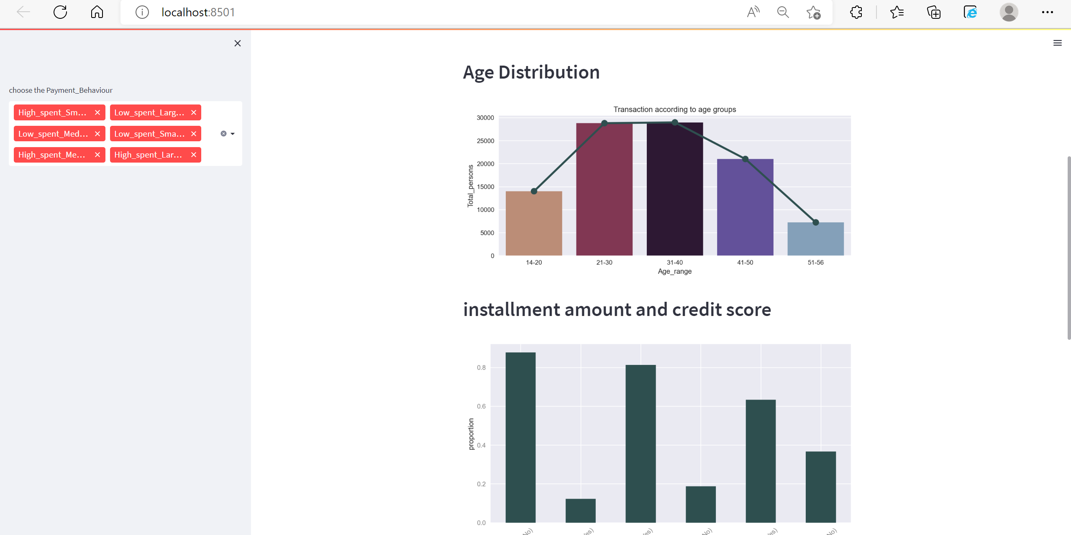
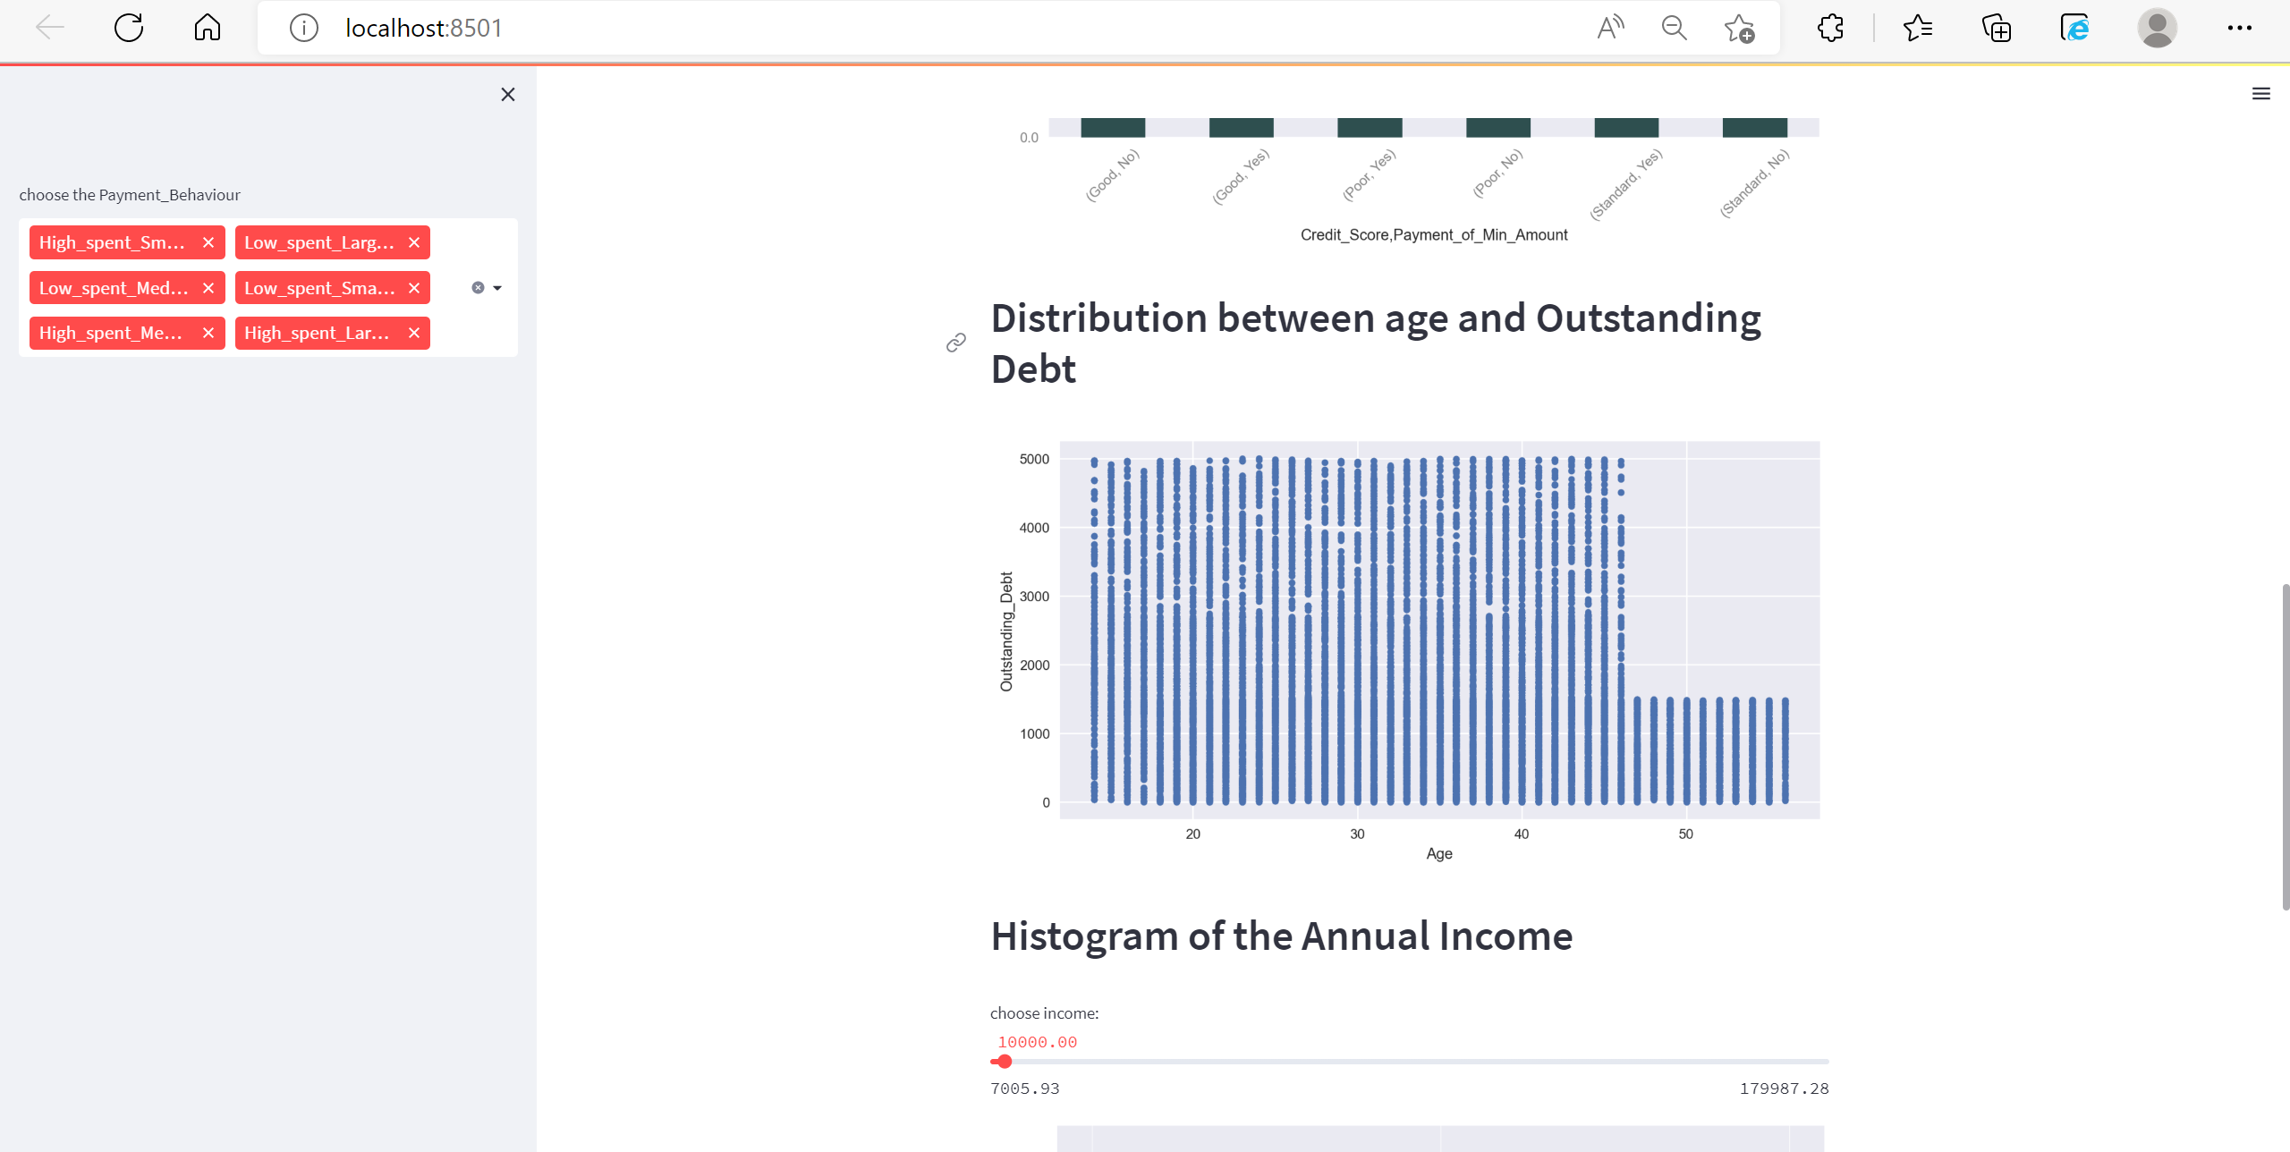
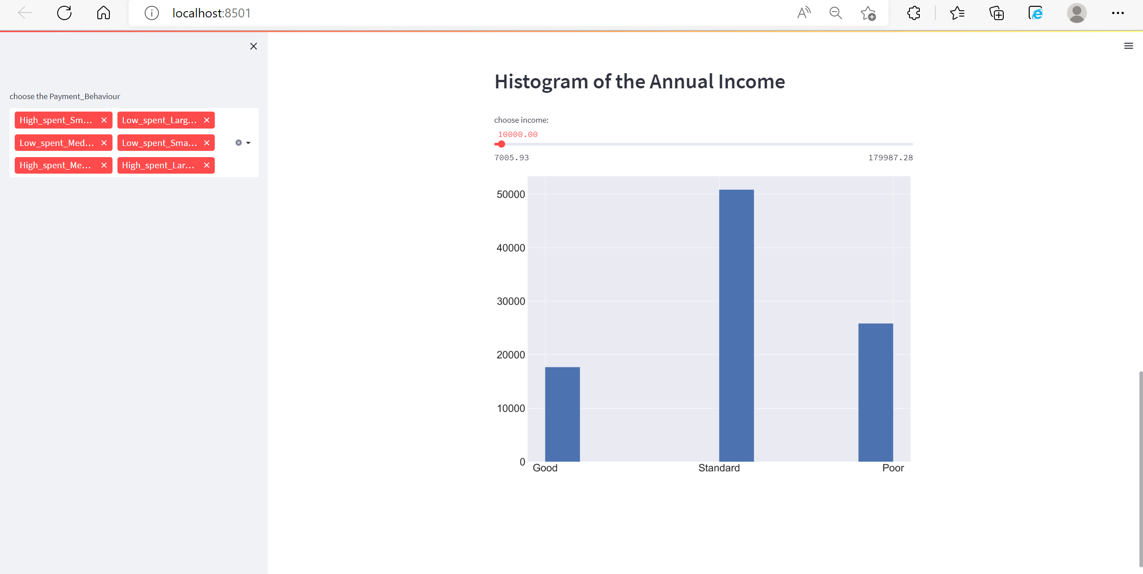
APP Demo

Slide 9
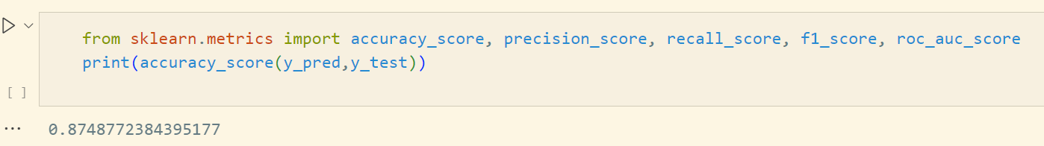
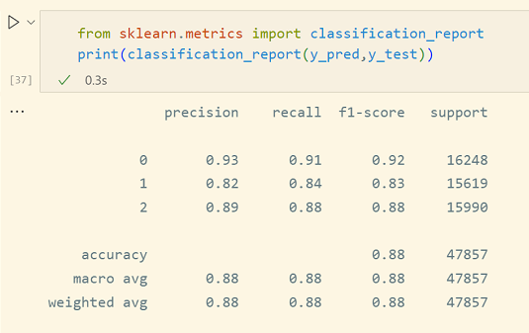
Prediction & Business Value
The final accuracy rate of our model is more than 0.87
More detailed test

Slide 10
THANKS

