Slide 1
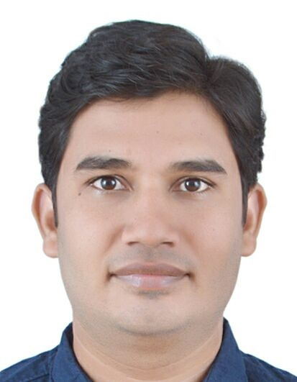
Photo
1.18“ x 1.41“
Satyendra Jain
Senior Frontend Engineer
Role and Background
  Satyendra has over 15+ years of experience in software industry and working as Senior Frontend Engineer. Ability to design and develop UI web application with usability standard, in depth understanding of cross-browser compatibility, front-end development issues, Semantic HTML Coding/W3C standards, Responsive web design, user friendly and Google Analytics/SEO friendly architecture (web 2.0 concept layouts).
  He worked in various roles like user interface developer, module lead, team lead etc.
  He has domain expertise and functional expertise in “Banking & finance”, “Retail”, “Manufacturing” and “Travel, Transport and Hospitality” domain.
  He worked various technologies like: VUE JS, Angular, React JS, TypeScript, JavaScript(ES6), Angular JS 1.xx, Backbone JS, Underscore, HTML5, CSS3, LESS/SASS, Handlebars. Also experience in frontend testing frameworks such as Jasmine-karma, Jest.
  Working knowledge of Devopps tools like Hudson, Jenkins, Git, GitHub Action, Jira, Bitbucket, Confluence, NPM, Bower etc.
  Experience of working in both Agile delivery and Waterfall models.
Representative Accomplishments
  Performed Developer/Lead Developer roles for various clients like: Maersk (Danish shipping and logistics), Vanguard (American registered investment advisor ), Genworth, Legal & General, PruHealth (Insurance), HDFC (Indian banking and financial services), DaVita (Healthcare) etc.
  Responsible for Requirement Analysis, Estimation, Planning, Execution, Coordination and Product release.
  Design and develop high/low level layouts & prototypes as per business requirements. Client communication regarding business and technical requirements based on project requirements.
  Certification held - Digital : MFDM™ AI Aware Certification, Process : Agile Way of Working
Educational Background
  Bachelor of Commerce from D.A.V.V. University Indore, India.
  Multimedia Certification Course for “UI Design & Development”.

