Slide 1
Doom Carnival
Team Armor
Joe Rivera
Robert Monart
Andrew Yacoub
Miguel Hernandez

Slide 2
About Doom Carnival
Background Story
Rustee the Clown (Antagonist)
Clowns
Demons
First Person Shooter (FPS)
Blueprints

Slide 3
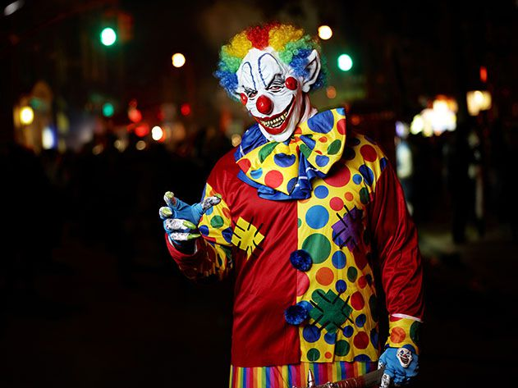
Background Story
Chaos has been unleashed, demons are being released all around neighborhood and your daughter has been kidnapped by an evil clown that goes by the name, Rustee. Will you be able to defeat Rustee and save your daughter from this Doom Carnival?

Slide 4
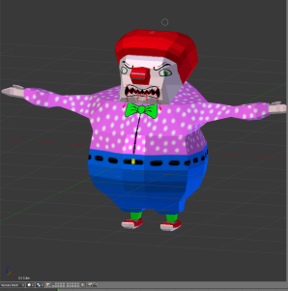
Rustee the Clown
Rustee the Clown is the main antagonist.

Slide 5
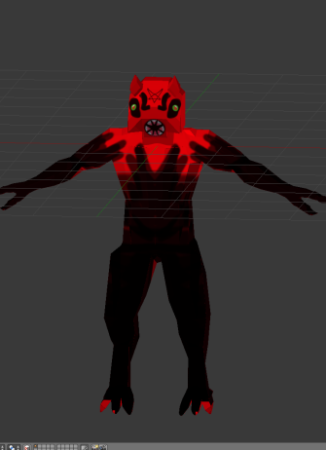
Demon
This Demon is just a common enemy you’ll see throughout the game.

Slide 6
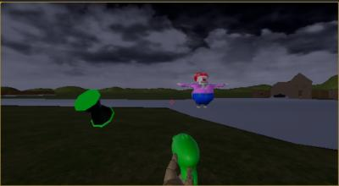
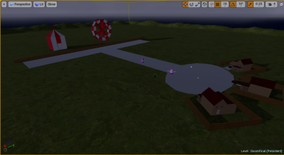
Map/First Person Shooter (FPS)
This game will be in the First Person perspective and shows Rustee (left picture) and the map layout (right picture).

Slide 7
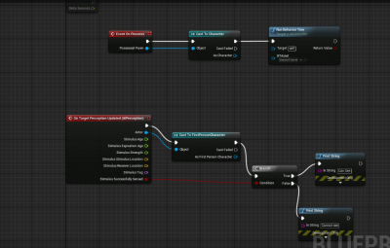
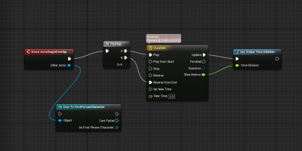
Blueprints
An example of a Blueprint is the Slow Motion Blueprint that is given below.
A Blueprint that is being tested to see if the enemy can detect the player.

