Slide 1
CRUD Project
Samuel Knapp

Slide 2
Planning
Technologies
Demo
Summary

Slide 3
Planning

Slide 4
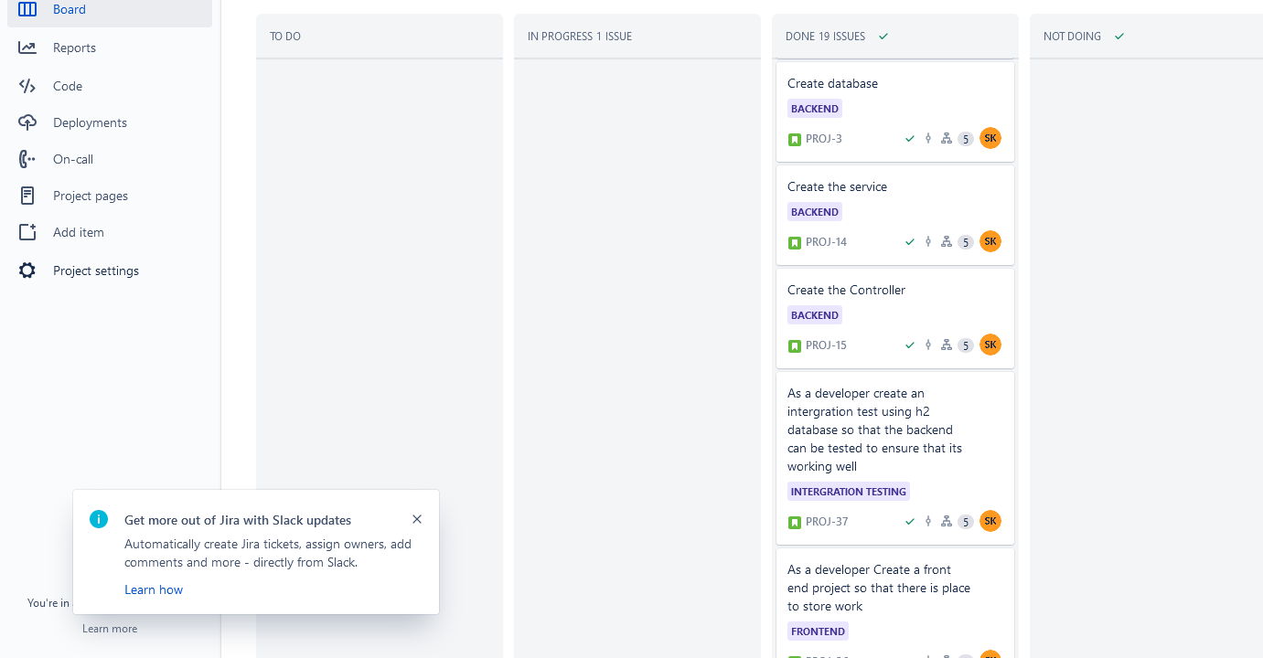
Jira
Sprint board used
Developed user stories on
Formed a solid idea of what I wanted for the project by planning the stories

Slide 5
Technologies

Slide 6
Technologies
Git
Database (Mysql)
Backend
  Java -Mockito -Spring boot
Frontend
  Html -Css -javascript
Testing
  Postman -Selenium -Mockito -Mockmvc

Slide 7
Demo

Slide 8
Reflection
What went well
Time management in getting everything to come together in time
What went less well
Most tests are very happy path
Best learning
Learning how everything fits together
Done differently
Plan the UI design in advanced
Write documentation I go

