Slide 1
Madeups

Slide 2
Ignore the slides upto Slide 12

Slide 3
Overview Page
Home
Logout
1. Greige Fabric Inwards
2. Dyeing
A (1) . Dyeing Outwards
a (2). Dyeing Instructions
b. Dyeing Inwards
c. Dyeing Inwards Quality Check
3. Stitching
a. Stitching Outwards
b. Final product Inwards
4. Sales

Slide 4
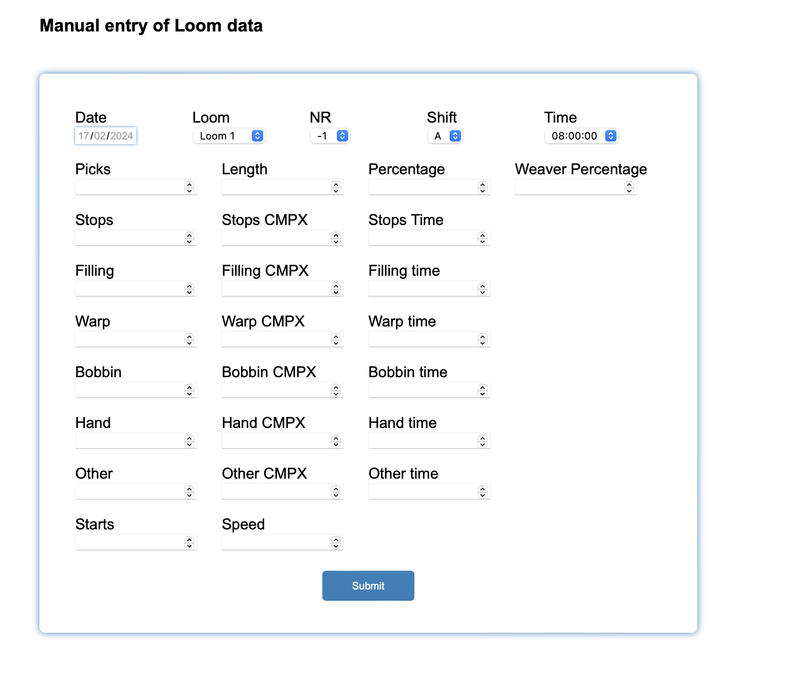
Sample form design

Slide 5




Form – 1: Greige Fabric Inwards
Incoming Date
Supplier Name | (Dropdown to chose the supplier)
Construction | (Dropdown to chose the construction)
Greige Fabric Code
Meters
Organic / Egypitan / Supima fabric | Dropdown to chose the fabric type)
GSM / GLM (to be calculated) is there a formula for it?
Width
Roll Number
Roll Weight
Thread Count
Design | Dropdown

Slide 6
Change type of fabric to Fabric Fiber Content (Dropdown-100% Cotton, 100
• Mercerizing – (Yes/No)
• Sanforising (zero-zero) – (Yes/No)
• Softener - (Choose from Drop Down - Hydrophilic Only, Super Silky Finish)
• Change Expected Width to Finishing Width
• Remove meters in Pantone Code Row
• Change Dyeing finish to Special Finish (Dropdown – Resin/Wrinkle Free, Antimicrobial,
Moisture Management)
• Light Fastness
• Wash Fastness
• Dry Rub
• Wet Rub
• Pilling
Form – 2A (2) : Dyeing Outwards – Dyeing Instructions
Greige fabric
Pantone Color + Meters
Expected Width
Dyeing Finish
Sample or bulk
Type of fabric
Thread Count
Expected delivery date
Swatch added/not
Lap dip (Need / not needed) (completed / incomplete)
Total meters given for dyeing
Print PDF

Slide 7
What is the difference between meters sent for dyeing and roll meters?
• Quantity sent in terns of weight (kg) to be added
• Meters and weight entered should match with calculated GLM
Form – 2A (1) : Dyeing Outwards
Outgoing Date
Dyeing Unit | (Dropdown to chose the dyeing unit)
Choose Greige fabric Code | (Dropdown to chose the code)
Metres sent for dyeing
Roll No
Roll Meters

Slide 8
Form - 2B : Dyeing Inwards
Dyeing Inwards date
Greige Fabric Code | Will automatically display the chosen grey fabric code
Unit Processed | Will automatically display the processing unit for the chosen grey fabric code
Meters GIVEN for dyeing (GRIEGE) | Will automatically display the meters for the chosen grey fabric code
Dyed fabric Color Code 1 | Code | Meters
Dyed fabric Color Code 2 | Code | Meters
Dyed fabric Color Code 3 | Code | Meters
Dyed fabric Color Code 4 | Code | Meters
Dyed fabric Color Code 5 | Code | Meters
Roll No and meters to be entered
Choose Greige Fabric Code | (Dropdown to chose the greige fabric code)
Display details
Will display the details of chosen greige fabric code
Shrinkage Length - to be calculated from Greige Meters Sent data and Dyeing Received data
(Both in actual meters and in percentage)
• Shrinkage Width – to be calculated from greige width and dyed fabric width (same as
pervious act &amp; percentage)
• Weight Loss (Actual &amp; Percentage) – To be calculated from Greige Roll weight sent to dyeing
and Roll weight received from dyeing
• Note: For each colour separate dyeing outward DC has to be made. They cannot combine.
Weight and meters also should be separate for each colour
Once submit is entered, it will display the meter difference and shrinkage difference(width)

Slide 9
Form – 2C : Dyeing Inwards Quality Check
Date
Dyed Fabric Code | Will automatically display the chosen dyed fabric code
Meters Processed | Will automatically display the processing unit for the chosen dyed fabric code
Status (Three options – Passed / Pending / Rejected) | Passed | Need to enter meters | Specify Reason
 | Pending | Need to enter meters | Specify Reason
 | Rejected | Need to enter meters | Specify Reason
Choose Dyed Fabric Code | (Dropdown to chose the dyed fabric code)
Display details
Will display the details of chosen dyed fabric code
Following quality test report to be received from the Dyeing
• Light Fastness
• Wash Fastness
• Dry Rub
• Wet Rub
• Pilling
Form 3A – Stitching Outwards change to Stitching Job Card
• Once Job card is created, Dyed fabric Code to be converted to the respective finished
product codes (i.e we need separate codes for each size and products, refer nomenclature
for better understanding)

Slide 10
Form 3A – Stitching Outwards
Stitching outwards date
Dyed Fabric Color Code | Will automatically display the chosen dyed fabric code
Meters in Stock | Will automatically display the meters for the chosen dyed fabric code
Meters given for stitching
King Set (optional)
Queen Set (optional)
Single Set (optional)
Duvet Cover (optional)
Custom Size (optional) | Dimension to be inputted | No of Sets for the customised size
Pillow cases
Choose Dyed fabric Color Code | (Dropdown to chose the dyed fabric color code)
Display details
(Will display the details of chosen dyed fabric code)
We should be able to print a stock report which has stock in the following category wise
(greige fabric, dyeing fabric, finished products)
• We should be able to sell all the above mentioned products. It should adjusted from the
stock once sales is entered.
Print PDF
(Will save the details submitted and download the details in a pdf format)

Slide 11
Form 3B – Stitching Inwards
Stitching inwards date
Dyed Fabric Color Code | Will automatically display the chosen dyed fabric code
Meters given for stitching | Will automatically display the meters for the chosen dyed fabric code
No of King Sets stitched (optional)
No of Queen Sets stitched (optional)
No of Single sets stitched (optional)
No of Duvet Covers stitched (optional)
No of Custom Sizes (optional) | Dimension will be automatically displayed | No of Sets for the customised size
Choose Dyed fabric Color Code | (Dropdown to chose the dyed fabric color code)
Display details
(Will display the details of chosen dyed fabric code)

Slide 12
Form 4 – Sales
Sales Date
Dyed Fabric Code | Choose dyed fabric Code
Type of Product (King Flat / King Fitted / Queen Flat / Queen Fitted / Single flat / Single fitted / Customised Set / Pillow Covers) | Choose type of product
Type of Sales (Direct Sales / Online Sales / Free Sales/Chennai Stock) | Choose type of Sales
Remarks | Any remarks to be mentioned here
No of Set

Slide 13
Madeups Software
Not doing now
PART E
PART F
PART G
PART A
PART B
PART C
PART D
Enquiry List
Sales Order
Work Order
Greige Fabric Purchase
Dyeing Fabric Issue
Dyeing Fabric Inward
Dyeing Fabric Issue
Dyeing Fabric Return
Order Details
Checklist Items
Greige Fabric PO
Dyeing fabric instruction
Dyeing fabric inspection
SKU Master

Slide 14
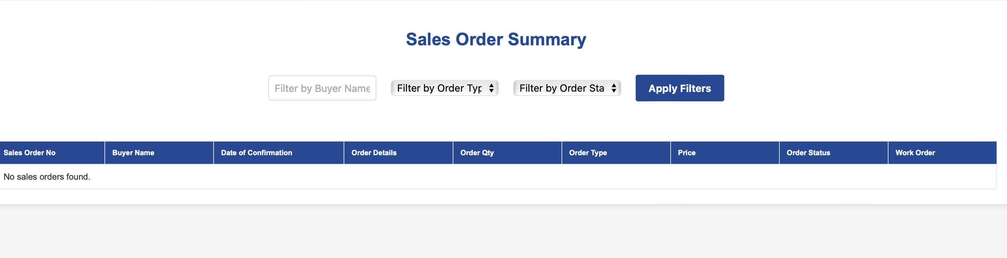
PART – D Greige Fabric PO (1/5)
1. Please use the below format for Html display for Greige Fabric Purchase Order and the contents are mentioned in the table. Along with it, give a link to add new PO.
SNo | Sales Order No | Greige Fabric PO No | TC | Finished Fabric Construction | Weave Design | Greige Fabric Construction | GSM | Qty (meters) | Supplier Details | PDF Download | PO Status
1 | SO1 | SO1/FPO1 | 300 | 60s Cotton * 60s Polyester 195*98/1 | Sateen | 60s Cotton * 60s Polyester 195*98/1 | 234 | 12000 | SJLT Wovens | Pdf download link | Completed / Ongoing

Slide 15
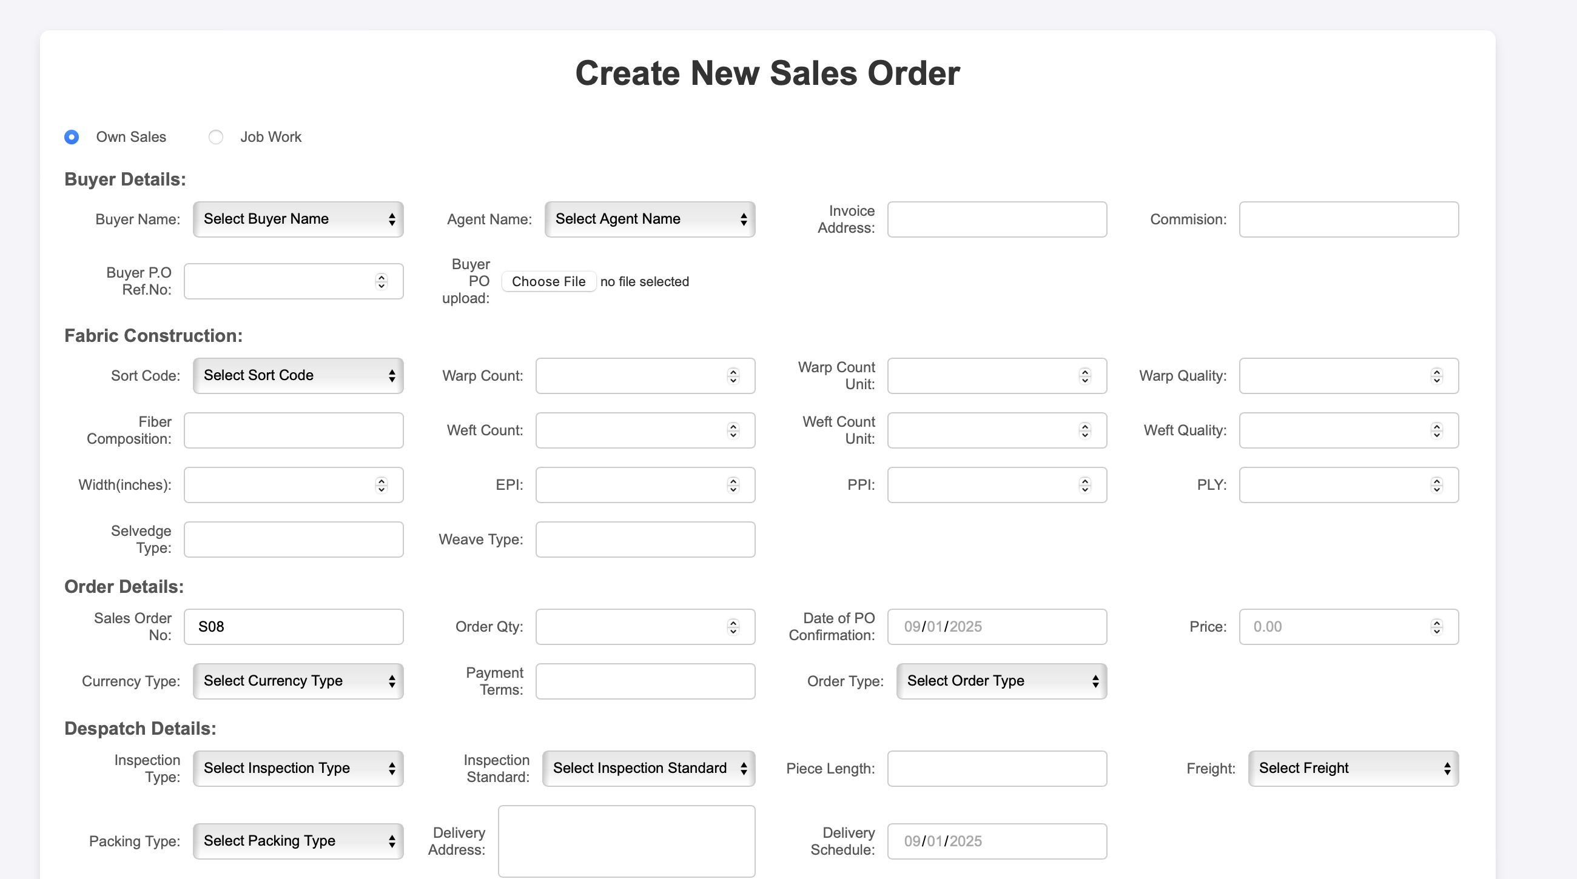
PART – D Greige Fabric PO (2/5)
2. When clicked add button, following page with this format to be displayed.

Slide 16
PART – D Greige Fabric PO (3/5)
3. In the add section, include the following items for form submission. We can have more than two construction in the same PO. Need to incorporate that also.
New Greige PO
Submit (button)
Back
Sales Order No
Select option
Greige Fabric PO No
Auto generated value – SO1/FPO1
Finished Fabric Construction
To display the finished fabric construction for the particular Sales Order as one single text of the below values. In the sales order, if there are two or more fabric construction then all of them should be displayed and for each finished fabric construction, greige fabric construction has to be inputted by the user.
Fabric Construction SNo | TC | Warp Count | Warp Composition | Weft Count | Weft Composition | EPI | PPI | Ply | GSM | Fabric | Weave Design
 |  | Number input | Text | Number | Text | Number | Number | Number | Number | Text | Text
Input values in each column table.
Greige Fabric Construction
Warp Count | Warp Composition | Weft Count | Weft Composition | EPI | PPI | Ply | GSM | Width (inches) | Weave Design
Number input | Text input | Number input | Text input | Number input | Number input | Number input | Number input | Number input | Text input

Slide 17
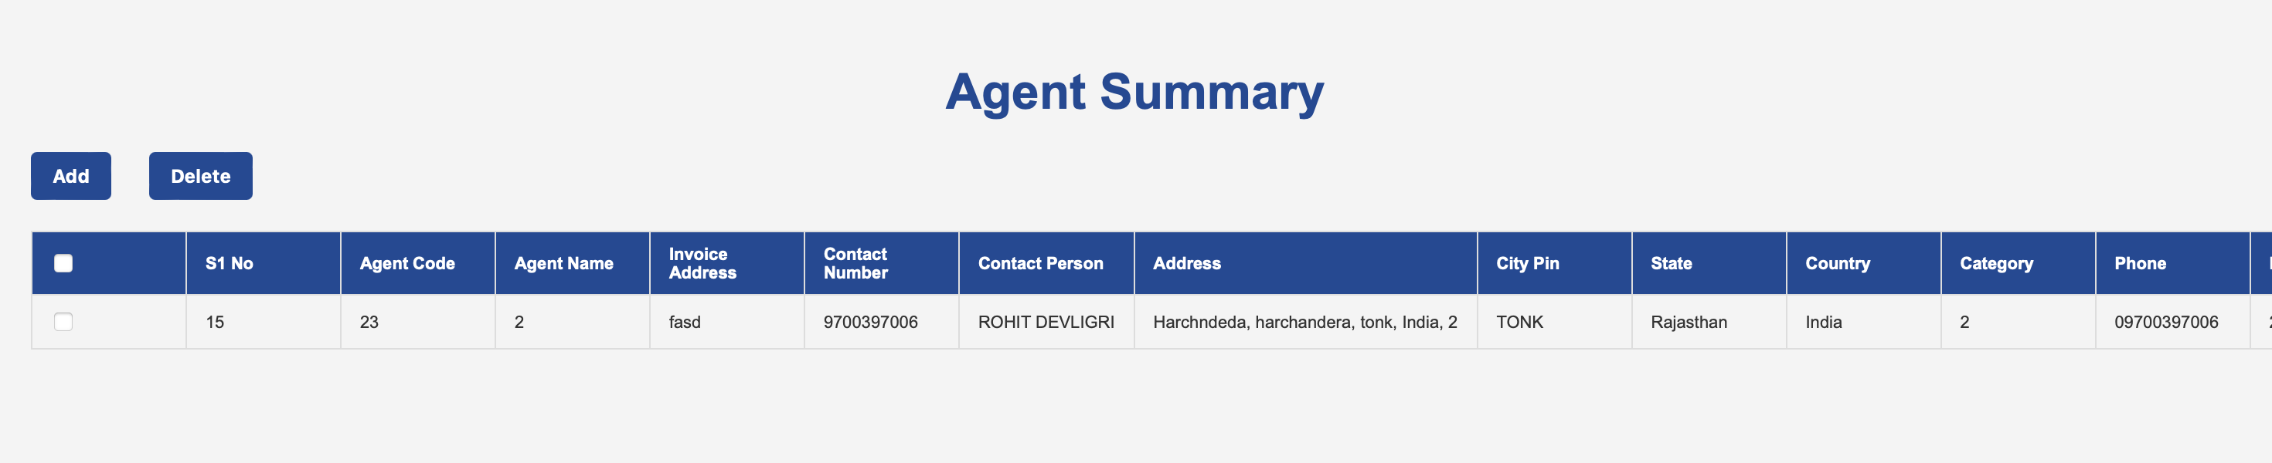
PART – D Greige Fabric PO (4/5)
4. When clicked delete button, pop up window should appear to confirm if the entry can be deleted.

Slide 18
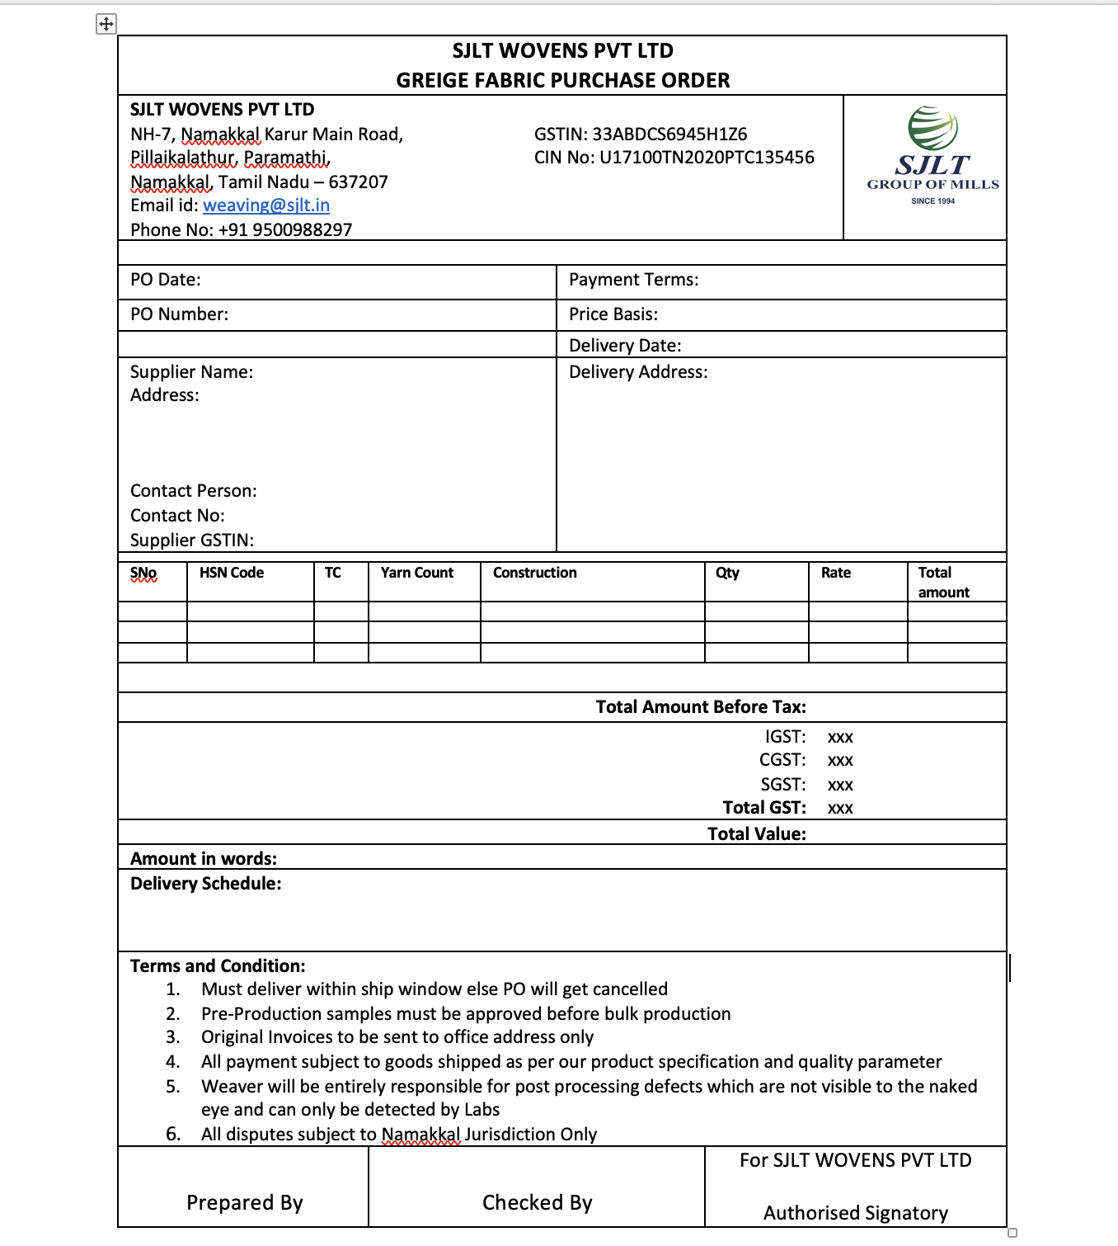
PART – D Greige Fabric PO (5/5)
5. Need a pdf page of the greige fabric PO to download and print.

Slide 19
PART – D SKU Master (1/3)
1. Please use this format for Html display for SKU summary page
SNo | SKU | TC | Fabric | Weave Design | Finished Fabric Construction | Greige Fabric Construction | GSM | Color
1 | KJB12 | 300 | Cotton Finished fabric warp composition + Finished fabric weft composition (If both composition same – then display only one) | Sateen | 60s Cotton * 60s Polyester 195*98/1 | 60s Cotton * 60s Polyester 195*98/1 | 234 | White

Slide 20
PART – D SKU Master (2/3)
2. When clicked add button, following format to be used
Submit (button)
Back
SKU Details
SKU Number
Text input
Fabric
Text input
TC
Number input
Weave Design
Text input
Finished Fabric Construction
Warp Count | Warp Composition | Weft Count | Weft Composition | EPI | PPI | Ply | GSM
Number input | Text input | Number input | Text input | Number | Number | Number | Number
Greige Fabric Construction (optional input)
Warp Count | Warp Composition | Weft Count | Weft Composition | EPI | PPI | Ply | GSM
Number input | Text input | Number input | Text input | Number | Number | Number | Number

Slide 21
PART – D SKU Master (3/3)
3. When clicked delete button, pop up window should appear to confirm if the entry can be deleted.
4. Apart from this, we need to add column like color and Width Later and not at this stage.

