Slide 1


Slide 2
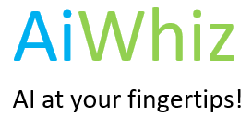




What’s AiWhiz?.
We are an aspiring AI Start-Up with the goal of popularizing AI usage among organizations and businesses to make data centric decisions on a daily basis using the quickest means possible.
Having this goal in mind we simplified the Data Science implementation processes for any businesses and organizations, using the cutting-edge technology tools to deliver AutoML solutions as a Service (MLaaS) to our customers.
We offer end-to-end solution from data acquisition to model deployment and operationalization services.
Easy to deploy AI solutions from Day 1

Slide 3
Thank You Very Much ONDC Team for this wonderful Opportunity

Slide 4

The Problem – Innovation Challenge 3 - Optimal Available Price
Our Approach
We consider this price optimization problem as a dynamic problem and machine learning based solutions would be better to come up with the better results
Technology Stacks
Model Development & Building – Python
API End Point & Web Interface – Django
Model Repository – Pickling Concept

