Slide 1
SHREKBEES the sequel
Brian Ressler – Joanna Jian – Jennifer Seo – Emilio lopez –
Anthony flores-rodriguez – Justin oidem

Slide 2
Why are we shrekbees “the sequel”???
Joanna and Brian were in last semester 175 and their group name was Shrekbees, thus our project is the continuation of that Shrekbees.
It is called Shrekbees because Brian really likes Shrek and Joanna really likes Bees and the rest of us didn’t really care about our group name.
Just accept our name.

Slide 3
Our concept
Confessional website where people are able to post anything they like anonymously.
We pushed it further by adding a physical element into the space so those without the ability to go to the internet can still interact with our project.
We incorporated a printer that connects to the server and print confessions in real time.

Slide 4
How we did it
We used AWS (Amazon Web Services) to host our website. Brian used Node.js and Websocket to have the Raspberry Pi communicate with the server. This also allowed the printer to receive live data and print out the confessions.
For our Physical object, Emilio 3D printed a plinth to enclosed the Raspberry Pi and Printer then hardwired a button so people can just…press a button. And lights to attract people to the plinth.
Justin designed the flyers and created a QR code on them so it is quick to access to the website.
Anthony, Joanna, and Emilio designed several website layouts and artistic designs.
Jennifer came up with the concept while Anthony wrote the artist statement.
Joanna was in charged of documentation and Jennifer semi attempted in hardware of the Raspberry Pi.
We all banded together and did installation and de-installation of the gallery, yay teamwork!!

Slide 5
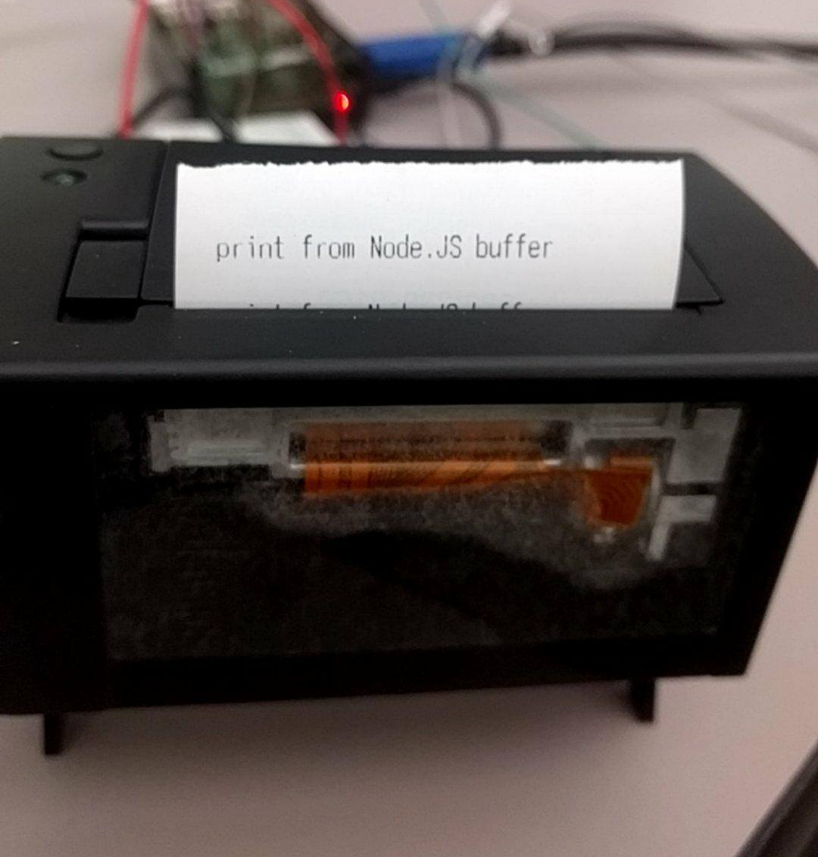
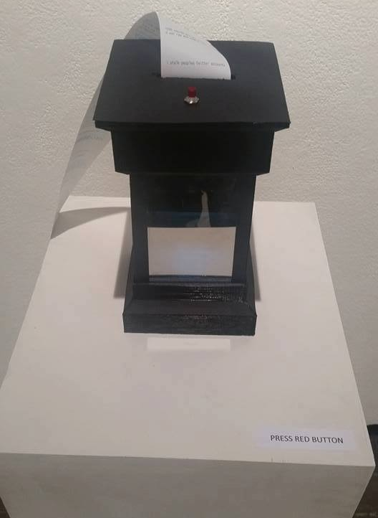
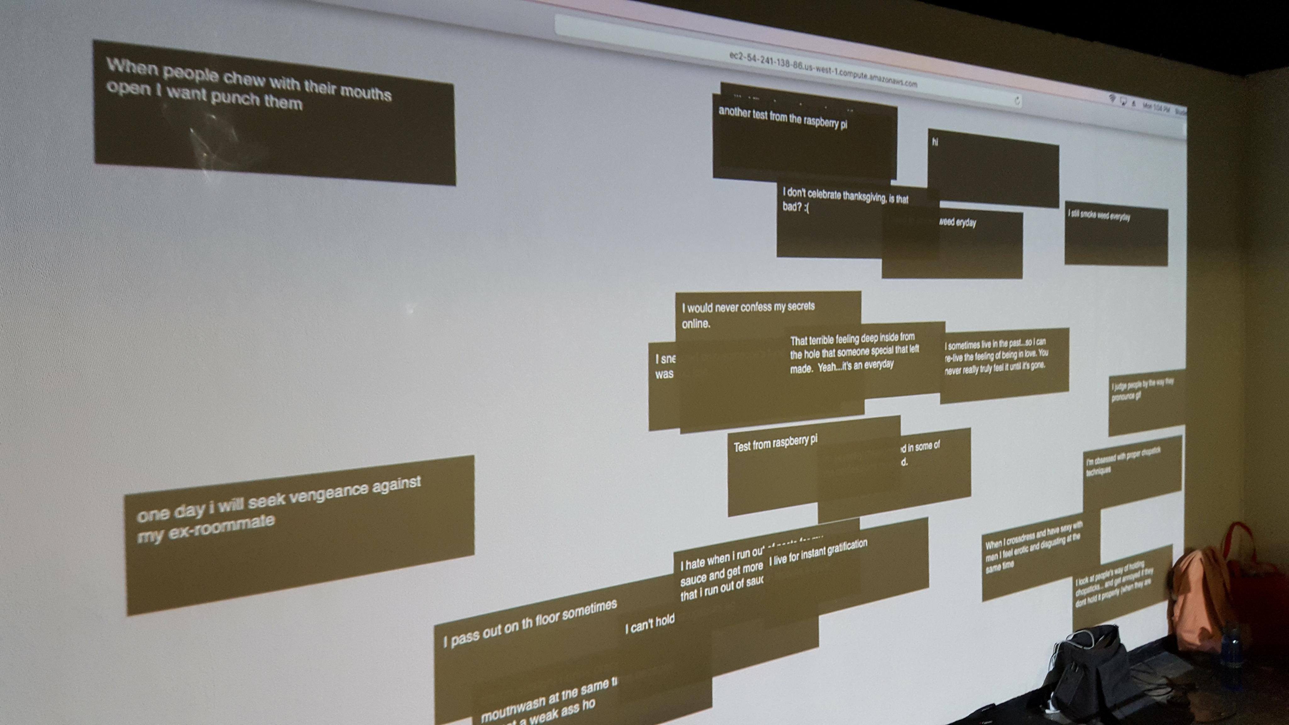
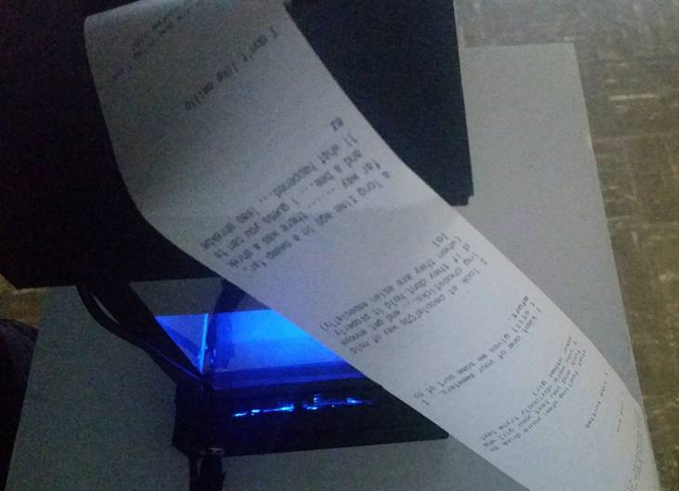
Pictures of our project

Slide 6
meaning
By positioning the receipt to the gather on the floor, we wanted to symbolically represent the continuity of people’s confessions being open to viewers in the space.
We also wanted to see if people would feel comfortable letting out their secrets into the world like on the internet.

Slide 7

yeah

