Slide 1
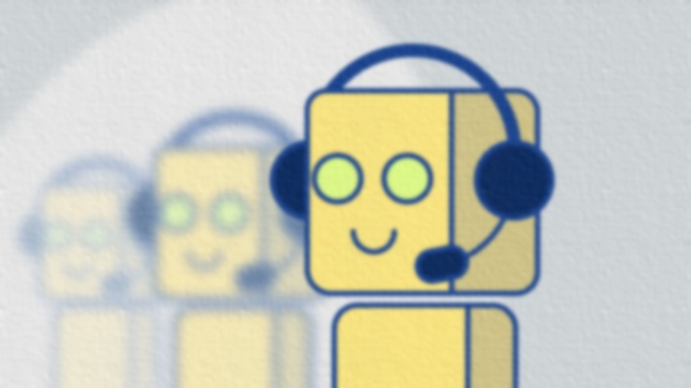

BOTMAN
SJSU CMPE 272 TEAM 30
Nachiket Joshi - 011408956
Sagar Mane - 011419135
Abhishek Madan - 011408969
Saurabh Gedam - 011451674

Slide 2
What is BotMan ?
A framework, as a hosted service, which would assist a novice person with coding a bot, guide him through the process of setting up of the environment and deploy the bot on the cloud on a single button click.
Anyone can create bot using node and integrate it with his slack channel.
User can focus more on the behavioral part of the bot and less on the configuration part.

Slide 3




Architecture
5. Bot deployed on Heroku listen’s
on Slack Channel and replies.
4. Push bot to cloud
and run it to make
it live.
2. Create a Heroku
Directory for deploying
a bot.
Register a new bot
on a channel and obtain
accesses token.
3. Upload bot source code on
Git.

Slide 4
UI Flow

Slide 5
Load test statistics

Slide 6
Future scope
Support more programming languages.
Maintain all the bots created by the user in the past.

Slide 7


Time for Demo!

