Slide 1
CleverCare
Reducing Hospital readmissions

Slide 2
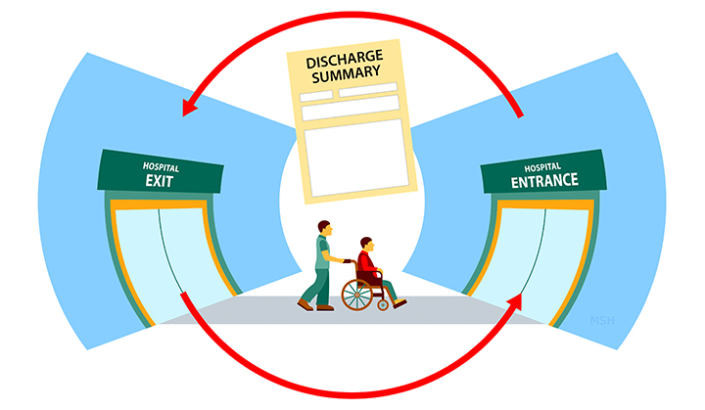
What is readmission?
A hospital readmission is an episode when a patient who had been discharged from a hospital is admitted again within a specified time interval.

Slide 3
The problem
Nearly 20% of all discharges had a readmission within 30 days.
Among this, an estimated 12% of readmissions are avoidable. Even if 10% of these readmissions are prevented, it can save up to $1 billion which is a huge amount.
Hospitals are charged penalty for excess readmissions of patients that could have been avoided otherwise.

Slide 4
Some intervention methods
Improved patient education and self-management support.
Early post-discharge follow-ups.
Improved discharge process.
Remote monitoring.

Slide 5
Our solution
Early post-discharge follow-ups.
Predicting the chances of readmission of a patient based on the inputs taken in the follow-up.
Improved patient education and self-management support.
Doctor can send educational content and suggestions(notes) by reviewing patient’s follow-up.

Slide 6
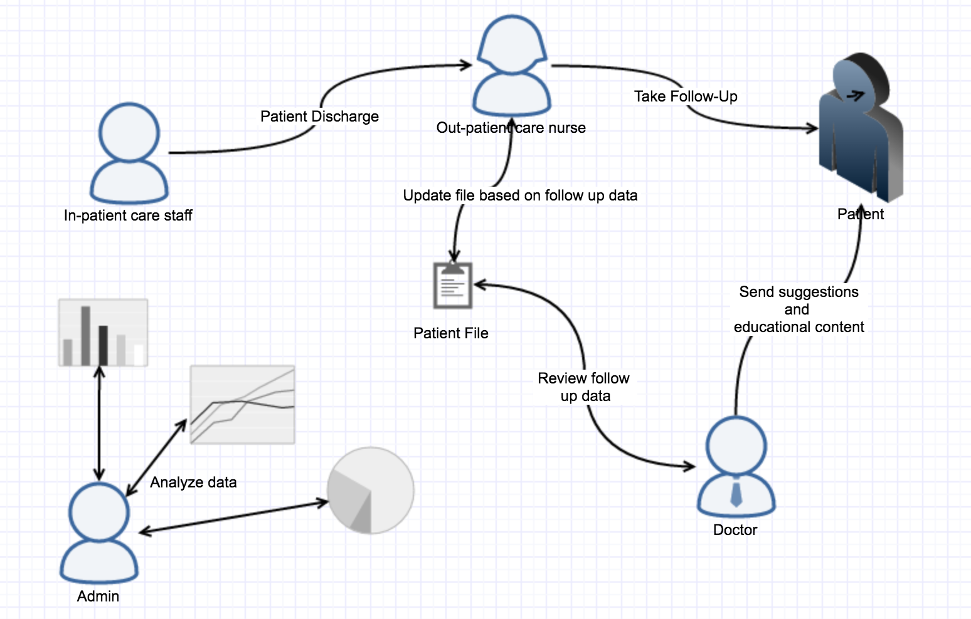
Flow diagram

Slide 7
Links
Github Link: https://github.com/SJSU272Lab/Fall16-Team3
Introductory video: https://www.youtube.com/watch?v=NZ78HN0rBDo
Demo of application: https://youtu.be/1EiYRQDF75I

Slide 8
References
https://www.healthcatalyst.com/CMS-reporting-requirements-4-changes-2014
http://www.chqpr.org/readmissions.html
https://aws.amazon.com/blogs/big-data/readmission-prediction-through-patient-risk-stratification-using-amazon-machine-learning/
https://spark.apache.org/docs/1.6.2/ml-classification-regression.html#random-forest-classifier
https://www.npmjs.com/
http://flask.pocoo.org/docs/0.11/quickstart/

