Slide 1

Team 1: aVADH BORIya
QIUYE KANG

Slide 2
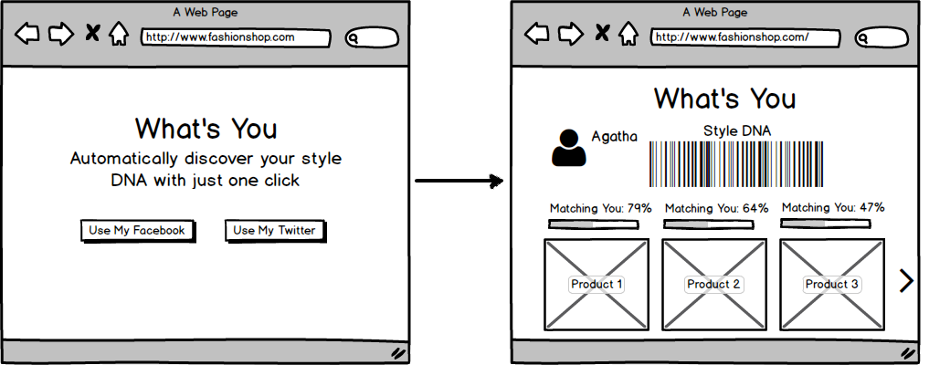
Guide Customers to Buy
Instead of asking the customers to fill in a lengthy survey, goBuy analyzes their opt-in data (e.g., tweets) and automatically infers their unique needs and wants .We use twitter data based on their likes of the twitter ,we recommend appropriate products.

Slide 3
Technologies used
Micro services
Bootstrap
JavaScript
Ajax
Twitter API
Amazon API (in flight)
Spring framework

Slide 4

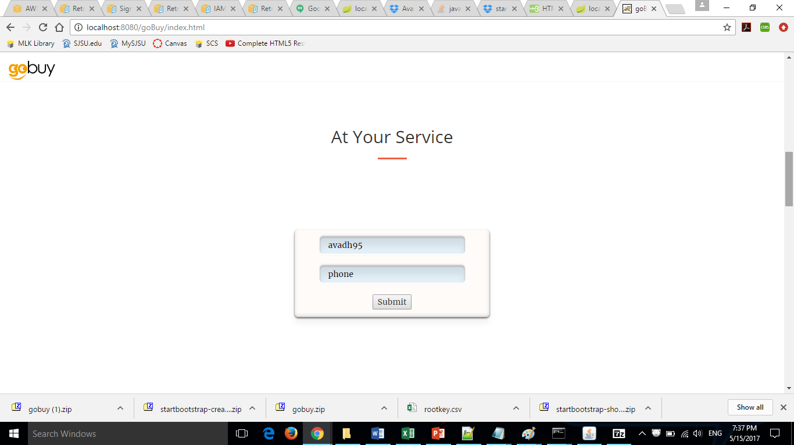
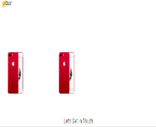


Slide 5
Thank You

